Slide 1

Using Math Acceleration to Address Deficiencies of STEM Students
Jesse Kiefner
Director, Accelerated Math Program
Community College of Baltimore County, Maryland
Access presentation materials at tinyurl.com/SavannahAMP

Slide 2








^{Today’s Agenda}
Nuts and Bolts of AMP
Marketing
Data
Advising
Faculty Training
Engagement Activities
Scaling Up

Slide 3

Who is CCBC?

Slide 4
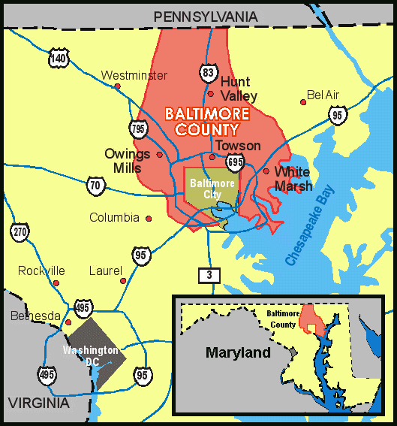
MAIN CAMPUSES
  Catonsville
  Dundalk
  Essex
EXTENSION CENTERS
  Randallstown
  Owings Mills
  Hunt Valley

Slide 5
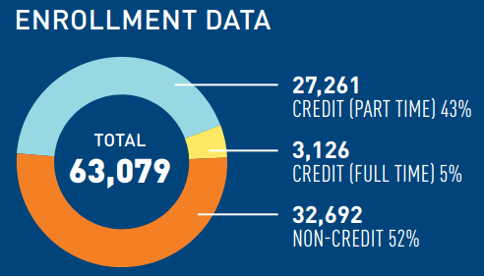
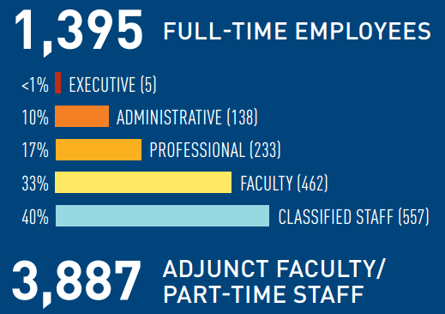

Slide 6
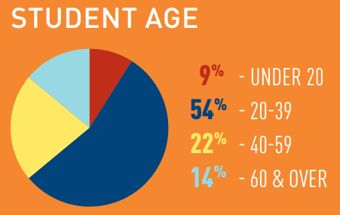
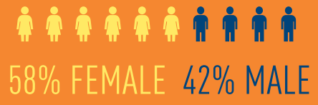
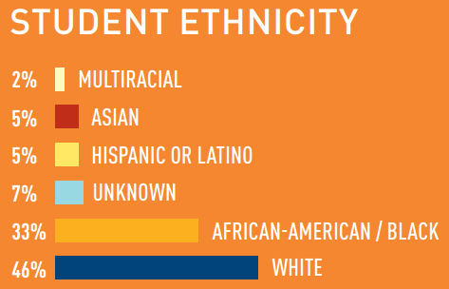
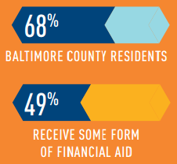
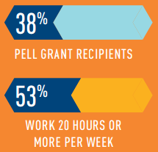

Slide 7
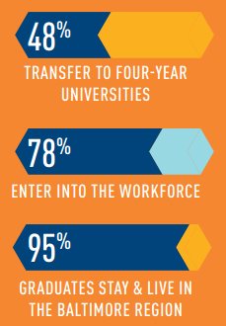
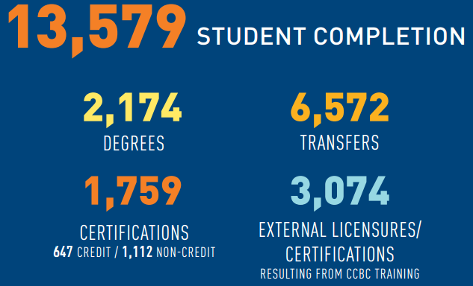
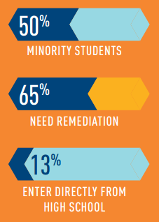
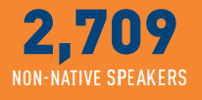


Slide 8
Mathematics Department

Slide 9
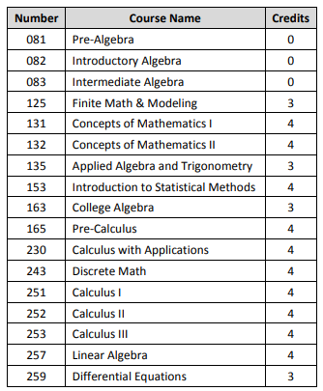
CCBC MATHEMATICS COURSES
125
Non-Scientific Major Programs AND Business/Liberal Arts Program
081
082
153
Statistics Track
125
Non-Scientific Major Programs AND Business/Liberal Arts Program
083
131
Teacher Education Programs
132
135
Radiography and Some Other Technical Programs
153
Statistics Track
Engineering/Computer Science Track
163
165
251
252
253
230
243
257
259

Slide 10
FACULTY AND STUDENT MAKEUP
Approximately 50 FT Faculty
Approximately 40% FT and 60% PT
Student Enrollment, Spring 2017
MATH 081: Pre-Algebra | 814
MATH 082: Introductory Algebra | 1,277
MATH 083: Intermediate Algebra | 978
MATH 125: Finite Math & Modeling | 532
MATH 153: Intro. to Statistical Methods | 1208
MATH 163: College Algebra | 821

Slide 11


PLACEMENT
HOW?
WHAT TO DO?
Placement Test
Take placement test on any campus at Testing Center. Accuplacer MATH can be taken twice. Students who wish higher placement must then “appeal”. Appeal is request to take a pencil-and-paper type test on material from the course they placed into.
Transfer Credits
Bring transcript showing general education math credits from another college or university to CCBC for evaluation. If completed in Maryland, the highest level developmental math course, Intermediate Algebra can be used for placement.
SAT or ACT Scores
Placement by SAT MATH score of 500 or higher (or by ACT MATH score 21 or higher) places the student into an entry-level general education math course (MATH 111, 125, 131/2/3, 135, 163). For higher placement, the student must take Accuplacer MATH.
High School AP Scores (Mathematics)
Students with documentation of AP math scores of 3, 4, or 5 from high school can be awarded college credit and placement according to this chart.

Slide 12
Mathematics Acceleration

Slide 13
Lingo
CCBC
ALP
AMP

Slide 14
ALP versus AMP
ALP (ACCELERATED LEARNING PROGRAM)
AMP (ACCELERATED MATH PROGRAM)
English/reading acceleration
Developmental students integrated with credit-level students
Math acceleration
Same set of students in both classes
All students at developmental level
True cohort model
English/reading acceleration
Developmental students integrated with credit-level students
Math acceleration
One set of students in both classes
All students at developmental level
True cohort model

Slide 15

Connotations of “Acceleration”
Fast paced
Advanced
More work
Alternate Labels
Corequisite model
Just-in-time learning
Integrated review
Blended courses
Supplemental instruction

Slide 16
Why is math acceleration needed?
Incoming Students Not College-Ready in Mathematics
≈ 70%
Success Rates of Traditional Developmental Mathematics Courses
≈ 50%
SB 740 – Pathway Must Include Credit Bearing Math and English Within the First 24 Credit Hours of Courses for First Time Degree Seeking Students

Slide 17

Meet 100 First-time Students starting in 2010 who placed in MATH 081

Slide 18
Relevant Facts
Of these 100 students who placed in lowest level of developmental math, Pre-Algebra:
68 are minority
67 are part-time
51 live below the poverty line
52 work

Slide 19
Of those 100 math students…
Fewer than 10 passed a credit math course…
How many graduated?

Slide 20

three

Slide 21
Math Acceleration Models

Slide 22
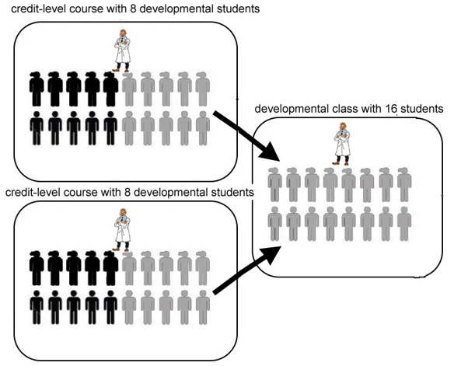
Triangle Model

Slide 23
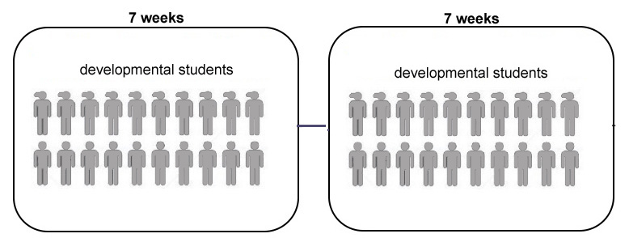
Compressed Model

Slide 24
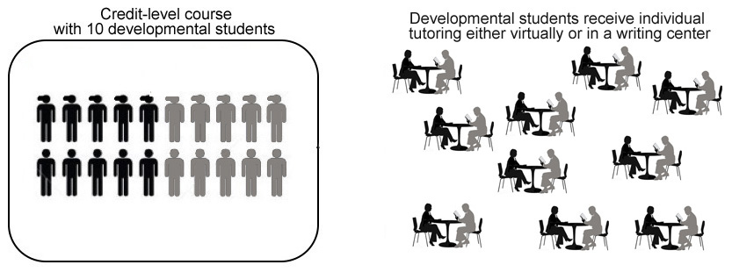
Tutoring Model

Slide 25
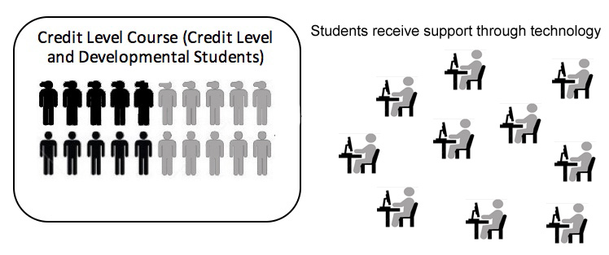
Technology Model

Slide 26
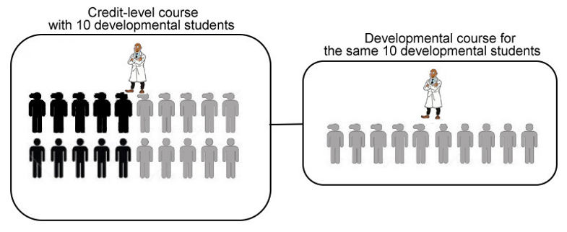
Support Course Model (ALP)

Slide 27
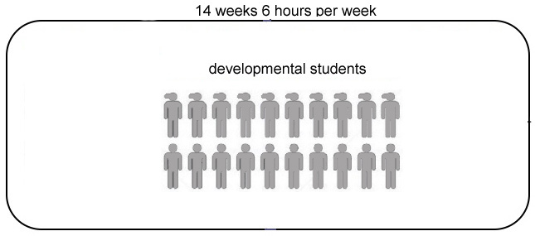
Merged Model (AMP)

Slide 28
Accelerated Mathematics Program AMP It Up!
Established in Fall 2009
Students Enroll in 6-Credit “Combo” Classes
Course Topics are Integrated
Combined Course Options:
Pre-Algebra & Introductory Algebra
Introductory Algebra & Intermediate Algebra
Intermediate Algebra & College Algebra
Intermediate Algebra & Applied Algebra and Trigonometry

Slide 29
CCBC MATHEMATICS COURSES
125
Non-Scientific Major Programs AND Business/Liberal Arts Program
081
082
153
Statistics Track
125
Non-Scientific Major Programs AND Business/Liberal Arts Program
083
131
Teacher Education Programs
132
135
Radiography and Some Other Technical Programs
153
Statistics Track
Engineering/Computer Science Track
163
165
251
252
253
230
243
257
259

Slide 30
Data Analysis – Students Beginning at the MATH 081 Level

Slide 31
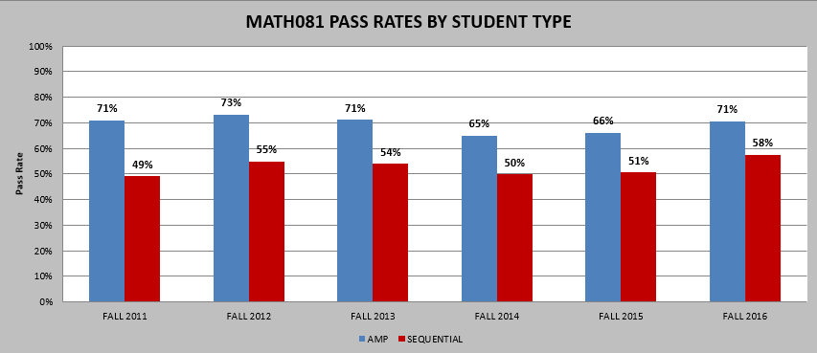

Slide 32
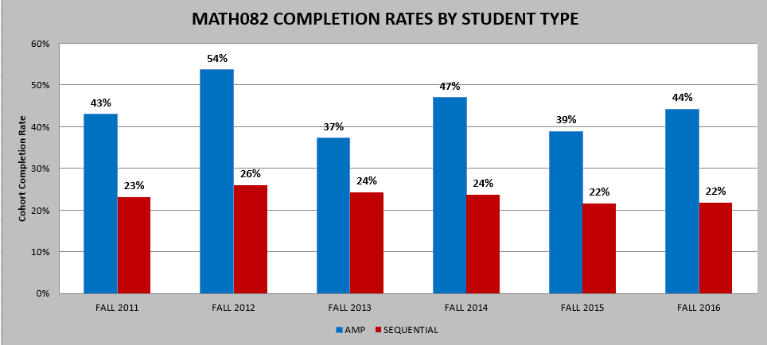

Slide 33
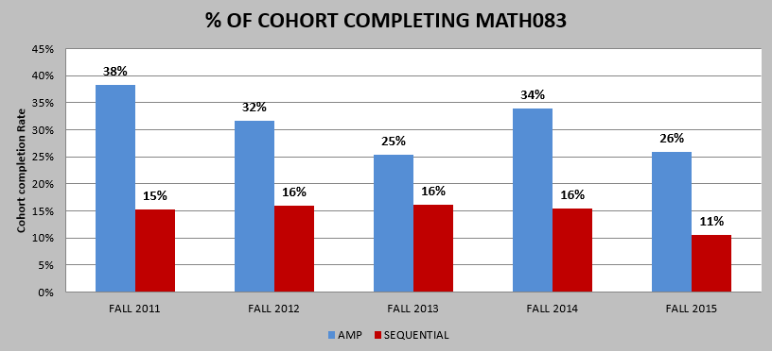

Slide 34
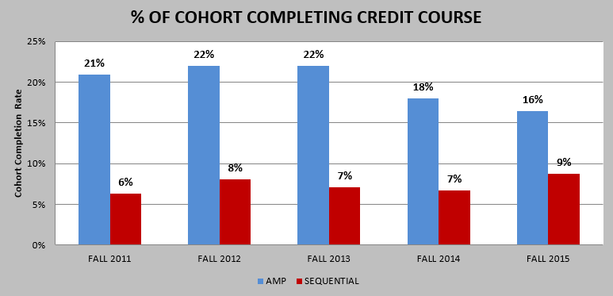

Slide 35
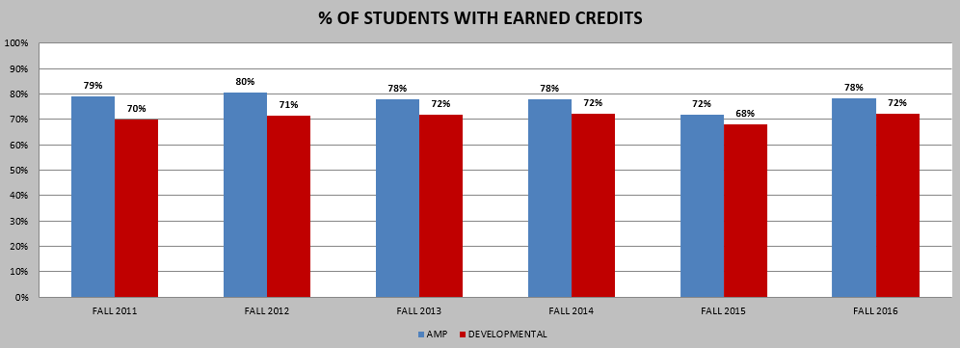

Slide 37
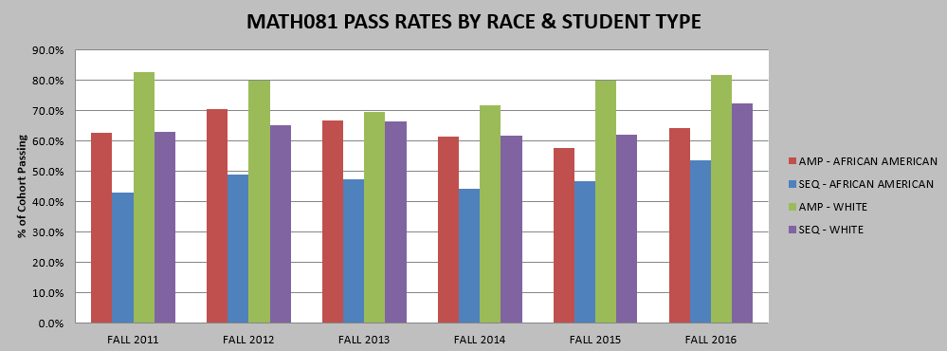

Slide 38
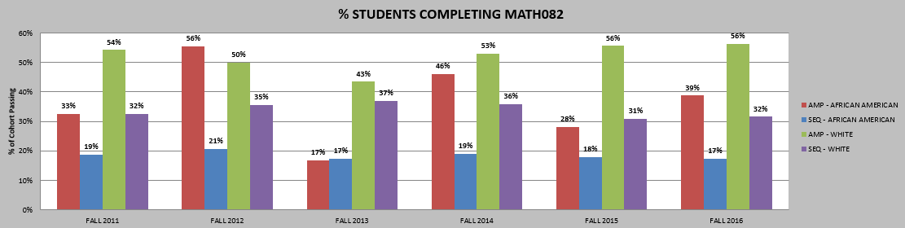

Slide 39
Data Analysis – Students Beginning at the MATH 083 Level

Slide 40
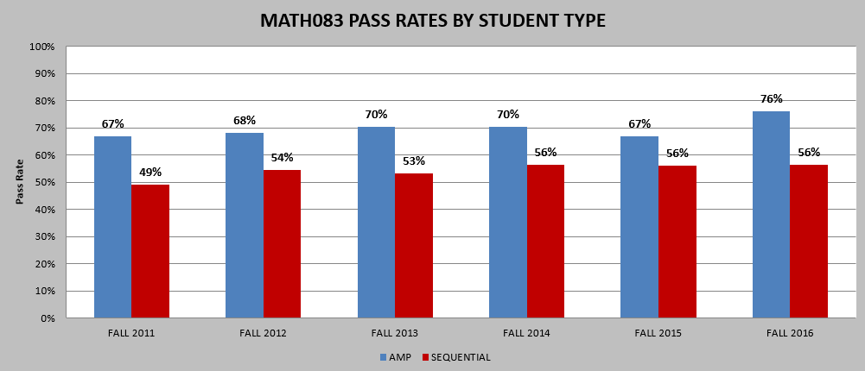

Slide 41
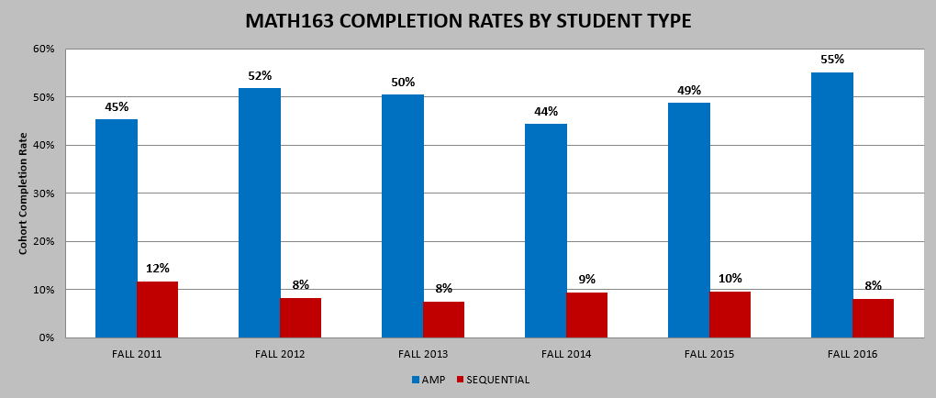

Slide 42
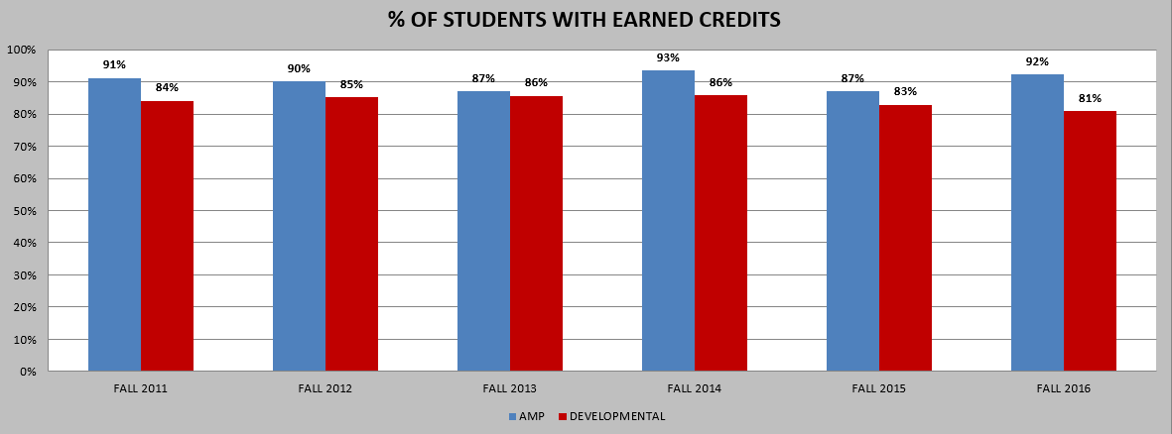

Slide 44
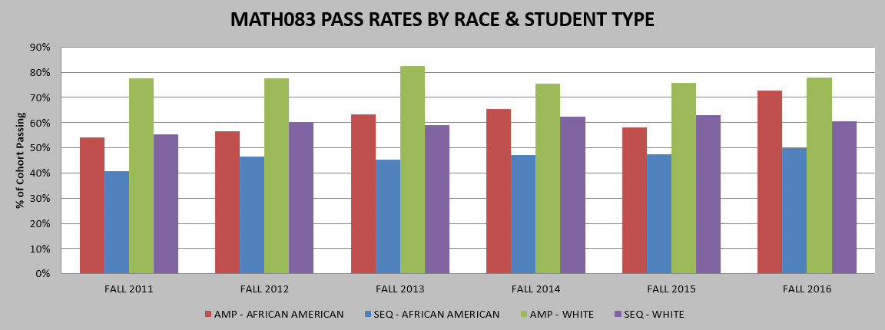

Slide 45
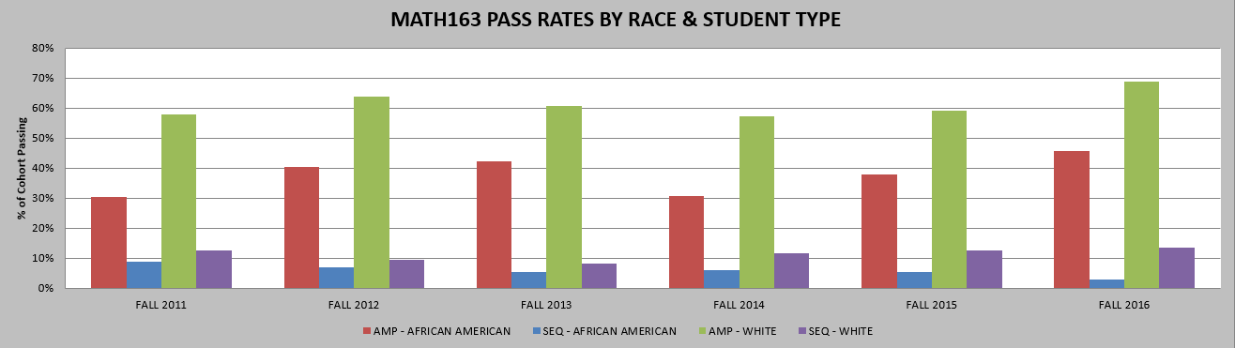

Slide 46
Scaling Up
Semester | 081/082 Sections | Total 081 Sections | Percent of 081 Sections That are 081/082 AMP
Fall 2014 | 5 | 76 | 6.58%
Spring 2015 | 6 | 62 | 9.68%
Fall 2015 | 14 | 72 | 19.44%
Spring 2016 | 10 | 48 | 20.83%
Fall 2016 | 14 | 56 | 25.00%
Spring 2017 | 12 | 44 | 27.27%
Semester | 083/163 Sections | Total 083 Sections | Percent of 083 Sections That are 083/163 AMP
Fall 2014 | 7 | 102 | 6.86%
Spring 2015 | 9 | 88 | 10.23%
Fall 2015 | 15 | 108 | 13.89%
Spring 2016 | 14 | 81 | 17.28%
Fall 2016 | 12 | 61 | 19.67%
Spring 2017 | 8 | 51 | 15.69%

Slide 47
Building the Program

Slide 48
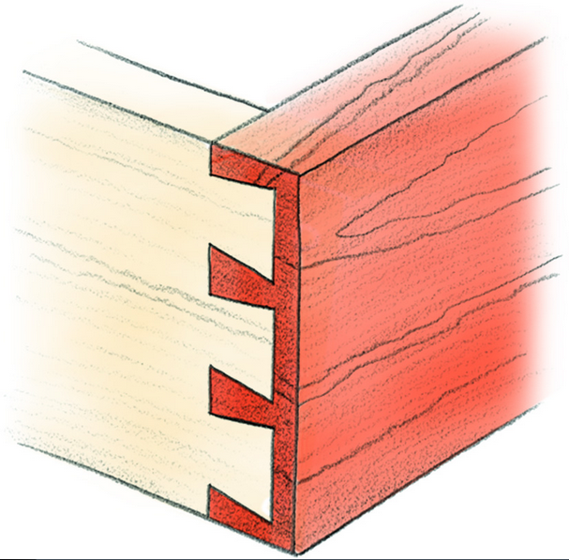
The Goal
Lower-Level Course Content
Upper-Level Course Content
“dovetail strategy”

Slide 49
Combined Course Setup
Combined courses are 6-credits total.
Students cannot drop one course; both courses must be dropped if requesting withdraw.
Each student must register for two courses (3 credits each) that are scheduled during consecutive time periods.
Topics in each course are integrated.
The combined class, both sections, are taught by the same instructor.
Students only purchase the higher-level course textbook.
No registration blocks! Open to all!
Grading is separated along the way and the student receives two grades.

Slide 50
Administrative Details
Online Registration
Number of Students Per Class
Scheduling Six Hour Classes
Using Existing Courses

Slide 51

How Do We Integrate?

Slide 52
Combined Course Instruction: Making the Connection
 | Lower Level | Upper Level
Pre-Algebra / Introductory Algebra | Solving Linear Equations | Solving Quadratic Equations
 | Evaluating Exponents | Scientific Notation
Introductory Algebra / Intermediate Algebra | Exponent Laws | Radicals
 | Graphing Linear Functions | Graphing Quadratic Functions
Intermediate Algebra / College Algebra | Graphing Quadratic Functions | Transformations of Quadratic Functions
 | Factoring | Determining Zeros of a Function
Intermediate Algebra / Applied Algebra & Trigonometry | Solving Quadratic Equations | Applications of Quadratic Equations
 | Evaluating and Graphing Exponential Functions | Modeling Data Using Exponential Functions

Slide 53
Assessment in Combined Courses
Students receive a final grade for each course.
Any student who fails the lower-level course automatically fails the upper-level course.
Instructors keep grading separate for each course.
Students complete the same comprehensive final exam as students in traditional sections.
Students can pass the lower-level course and fail the higher-level course.
The same “course rules” are applied.

Slide 54
Traditional Class Rules
1
4
Pre-Algebra
85% Rule
Common Final Exam – 30%
College Algebra
80% Rule
Project – 10%
Common Final Exam – 20-30%
2
5
Introductory Algebra
85% Rule
Common Final Exam – 30%
Applied Algebra & Trigonometry
Project – 10%
Comprehensive Final Exam (Instructor Created)
3
Intermediate Algebra
85% Rule
Common Final Exam – 30%

Slide 55
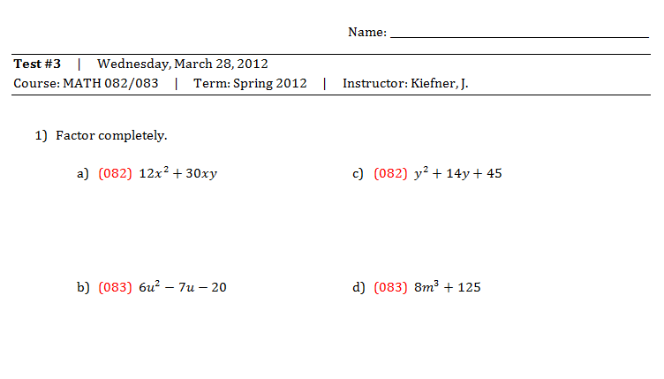
Grading in Combined Courses: Semester Tests
“All in One” Approach

Slide 56
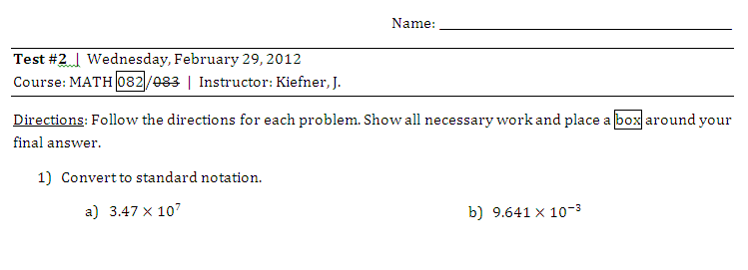
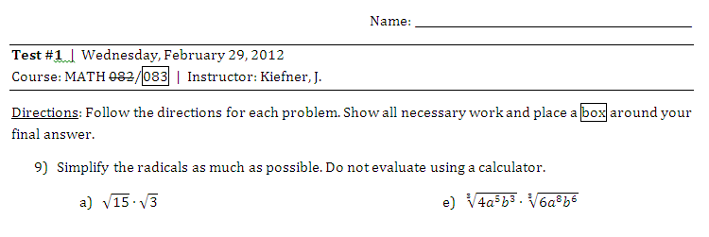
Grading in Combined Courses: Semester Tests
“Side by Side” Approach

Slide 57
Advantages of Combined Setup
Overlap in course content allows for additional time to devote to more challenging topics.
Students form a supportive cohort.
Students are able to see the connection and relation between two math courses; content doesn’t appear disjoint.

Slide 58
Supplementing
with OERs

Slide 59
How do we make up for missing content?
OPEN SOURCE TEXTBOOKS
http://www.ccbcmd.edu/Programs-and-Courses/Schools-and-Academic-Departments/School-of-Mathematics-and-Science/Mathematics.aspx
ORIGINAL TEXTBOOK SOURCES
http://www.wallace.ccfaculty.org/
http://www.mathispower4u.com/
ONLINE HOMEWORK (OPTIONAL)
www.myopenmath.com (MATH 081/082) or ALEKS (MATH 083/163)

Slide 60
Facilitating Student Engagement

Slide 61
Managing Extra Time
INTERACTIVE LABS (OPTIONAL)
  Modeling Tuition Lab
  Bottle Water Flow lab
  Exponential Decay Lab
  Work Together Lab
GROUP SESSIONS
REVIEW FOR EXAMS

Slide 62
Lab 1
Students model the CCBC tuition billing structure using a linear equation.
The y-intercept and slope are considered in the context of an application.
The linear model is examined graphically.
Students find this lab eye-opening.

Slide 63
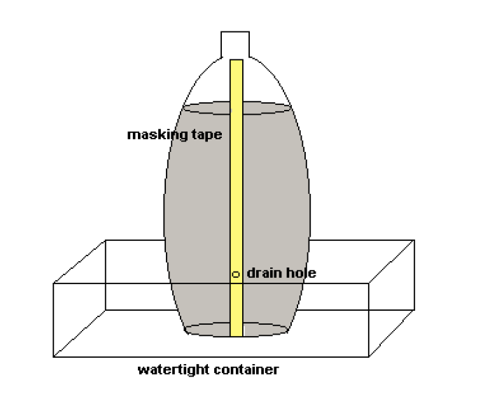
Lab 2
Uses a quadratic to model fluid flow from a
two-liter bottle of water
Nice break after factoring quadratics
Students should bring in used two-liter
bottles
Students love this lab!

Slide 64
Lab 3
Exponential decay problem involving the environmental impact of tropical rainforest destruction.
Students create an exponential model and use it to predict the amount of rainforest remaining in the future.
Students use logarithms to solve exponential equations.
Students don’t exactly love this lab.

Slide 65
Lab 4
Similar to Lab 2, students use a water flow experiment to test the validity of a rational equation that predicts the time required to drain a container.
Difficult logistically because students must fill the container and let water drain three times.
Students love this lab.

Slide 66
Marketing

Slide 67
Marketing Tools
Brochure
Commercial
Poster
Advising Tool

Slide 68
Faculty Training Model

Slide 69
AMP Instructor Training
Instructors participate in one training for all AMP courses.
Training offered twice per year (January & August).
1st Model:
Two Full Days
2nd Model:
Online Modules Blended with One Full Day
3rd Model:
One Half Day (Current)

Slide 70
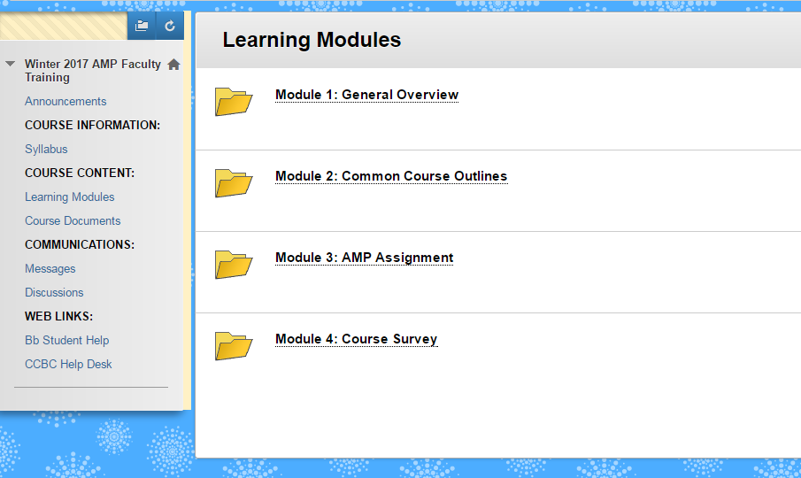

Slide 71
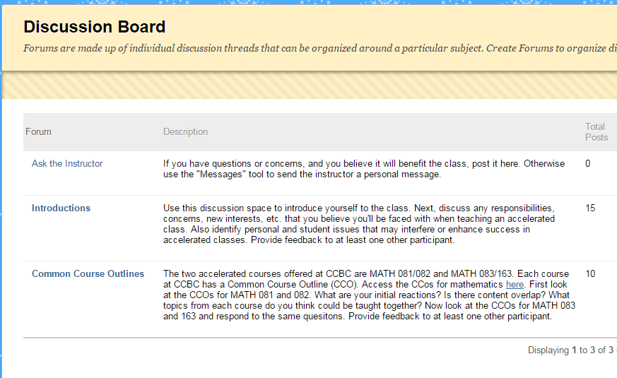

Slide 72
Day 1 Discussions
Is an AMP class right for you?
Twice the time is spent on homework and studying.
What should you do to be successful in a math course?
You cannot withdraw from one class without withdrawing from the other.
Attendance is extremely important. Miss one class is equivalent to missing a week.
If you fail one or both classes, you risk losing financial aid. Discussing the financial aid policy is key.

Slide 73
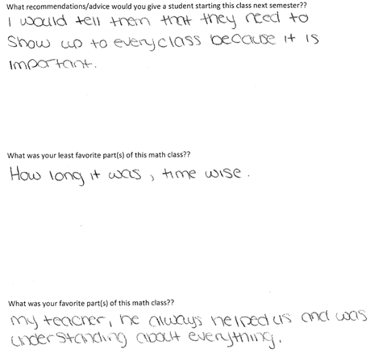
Sample: Sharing Student Surveys

Slide 74
Future of AMP

Slide 75

The Road Ahead
Mentorship of Faculty
Continued Marketing
Combining Introductory Algebra
with Statistics and Finite Math

Slide 76
www.ampatccbc.org
AMP@ccbcmd.edu

