Slide 1
The use of educational biographies in academic librarianship information literacy practice - encouraging reflective and purposeful instruction
SoTL Commons Conference
February 17, 2023
Michelle Brown, Jolene Hurtubise, Caitlin McClurg

Slide 2
Learning Outcomes
By the end of this presentation participants will:
Receive an introduction to educational biographies
Engage with each other on perceptions on reflective practice, specifically in personal narratives surrounding experiences in education
Consider educational biographies as a scholarly activity within SoTL
Learn from academic librarian reflections how educational biographies can affect pedagogy, identity and empathy in adult learning contexts

Slide 3
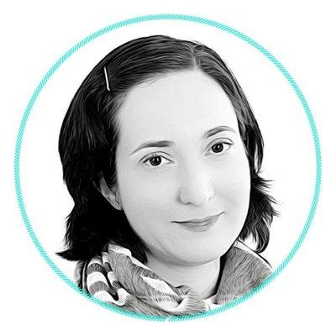
Presenter: Michelle Brown
Michelle Brown is currently the Head of Learning and Student Success at the University of Ottawa Library. Previous to this she was the Liaison Librarian to the Faculty of Education at the University of Ottawa.
She holds an MLIS from McGill University and an M.Ed from the University of Ottawa. She is currently pursuing her Doctor of Education in Adult Learning at the Werklund School of Education at the University of Calgary.
Her research interests include Indigenous Education, equity and inclusion in academic libraries, and the intersection of equity and open education.

Slide 4
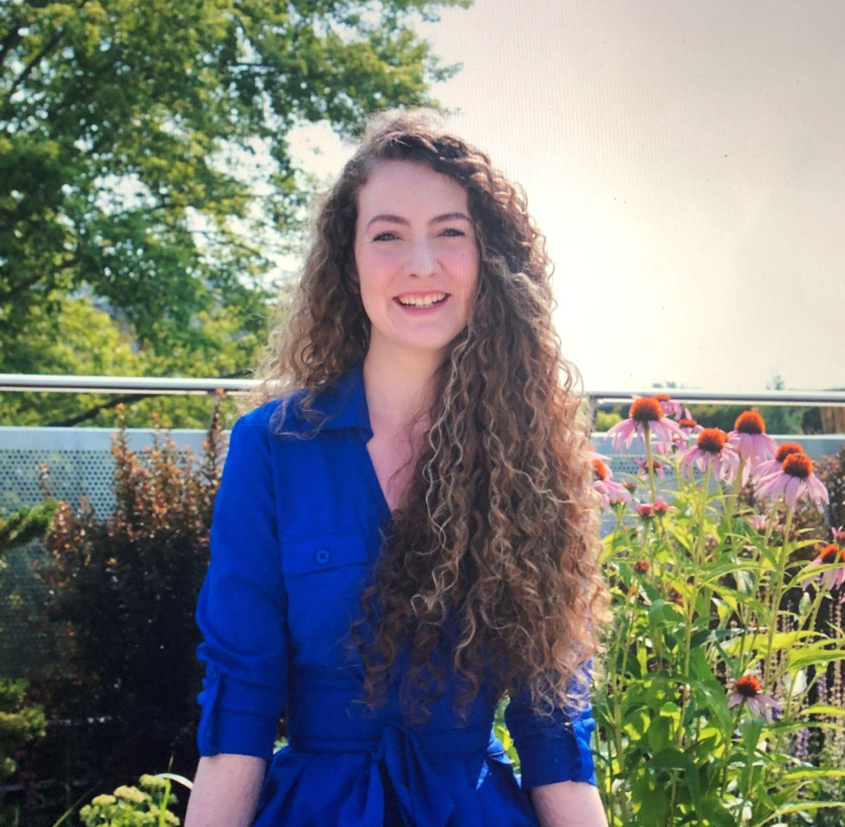
Presenter: Jolene Hurtubise
Jolene Hurtubise is currently the Student Success librarian at the University of Ottawa Library. Previously, she was a Science and Engineering Research Librarian. Her role is focused on instruction and supporting student learning, working primarily with students that are new to the University.
She holds a Bachelor of Science from the University of Ottawa, and a Master of Information with a concentration in Library and Information Studies from the University of Toronto.
Her research interests include open educational resources, e-learning and affective learning.

Slide 5
Presenter: Caitlin McClurg
Caitlin McClurg received her Bachelor of Arts and Master of Library and Information Studies from the University of Alberta. She is currently pursuing her Doctor of Education in Adult Learning at the Werklund School of Education at the University of Calgary. Her areas of interest include SoTL, medical education, academic librarianship workplace culture, and career identity. When she isn’t at work, Caitlin can be found gardening and cooking to pop culture and comedy podcasts, or walking with her young family and big dog along the Bow River in Calgary, Alberta.

Slide 6
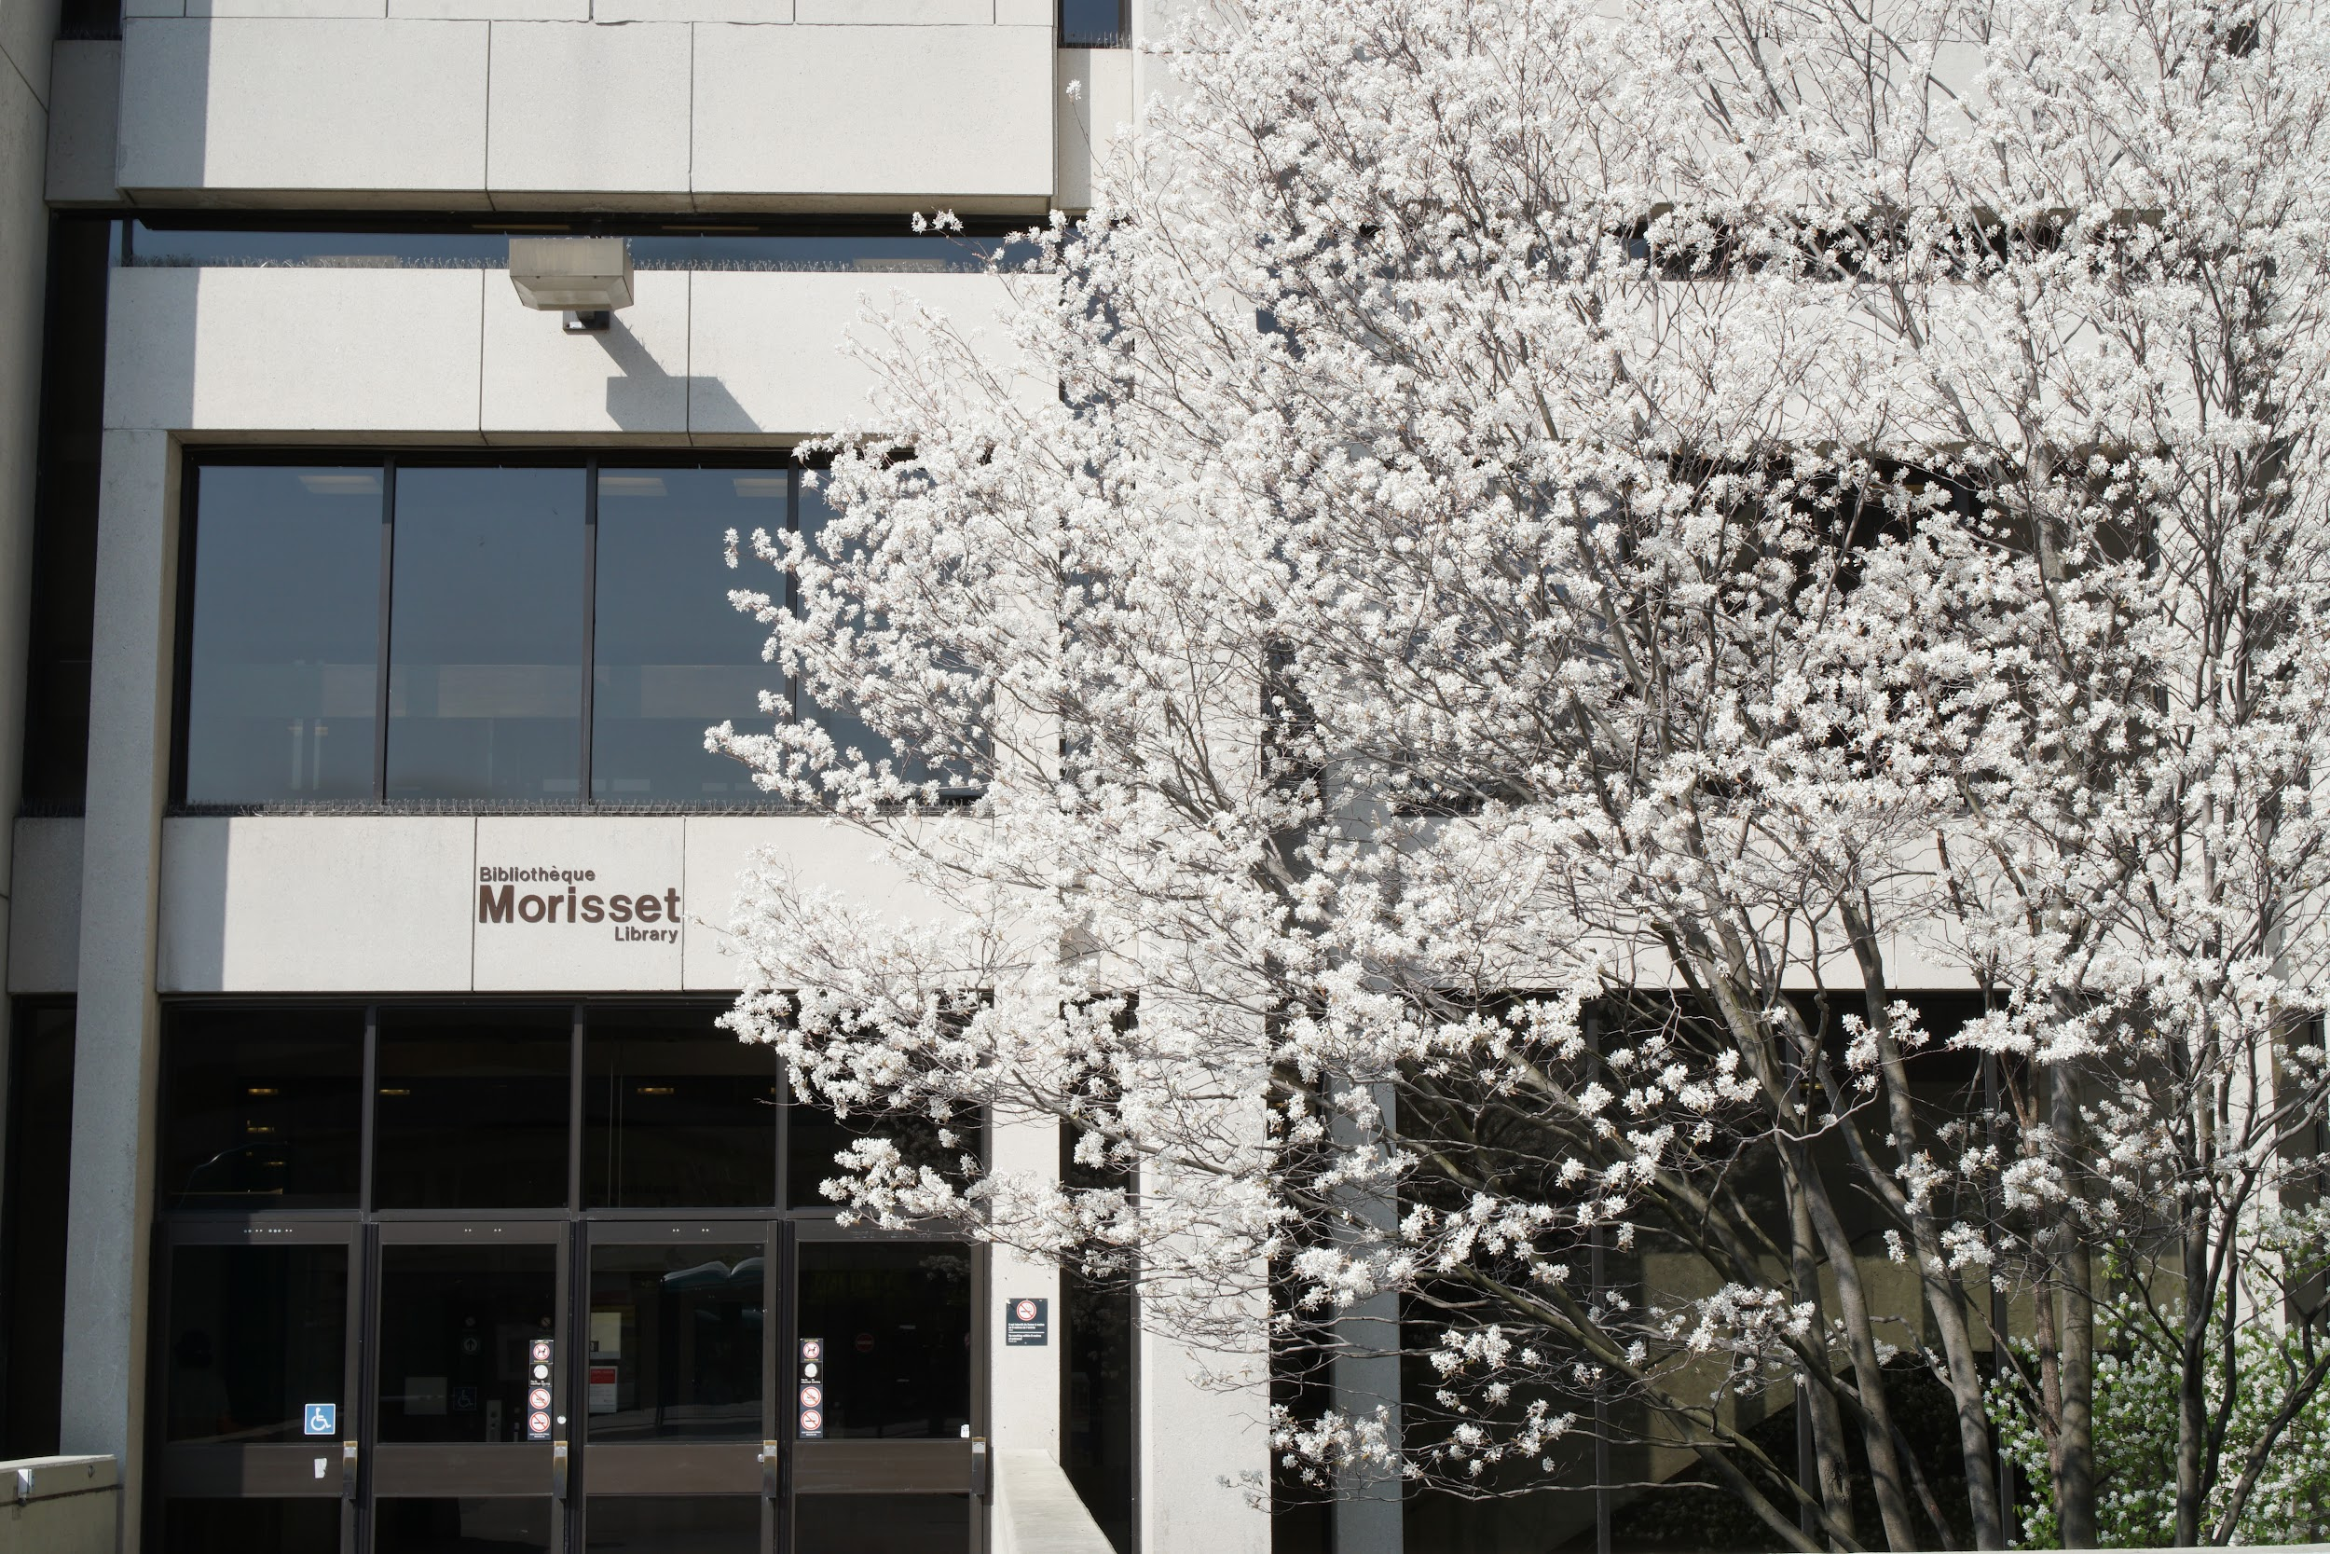
Context - Academic Libraries
U15 -Group of Canadian Research Universities
Taylor Family Digital Library
University of Calgary
Morisset Library at the University of Ottawa

Slide 7
Educational Biography: What & Why?
Pierre Dominicé (2000) described educational biographies are autobiographical exercises to share with a partner or group
Opportunity to interpret learning journey
Jack Mezirow’s transformative learning theory posits that learning occurs “as a result of reflecting upon experience”, including the transitions and crises referred to as the “disorienting dilemma” (Jarvis, 2010, p. 10).
Craig Kridel offered in their 1998 edited book introduction that “biographical inquiry in education” and the need to “emphasize that the self-examination of a biographer” enhances educational research (2013, p. 5).
In their work on personal agency and adult learning, researchers Biesta and Tedder (2007) isolates agency as an action one does between the past and future and encourage the use of biography to learn about and from one’s life (p. 139).

Slide 8
Our Experiences - Examples
Jolene | Michelle | Caitlin
Affective dimension creating a welcoming learning experience Give the ability for students to choose what works for them | Early literacy experiences -passion for books Travel and informal learning experiences “Books are the quietest and most constant of friends; they are the most accessible and wisest of counsellors, and the most patient of teachers.” ― Charles W. Eliot | Interpersonal relations impacting future interactions with students Identity and empathy

Slide 9
Applied Practice - Challenges & Benefits
Challenges
Lack of familiarity
De-centering/ vulnerable experience
Time consuming
Can be difficult to integrate into instruction
Benefits
Creates time and space for reflection
Transparency
Helps to understand your students perspectives
Honoring lived experience/ informal learning

Slide 10
References
Biesta, G., Tedder, M. (2007). Agency and learning in the lifecourse: Towards an ecological perspective. Studies in the Education of Adults, 39(2), 132-149. https://doi.org/10.1080/02660840.2007.11661545
Dominicé, P. (2000). Learning from our lives: Using educational biographies with adults. Jossey-Bass Publishers.
Jarvis, P. (2010). Adult education and lifelong learning: Theory and practice. Taylor & Francis Group.
Kridel, C.A. (Ed.). (2013). Writing educational biography: Explorations in qualitative research (2nd ed). Routledge. Taylor & Francis Group.

Slide 11
Thank you
Questions?

