Slide 1
Comparative Analysis of Gaming as an Effective Pedagogy to Enhance Student Learning in Nursing
Betty Abraham-Settles, DNP, RN-BC
Joyce Pompey, DNP, APRN-BC, CNE
Suzanne Fowley, MSN, RN
Briana Aaron, MSN, RN
Adam Pazda, PhD

Slide 2
Gaming & Student Engagement

Slide 3
Introduction & Background

Slide 4
“ The Games”

Slide 5
The Games cont.
www.jeopardylabs.com
www.Socrative.com
www.kahoot.com

Slide 6
Kahoot! Let’s Play!
https://create.kahoot.it/share/enter-kahoot-title/10144c3c-c98f-4dbf-92b9-374367aa586c
Joyce Pompey, DNP, APRN-BC, CNE
Joyce Pompey, DNP, APRN-BC, CNE

Slide 7
Jeopardy! Let’s Play!
https://jeopardylabs.com/play/urinary-disordersacutechronic-renal-issues-2
Joyce Pompey, DNP, APRN-BC, CNE
Joyce Pompey, DNP, APRN-BC, CNE

Slide 8
Methodology

Slide 9
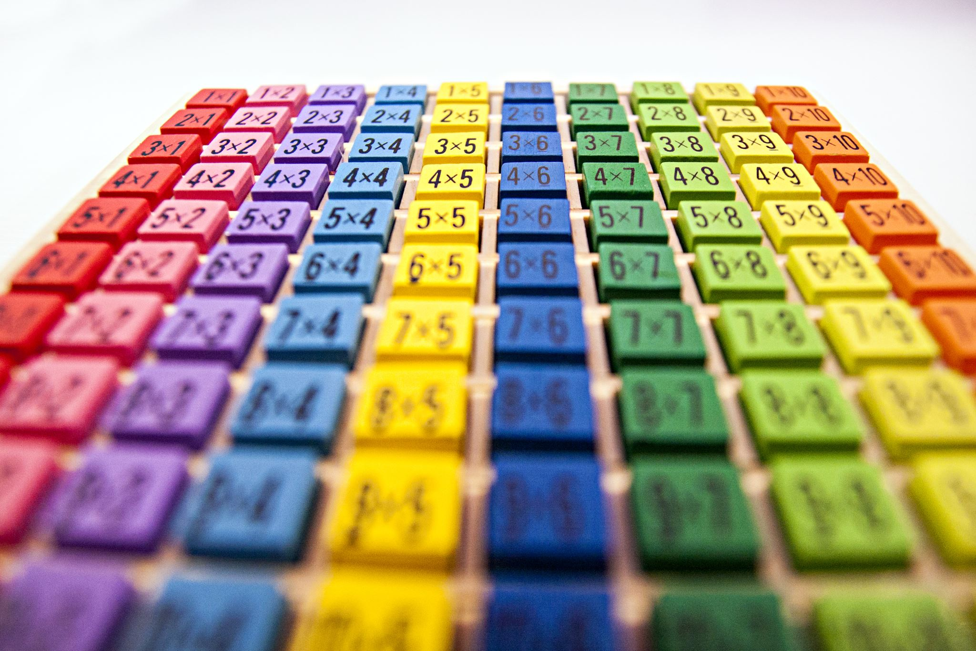
Results
Sample—93 students participated in the study
Participant ratings were averaged within each game category to form composite indices reflecting attitudes toward the games.
The variables were then substituted to a repeated-measures ANOVA using SPSS statistical software to determine whether student attitudes towards the three games were significantly different.

Slide 10
Game Preferences for Level 4

Slide 11
Game Preferences for Level 6

Slide 12
Game Preferences for Level 8

Slide 13
Results of Game Preferences for All Levels

Slide 14
Implications for Nursing

Slide 15
Recommendations & Conclusions
Notes:
.

