Slide 1
Analysis of Student Success: Hybrid Versus Traditional Classroom Model of Instruction for Introductory College Science COURSES
Dr. Rebecca Brosky
Dalton State College
SOTL Commons Conference 2023

Slide 2
Status OF STEM COURSES at DSC
certain upper-level life science courses have offered both hybrid and traditional options for a number of years
During and post-COVID: other STEM hybrid introductory course sections initiated
Life Sciences: Principles of Biology I and Human Biology*
Physical Sciences: General Chemistry I and II and Principles of Geology**
*no lab, only lecture for non-majors* **hybrid sections existed before COVID*

Slide 3
Definition of hybrid course at DSC
One weekly face-to-face lab and one lecture
One weekly virtual lecture (asynchronous)

Slide 4
Introduction to the issue
2018-2022: LIFE AND PHYSICAL SCIENCE courses:
general decline in final student grades: HYBRID COURSE MODELS
</= 33% DFW rates: PRE-COVID COURSES (hybrid and non)
</= 40% DFW rates: DURING and POST-COVID NON-HYBRID
>/=29% DFW rates: DURING AND POST-COVID HYBRID
*exception is PRINCIPLES OF GEOLOGY which had only slightly elevated DFW DURING AND POST COVID*

Slide 5
Explanation of work
DFW rates for introductory STEM courses were explored and categorized based on:
type of course
time of day course was taught
hybrid versus face-to-face

Slide 6
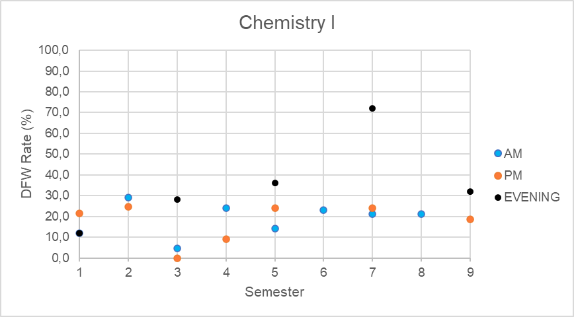
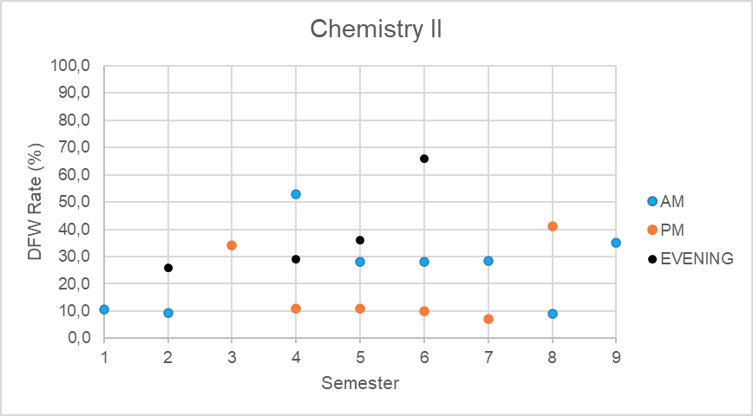
Chemistr chemistry
H
Fa 2019
H
H
H
H
Fa 2019
H
H

Slide 7
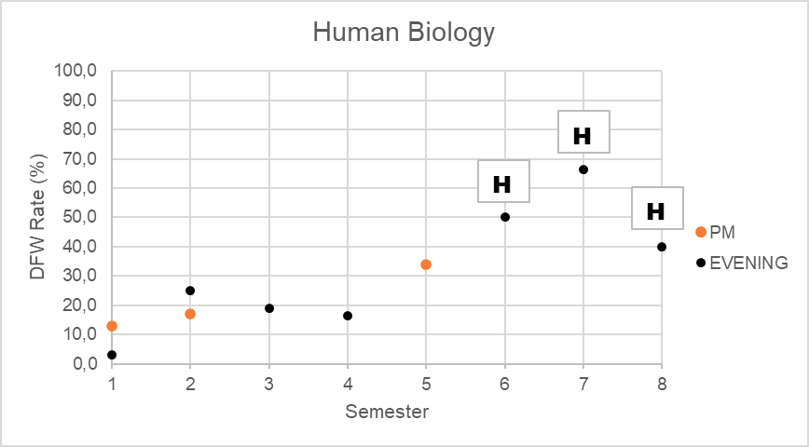
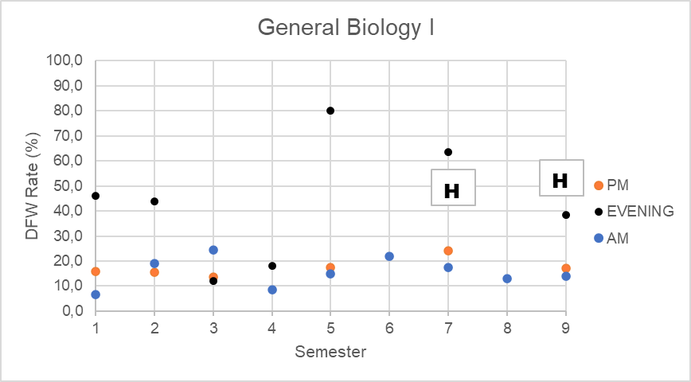
biology
Fa 2019
Fa 2019

Slide 8
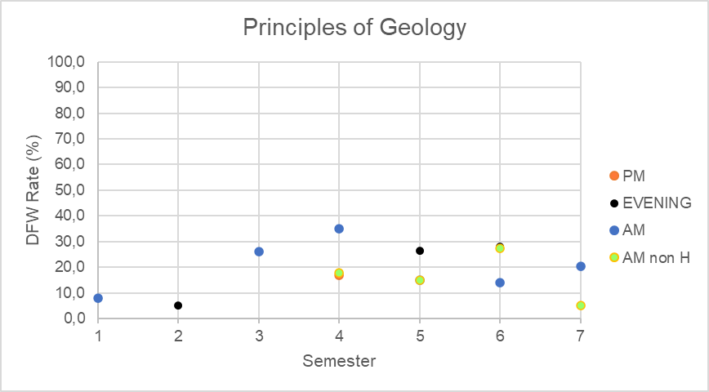
geology
Fa 2019

Slide 9
General conclusions: General Chemistry I
Highest DFW
Evening/hybrid courses
RANGE: 28-72%
Other DFW
Distributed between AM and PM courses
RANGE: 0-28%

Slide 10
General conclusions: General Chemistry II
Highest DFW
Evening/hybrid courses
RANGE: 28-66%
Other DFW
Distributed between AM and PM and EVENING courses
RANGE: 8-41% (one anomaly at 52%)
*range is wider than with CHEMISTRY I

Slide 11
General conclusions: human biology
Highest DFW
Evening/hybrid courses
RANGE: 40-68%
Other DFW
Distributed between PM and EVENING courses
RANGE: 4-33%

Slide 12
General conclusions: biology i
Highest DFW
Evening/hybrid courses
RANGE: 39-62%
Other DFW
Distributed between EVENING courses
RANGE: all but 2 courses between 43 and 80%
AM and PM courses much less
RANGE: 9-25%

Slide 13
General conclusions: principles of geology
*most courses taught in hybrid format*
Highest DFW
Random!
RANGE: 5-33%

Slide 14
Previous works and possible explanations
High DFW rates explored for freshman engineering lab course during pandemic; students preferred ‘hands-on’ learning and did not attempt many assignments because of the online nature of the course.
‘The surplus of information and coursework proved to lower the engagement of students which was directly related to student motivation. ….instructors should move forward by including more experiential learning opportunities that reinforce key learning concepts and moving away from the classic passive learning structure’ (Reeves, 2022).

Slide 15
Previous works and possible explanations
High DFW rates explored for another first year STEM (engineering) introductory course alluded to less hands-on assignments and less strict deadlines for the increases.
‘For the course delivery method, we learned that most of our students prefer in-person classes. The hybrid delivery method did not work for the instructors; we felt like we were not serving our students well’ (Schluterman et al, 2022).

Slide 16
Future work
Analyse hybrid/non-hybrid DFW grade distribution in introductory STEM classes by:
STEM VS non-STEM major
comparison of percentage of hands-on VS virtual/paper or traditional learning activities in hybrid/non-hybrid courses
Apply standardised measures of success (exams or projects) and student statistics/post-data-analysis statistics (Arias et al, 2018)
Compare DFW results with upper-level hybrid/non-hybrid STEM courses

Slide 17
On an interesting future note…
Is it evening courses that have a high DFW…or a hybrid course….or both?
All courses analysed EXCEPT Chemistry II had highest DFW in hybrid courses…
Also happen to be evening courses…
EXCEPT for Principles of Geology
More information? rbrosky@daltonstate.edu

Slide 18
references
Arias, J.J. (2018). Online Vs. Face-to-Face: A Comparison of Student Outcomes with Random Assignment. Kay Anderson e-Journal of Business Education & Scholarship of Teaching, Vol. 12, No. 2, September 2018, pp: 1-23.
Reeves, S. M. (2022). Factors Affecting the Success Rate of First Year Chemical Engineering Students. 2022 ASEE Gulf Southwest Annual Conference, Prairie View, Texas. https://peer.asee.org/39182
Schluterman, H. A., Galbraith, A., Massey, L. B., Crisel, B., & Rainwater, C. A. (2022). Evaluating Freshmen Engineering Students’ Experience in a First-Year Engineering Program and Lessons Learned during Covid-19 Pandemic. 2022 First-Year Engineering Experience, East Lansing, Michigan. https://peer.asee.org/42223

