Slide 1
Teaching and learning in art and design: Results and reflections on two SoTL projects within a new Master of Art
Rebecca Layson |GRA |Kennesaw State University
rlayson@students.Kennesaw.edu
Diana Gregory |Professor Art Education| Kennesaw State University
dgregory@Kennesaw.edu

Slide 2
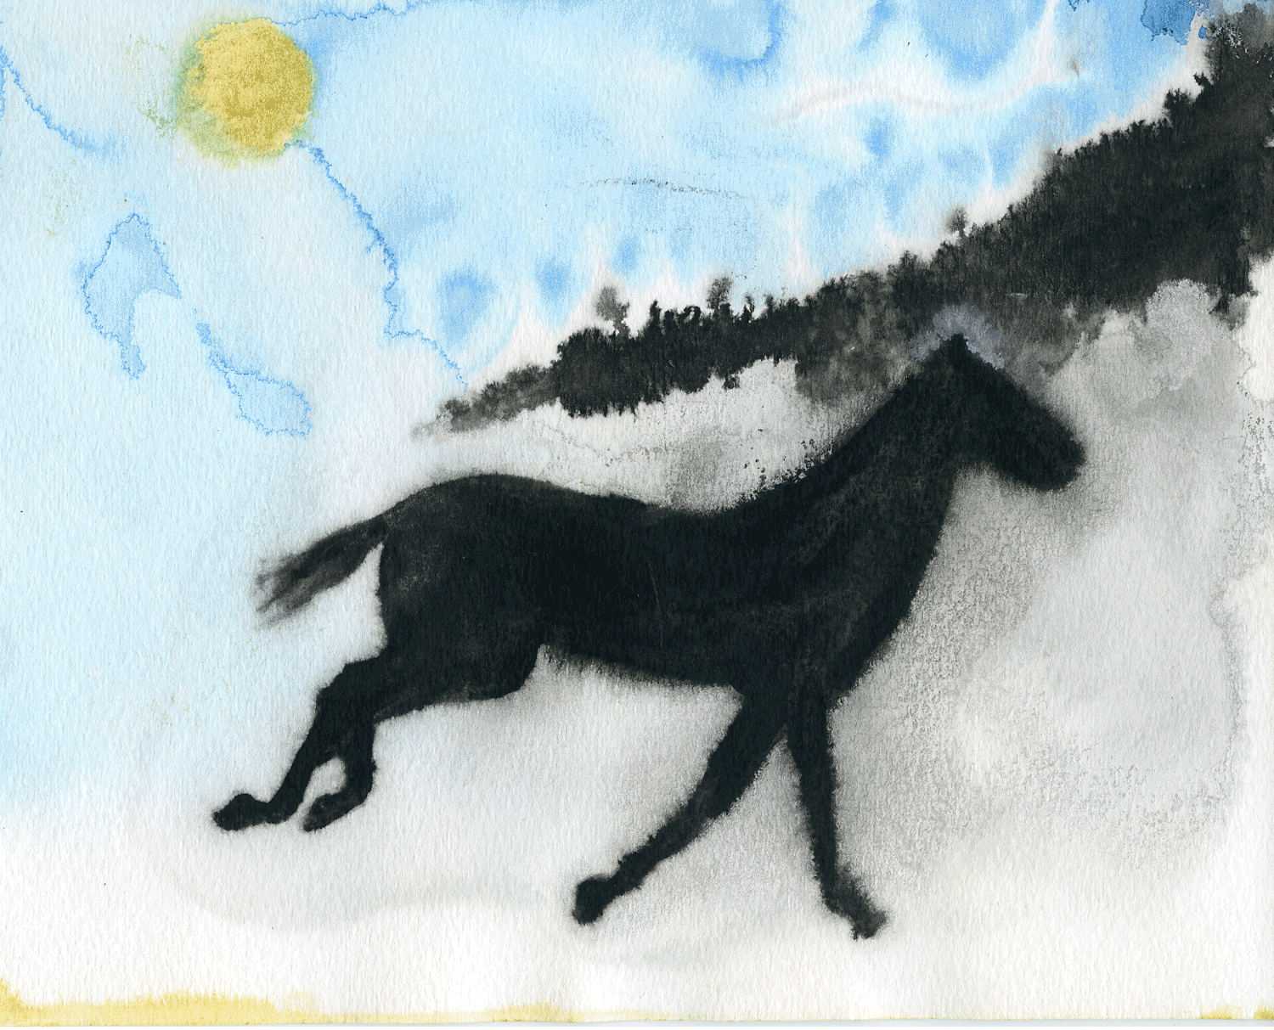
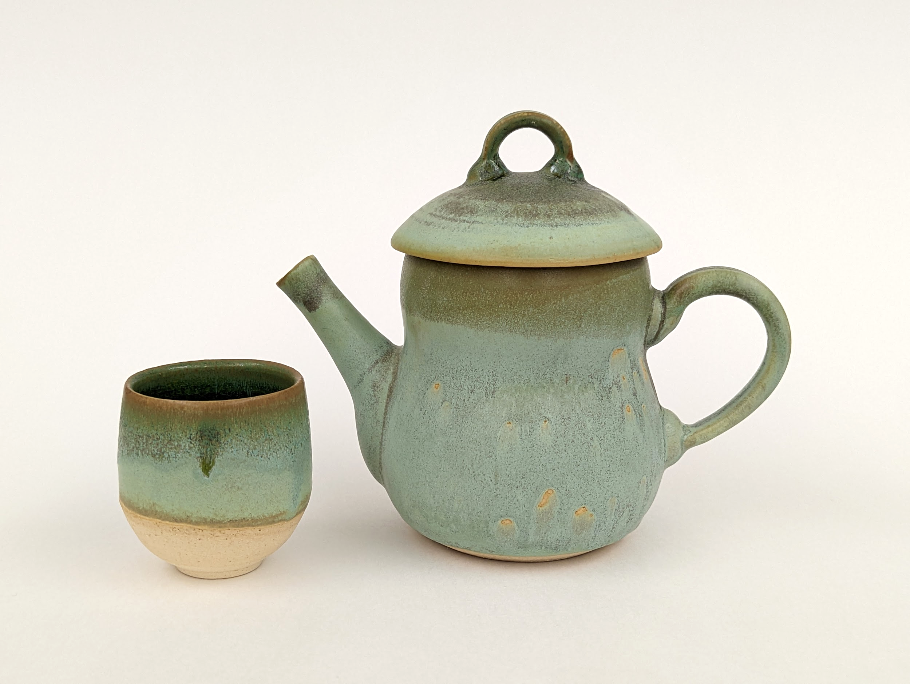
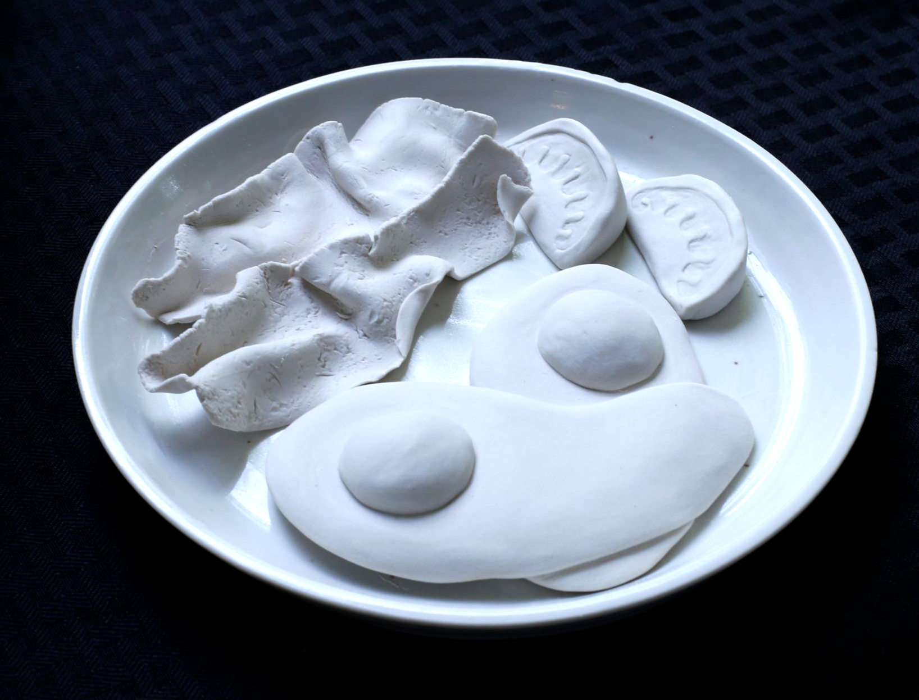
Rebecca Layson
artist/teacher/researcher
rlayson@students.kennesaw.edu
rlayson@atlantagirlsschool.org

Slide 3
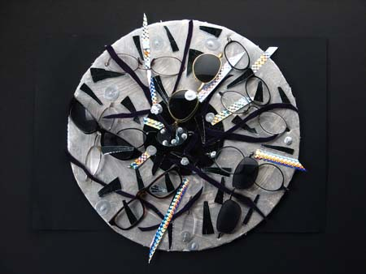
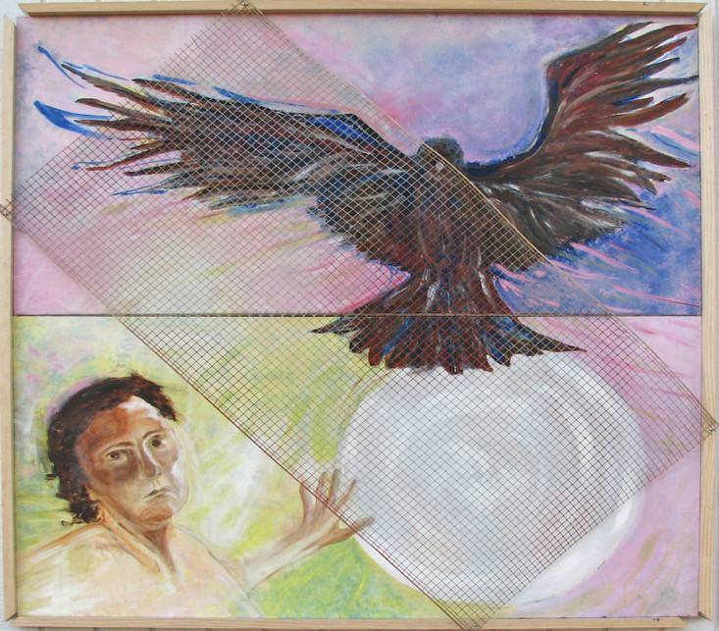
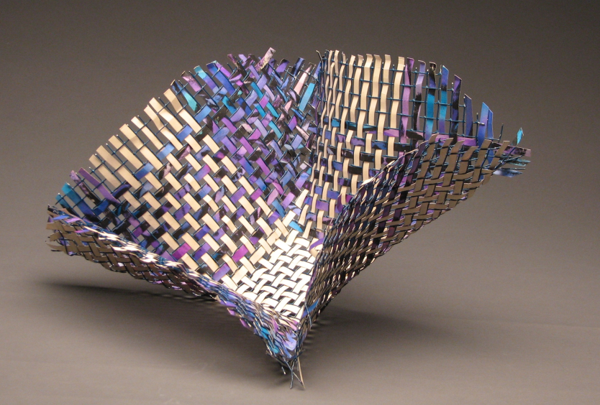
Diana Gregory a/r/tographer
artist/researcher/teacher
dgregory@kennesaw.edu
Notes:
DG – Hello everyone I’m Diana Gregory

Slide 4
We …
a graduate research assistant (GRA) and a faculty instructor – are presenting results from the two scholarship of teaching and learning (SoTL) processes
First Project
We share the results of our self-reflective interview process based on our response to and the implications of synthesizing Lock, Johnson, Hill, Ostrowdun, & da Rosa dos Santos’ (2021) graduate student-faculty partnership framework within our real-time semester-long relationship.
Second Project
Our work was modeled on the students-as-partners (Healey, Flint, & Harrington, 2016) framework where I, as the GRA, served as a participant observer and author of the survey that asked: what is it that you (the candidates) learned this semester in ART 6010: Context, Culture, & Contemporary Practice, and what effect did this learning have on your development of the final project in ART 6010?

Slide 5
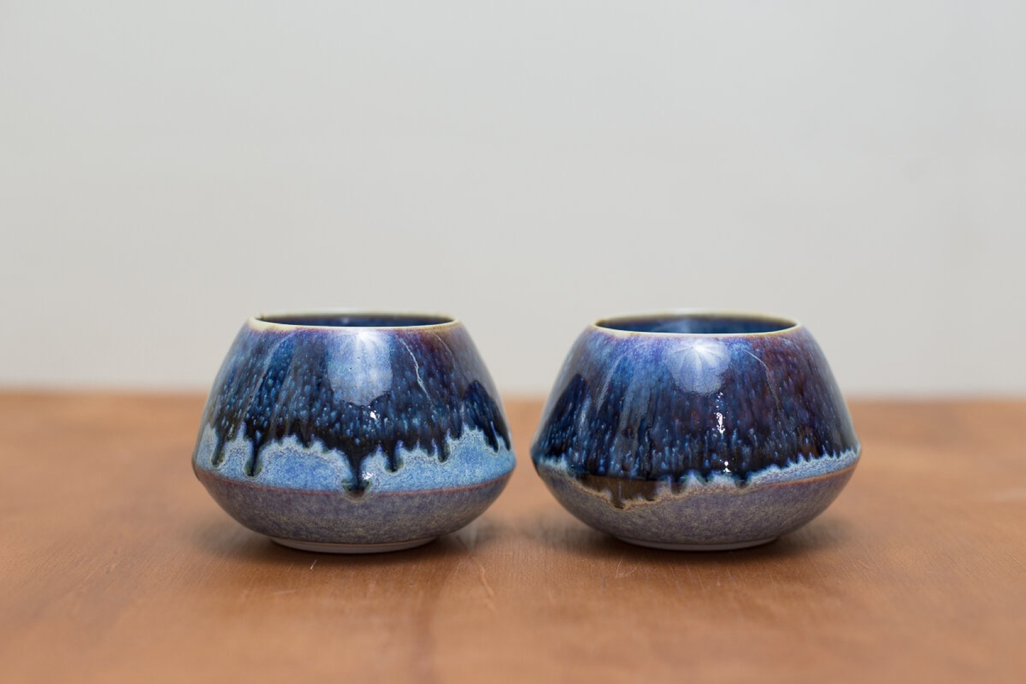

Slide 6
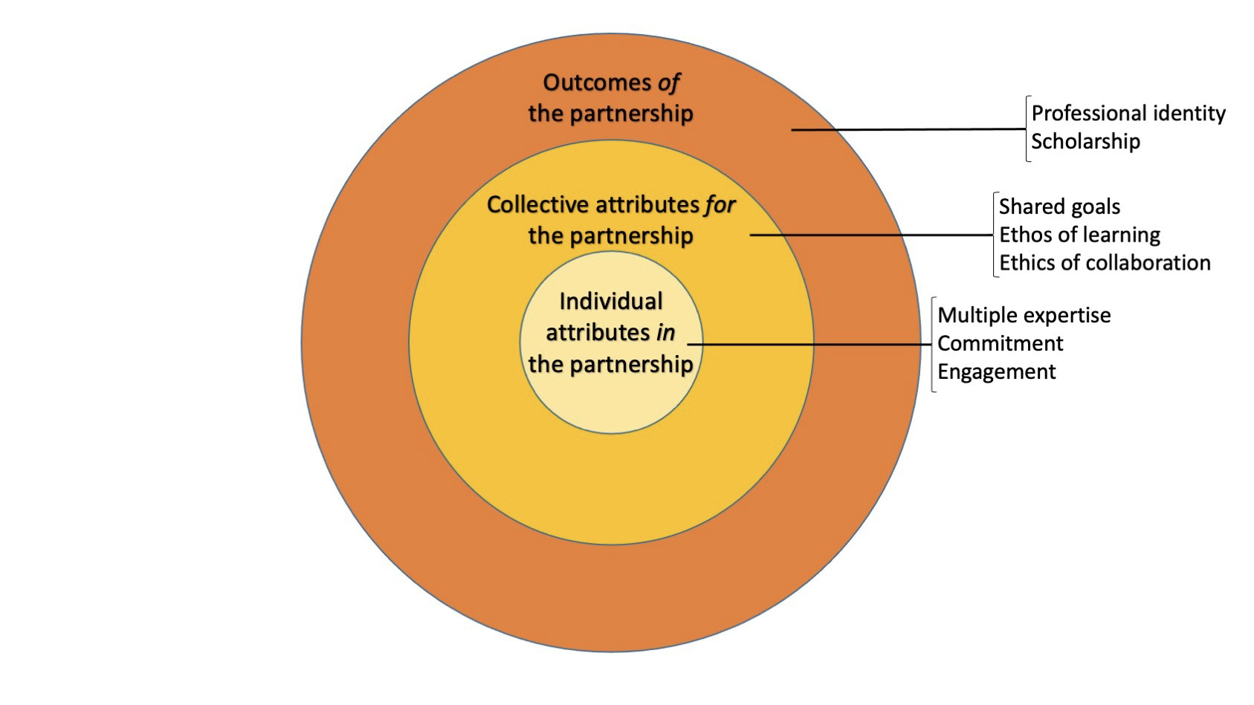
Figure 1. Graduate student-faculty partnership framework
Lock, J., Johnson, C., Hill, L., Ostrowdun, C., & da Rosa dos Santos, L. (2021).“From Assistants to Partners: A Framework for Graduate Students as Partners in SoTL Research.” Teaching & Learning Inquiry 9 no. 2. http://dx.doi.org/10.20343/teachlearninqu.9.2.9

Slide 14
Notes:
Reflecting on our time and work together, was this truly a collaborative process in your opinion? Why/why not?
Diana stepping back, me being open and asking questions
Process of getting proposal in -
Very equal, good two-way street. Has not felt one way
Sense of self - willingness to be vulnerable – page 8
Confirmed!!

Slide 18
Notes:
Was there a moment in this process where you felt a shift in viewing me as an emerging colleague versus just a student? Did that happen early on or later in the process? What made that shift occur if it happened?
When we committed to the project for SoTL Commons and taking the article as the base for this
Layers – improvement and feedback from 6010 which we may not have quite as much to talk about
Working from the article and reflecting on the process in a personal probe (graduate-student partnership)
When we decided what our collaboration would be, October-ish
Balance shifted

Slide 21
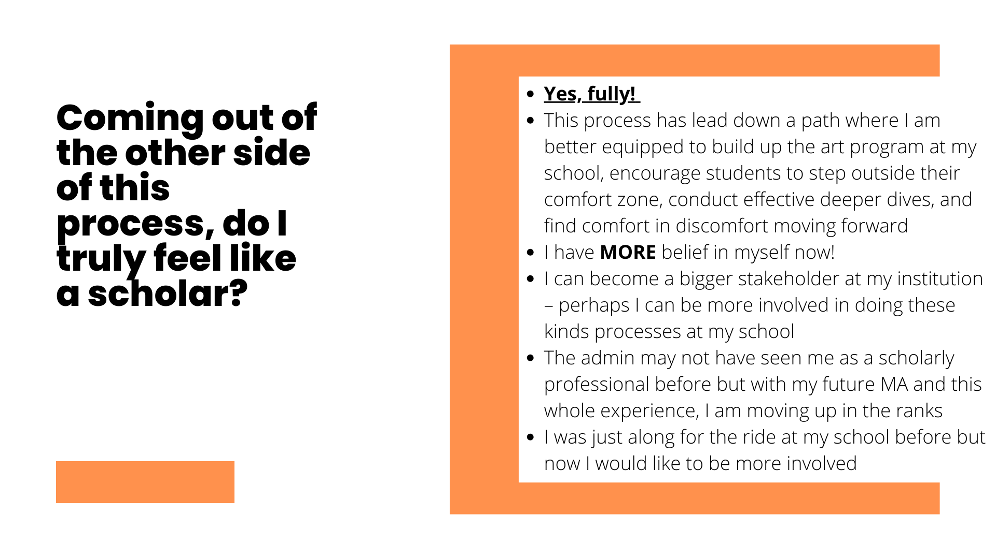

Slide 28
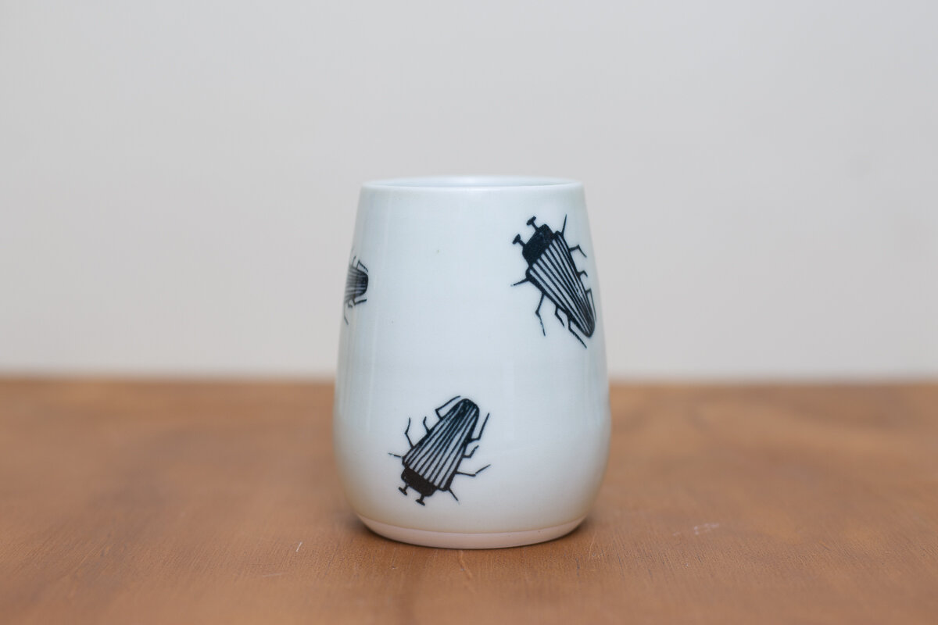
Questions & Reflections on the 1st project

Slide 29
Introduction and Background Information: SoTL Project ART 6010
Survey data: GRA survey fall 2022,
Instructor course evaluations fall 2021 & 2022
ART 6010: Context, Culture, & Contemporary Practice
Course Description
This course provides historical and contemporary developments
In the field of art and design, as a means to compose a personal
philosophy relevant to professional practices. In-depth exploration
results in the integration of concepts and issues to create a
comprehensive view of the multiple fields. Technological applications
integrated with social, psychological, affective, and contextual
components of creating relevant to art practices are a primary focus.
Course Objectives
By the end of this course, students will be able to:
Collaborate on our core values for the development of a personal narrative that intrinsically values art
Describe contemporary issues in art through historical, contemporary culture and diverse contexts
Compare historical and contemporary philosophies in order to construct a personal narrative for scholarly and professional practice
Analyze issues and concerns within art and design practices
Summarize and integrate concepts to create a comprehensive view of art and design locally, nationally, and internationally

Slide 30
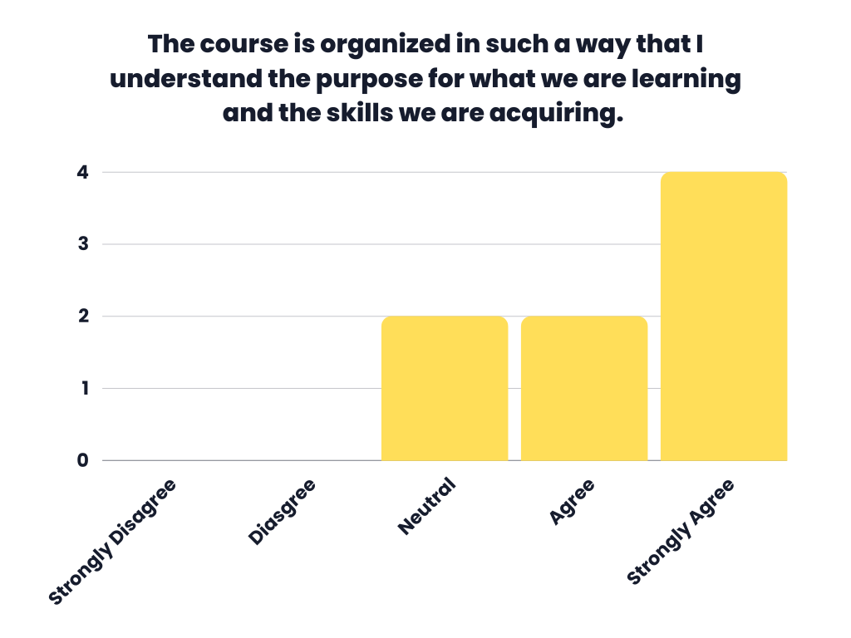
GRA Survey Fall 2022
Part of IRB-FY21-642

Slide 31
Instructor Clearly Established Objectives
Fall 21
Fall 22

Slide 32
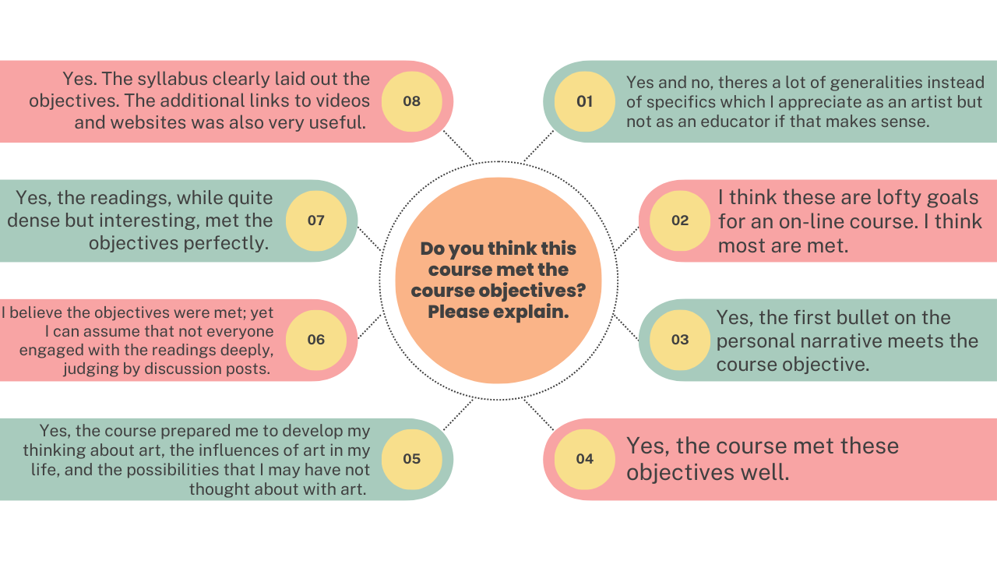

Slide 33
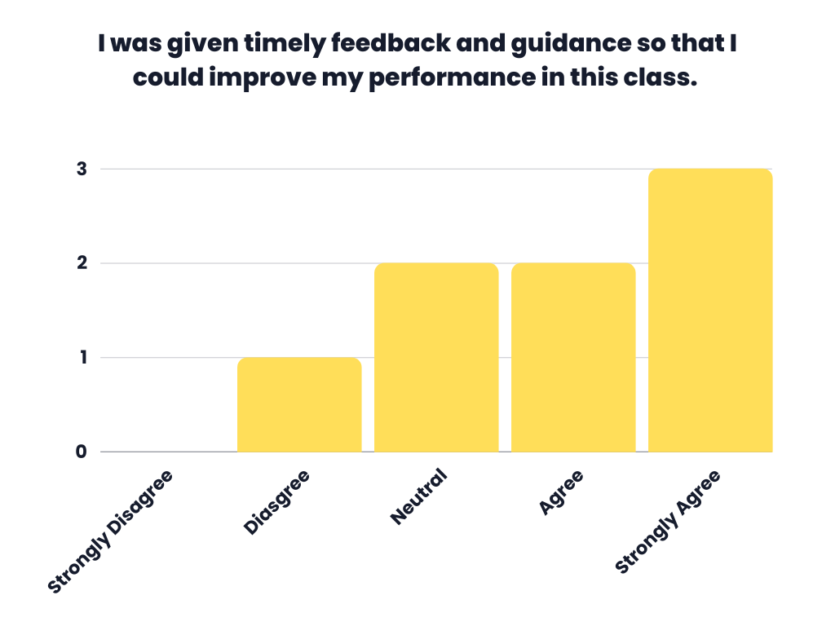
GRA Survey Fall 2022

Slide 34
Instructor Encouraged In-Depth Thinking
Fall 21
Fall 22

Slide 35
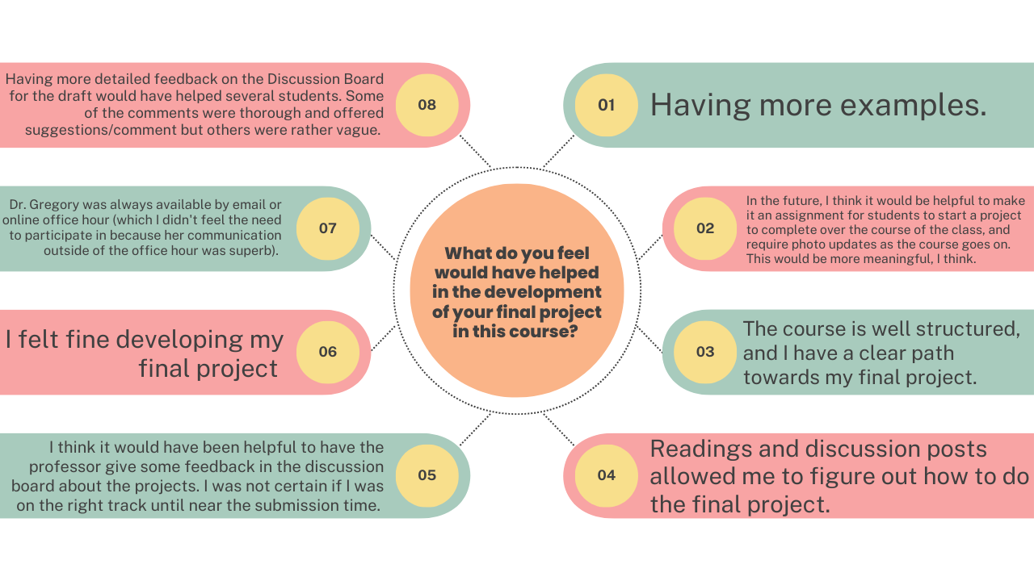

Slide 36
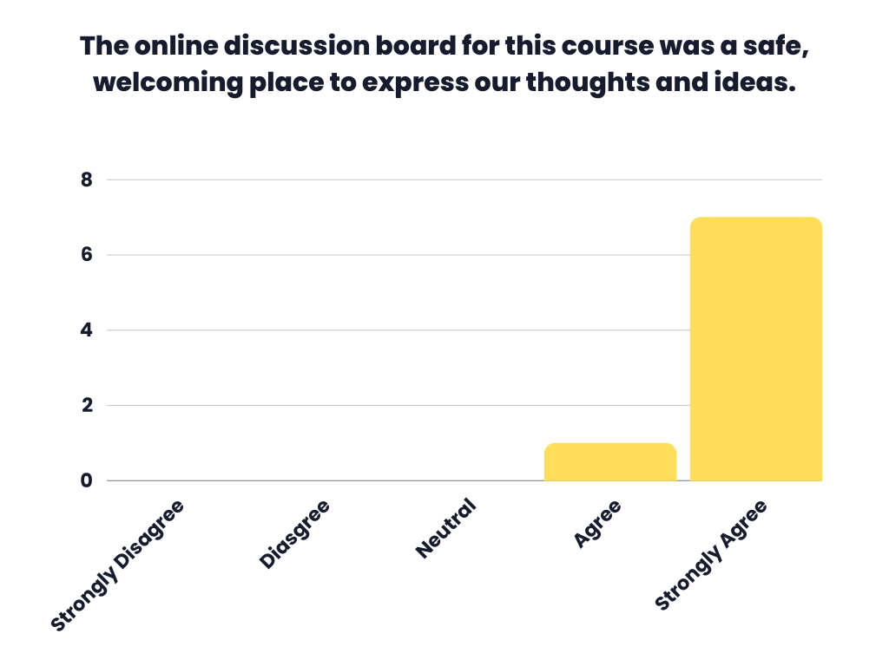
GRA Survey Fall 2022

Slide 37
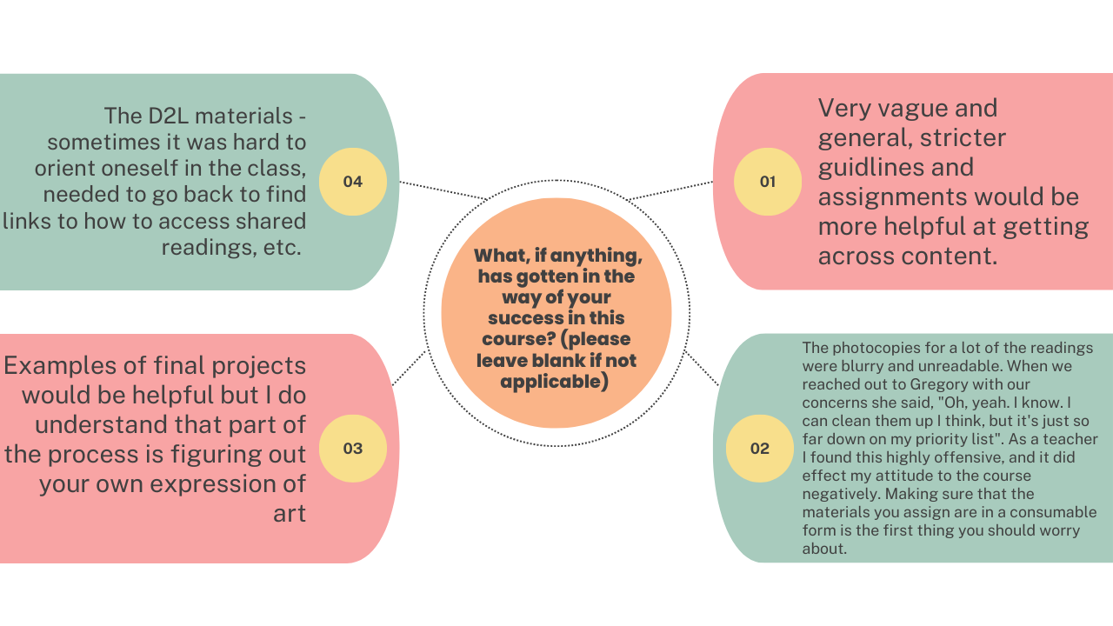

Slide 38
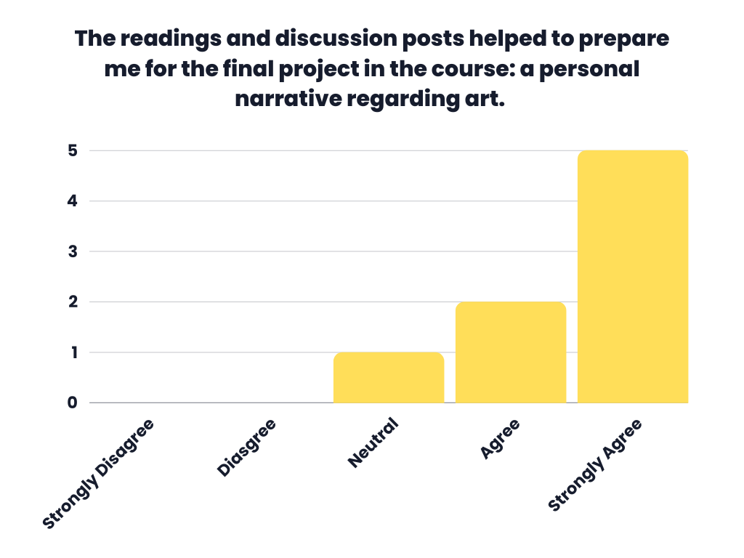
GRA Survey Fall 2022

Slide 39
Overall Quality of Instruction
Fall 21
Fall 22

Slide 41
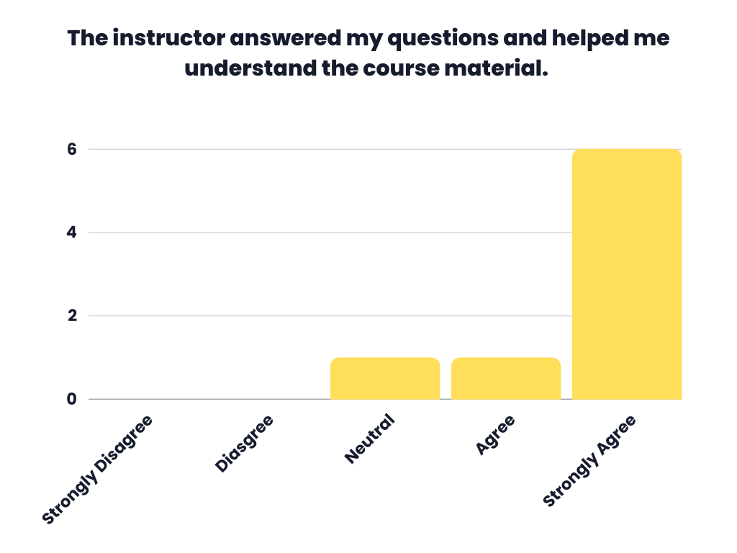
GRA Survey Fall 2022

Slide 42
Evaluation Method Was Clearly Established and Explained
Fall 21
Fall 22

Slide 44
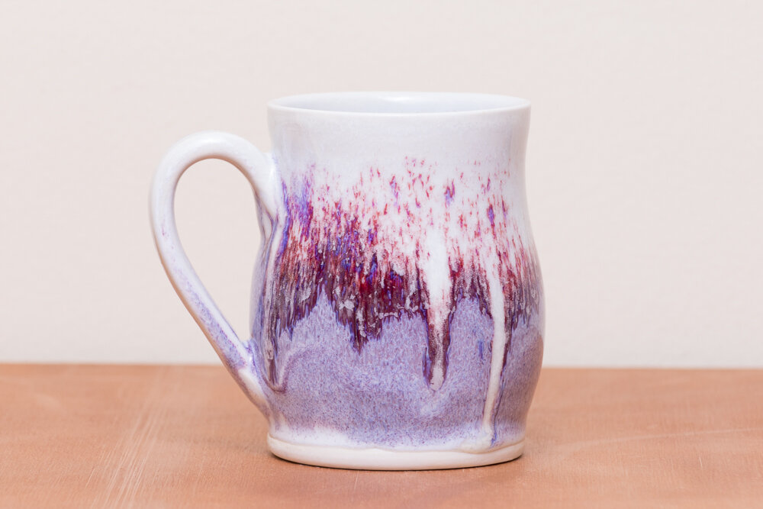
Questions & Reflections on the 2nd project

Slide 45
References
Felten, P. (2013). Principles of good practice in SoTL: Teaching and Learning Inquiry 1, no. 1: 121-25.
http://doi.org/10.20343/teachlearninqu.1.1.121
Fielding, M. (2004). Transformative approaches to student voice: Theoretical underpinnings, recalcitrant realities. British Educational Research Journal 30, no. 2: 295-311.
https://doi.org/10.1080/0141192042000195236
Gregory, D. (2022). Designing a Master of Art in Art and Design: Student-staff reflections on first-year experience. Journal of Educational Innovation, Partnership, and Change
https://journals.studentengagement.org.uk/index.php/studentchangeagents/issue/view/84
Healey, M., Flint, A., & Harrington, K. (2014). Engagement through partnership: Students as partners in learning and teaching in higher education. Higher Education Academy, York: HEA https://www.heaacademy.ac.uk/engagement-through-partnership-students-partners-learning-and- teaching-higher-education
Lock, J., Johnson, C., Hill, L., Ostrowdun, C., & da Rosa dos Santos, L. (2021).“From assistants to partners: A framework for graduate students as partners in SoTL research.” Teaching & Learning Inquiry, 9 no. 2. http://dx.doi.org/10.20343/teachlearninqu.9.2.9

Slide 46
Contact
Rebecca Layson
GRA | MA in Art and Design | Kennesaw State University
rlayson@students.kennesaw.edu
Atlanta Girls’ School
rlayson@atlantagirlsschool.org
www.bexpottery.com
Diana Gregory, PhD
School of Art and Design| Kennesaw State University
dgregory@kennesaw.edu
https://kennesaw.academia.edu/DianaGregory

