Slide 1
High Impact Practices Faculty Perceptions and Barriers to Implementation
Virginia Wickline, PhD; Rami Haddad, PhD;
Padmini Shankar, PhD, RDN & Karelle Aiken, PhD
Georgia Southern University HIPs Implementation Team
For more information, contact: vwickline@georgiasouthern.edu

Slide 2
What are HIPs?
Why do you do HIPs?
Why don’t you do HIPs?
What would motivate you to do HIPs more often?
https://hips.uark.edu/whats-your-hip/
“We need more time, I am drowning with overloads, larger classes, more grading.
I need to reduce some of my writing assignments, so I can keep up with grading.”

Slide 3
Outline
Defining HIPs
HIPs’ role in extraordinary student outcomes
HIPs Implementation initiative goals
Creating a foundation for successful and sustainable efforts
Survey method and results on perception of HIPs and barriers to implementation
Data-informed strategies for moving forward

Slide 4
What are HIPs?
High Impact Practices (HIPs) are evidence-based teaching strategies that promote effective learning by engaging students in meaningful academic experiences, fostering active learning, collaboration, confidence, and leadership skills.
https://cah.georgiasouthern.edu/

Slide 5
High Impact Practices
The American Association of Colleges & Universities (AAC&U) has identified 11 High Impact Practices (HIPs) that it encourages post-secondary institutions to adopt and scale.
Based on the work of George Kuh, founder of Indiana University Center for Postsecondary Research & the National Survey of Student Engagements (NSSE)
HIPs are rigorously tested—strong evidence that HIPs are beneficial for college students from all backgrounds.
HIPs take many different forms, depending on learner characteristics, and institutional priorities and contexts.
- AAC&U, https://www.aacu.org/leap/hips

Slide 6
HIPs: 11 Categories
First-Year Seminars and Experiences
Common Intellectual Experiences
Learning Communities
Writing-Intensive Courses
Collaborative Assignments and Projects
Undergraduate Research
Diversity/Global Learning
ePortfolios
Service Learning/Community-Based Learning
Work-based Learning/Internships
Capstone Courses and Projects
- AAC&U, https://www.aacu.org/leap/hips

Slide 7
Example: Impact of HIPs in a Georgia Southern (GS) University College—Undergraduate Research
Six-Year Graduation Rate, 2014, 2015 and 2016 cohorts (graduate by fall 2020, 2021 and 2022, respectively):
Overall (all students), 52-55%
Not Research Enrolled, 42-44%
Research-Enrolled, 91-99%
Key Takeaways:
“Real-life” evidence—HIPs works!
Overwhelmingly positive correlation—HIPs engagement & student outcome
Guaranteed payoff—100% worth investing in faculty & staff to scale such efforts!

Slide 8
HIPs Elements
Essential characteristics of HIPs:
Achievement of deep learning,
Significant engagement gains, and
Positive differential impact on historically underserved student populations.
Kuh, George D. & O'Donnell, K. (2013). Ensuring quality & taking high-impact practices to scale. Washington, DC: Association of American Colleges & Universities.

Slide 9
EIGHT COMMON CHARACTERISTICS OF HIPS
Performance expectations set at appropriately high levels
Significant investment of time and effort over an extended period of time
Interactions with faculty and peers about substantive matters
Experiences with diversity, wherein students are expected to and must contend with people and circumstances that differ from those with which students are familiar
Frequent, timely and constructive feedback
Periodic, structured opportunities to reflect and integrate learning
Opportunities to discover relevance of learning through real-world applications
Public demonstration of competence

Slide 10
Georgia Southern HIPs Implementation Initiative
Support the University System of Georgia (USG) Momentum Approach HIPs implementation initiative to expand equitable access to and participation in HIPs and related experiential learning opportunities for undergraduate students enrolled at USG institutions.
https://cah.georgiasouthern.edu/languages/

Slide 11
GS HIPs Implementation Initiative Goals
Quantify & evaluate current GS HIPs offerings
Assess GS faculty (& staff) perceptions of HIPs & barriers to implementation
Educate faculty & staff about HIPs
Provide resources for developing/enhancing HIPs offerings
Ensure high impact & equity in GS student experiences with HIPs
Tap into and promote knowledge/experience of all 26 USG institutions
Long-term…Planning & implementation of HIPs at a scale that can serve as (new) models for learning

Slide 12
The Research
Survey sent to all 3,150 employees
10.6% response rate
613 began survey; 283 completed 50% or more (53.8% attrition rate)
Responders’ institutional roles
154 staff/administration
129 faculty
Majority female (57%) and White (70%)
Median of 8 years at the university
All 9 colleges represented

Slide 13
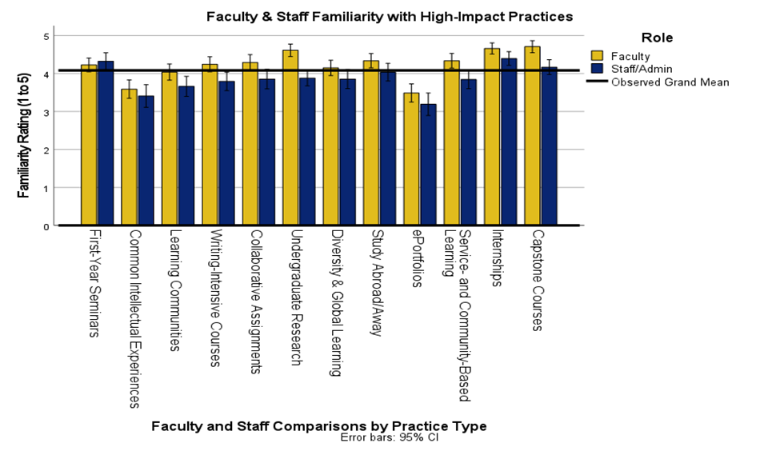
Notes:
Familiarity with HIPs. On a scale from 1 (Unfamiliar) to 5 (Familiar), faculty (n = 127) and staff members (n = 83) rated themselves as fairly familiar with HIPs practices (Grand Mean = 4.05). The most familiar strategies were undergraduate research, internships, and capstones. The least familiar strategies were common intellectual experiences and ePortfolios. With one exception (first-year seminars), faculty familiarity ratings were higher than staff/administrators (see Figure 1).

Slide 14
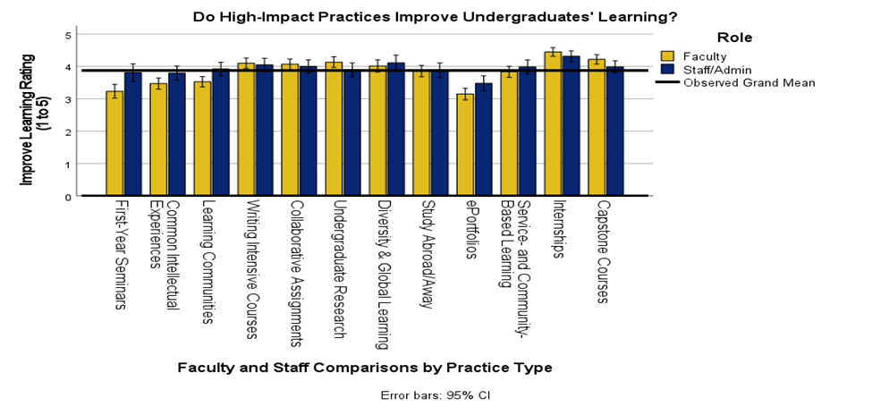
Notes:
HIPs Improving Learning. On a scale from 1 (Not at All) to 5 (A Great Deal), faculty (n = 127) and staff members (n = 79) both rated HIPs practices as important for improving undergraduates’ learning (Grand Mean = 3.89). The highest-rated strategies by both faculty and staff were writing-intensive courses, collaborative assignments, undergraduate research, diversity & global learning, study abroad/away, service-learning & community-based learning, internships, and capstones. These would be the areas of common ground between faculty and staff to expand upon by Georgia Southern (see Figure 2,

Slide 15
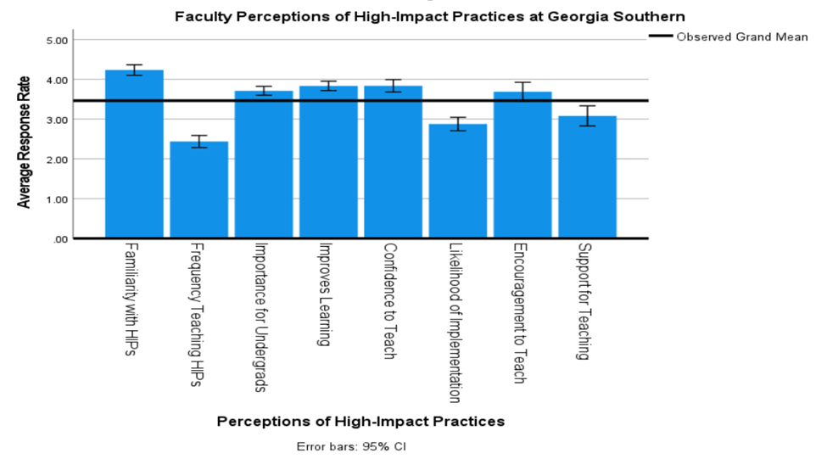
Notes:
Faculty Perceptions. Faculty only were then asked their perceptions of HIPs at the university, which were each measured on a scale from 1 to 5, where 5 is a more favorable rating. Although favorable ratings existed for HIPs overall (Grand Mean = 3.46), faculty reported significantly lower behavioral indicators, being neutral to negative in how frequently they taught them, their likelihood of teaching them, and the institution’s support for teaching them. Thus, it seems that a disconnect exists between the value for and implementation of HIPs at Georgia Southern, implying that practical and logistical barriers will need to be addressed if we are to encourage more widespread adoption of these practices at the university. Please see Figure 3.

Slide 16
Barriers to Involvement
“You want us to do this more often? Give us the faculty lines we need to cut our courses to 1/3 their size or even less, rigorously protect those caps, let us hold students accountable for not doing the work instead of focusing on DFW rates and RPG, and explicitly reward faculty who use these practices with guaranteed permanent raises. If the university won't put significant recurring money behind this, there is zero chance at systemic lasting change.”
Time
Lack of resources
Lack of recognition
Other
Notes:
Barriers to Involvement (qualitative). Participants identified a number of important barriers to the broader implementation of HIPs. The primary themes were time, lack of resources, and lack of recognition/support.
Time: Teaching load and general workload too high, too many courses, large and growing class sizes, no time to learn more or develop courses
Lack of resources: No grad assistants, lack of pay/funding for programs like first-year experience (FYE) and conversations with professors (CwP), difficulty finding community partners, lack of training, no financial incentives
Lack of recognition: Administrative interference and demoralization; no recognition in annual reports, P&T, raises; no reward structure; deans/chairs do not support; does not seem to be an institutional priority; no value-added
Other: Lack of student interest/effort, COVID concerns, unfamiliarity with HIPs approaches

Slide 17
Suggestions and solutions?
What are the barriers to HIPs where you work?
What can you and others do (or what have you done) to address them?
What has worked for you and/or your institution?

Slide 18
Incentives, Motivation & Solutions
“I'm not an English teacher and I do not have time to grade intensive writing papers.
Provide Teaching Assistants to grade these.
Fund teaching extra courses like FYE and Conversations with Professors.”
Time
Money
Recognition
Training
Other
Notes:
Incentives, Motivations, and Solutions (qualitative). Participants indicated time, money, recognition, and training as ways the university could incentivize more faculty involvement.
Time: Smaller teaching load; smaller enrollment caps for HIPs courses; course releases for converting, revamping, and/or teaching HIPs course; graduate assistants to help with writing-intensive courses/grading
Money: Incentives for faculty training, designated funding stream to provide payment/professional development funds for converting/developing a HIPs course, paid mentor/mentee program, professional development to attend conferences/workshops on HIPs outside of campus
Recognition: Deans’ and chair’s recognition of importance; credit on annual reports, workloads, and promotion and tenure materials, sharing local HIPs examples/success stories, newsletter
Training: New faculty session, virtual or face-to-face synchronous professional development opportunities, asynchronous online training opportunities, faculty learning communities, workshops by faculty teaching HIPs courses, HIPs mentors, new CTE badge
Other: Clearinghouse of undergraduate research opportunities, fixing the first-year experience program

Slide 19
Years 1-2: Accomplishments
Pre-test assessment (discussed today)
Partnered with Faculty Center to launch new HIPs badge
Two Faculty Center workshops (Introduction to HIPs, funding for HIPs
Synchronized efforts with Office of Leadership & Community Engagement to provide service-learning workshops for HIPs badge
Publicized USG HIPs training
Shared Banner coding for HIPs courses with Deans, Chairs, and Curriculum Committees
Launched a HIPs website & Google group (listserv)
Advocate for reduced class sizes, P&T recognition, funding (no success here yet)

Slide 20
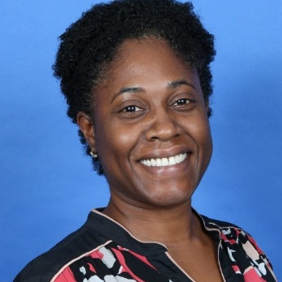
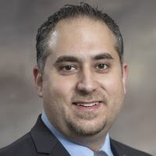
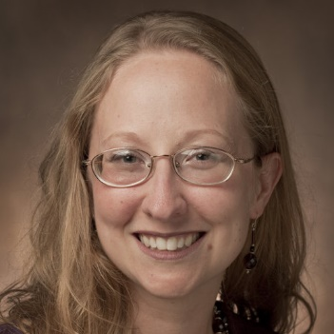
GS HIPs Implementation Team
Karelle Aiken, Professor, Dept. of Chemistry and Biochemistry
Rami J. Haddad, Associate Professor & Interim Chair, Dept. of Electrical and Computer Engineering
Padmini Shankar, Professor, Dept. of Health Sciences and Kinesiology
Virginia (Ginger) Wickline, Associate Professor, Dept. of Psychology
Georgia Southern (GS) HIPs Implementation Website: https://sites.google.com/georgiasouthern.edu/hips

Slide 21
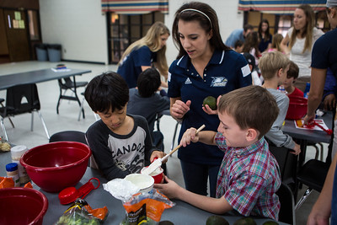
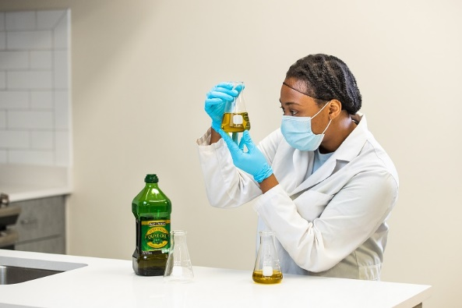
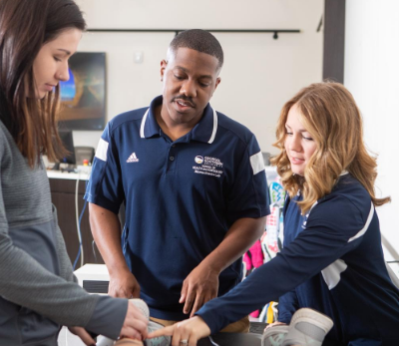
Thank you for your time…
Questions?
vwickline@georgiasouthern.edu
https://chp.georgiasouthern.edu/

