Slide 1
Testimonials
Instructor

Slide 2
The Impact
OF
RECOGNIZING FACULTY ENGAGEMENT
Notes:
Menti- full screen mode
Music instead of timer on think pair share
Some sort of sound on research
Beginning provide context about worldwide- maybe when we introduce ourselves.
Research dispursed adjunct feeling isolated, not culture of university
Context behind 5Cs
Make research text bigger than source
Recognition went to chairs
How we choose them
Pass out rubric
How we get the information- how we are involved in their classes
Add slides on process of giving a 5C
QR code with access to rubric
Print small QRS

Slide 3
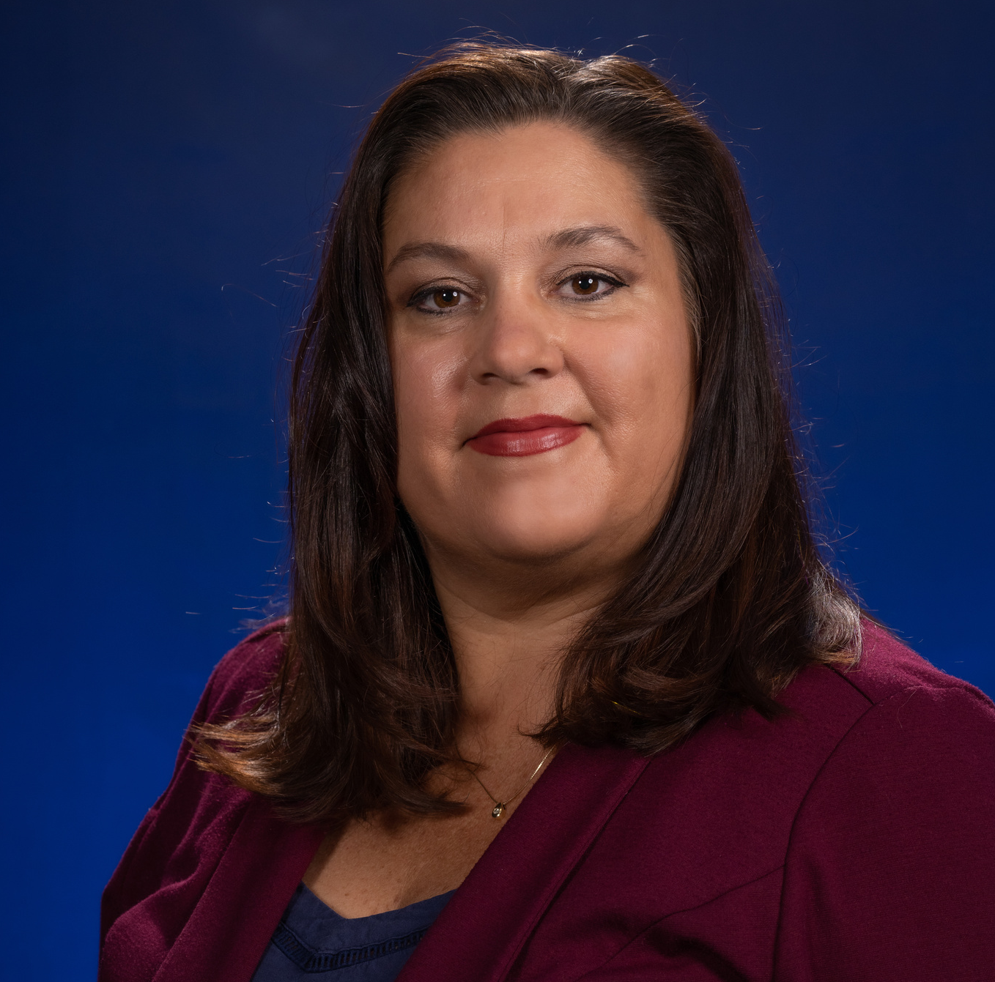
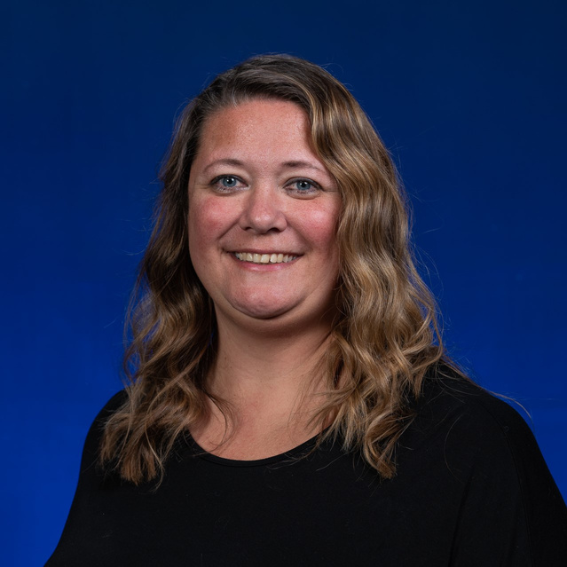
Get in
Helena Hübl
hublh@erau.edu
Instructional Consultant II
RCTLE
Embry-Riddle
Aeronautical University
Sharron DeRosier
derosies@erau.edu
Senior Instructional Consultant
RCTLE
Embry-Riddle Aeronautical University
Touch

Slide 4
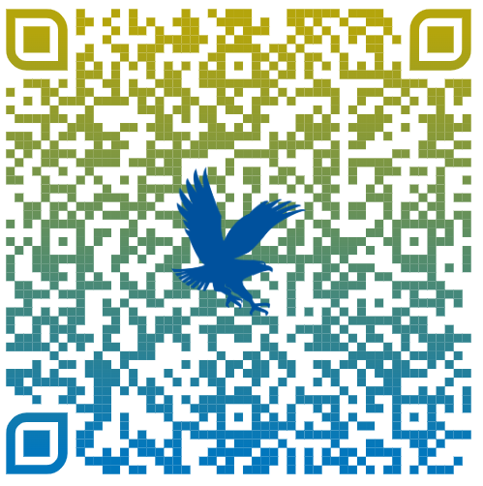
The 5Cs Award Pilot Program
Dispersed Online Adjunct Faculty
Course Visits
Change in perceptions
5Cs Award shared with Chair
Process Guide
Notes:
Talk about Worldwide- context on type of courses
How we get the information- why we are in their courses/templated courses?
Process of giving 5C

Slide 5
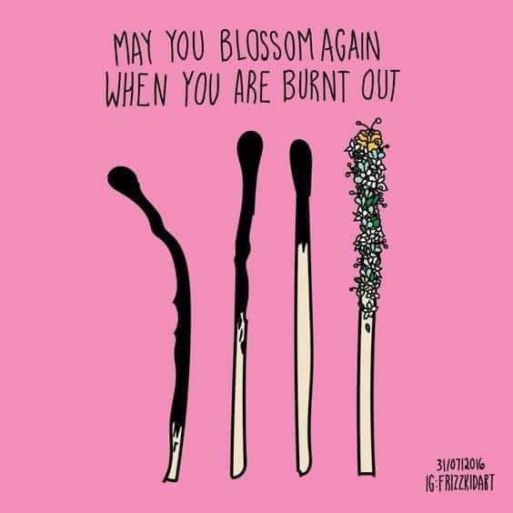
When employees believe they will be recognized, they are 2.7x more likely to be highly engaged.
Source: Quantum Workplace
The #1 reason most people leave their jobs is a lack of recognition.
Source: Gallup
Organizations with recognition programs had 31% lower voluntary turnover than those without.
Source: Bersin by Deloitte
52.5% of employees want more recognition from their immediate manager.
Source: Recognition in the Workplace, Quantum Workplace and BambooHR
Research
Notes:
Sharron

Slide 6
Employee
Recognition
What feelings do you associate with receiving recognition?
Notes:
Interactive word cloud
Mentimeter
Helena
https://www.mentimeter.com/app/presentation/al11zguwf8tizgodwazrm1earwptkzfd

Slide 7
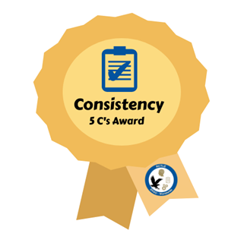
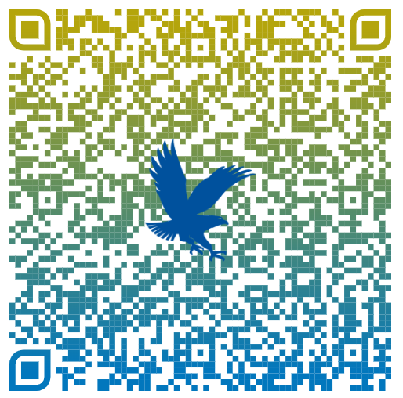
Project Progression
Faculty Focus: “How to Improve and Promote Student Engagement in the Online Classroom”
Humanizing the Learning Experience Using the 5Cs
RefreshER- Annual required training
Notes:
Helena
Why: Received pushback from faculty re
Planning: We formed a committee and developed ideas for how to recognize instructors who were implementing the 5Cs in their courses.
Implementation: We developed criteria for receiving the awards, templates for emails to send to instructors, and a tracking sheet

Slide 8
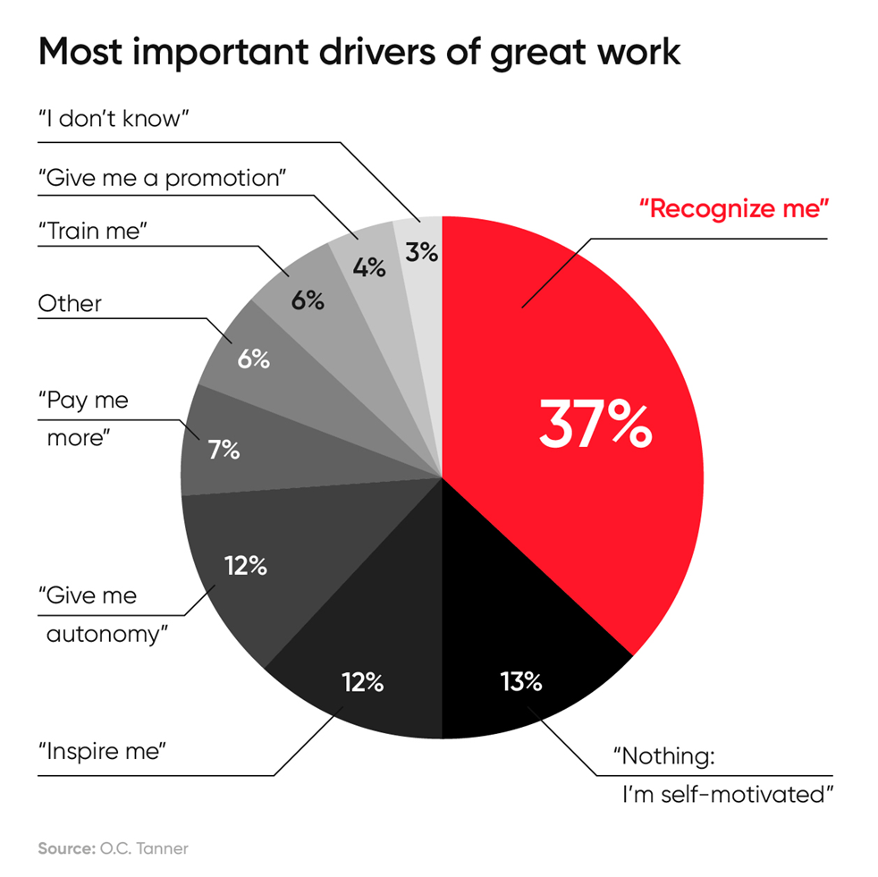
After being recognized, 5C Award winners continue to use best practices in future courses
Recognize me!
37%
Notes:
Our research shows that winners of an award went on to continue best practices. The reason this is so important, as this graph shows, the #1 way employees want to be acknowledged is through recognition, and they continue these best practices in later terms and continue to grow thanks to our prof. dev.
Helena

Slide 9
5Cs Award Testimonial
Notes:
Helena

Slide 10
future
Looking into the
Notes:
Helena

Slide 11
What do you
think?
Think: For 27 seconds think about the ways you prefer to be recognized and what you like to be recognized for.
12
10
11
18
13
19
2
5
27
14
0
8
23
3
21
4
9
6
15
7
26
1
25
20
22
24
17
16
Pair: Talk for 112 seconds with people sitting near you about the impact of being recognized.
74
Share: With the group ways you could implement or would like to see something like this implemented?
103
102
87
86
85
84
83
109
108
110
30
100
99
98
97
89
88
96
72
71
73
64
75
67
79
78
33
3
2
104
0
101
10
12
8
5
4
11
6
9
13
20
23
24
21
80
27
14
29
26
22
19
15
105
25
106
107
112
111
53
31
82
81
94
93
92
91
90
95
55
66
62
57
58
59
60
61
63
65
68
77
76
70
32
34
39
40
38
43
41
1
42
7
16
17
18
49
28
54
50
56
69
35
37
36
44
45
46
47
48
52
51
Notes:
Sharron

Slide 12
Q&A
Thank you for your participation
Helena Hübl
hublh@erau.edu
Instructional Consultant II
RCTLE
Embry-Riddle
Aeronautical University
Sharron DeRosier
derosies@erau.edu
Senior Instructional Consultant
RCTLE
Embry-Riddle Aeronautical University

