Slide 1
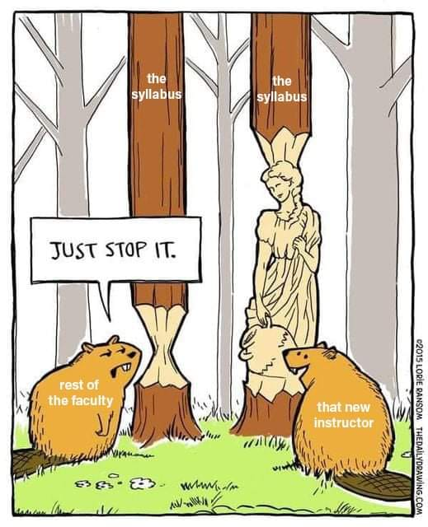
Consider Your Syllabi: Ask Yourself…
Do you think syllabi should be brief or detailed? Why?
Do you include graphics, images, or color on your syllabus? Why or why not?
Have you ever heard of a syllabus snapshot or graphic syllabus?
What skills do you directly or indirectly list on your syllabus?
Do you have a syllabus assignment?
Notes:
GW

Slide 2
First Impressions:
Engage Your Students Starting with the Syllabus!
Dr. Virginia B. Wickline (Georgia Southern University) - vwickline@georgiasouthern.edu
Dr. Drew C. Appleby (IUPUI) – dappleby@iupui.edu
Abstract
First impressions in the classroom are crucial! Research shows that impressions of teachers in the first few minutes of class on the first day can influence end-of-course student evaluations (Ambady & Rosenthal, 1993). What professors consider less often is that their students’ first impressions of them begin with the course management site and syllabus, which are often available to students even before classes begin. Syllabus characteristics sometimes impact students’ perceptions of teacher and course (e.g., Jenkins et al., 2014; Overman et al., 2019; Richmond et al., 2019, 2016; Wickline et al., 2021, under review), including master teacher behaviors like care and competence (Keeley et al., 2009). We all know cases, too, where students are looking at the syllabus to decide whether or not to stay enrolled in the course. A bad first impression cannot be overcome if students drop the course!
Notes:
GW

Slide 3
Session Strategy
Opening: “Ask Yourself…” discussion questions: self or elbow neighbor (3 mins)
Session learning outcomes (2 mins)
Why syllabus design could be important (10 mins)
For first impressions
For student motivation
Questions/discussion (15 mins)
Syllabus and assignment examples (take-away)
Notes:
GW

Slide 4
Learning Outcomes
By the end of this session, you should be able t0:
Reflect on your syllabus as a valuable opportunity for making first impressions
Articulate the benefits of engaging, learner-centered syllabus strategies like warm tone, graphics/color/video, and a skills emphasis
Describe strategies to get students to read the syllabus (syllabus design, syllabus assignments)
Modify your syllabus to give the impressions you want to students

Slide 5
The Syllabus: What is its Purpose?
Remember: High schools do not often use syllabi (unless AP courses). We take for granted college students will naturally know it is important (they won’t) and will care (they won’t).
Discuss: What do you hope students take away from your syllabus the first day?
Challenge?
Contract?
Details?
Power?
Signaling device?
(Fornaciari & Dean, 2014)

Slide 6
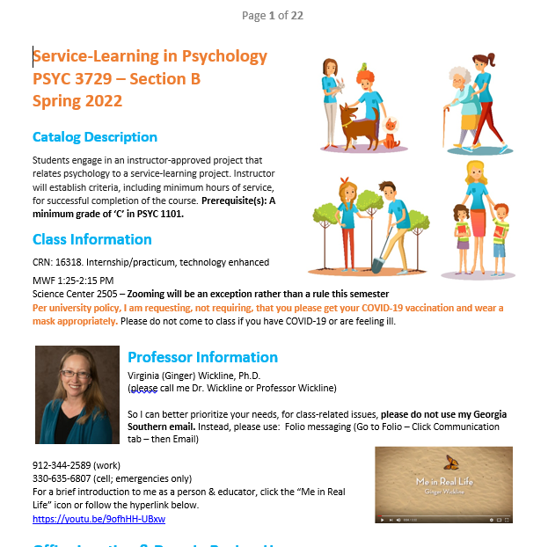
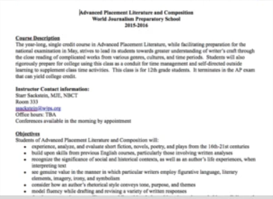
First Impressions?
30 seconds or less to make a first impression with students (no pressure!)
(Ambady & Rosenthal, 1993)

Slide 7
Engaging Students with the Syllabus
Be savvy: Prepare to sell yourself and your course to students!
Students’ overall well-being and attachment to their college correlated with feeling supported in a national poll of over 30,000 college graduates
Your syllabus can make your first step toward being caring and encouraging, making students excited to learn, and helping them feel supported
(Gallup, 2014)

Slide 8
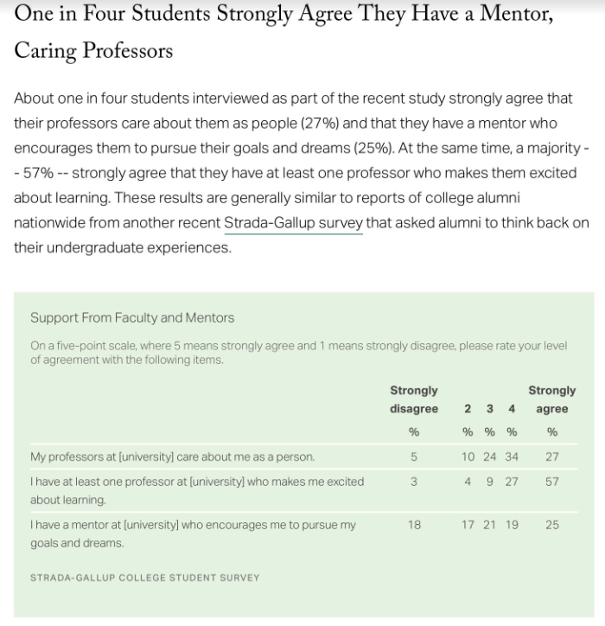
(Gallup, 2018)

Slide 9
Learner-Centered or Teacher-Centered?
Warm, learner-centered syllabi focus on:
Accessibility
Community building
Intrinsic motivation
Formative feedback
Relevance
Learner-centered syllabi impact students’ impressions of master teacher behaviors and rapport
(Cullen & Harris, 2009; Richmond et al., 2016)

Slide 10
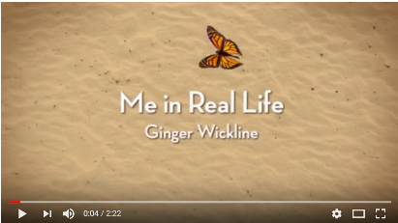
Catch Their Attention
Consider a welcome video or graphic introduction
Graphics: Better instructor impressions
Then, there are:
Syllabus snapshots
Graphic syllabi
Bitmoji: Cool or cheesy?
(Lightner & Benander, 2018; Overman et al., 2019; Wickline et al., 2021; Wickline et al., under review)

Slide 11
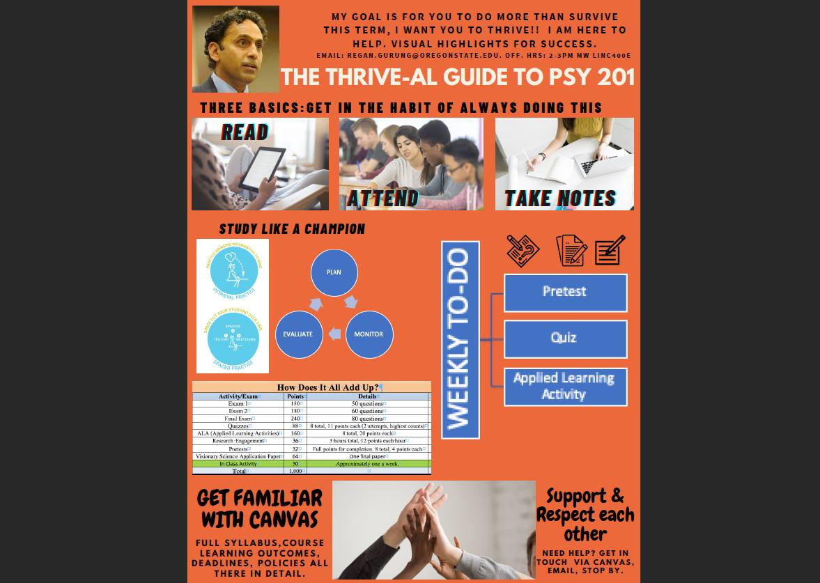

Slide 12
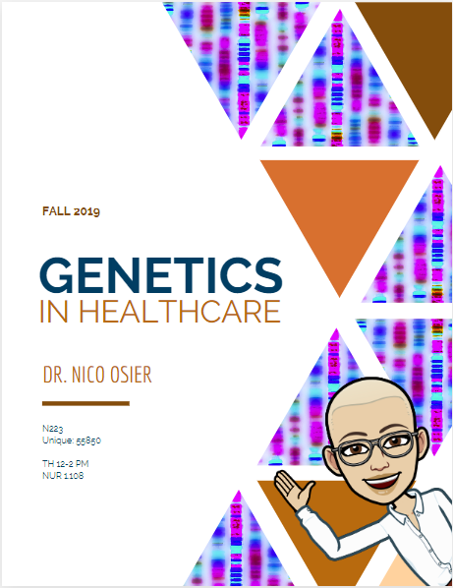
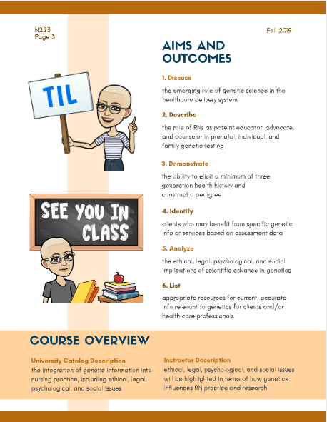

Slide 15
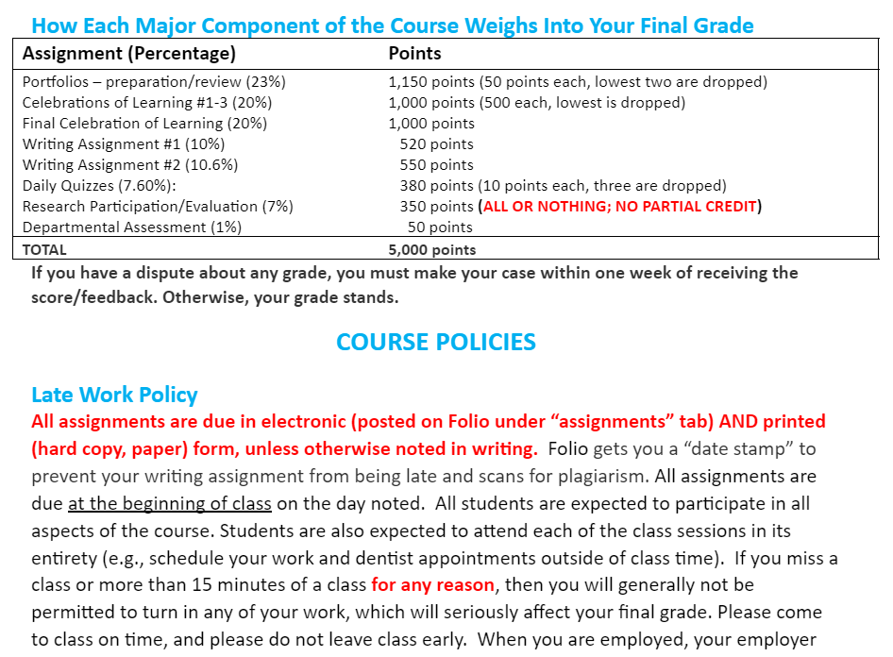
Students Say: Avoid CAPS and Red

Slide 16
Make it Matter: Highlight Skills
Can they persuade employers and graduate schools they have the necessary skills to be successful?
Consider a skills-based syllabus section in every syllabus, which contributes to positive student perceptions of the value of the course for their futures
(Appleby et al., 2019; Wickline et al., 2021; Wickline et al., under review)

Slide 17
Skills-Based Syllabus Section: An Example
The skills-based syllabus section example being handed out to you:
Was utilized in a syllabus by Wickline (2019)
Was subsequently modified and published in Appleby et al. (2019) in The Scholarship of Teaching and Learning in Psychology
Refers students to specific skills listed by Naufel et al. (2018) in The Skillful Psychology Student: Preparing for Success in the 21st Center Workforce published by the American Psychological Association as part of the American Psychological Association’s Committee on Associate and Baccalaureate Education (CABE).
Here is an example syllabus (with graphics, no more red or CAPS)

Slide 18
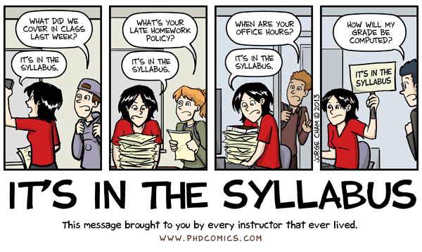
Will They Read It?
Discuss: How long do you think students typically look at a syllabus?
8-12 minutes
(Lightner & Benander, 2018)

Slide 19
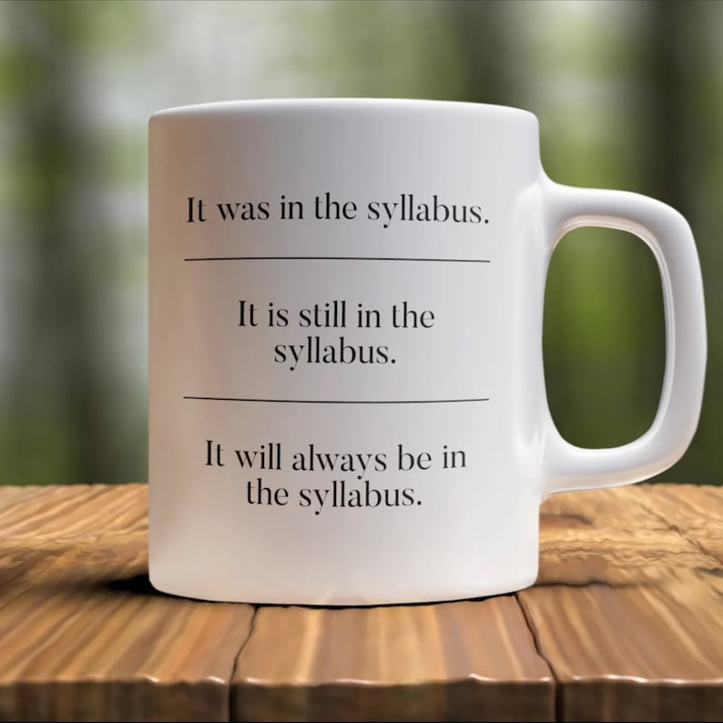
Will They Read It? (Yes, if “Encouraged”)
Provide extrinsic motivation; show you want them to read it
Syllabus quiz
Multiple choice
Multiple attempts
Record the highest score
Syllabus discussion
Students read in class
Discuss key questions/concerns together
Syllabus reflection
3-2-1: 3 things noticed, 2 questions, 1 concern

Slide 20
Final Thoughts
Suggestion: Consider carefully what your syllabus says about you – some students are looking for clues!
What have you tried that works for you?
Students want details but do not pay attention equally to syllabus elements (Becker & Calhoun, 1999)
Students prioritize due dates, grading policies
How will you get them to read it?
Hive mind: What would you like to ask each other?
As a result of today’s session, how might your syllabi improve?

Slide 21
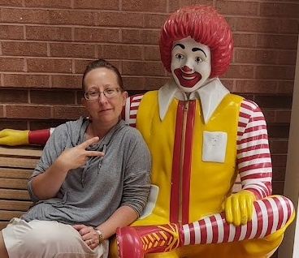
Make Your Syllabi Better!
…Please let Ginger Wickline know if you would like a copy of her current Research Design & Analysis (statistics) survey as a model
…contact Ginger Wickline (vwickline@georgiasouthern.edu) or Drew Appleby (dappleby@iupui.edu) or for suggestions to make your syllabi more effective and engaging
…let’s talk about what you have tried and if you have data or feedback showing that it works for students!

Slide 22
References
Ambady, N., & Rosenthal, R. (1993). Half a minute: Predicting teacher evaluations from thin slices of nonverbal behavior and physical attractiveness. Journal of Personality and Social Psychology, 64(3), 431-441. https://psycnet.apa.org/doi/10.1037/0022-3514.64.3.431
Appleby, D., Appleby, K., Wickline, V. B., Apple, K. J., Bouchard, L. M., Cook, R., Erickson, L. V., Halpern, D. F., & Kelly, S. M. (2019). A syllabus-based strategy to help psychology students prepare for and enter the workforce. Scholarship of Teaching and Learning in Psychology, 5(4), 289-297. https://psycnet.apa.org/doi/10.1037/stl0000279
Becker, A. H., & Calhoon, S. K. (1999). What introductory psychology students attend to on a course syllabus. Teaching of Psychology, 26 (1), 6-11. https://psycnet.apa.org/doi/10.1207/s15328023top2601_1
Cullen, R., & Harris, M. (2009). Assessing learner-centeredness through course syllabi. Assessment & Evaluation in Higher Education, 34(1), 115-125. https://doi.org/10.1080/02602930801956018
Fornaciari, C. J., & Dean, K. L. (2014). The 21st-Century syllabus: From pedagogy to andragogy. Journal of Management Education, 38(5), 701-723. https://doi.org/10.1177%2F1052562913504763

Slide 23
References
Gallup (2014). Great jobs, great lives: The 2014 Gallup-Purdue Index Report. Washington, D.C.: Gallup, Inc. http://www.gallup.com/file/services/176768/GallupPurdueIndex_Report_2014.pdf
Gallup (2018). 2018 Strada-Gallup Alumni survey. https://news.gallup.com/reports/244058/2018-strada-gallup-alumni-survey.aspx#
Garavalia, L. S., Hummel, J. H., Wiley, L. P., & Huitt, W. G. (2000). Constructing the course syllabus: Faculty and student perceptions of important syllabus components. Journal of Excellence in College Teaching, 10(1), 5-22. http://www.edpsycinteractive.org/papers/cons-course-syll.pdf
Gurung, R. (2021, October 28). Regan A. R. Gurung – I’m a ember of STP and this is how I teach. https://teachpsych.org/page-1703896/12079061
Keeley, J., Furr, R. M., & Buskist, W. (2009). Differentiating psychology students’ perceptions of teachers using the Teacher Behavior Checklist. Teaching of Psychology, 37(1), 16-20. https://doi.org/10.1080/00986280903426282
Lightner, R., & Benander, R. (2018). First impressions: Student and faculty feedback on four styles of syllabi. International Journal of Teaching and Learning in Higher Education, 30(3), 443-453. https://www.isetl.org/ijtlhe/

Slide 24
References
Naufel, K. Z., Appleby, D. C., Young, J., Van Kirk, J. F., Spencer, S. M., Rudmann, J., …Richmond, A. S. (2018). The skillful psychology student: Prepared for success in the 21st century workplace. Retrieved from https://www.apa.org/careers/resources/guides/transferable-skills.pdf
Osier, N. (2019). Genetics in healthcare [syllabus]. University of Texas. https://utexas.app.box.com/s/kprznom5u8ng75fcfojw9ix7gpkifvgv
Overman, A. A., Xu, Q., & Little, D. (2019). What do students actually pay attention to and remember from a syllabus? An eye tracking study of visually rich and text-based syllabi. Scholarship of Teaching and Learning in Psychology, 6(4), 285-300. https://psycnet.apa.org/doi/10.1037/stl0000157
Richmond, A. S., Slattery, J. M., Mitchell, N., Morgan, R. K., & Becknell, J. (2016). Can a learner-centered syllabus change students’ perceptions of student-professor rapport and master teacher behaviors? Scholarship of Teaching and Learning in Psychology, 2(3), 159-168. https://psycnet.apa.org/doi/10.1037/stl0000066
Saville, B. K., Zinn, T. E., Brown, A. R., & Marchuk, K. A. (2010). Syllabus detail and students’ perceptions of teacher effectiveness. Teaching of Psychology, 37(3), 186-189. https://psycnet.apa.org/doi/10.1080/00986283.2010.488523

Slide 25
References
Twenge, J. M., & Donnelly, K. (2016). Generational differences in American students’ reasons for going to college, 1971–2014: The rise of extrinsic motives. The Journal of Social Psychology, 156(6), 620-629. https://psycnet.apa.org/doi/10.1080/00224545.2016.1152214
Wickline, V. B. (2019). Research & Analysis I [syllabus]. Project Syllabus: Society for Teaching of Psychology. https://teachpsych.org/resources/Documents/otrp/syllabi/VW19stats.pdf
Wickline, V. B., Capeles, K., Morris, H., Warden, A., Appleby, K., & Appleby, D. C. (2021). Day 1 Lesson Plan – Discuss Skills. Repeat. Repeat. Repeat. (Or: How a focus on professional skills impacts psychology statistics students’ course, instructor, and self-perceptions). Scholarship of Teaching and Learning in Psychology. Advance online publication. https://psycnet.apa.org/doi/10.1037/stl0000279
Wickline, V.B., Middleton, R., & Appleby, D.C. (under review). Syllabus factors (described skills and graphics) but not length impact college student perceptions of instructor and course . Manuscript under review

