Slide 1
Refreshing the Literary Research Process
Today’s presenters:
Barry Mauer
John Venecek
Team: Barry Mauer, John Venecek, Emily Smeltz, Erika Heredia, Nicole Suarez, James Paradiso, Mireya Ramirez

Slide 2
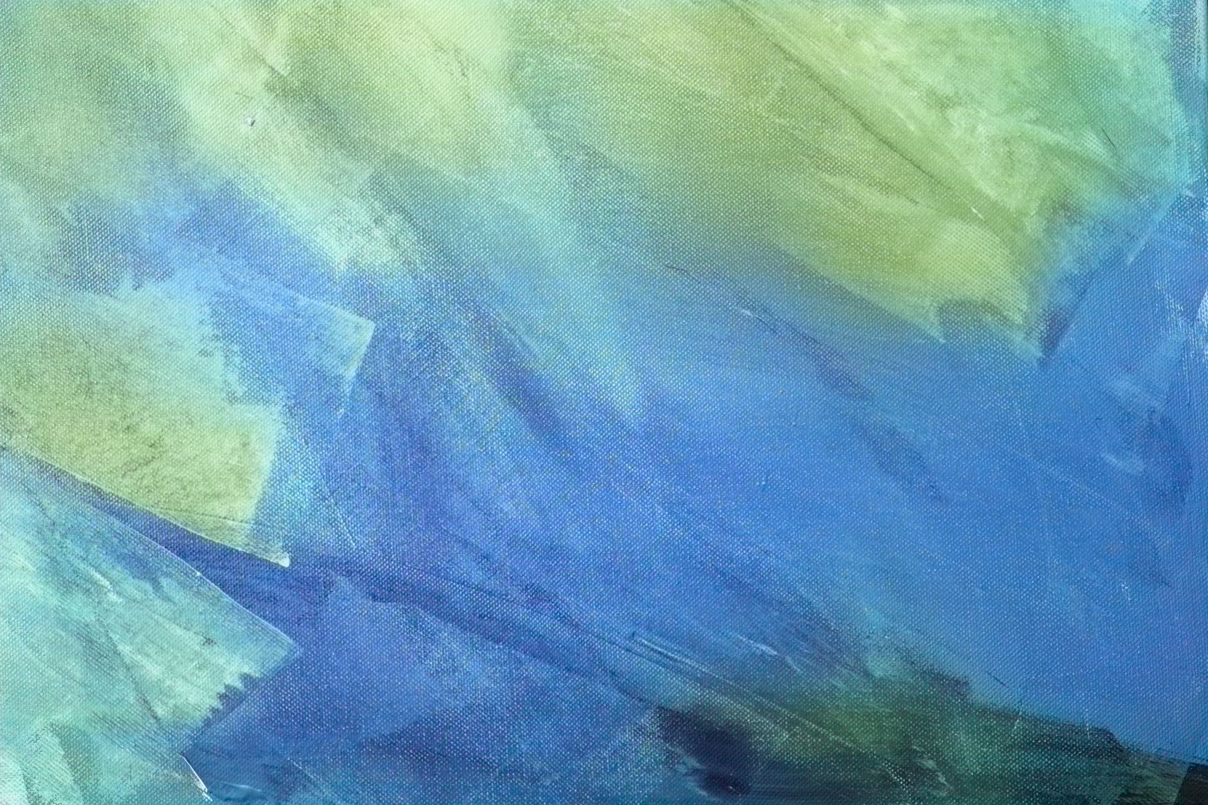
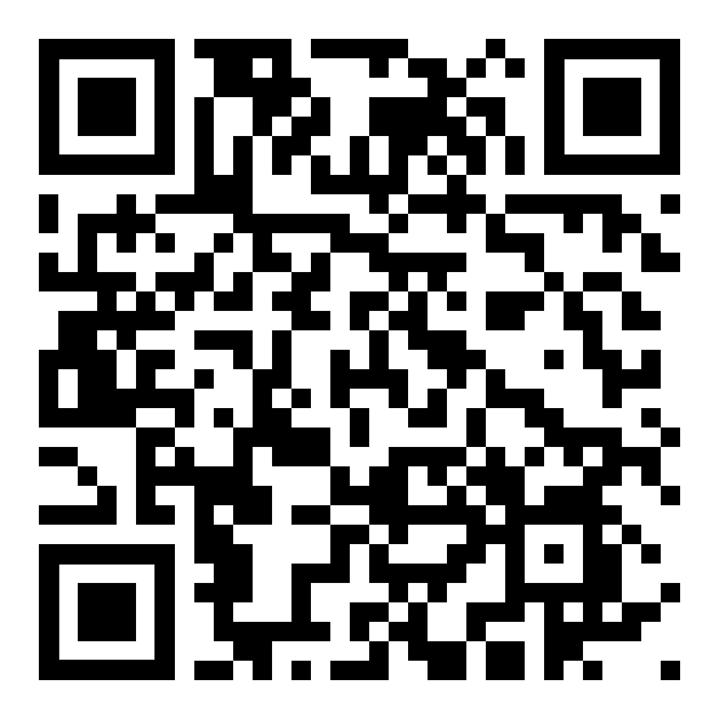
pressbooks.online.ucf.edu/strategies2e/
Notes:
Linked to book - choose particular pages

Slide 3
Origins: Problems we needed to address

Slide 4
Library:
John Venecek
John started noticing a decline in requests for library instruction throughout the humanities;
After meeting with several department chairs and program directors, we determined that the library needed a more flexible model to accommodate mixed mode and hybrid courses;
Dr. Mauer and John developed a series of research modules that could be shared and adapted to multiple courses and modalities.
Notes:
Barry

Slide 5
Teaching:
Barry Mauer
I converted the handouts I’d been using into course modules;
Previously, my students would read a folder of handouts at the beginning of the semester related to essay structure, persuasive writing, note taking, research guidelines, etc.;
The lessons didn’t “stick” when students later conducted their research and wrote their papers;
Our new course expanded the handouts and led students step-by-step through the research and writing process.
Notes:
Pandemic increased demand

Slide 6
Objectives for teachers, students, UCF, and the profession
For teachers: Create a plug-and-play option for teaching literary research. [My course was designated Research-Intensive and Quality Online];
For students: Instill an understanding that research is an iterative and recursive process;
For UCF: research support provided by the Libraries, Writing Center, and the Office of Undergraduate Research are integrated into our course materials;
For the profession: Connect students to external sources such as professional organizations and CFPs.
Notes:
An (RI) course is one that provides curriculum-based active engagement in a line of inquiry that is guided by a content expert, adheres to aspects of the academic research or scholarship process, and includes a research deliverable.
Quality Online designation - course components proven to be best practices in online course design

Slide 7
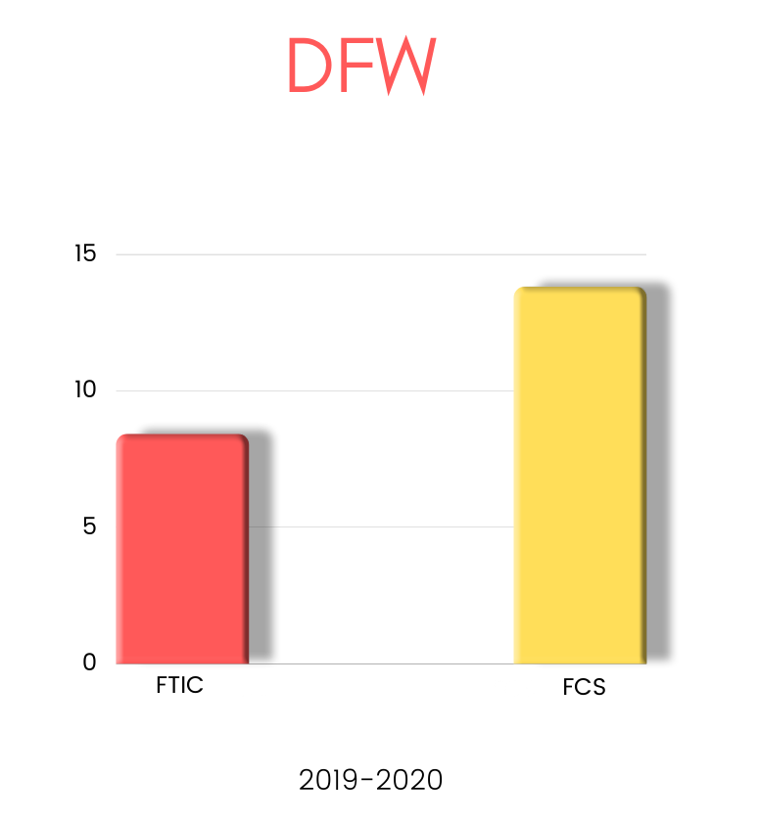
Lowering DFW
Florida College System (FCS) and transfer students outnumber First Time in College (FTIC) students by a nearly two-to-one ratio;
In addition, FCS students have Failing & Withdrawing (DFW) outcomes over 50% higher than those of FTIC students.
Part of the gap, we surmise, results from the lack of rigorous training in research that FCS students receive before transferring to UCF.
Another factor may be the inadequacy these students feel when confronted with complex and demanding research at UCF for which they are unprepared.

Slide 8
Project Overview
Create an adaptable Open Educational Resource [OER] textbook that guides students through the entire literary research process;
Integrate the Association of College & Research Libraries [ACRL] Framework for Information Literacy;
Focus on:
Adaptability;
Dynamic Content;
Student Engagement;
Faculty Involvement;
Connecting to UCF resources.

Slide 9
Notes:
Erika

Slide 10
Information Literacy Framework
Research as Inquiry
Authority is Constructed and Contextual
Scholarship as Conversation
Searching as Strategic Exploration
Notes:
Barry to add note about relevance –

Slide 11
Research as Inquiry
“Research is iterative and depends upon asking increasingly complex or new questions whose answers in turn develop additional questions or lines of inquiry in any field.”

Slide 12
Research as Inquiry
Students Learn To:
Formulate research questions based on information gaps or on reexamination of existing, possibly conflicting, information;
Consider research as open-ended exploration and engagement with information;
Value intellectual curiosity in developing questions and learning new investigative methods;
Seek multiple perspectives during information gathering and assessment;
Organize information in meaningful ways;
Synthesize ideas gathered from multiple sources.
Notes:
Add objectives from book

Slide 13
Scholarship as Conversation
“Communities of scholars, researchers, or professionals engage in sustained discourse with new insights and discoveries occurring over time as a result of varied perspectives and interpretations.”
Notes:
Add objectives from book

Slide 14
Scholarship as Conversations
Students Learn To:
Recognize they are entering an ongoing scholarly conversation and not finishing one or ending discussion;
View themselves as contributors to scholarship rather than consumers;
Recognize that scholarly conversations take place in various venues;
Critically evaluate contributions made by others in participatory information environments.
Seek out conversations taking place in their research area;
Notes:
Add objectives from book

Slide 15
Searching as Strategic Exploration
“Searching for information is often nonlinear and iterative, requiring the evaluation of a range of information sources and the mental flexibility to pursue alternate avenues as new understanding develops.”
Notes:
Add objectives from book

Slide 16
Searching as Strategic Exploration
Students Learn To:
Determine the initial scope of the task required to meet their information needs;
Match information needs and search strategies to appropriate search tools;
Exhibit mental flexibility and creativity;
Recognize the value of browsing and other serendipitous methods of information gathering;
Seek guidance from experts, such as librarians, researchers, and professionals.
Notes:
Add objectives from book

Slide 17
Authority is Constructed & Contextual
“Information resources reflect their creators’ expertise and credibility, and are evaluated based on the information need and the context in which the information will be used.”
Notes:
Add objectives from book

Slide 18
Authority is Constructed & Contextual
Students Learn To:
Define different types of authority, such as subject expertise, societal position, or special experience;
Use research tools and indicators of authority to determine the credibility of sources, understanding the elements that might temper this credibility;
Develop awareness of the importance of assessing content with a skeptical stance and with a self-awareness of their own biases and worldview;
Acknowledge they are developing their own authoritative voices and recognize the responsibilities this entails, including seeking accuracy and reliability, respecting intellectual property, and participating in communities of practice.
Notes:
Add objectives from book

Slide 19
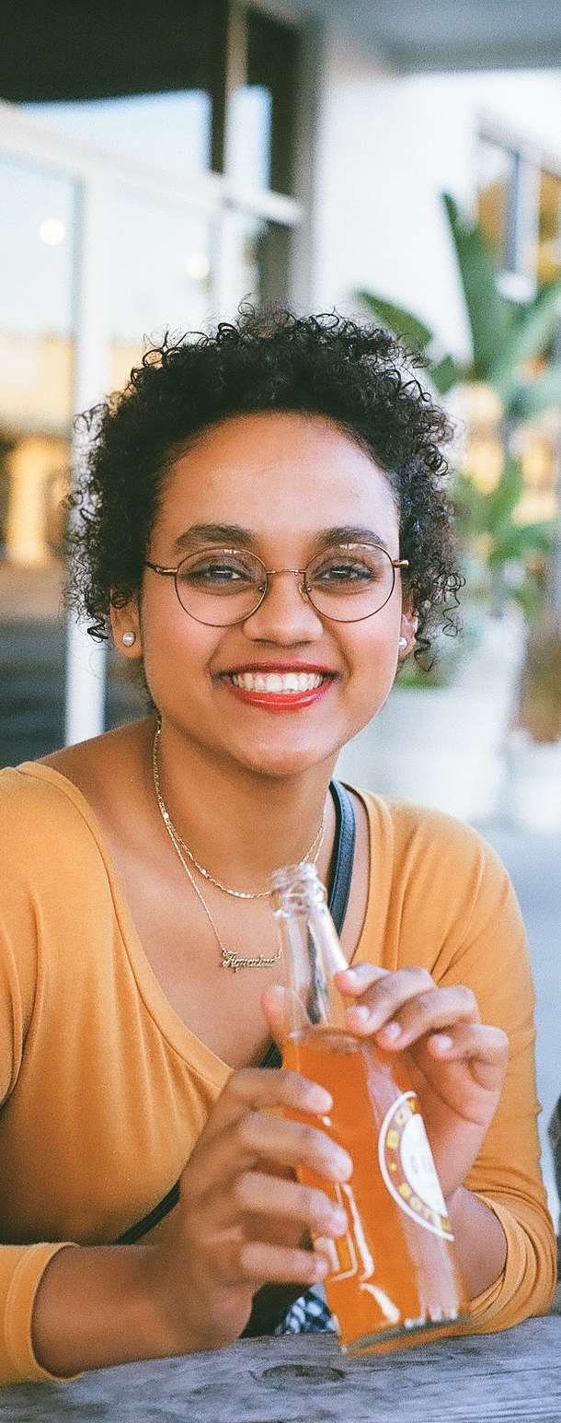
Meet Jada!
We worked with an English major, Jada, to create a relatable persona for the course;
Jada discusses James Baldwin’s short story “Sonny’s Blues;”
We worked with the UCF’s Center for Distributed Learning to make videos of Jada discussing her project, which we include in the book.

Slide 20
Jada Video Topics:
Searching as Strategic Exploration
Scholarship as Conversation
Using Library Resources
Refining Your Research Question
Evaluating your Research Question
Managing Your Research
Each video connects to a specific aspect of the ACRL Framework for Information Literacy.

Slide 21
Philosophy:
Open access
Open involvement

Slide 22
Open Approach
We wanted to create an OER that would be easy to share with other instructors and that students could participate in developing as well.
We wanted an option that would be more open and flexible than Canvas modules, which led us to Pressbooks.
Pressbooks allowed us to reimagine the course as an interactive book that can be easily revised, published, shared as an OER or embedded in Canvas.

Slide 23
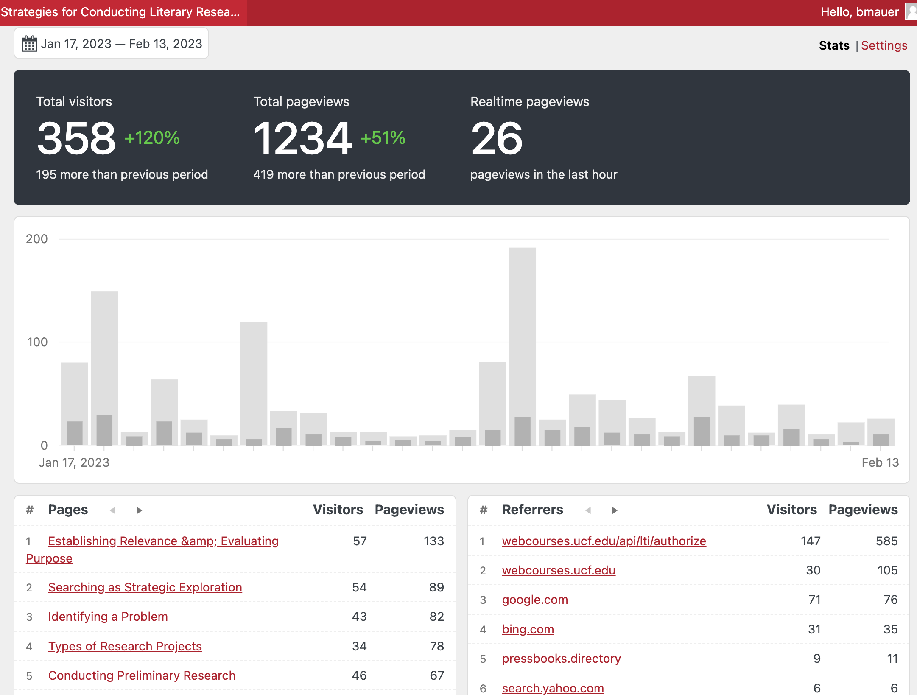
Stats
Open Approach
Open Educational Resource (OER)
We sought an alternative to Canvas that would be open but easier to use, which led us to Pressbooks.
Pressbooks allowed us to reimagine the project as an interactive book that can be easily revised, published, shared as an OER, or embedded in Webcourses.

Slide 24
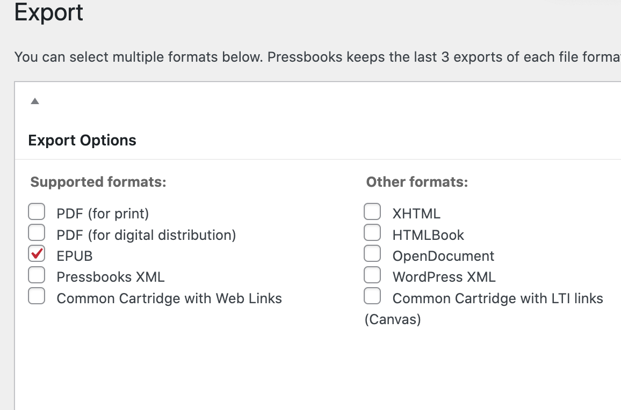
Pressbook Affordances
Pressbooks
Challenges
Formatting and coding options
Production is less intuitive than Canvas, so there’s a learning curve.
Preset themes
Conversion to ebook and pdf formats requires additional work.
Glossary and footnotes
H5P Artifacts: slideshows, accordions, interactive quizzes
Notes:
Erika

Slide 25
Adaptability

Slide 26
Adaptability
Instructors have the option of using the entire book or selecting certain chapters;
They are free to remix and re-use any of our content to adapt it to their own course and assignments;
We are discussing new editions that can be used throughout the humanities, and we’ve created a Canvas version for students who want to self-enroll;
We are developing a pdf version for download.

Slide 27
Student Involvement
Students provide feedback about the textbook through webcourse discussions.
We learn what’s working and what needs more work.
We can assess their work products and see whether they are applying new skills.

Slide 28
Professionalization
Teach students to think beyond specific assignments and towards developing and professionalizing their research skills;
Emphasize the value of networking and engaging in the profession even at the undergraduate level;
Connect them to CFP sites and professional organization;
Get them to talk to people in the profession!

Slide 29
Assessment

Slide 30
We incorporated rubrics from of The American Association of Colleges and Universities (AAC&U) such as Creative and Critical Thinking, Ethical Reasoning, Information Literacy, and Intercultural Knowledge and Competence;
We added new rubrics like: Identifying a Problem, Avoiding Plagiarism, Defining Key Terms, and Interpreting Literary Works;
Evaluating Student Performance
We could not find many examples of rubrics for things like title, research question, and thesis statement, so we made our own,
Our rubrics are in the “Back Matter” section of Pressbooks, which allows instructors to be selective about which rubrics to incorporate into their own Webcourses.
Notes:
Erika

Slide 31
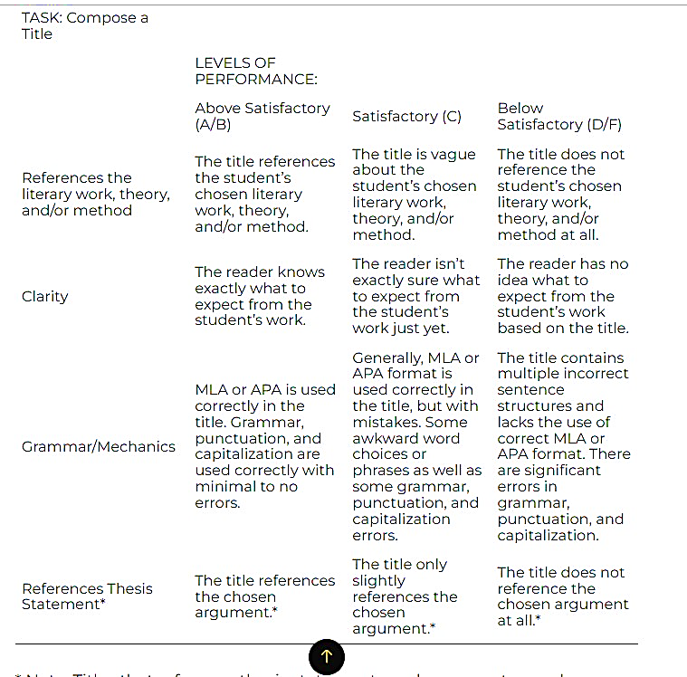
Rubric Example
Notes:
Erika

Slide 32
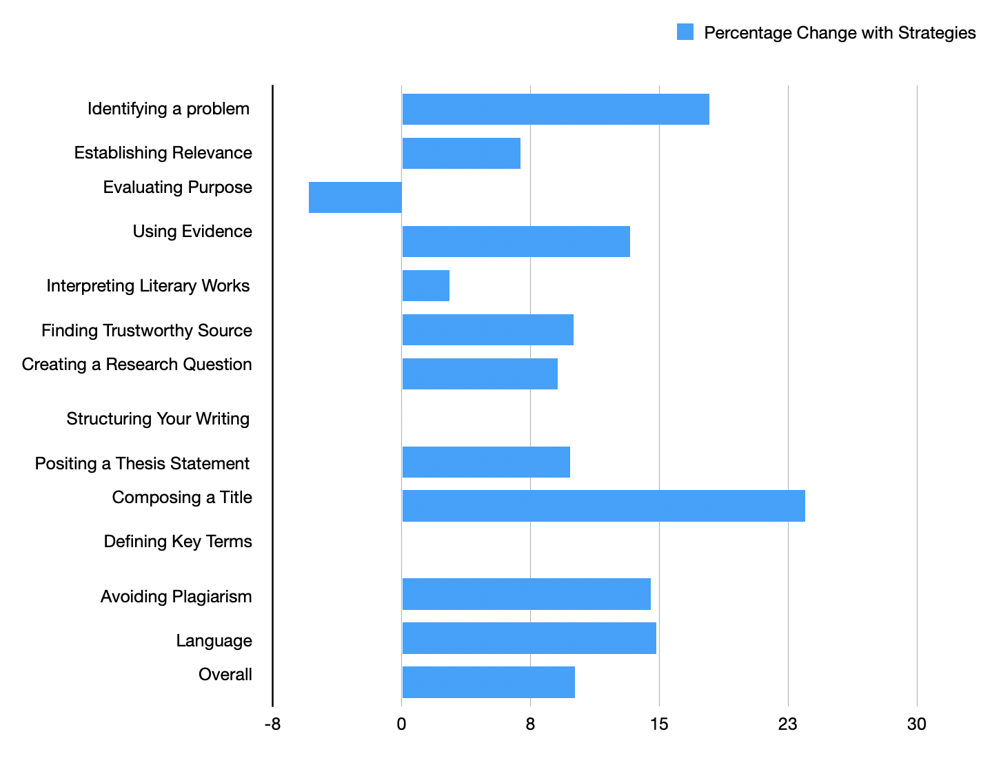
Points Scale
0 – Below Satisfactory
1 – Satisfactory
2 – Above Satisfactory
4 reviewers
10 papers
10 papers
Control Course
Test Course
Outcomes
Notes:
Erika

Slide 33
Kinds of Purposes
We gave students examples of the kinds of purposes they could adopt for their projects:
Historical: improve our understanding and appreciation of the past. Here we might seek to
Elevate an overlooked figure or literary work
Better understand major shifts around new literary forms, genres, and movements
Understand the relationship of literature to historical realities such as colonialism, industrialism, and information technologies
Theoretical: improve our understanding of major principles used to study literature. Such goals might be to
Better understand narrative, metaphor, and argument
Explain the relationship of literature to other kinds of writing, to life, and to thought
Explore the relevance of philosophy, psychology, sociology, and anthropology to literature
. . .
There are hundreds, if not thousands, more possible purposes for work in literary studies. Your goal is to articulate your purpose clearly, concisely, and directly in such a way that it guides your work.
Revising
Purpose
Notes:
Erika

Slide 34
Student Responses
“I thought I understood what purpose was but reading about the different kinds of purpose was definitely eye opening. Defining it simply as an answer to the question ‘What is my goal?’ already changed my perspective. Reading more about the 5 kinds as well as the terminology used by Baxandall allowed me to reach a deeper understanding on the subject matter. The first part of the historical section in particular ‘Elevate an overlooked figure or literary work’ was a great example. It immediately opened my mind to new potential research projects that I didn't think of beforehand.”
“I have taken literature classes before, but none were as in-depth. I have been able to better articulate myself in essays for other classes thanks to this class.”
“I definitely have a much better understanding of literary research as a discipline after working through the course.”
“I haven't had a class that has so thoroughly gone through each aspect of how to conduct and execute a literary research [project].”

Slide 35
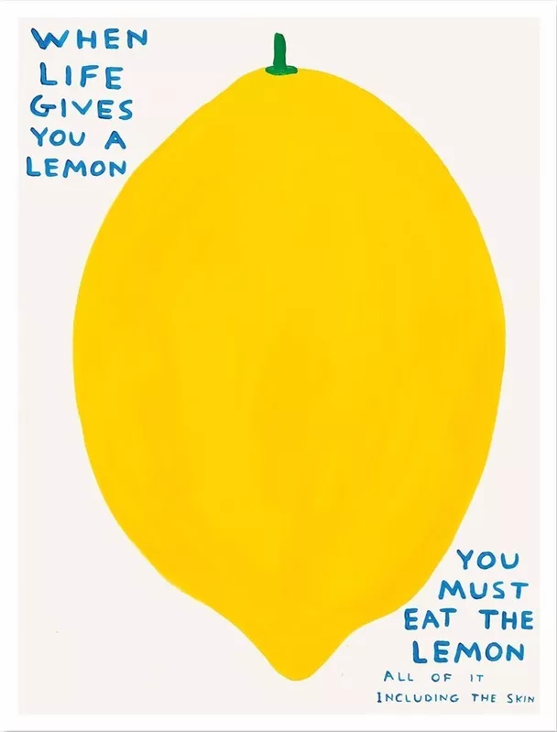
THE END
Art by David Shrigley

