Slide 1
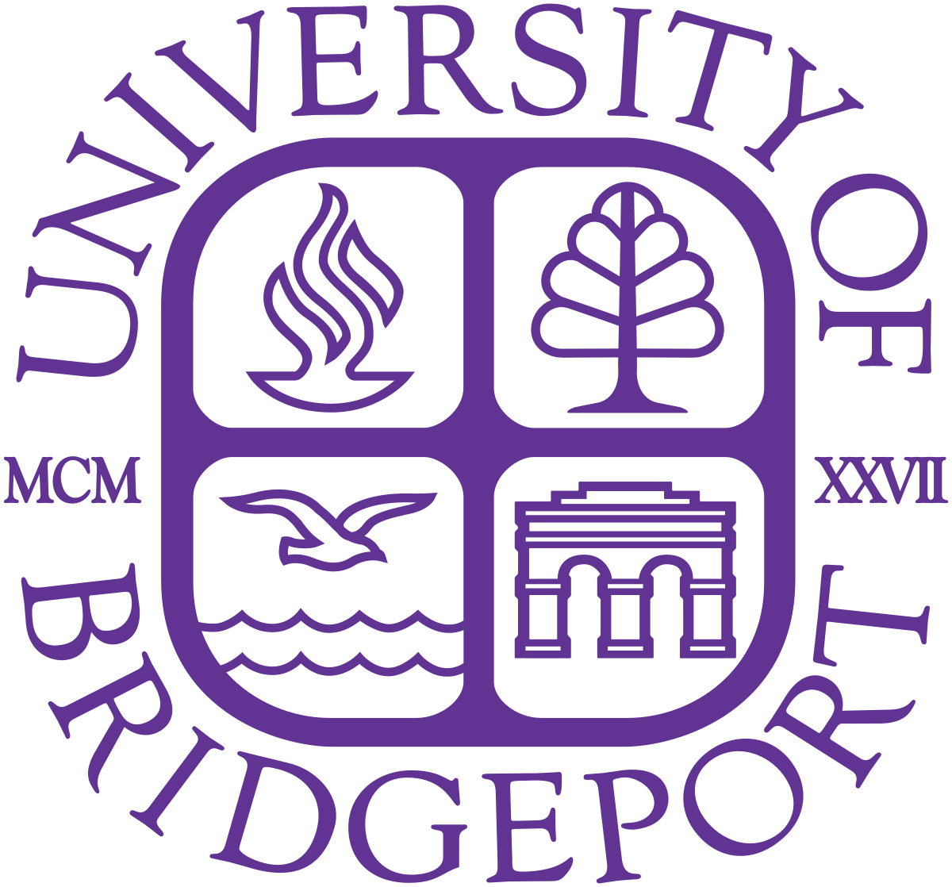
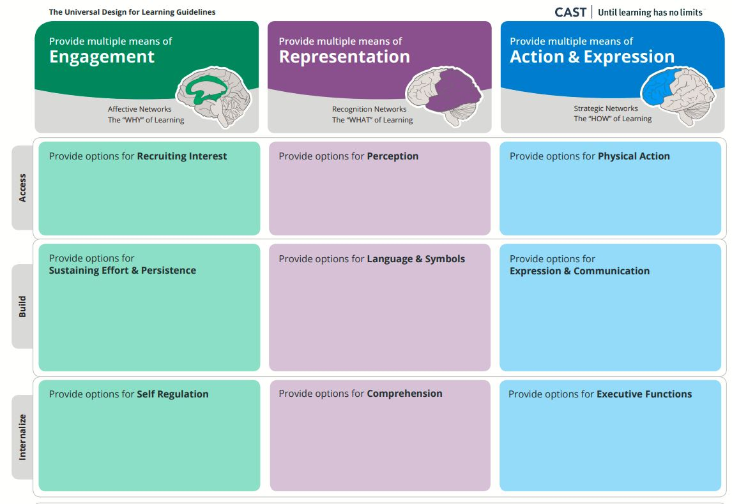
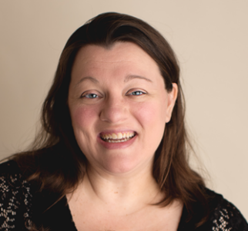
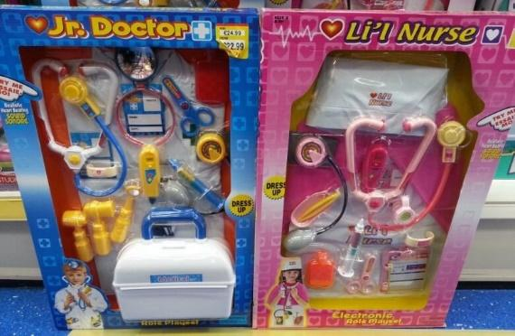
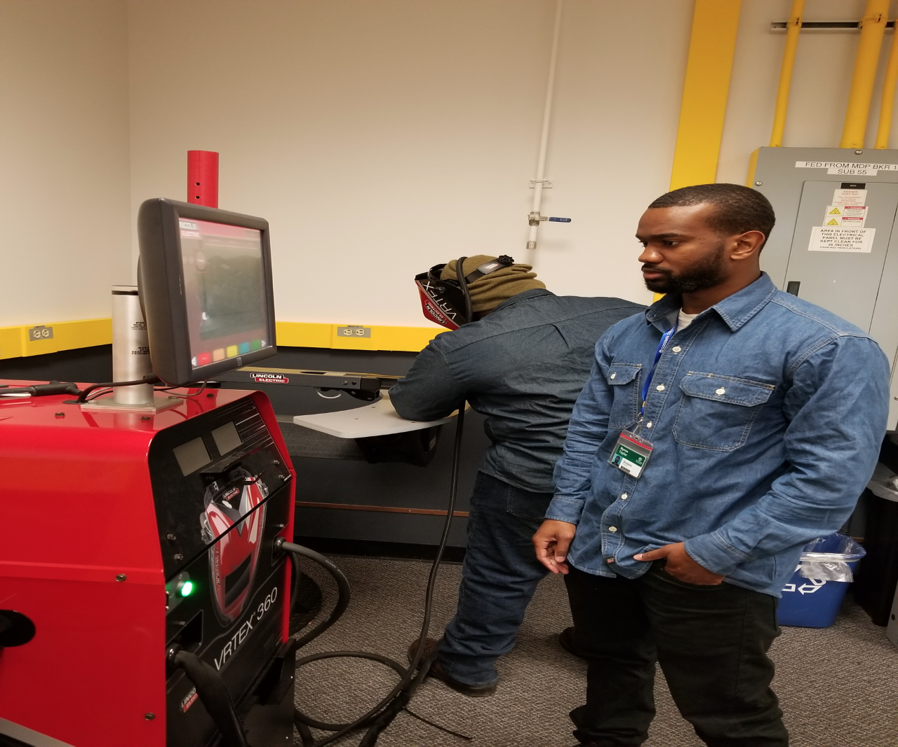
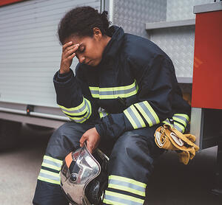
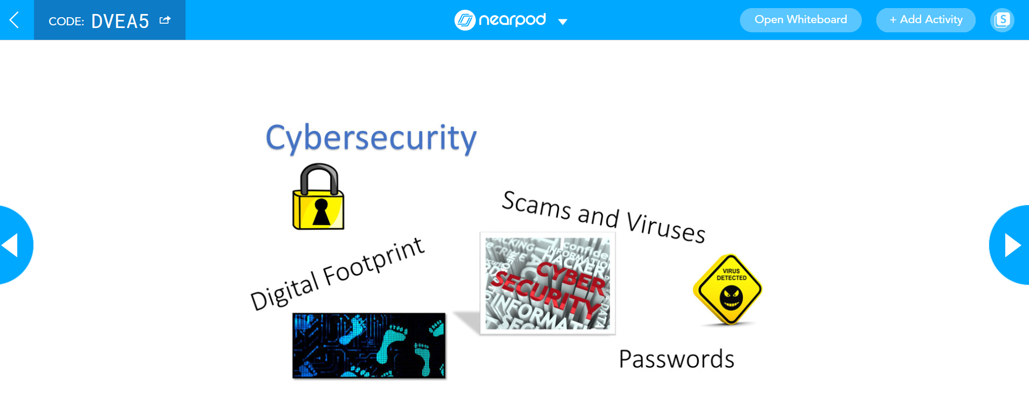
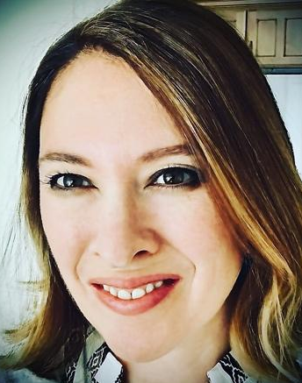
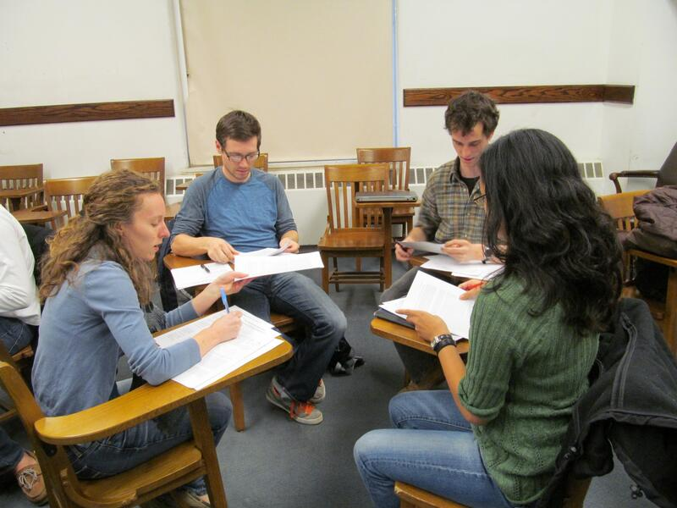
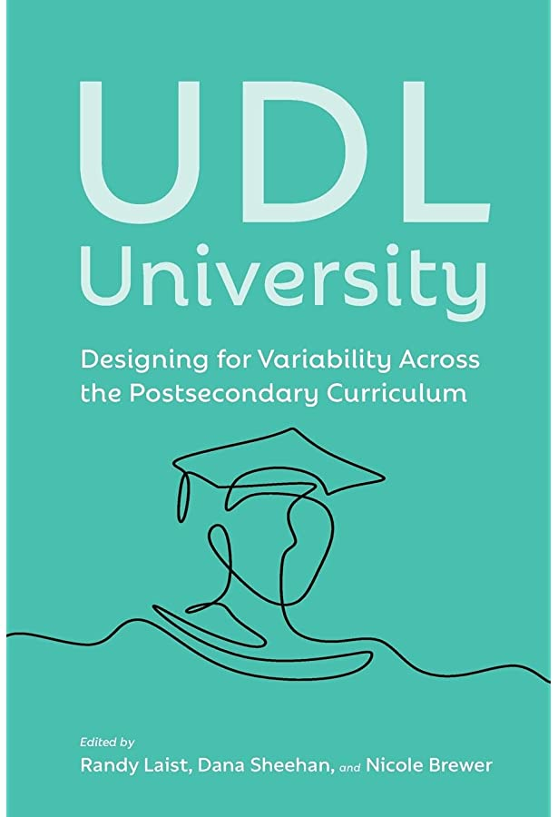
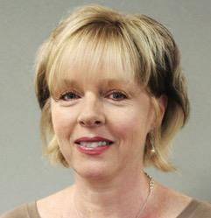
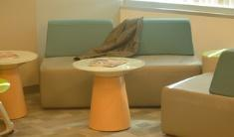
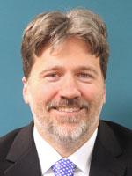
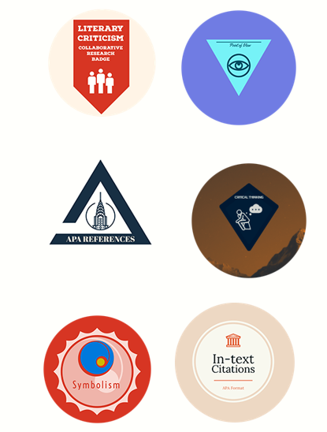
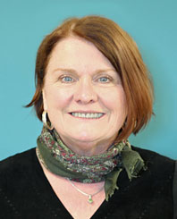
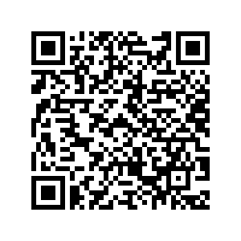
UDL Goes to College: Transforming the University Classroom with Universal Design for Learning Randy Laist, Ph.D., College of Science and Society, English Department University of Bridgeport, Bridgeport, CT
Abstract
The spirit of flexibility inherent in Universal Design for Learning (UDL) allows it to encompass the diversity of postsecondary educational environments. UDL-informed teaching can address what CAST refers to as “the wide variability of learners in higher ed environments” (n.d.), but it also provides an educational philosophy that is adaptable enough to apply to the wide variety of disciplines typically offered on most college campuses. UDL theory provides core principles that penetrate to the heart of any learning situation, making it a powerful framework within which to reflect on course design and teaching practice in a cross-disciplinary way.
Since 2018, Goodwin University has been partnering with CAST to incorporate UDL principles into our educational practice, as well as our organizational philosophy. Over the last few years, faculty members have been immersed in UDL training, and many of the university’s classes have been redesigned to anticipate and optimize learner variability. Throughout this process, we have fostered a campus-wide conversation about inclusivity in teaching and learning, and we have challenged ourselves to reimagine higher education for the twenty-first century.
This chart, modeled after CAST’s UDL Guidelines matrix, indicates some of the ways that Goodwin professors have adapted UDL principles into their teaching to address a variety of educational challenges across a wide spectrum of disciplines.
Sociology
Amy used controversial discussion topics, like the gender politics of toys, to activate students’ personal connection to the sociological topics she wanted to introduce them to.
Nursing
Robin had her students deliver Pecha Kucha presentations that enabled them to teach each other the content for the NCLEX exam.
Welding
Keith incorporated welding simulators into his training program, allowing students to practice their welding skills in a low-stakes environment.
Dr. Amy Beauchemin
Robin L.
Young-Cournoyer
Keith A. Carter
Capstone Project
Nicole encouraged her capstone students to identify real-world challenges in the community, such as the mental health of firefighters, and work to address them.
Computer Applications
Annjanette used Nearpod to enhance her classroom discussions with real-time surveys, a virtual field trip, and other interactive digital content.
Composition
Cynthia used role playing and social-emotional education to help students feel comfortable engaging in a meaningful peer review process.
Dr. Nicole Brewer
Annjanette Bennar
Cynthia J. Murphy
To hear more inspiring stories and to learn more about UDL in higher ed, order a copy of UDL University.
Histology
Kelli facilitated informal conversations with her students in a “café-like” setting that allowed them to process their personal and professional challenges.
Literature
Phil reorganized his online literature class to allow students to choose which “badges” they wanted to earn and to select one of several pathways to achieving their goals.
MSOL
Sandi challenges her Masters Students to experiment with different ways of expressing themselves by giving them a “golden ticket” that empowers them to take risks with their assignments.
Kelli Goodkowsky
Dr. Phil Fox
Sandi Coyne-Gilbert

