Slide 1
AIRCRAFT TURBINE SOUND AND VIBRATIONS SIGNATURES FOR A SYNTHETIC KEROSENE FUEL AND THEIR HUMAN EFFECTS
Aliyah Knowles, Emerald Simons, Martin Muiños, Jose Moncada
Supervisor: Dr. Valentin Soloiu

Slide 2
Table of Contents
Objective & Scope of the Research Project
Research Problems
Engine Specifications
SR-30 Turbojet Research Setup
Fuel Properties
Sound Measurement Results – CPB
Vibration Measurement Results – FFT
Conclusions
References & Acknowledgements
Principal Sponsors

Slide 3
Objective & Scope
Investigate the effects of F-T synthetic fuel types on the sound and vibration signatures of an operating aircraft gas turbine.
Analyze the sound and vibrations of the engine operating with F-T NG, F-T CG, Jet-A
Show the results that effect human health concerns

Slide 4
Research Problems
Aero-gas turbines generate high levels of sound.
Determine differences between fuels
Decrease sound levels for comfort of aircraft passengers.
Alternative fuels are sought in the aviation industry for the need of reducing emissions, promote sustainability, and for energy independence.
New fuels bring challenges from the sound & vibrations point of view and they must be researched.

Slide 5
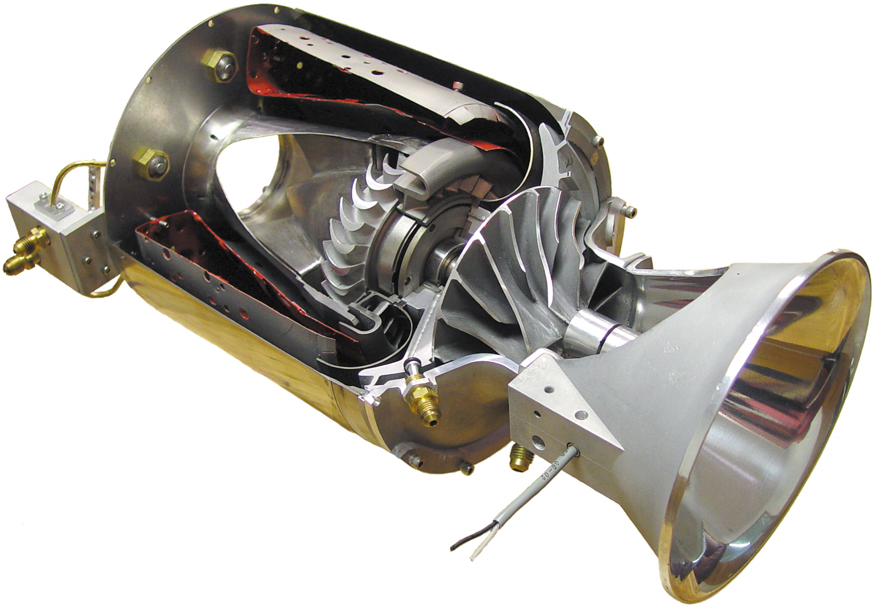
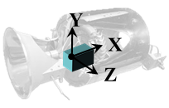
Engine Specifications
SR-30 Experimental Engine
Max RPM | 77,000
Max Exhaust Temp (°C) | 720
Max Air Pressure (kPa) | 1,103
Max Ambient Temp (°C) | 41
Max Thrust (lbf) | 40
Pressure Ratio | 3.4:1
Specific Fuel Consumption | 1.22 lbfuel/lbthrust

Slide 6
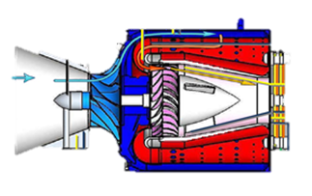
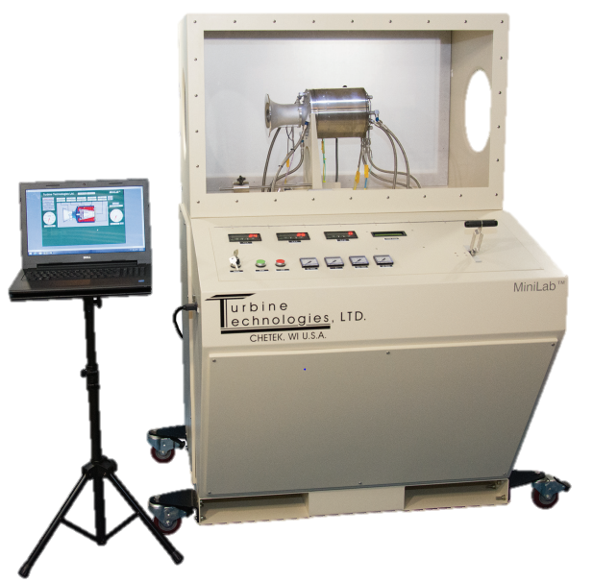
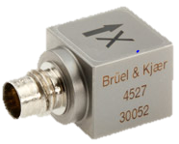
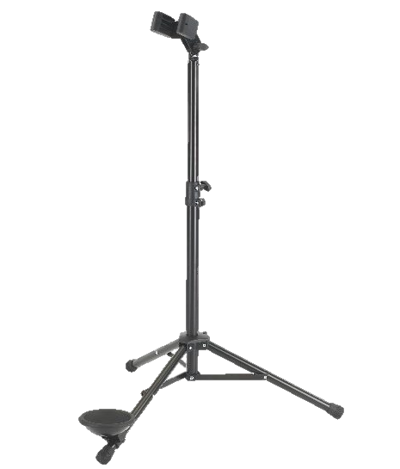
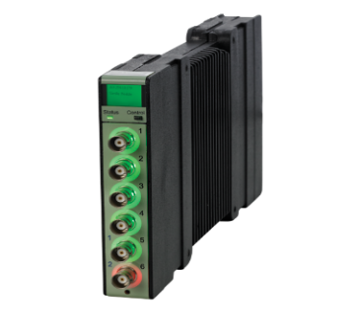
Y
SR-30 Turbojet Research Setup
X
Z
70,000 RPM
B&K 4527
B&K 4961
Acc. on support plate
Mic 1m away
B&K PULSE
B&K LAN-XI

Slide 7
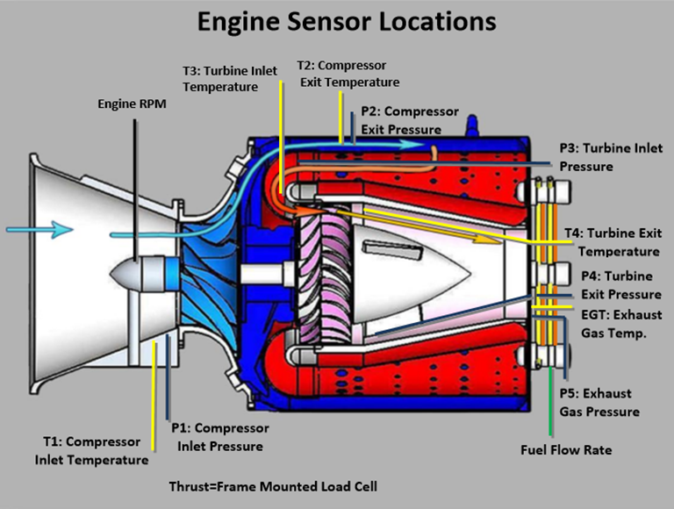
Engine Specifications

Slide 8
Fuel Properties
Properties | Jet-A | F-T CG | F-T NG
Flash Point (˚C) | 47² | 44⁴ | 49⁴
Viscosity @ 40 ̊C (mm²/s) | 1.56⁴ | 1.15⁴ | 4.6⁴
Net Heat of Combustion (MJ/kg) | 42.8⁴ | 44⁴ | 44.1⁴
Density @ 15 ̊C (kg/m³) | 806⁴ | 762⁴ | 757⁴
Cetane Number | 43.1¹⁵ | 26.2¹⁵ | 63¹⁶
Ignition Delay (ms) | 3.47¹⁷ | 5.11¹⁷ | 2.57¹⁷

Slide 9
Sound And Vibration Measurement Results
Points To Visit:
Constant Percentage Bandwidth (CPB)
Fast Fourier Transform (FFT)
Narrow Band Analysis
Order correlations

Slide 10
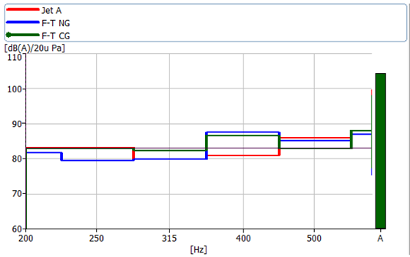
Sound Measurement Results – CPB
- Jet A
- S-8
- IPK
Center Frequency (Hz) | 250 | 315 | 400 | 500
Jet-A (dBA) | 83.2 | 79.8 | 81.0 | 86.0
F-T NG (dBA) | 79.6 | 79.8 | 88.0 | 85.1
F-T CG (dBA) | 83.0 | 82.4 | 87.0 | 83.0

Slide 11
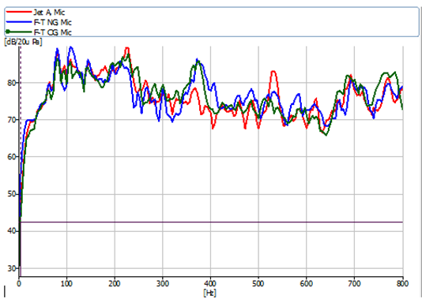
Sound Measurement Results – FFT
Narrow Band Analysis

Slide 12
Vibration Measurement Results – FFT
Frequency resolution : 25Hz
Sampling : 19.53 µs
Combustion: 300Hz-600Hz
Hanning Windowing

Slide 13
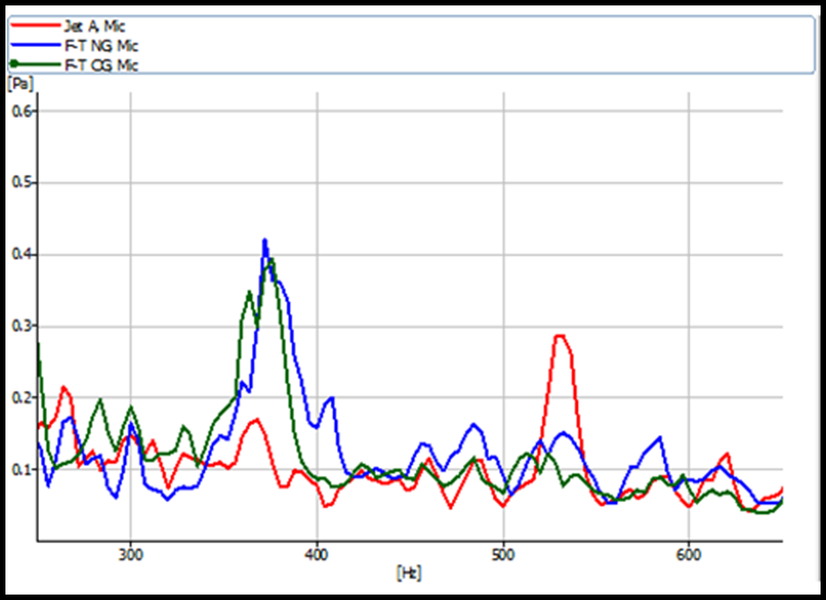

Slide 14
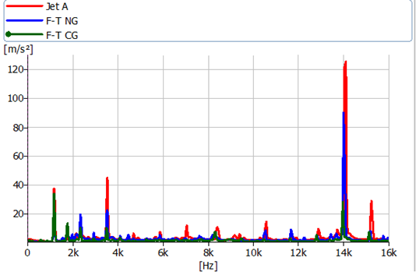
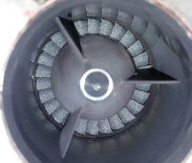
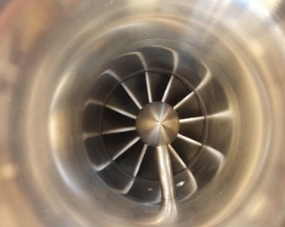
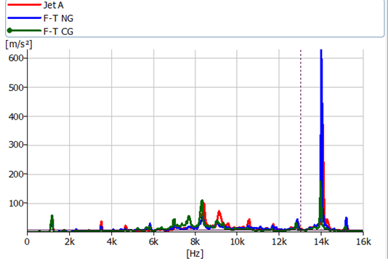
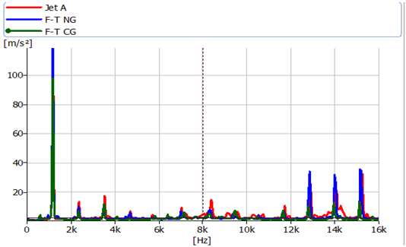
Vibration Measurement Results – FFT
70,000 RPM
1st
3rd
12th
X (turbine axis)
- Jet A
- S-8
- IPK
Y (radial-vert.)
Z (radial-horiz.)

Slide 15
Future Work
Sound Intensity and Power Measurements
Gas Emissions Testing
Determine benefits and detriments of each type.

Slide 16
Conclusions
S-8 resulted in lower sound levels than Jet A at more points than IPK.
Although the points where alternative fuels resulted in higher levels than Jet A were few, the difference is greater.
In X direction vibration, Jet A is consistently highest and IPK is consistently lowest. IPK is consistently lowest in Y direction as well.
Not too much difference between fuels

Slide 17
References
Emerald Simons, Valentin Soloiu, Aliyah Knowles et al. “Sound and Vibration Levels of CI Engine with Synthetic Kerosene and n-Butanol in RCCI”, 2016, SAE World Congress Proceeding: Paper No. 2016-01-1306
Aliyah Knowles, Valentin Soloiu, Emerald Simons et al. “Aircraft Turbine Sound and Vibrations signatures for a synthetic Kerosne Fuel”, 2016, ASME IMECE Proceedings: Paper No. IMECE2016-67000
Emerald Simons, Valentin Soloiu. Investigation of the Combustion Sound and Vibration Characteristics of and Aero-Derivative gas Turbine. Master Thesis Fall 2016.
Acknowledgements
Mr. Alfonso Moreira, Will Kinard, & Scott Hunt of B&K

Slide 18
Principal Sponsors
Georgia Southern University
Aero-engine Laboratory

Slide 19
Supporting Slides

Slide 20
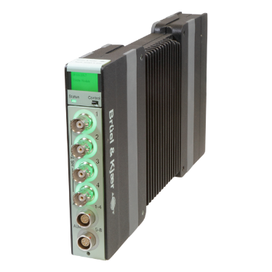
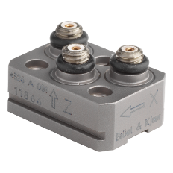
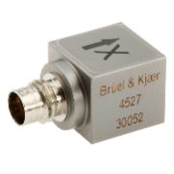
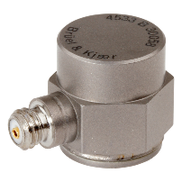
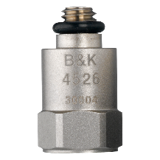
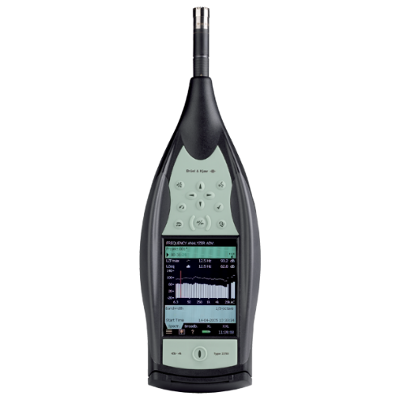
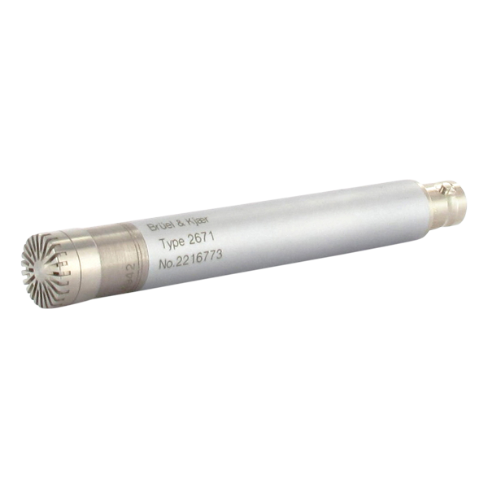
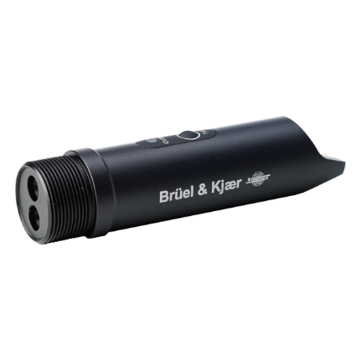
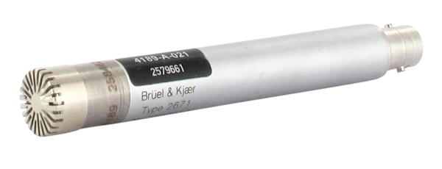
Sound & Vibrations Available for This Research
DATA ACQUISITION BOARDS
B&K ITEM NO. | DESCRIPTION | QTY
3056-A-040 | 4CH input/HS-Tacho + 8ch AUX | 1
3050-A-060 | 6CH input | 2
TRIAXIAL ACCELEROMETERS
4326-A-001- | Triax acc. 0.3pC/ms^s | 1
2647-A | Charge converter | 3
4527-- | Triax acc. 10mV/g | 1
UNIAXIAL ACCELEROMETERS
4526--001- | Deltatron acc. 10mV/g | 2
4533-B-- | IEPE acc. with TEDS 10mV/g | 2
MEASURING MICROPHONES
4189-A-021- | 1/2" free-field mic. | 5
4961 | ¼” multi-field mic. | 1
4942-A-021 | ½” diffuse-field mic. | 1
SOUND LEVEL METER
4189 | 1/2" free-field mic. for handheld analyzer | 1
2250-A-D00- | Hand held analyzer | 1
OTHER
2981-A-- | CCLD laser tacho probe | 1

Slide 21
Limitations
The sound level will be measured outside of the gas turbine enclosure. For safety reasons, the gas turbine may not be operated without the enclosure. The enclosure impose sound and vibration effects due to panel and hardware rattling. For the scope of this research, it is assumed that the sound levels due to these effects will be negligible, compared to the sound levels produced by the aero-gas turbine.

