Slide 1
APPLIED TECHNIQUES OF IMAGE CONTENT ANALYSIS USING AMAZON REKOGNITION
Alex Hooks, Stephen Mealor, Ashley Shiver,
Austin Weaver, Jordan Williams

Slide 2
Overarching Research Question
How can one analyze unstructured data (e.g. images, text) in order to extract business value, benefit consumers, and learn how people communicate via online channels such as social media?
Unstructured Data – Any information that does not reside in a traditional row-column database (images, videos, tweets, etc.)

Slide 3
Project Motivation And Desired Outcomes
Today’s society encourages people to share their life experiences and thoughts on social media platforms, such as Facebook, Instagram, and Twitter.
Provides valuable information about the way users behave as individuals and consumers, is difficult to analyze and breakdown into statistical measures.
Our goal is to provide a way for scholars, practitioners, and developers to conduct image analysis for image classification.
Notes:
define unstructured data (verbally or add written definition?)
we are looking at ways to take unstructured information from images to a structured format for analysis

Slide 4
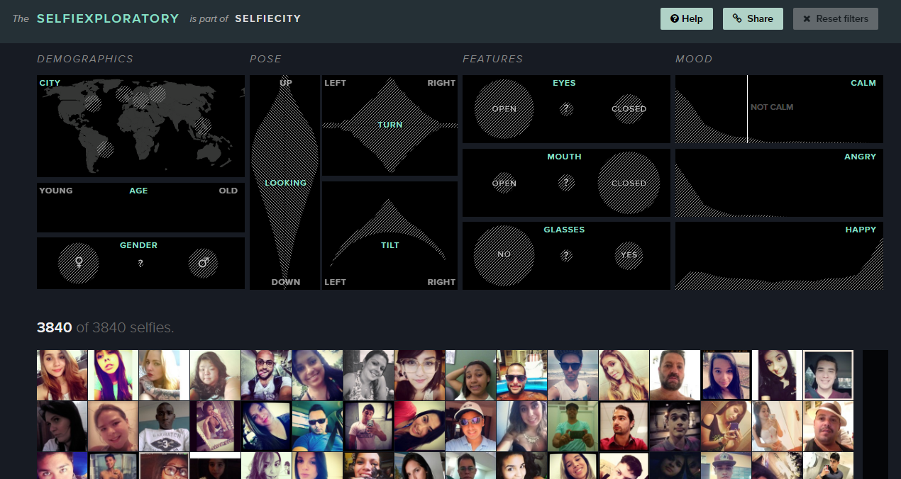
Related Works
Selfiecity.net
Randomly collects self portraits on instagram from five major international cities: Bangkok, Berlin, Moscow, New York, and Sao Paulo
Explores patterns in poses and expressions
Performs detailed statistical analysis of subject demographics based on location
Notes:
screenshot selfiecity

Slide 5
Approach
To approach this problem, our team designed a tool that will allow users to conduct image analysis on whichever photos they desire.
Selected images are uploaded to our web application
The uploaded images are processed by amazon Rekognition
Data collected from Rekognition’s output is then sent to a database
Image statistics are retrieved from database, and displayed on the web app in a simple format

Slide 6
Amazon Rekognition Architecture

Slide 7
Demo

Slide 8
Data from Rekognition
We analyzed 1,000 images
Large variety from food to travel to automobiles and people
Retrieved data in JSON format to perform additional analysis
Defining sub-groups of images
Identifying mislabeled images

Slide 9
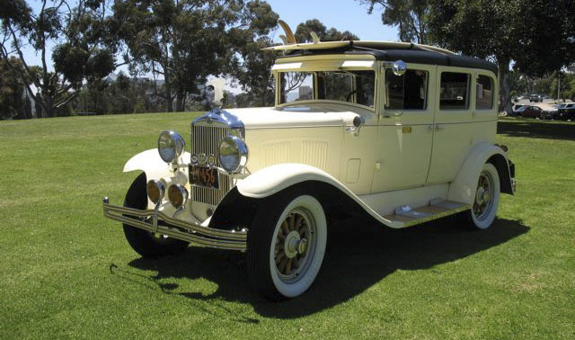
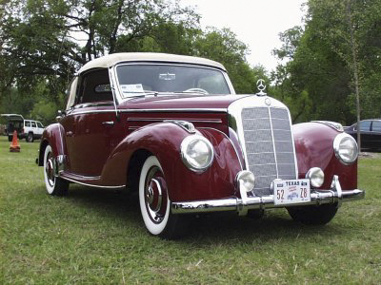
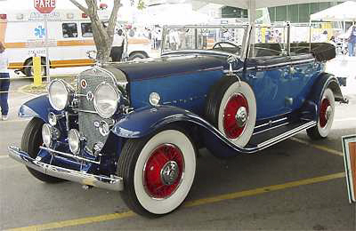
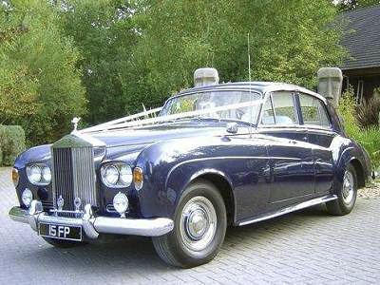
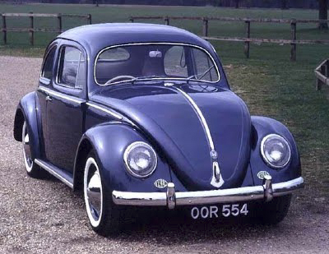
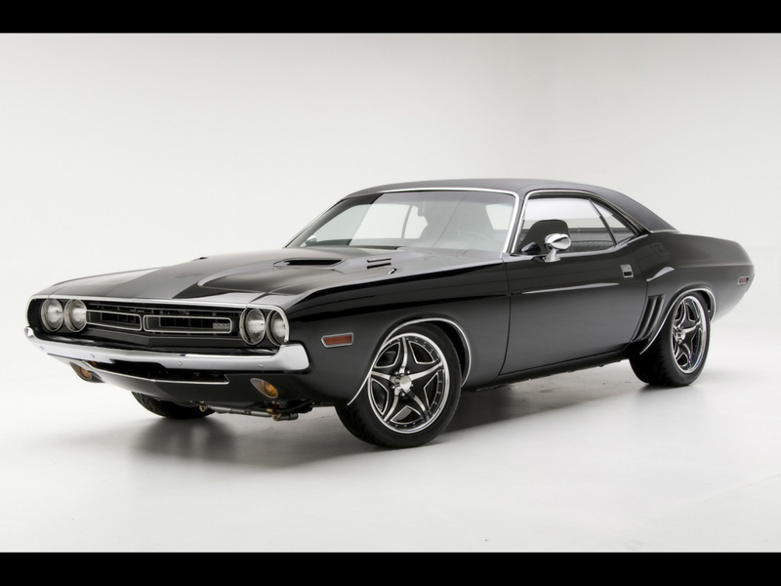
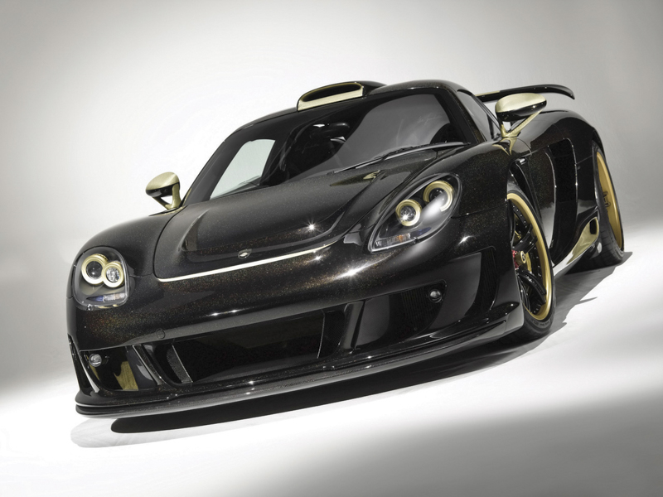
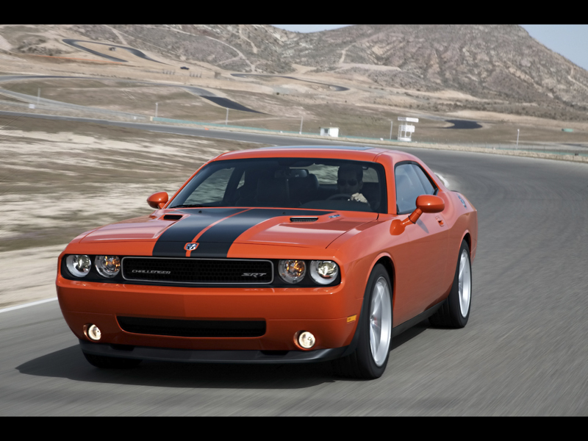
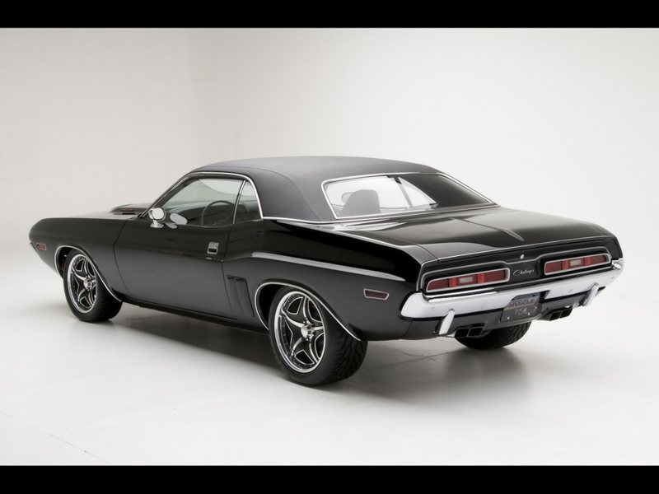
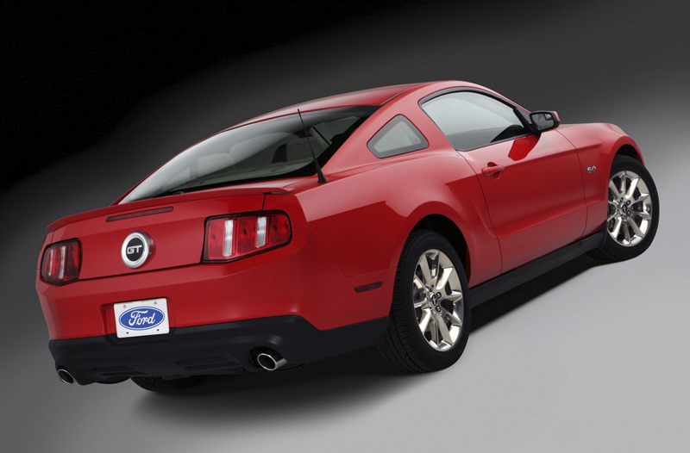
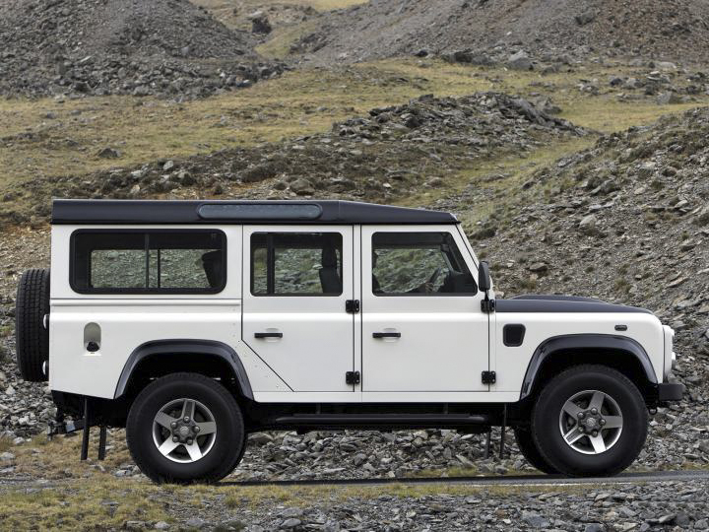
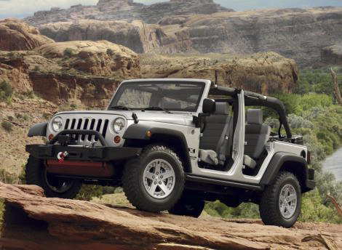
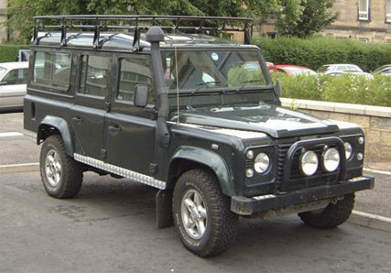
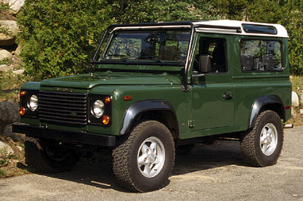
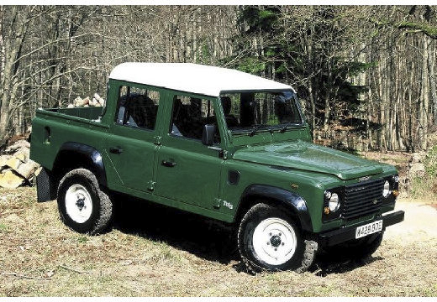
Data Sample - Cars

Slide 10
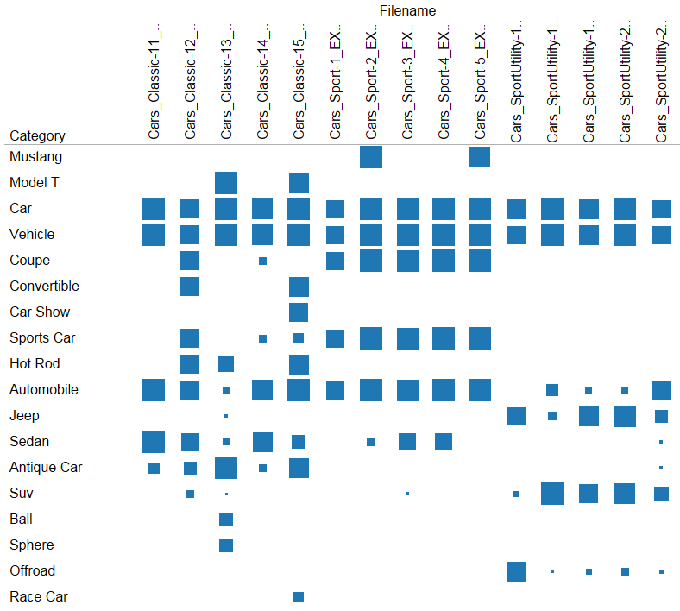
Analysis: Grouping Images into sub-groups
Find ‘major’ categories
Sports cars
Find ‘minor’ sub-categories
Antique cars
Sport Utility Vehicles

Slide 11
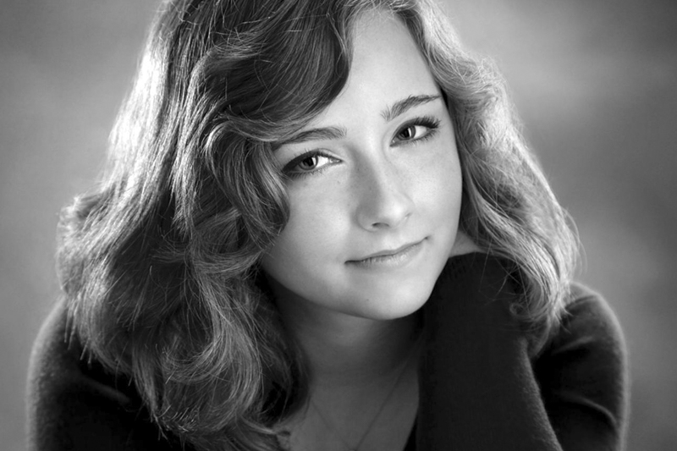
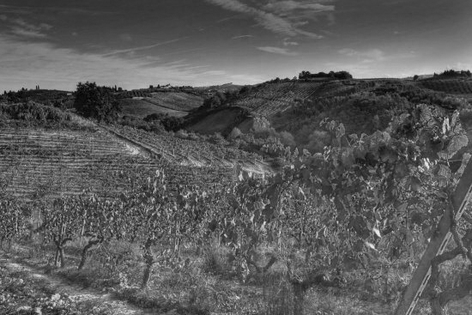
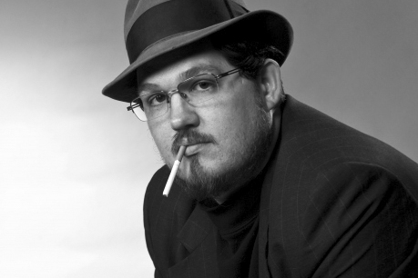
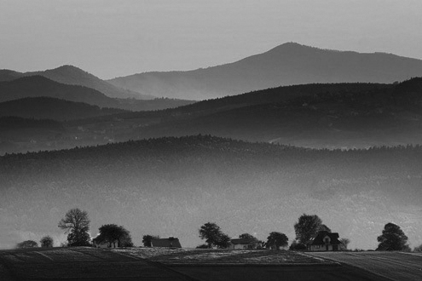
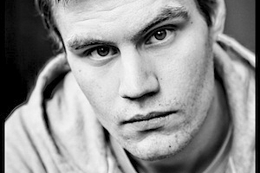
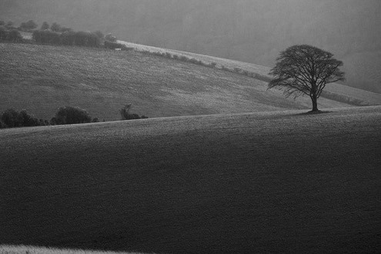
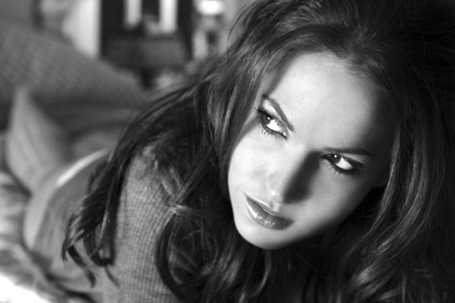
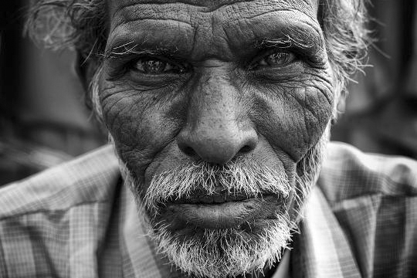
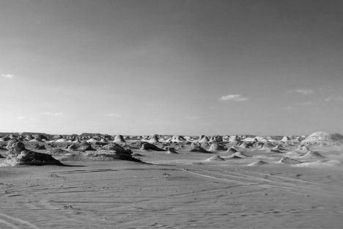
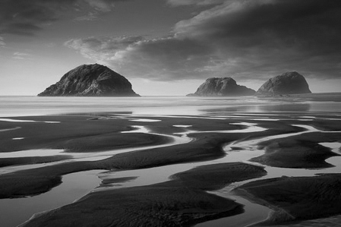
Data Sample

Slide 12
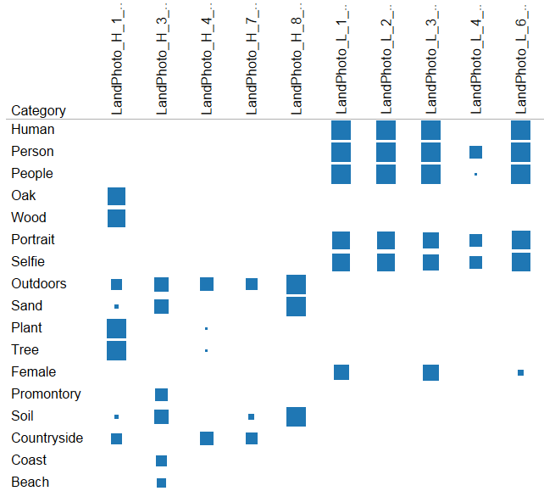
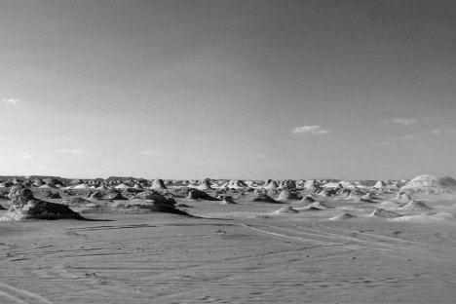
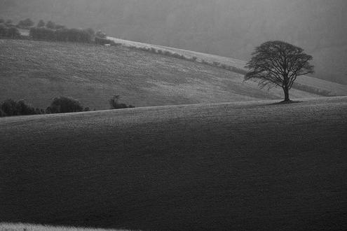
Analysis: Identifying Mislabeled Images
all labeled as ‘landscape’
People
Photos
female
promontory
Landscape
Photos

Slide 13
Application and Next Steps
Potential uses
Image library used for real estate property listings enabling buyers and sellers to search a property by specific objects and attributes
User verification that compares a live image to an image stored in a user/employee database
Facial similarity search based on a reference image that will return all matching faces found in a collection of images
Cataloging for e-commerce or archiving, Web development, improved image search, etc.
Next steps
Add facial recognition, emotion analysis, scene detection

Slide 14
Summary
We constructed an app to aid in the analysis of images.
Gathered data can be used to categorize images usable for research, marketing efforts, etc.
We demonstrated the use of this on a live web app
Our analysis shows the potential to define sub-groups and identify mislabeled images
Questions?

