Slide 1
Does Acute Pain Affect Executive Function?
Jenna Morogiello, LAT, ATC, CSCS
Nicholas Murray, PhD
Tamerah Hunt, PhD
Brandonn Harris, PhD
George Shaver, PsyD

Slide 2
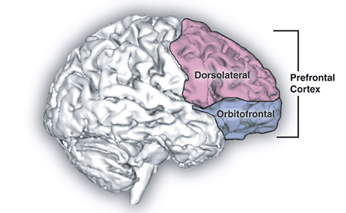
What is Executive Function?
The capacity to flexibly plan purposeful behavior ¹
  Prefrontal cortex (PFC)
  Ability to modify thoughts & actions
  Task switching, attention, planning, decision making, working memory etc.
  Highest level of human processing^{2,3}
(1. Howell, 2. Gilbert, 3. Wang)
Notes:
Your ability to resist temptation, to react to a similar situation in a different way, complex planning, ability to ignore cell phone during this presentation
CEO of the brain example
Hard to quantify because it is so complex
Howell D, Osterning L, Van Donkelaar P, et al. Effects of Concussion on Attention and Executive Function in Adolescentsd. Medicine and Science in Sports and Exercise. 2013. 45(6): 1030-1037.
Gilbert SJ, Burgess PW. Executive function. Current Biology. 2008;18(3):R110-R114.
1. Wang C, Shih C, Pesce C, Song T, Hung T, Chang Y. Failure to identify an acute exercise effect on executive function assessed by the wisconsin card sorting test. Journal of Sport and Health Science. 2015;4(1):64-72.
Lezak MD, Howieson DB, Loring DW. Neuropsychological assessment. Fourth ed. 198 Madison Avenue, New York, New York, 10016: Oxford University Press; 2004:1016
Image https://www.google.com/search?q=prefrontal+cortex&espv=2&biw=1341&bih=876&source=lnms&tbm=isch&sa=X&sqi=2&ved=0ahUKEwjw9JbYt7fOAhUFYyYKHeq9COYQ_AUIBigB#imgrc=pDO_t_9d9cEQGM%3A

Slide 3
Cognitive Functions
Input → storage→ processing → output
4 Classes of Cognition
Receptive Functions
Memory/ Learning
Thinking
Expressive functions
All 4 classes work together
Share the same basic neuroanatomical framework⁴
Specific roles & unique neuroanatomical structure⁴
(4. Lezak)
Notes:
4. Lezak MD, Howieson DB, Loring DW. Neuropsychological assessment. Fourth ed. 198 Madison Avenue, New York, New York, 10016: Oxford University Press; 2004:1016.
Receptive- 5 functions
Memory/learning-recall & recognition

Slide 4
Neuropsychological (NP) Tests
ImPACT, SAC, SCAT3
Automated Neuropsychological Assessment Metrics (ANAM)
Repeatable Battery for the Assessment of Neuropsychological Status (RBANS)
Hopkins Verbal Learning Test (HVLT)
Wechsler Adult Intelligence Scale (WAIS)
Wisconsin Card Sorting Test
Notes:
NP founded same assumptions as psychology but focuses on a behavioral outcome
Computerized vs pen and paper
In clinical neuropsychology a huge number of neuropsychological tests have been developed, and the corpus of these instruments is always increasing. Because of this, the question has been raised as to which are the most usefull instruments that provide the best neuropsychological profiles of the subjects. In the actual literature, In the present increased level of neuropsychological evaluation, computerized batteries still are not used in the majority of tests in clinical neuropsychology. Besides the impressive collection of neuropsychological instruments, the role of the educated and experienced clinician in neuropsychological evaluation is irreplaceable.
there are polemics about the advantages and disadvantages of computerized neuropsychological batteries versus standard paper and pencil tests.
http://www.ncbi.nlm.nih.gov/pubmed/20562739

Slide 5
NP Tests
Memory
RAVLT
Recognition
Free Recall
RAVLT
Attention
TMT-B
Digit Span

Slide 6
Pain
“An unpleasant sensory and emotional experience associated with actual or potential tissue damage” –IASP⁵
No “pain center”^{6,7,8}
Pain can affect cognitive networks over time⁹
Acute pain can trigger long term neural remodeling & mental distress¹⁰
  Chronic pain linked to changes in cortical volume and organization⁷
  Both coded in PFC where interpretation and coping mechanisms are decided ⁷
  Ability to self regulate thoughts, feelings, and behaviors relies heavily on executive functions, which may be impaired due to pain¹¹
(5.Merskey, 6. Melzack, 7. Jensen, 8. Moayedi, 9. Seminowicz, 10. Mathur, 11. Solberg)
Notes:
International association for the study of pain
- To be useful pain needs to override attention and current concerns, which it is very good at (Keogh 2013)
4 cortical regions in the brain for pain processing:
PFC
ACC anterior cingulate complex- limbic system
S1/S2 (Somatosensory complex)
Insula – limbic system
cortical regions include the prefrontal cortex, the anterior cingulate cortex, the somatosensory cortex, and the insula (see figure 1). ¹
Howell D, Osterning L, Van Donkelaar P, et al. Effects of Concussion on Attention and Executive Function in Adolescentsd. Medicine and Science in Sports and Exercise. 2013. 45(6): 1030-1037.
Gilbert SJ, Burgess PW. Executive function. Current Biology. 2008;18(3):R110-R114.
Wang C, Shih C, Pesce C, Song T, Hung T, Chang Y. Failure to identify an acute exercise effect on executive function assessed by the wisconsin card sorting test. Journal of Sport and Health Science. 2015;4(1):64-72.
Lezak MD, Howieson DB, Loring DW. Neuropsychological assessment. Fourth ed. 198 Madison Avenue, New York, New York, 10016: Oxford University Press; 2004:1016.
Merskey H, Bogduk N. Classification of chronic pain. 1994.
Melzack R. Pain and the neuromatrix in the brain. J Dent Educ. 2001;65(12):1378.
Jensen MP. A neuropsychological model of pain: Research and clinical implications. The Journal of Pain. 2010;11(1):2-12.
Moayedi M, Davis KD. Theories of pain: From specificity to gate control. J Neurophysiol. 2013;109(1):5-12.
Seminowicz DA, Davis KD. Interactions of pain intensity and cognitive load: The brain stays on task. Cereb Cortex. 2007;17(6):1412-1422.
Mathur VA, Khan SA, Keaser ML, Hubbard CS, Goyal M, Seminowicz DA. Altered cognition-related brain activity and interactions with acute pain in migraine. Neuroimage Clin. 2015;7:347-358.
Hutchison M, Comper P, Mainwaring L, Richards D. The influence of musculoskeletal injury on cognition: Implications for concussion research. The American Journal of Sports Medicine. 2011;39(11):2331-2337.
Riemann BL, Tray NC, Lephart SM. Unilateral multiaxial coordination training and ankle kinesthesia, muscle strength, and postural control. J Sport Rehabil. 2003;12(1):13-30
Hawker GA, Mian S, Kendzerska T, French M. Measures of adult pain: Visual analog scale for pain (VAS pain), numeric rating scale for pain (NRS pain), McGill pain questionnaire (MPQ), short-form McGill pain questionnaire (SF-MPQ), chronic pain grade scale (CPGS), short form-36 bodily pain scale (SF-36 BPS), and measure of intermittent and constant osteoarthritis pain (ICOAP). Arthritis Care & Research. 2011;63(S11):S240-S252.
Morone NE, Weiner DK. Pain as the fifth vital sign: Exposing the vital need for pain education. Clin Ther. 2013;35(11):1728-1732.
Sullivan K, Deffenti C, Keane B. Malingering on the RAVLT: Part II. detection strategies. Archives of Clinical Neuropsychology. 2002;17(3):223-233.

Slide 7
Pain and Cognition
  Acute musculoskeletal injuries have the potential to disrupt cognitive function ¹²
  May be due to shared amount of neural resources in the brain ⁹
Attention, processing speed, & psychomotor speed may be reduced when pain is present ⁴
Unclear whether or not there is a certain pain intensity or cognitive load needed to see these effects ⁹
(9. Seminowicz, 4. Lezak, 12. Hutchinson)
Notes:
Acute pain can be defined as “the normal, predicted physiological response to adverse chemical, thermal or mechanical stimulus… associated with surgery, trauma and acute illness”. ¹² According to the IASP, since pain is considered an unpleasant experience, it includes an emotional component as well. ⁴ Therefore, a patients beliefs and personalities can strongly affect their personal interpretation of pain. ¹² Previous literature suggests that even an episode of acute pain can trigger a cascade of long term neural remodeling and psychological distress, which indicates that although pain is typically classified into either acute or chronic, there are many links between them. ¹²
11. Hutchison M, Comper P, Mainwaring L, Richards D. The influence of musculoskeletal injury on cognition: Implications for concussion research. The American Journal of Sports Medicine. 2011;39(11):2331-2337.
provides evidence that athletic injury, in general, also may produce a degree of cognitive disruption. Therefore, a narrow interpretation of scores of neuropsychological tests in a sports concussion context should be avoided.

Slide 8
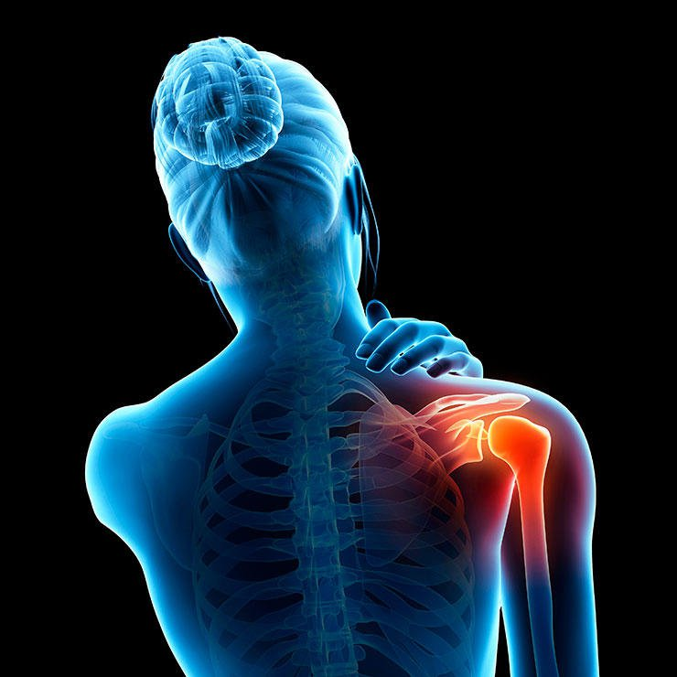
Purpose
The purpose of this study was to determine if acute pain affects cognition in the recreationally active who sustain a musculoskeletal injury.
Notes:
For the purpose of this study, executive function will be used as an umbrella term to refer to a subset of cognitive functions such as memory, attention, recall, recognition, etc.

Slide 9
Hypotheses
H₁: Cognition would be affected by acute pain
H₂: When in acute pain, participants would have reduced cognitive performance (DS, RAVLT, TMT-B)

Slide 10
Participants
Presented in acute pain at the RAC
Recreationally Active (n=24)
  Operationally defined as any physical activity for at least 20 mins at least 3x per week (Riemann 2003)¹³
21.5±2.1 years
Notes:
Riemann BL, Tray NC, Lephart SM. Unilateral multiaxial coordination training and ankle kinesthesia, muscle strength, and postural control. J Sport Rehabil. 2003;12(1):13-30.
-Prospective cohort Design
- Most participants played club sports

Slide 11
Criteria
Recreationally Active
Acute pain due to MSK injury (no fx)
  0-72 hours of injury
No MSK surgery within 6 months
No diagnosed concussion within past year
Not currently taking any pain medication
No hx of diagnosed mental illness or learning disability

Slide 12
Procedures
ATC evaluated participant that presented with acute MSK injury (0-72 hours)
Pain assessed using VAS
Scripted NP testing in private room
Follow up testing within 2 weeks
Notes:
Prospective Cohort Design

Slide 13
VARIABLES
VAS
Attention/set switching
TMT-B
Auditory memory & learning
DIGIT SPAN
Immediate recall & working memory
Pain Intensity
RAVLT

Slide 14

VAS
0-100 mm Line
0-4mm NO PAIN
5-44mm MILD PAIN (67%)
45-74mm MODERATE PAIN (33%)
75-100mm SEVERE PAIN
Based on the patient’s current pain perception
(tested within 0-72 hrs of initial injury)
Notes:
Measure of pain intensity
Commonly used and cited in literature ¹⁴
No gold standard, but noted to have good test-retest reliability (r = 0.94, p <0.001) ¹⁴
Validated in chronic & acute pain populations^{14, 15}

Slide 15
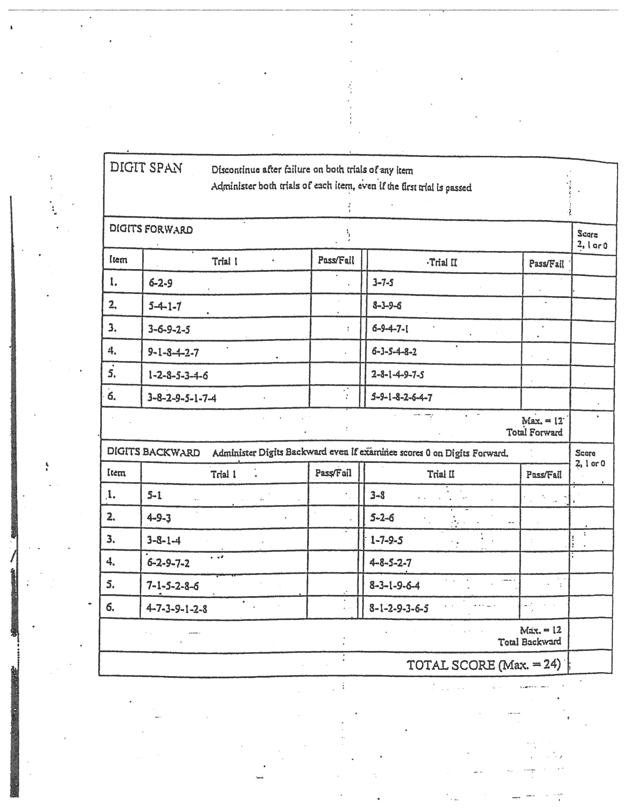
Digit Span (DS)
Wechsler battery (WAIS)
Forward
  Immediate Recall
  Relies short term storage
Backward
  Working memory
  Discontinue with failure on both trials (24)
Notes:
Typically 5-7 pieces of info in short term storage

Slide 16
Digits Backward
Working Memory
  - Ability to manipulate info
  - 12 trials
Discontinue with a failure on both trials
Max score of 24
Notes:
Example: recalling steps of a recipe while making a favorite meal
Core deficit in those with ADD/ADHD

Slide 17
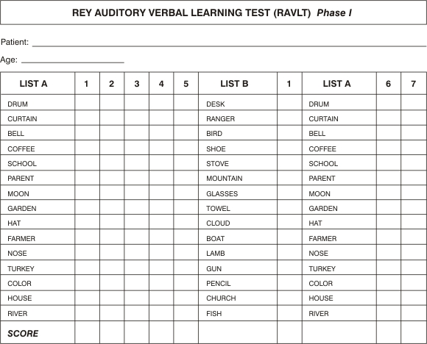
RAVLT
Auditory and verbal memory and learning¹⁶
  Immediate recall (A1)
  Learning curve (sum)
  Interference (A6)
  Delayed Recall (A7)
  Delayed Recognition
Alternate form follow up testing

Slide 18
RAVLT
Total List A: _____
Notes:
-No time limit
-semantically and phonetically similar words,
RELIABILITY?

Slide 19
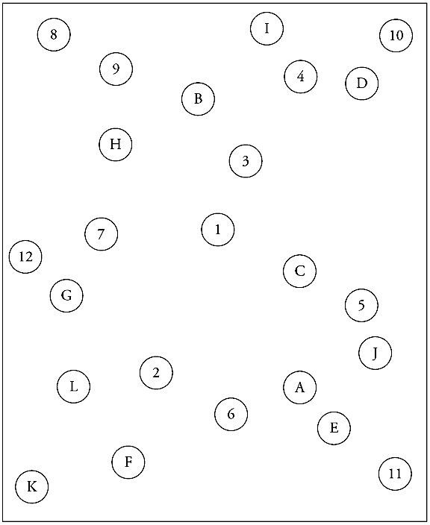
Trails Making Test B (TMT-B)
Army Individual Test Battery (1944)
Attention, set switching, visual motor tracking
Sample given first
Scored based on seconds to complete
Reliability coefficients for this test range from 0.6-0.9, with many reports of 0.8⁴
Notes:
Part B more taxing
Cognitive flex (2 stimuli) 7 working memory
Longer
Lezak 2009, Sanchez-Cubillo 2009
- Given sample firsts

Slide 20
Statistical Design
Seven paired samples t-tests using SPSS
  DS (2 scores)
  RAVLT (4 scores)
  TMT-B (1 score)
Adjusted alpha level of .007

Slide 21
VARIABLES
VAS
Attention/set switching
TMT-B
Auditory memory and Learning
Free Recall
DIGIT SPAN
Forward: Immediate Recall
Pain Intensity
List A
Immediate Memory (A1)
Interference (A6)
RAVLT
Backward: Working Memory
Recognition
Auditory/Verbal Memory (Sum A1 to A5) “Acquisition”
Notes:
djusted alpha level of 0.007

Slide 22
Results
Variations in Cognitive Performance During and After a Musculoskeletal Injury
Pair | Time | Mean | N | Std. Deviation | P
DSF | 1 2 | 8.7 9.6 | 24 24 | 1.8 1.8 | 0.001*
DSB | 1 2 | 6.5 7.3 | 24 24 | 2.2 2.3 | 0.023
A1 | 1 2 | 6.4 6.8 | 24 24 | 1.7 2.2 | 0.563
SUM | 1 2 | 53.8 53.9 | 24 24 | 7.7 8.3 | 0.953
A6 | 1 2 | 11.8 11.8 | 23 23 | 2.3 2.4 | 1
REC-A | 1 2 | 14.6 13.8 | 21 21 | .68 1.2 | 0.009
TMT-B | 1 2 | 48.4 39.6 | 22 22 | 12.6 9.4 | 0.000*
Notes:
Sig 2 of 7 measures
Time 1: ACUTE PAIN
Time 2: NO PAIN

Slide 23
Discussion
Hypothesis partially supported
  Significance for 2 of 7 measures
First study to look at acute pain and EF in the recreationally active who sustain MSK injury
TMT-B consistent with chronic pain literature¹⁵
  Similar to Weiner et al.¹⁷ 50.7±10.2sec (CLBP) and RBANS immediate memory (p =0.002)
DS Forward similar to acute migraine < 3 per month¹⁸
  Our pain group (8.7±1.8) migraine < 3 (6.48±1.3)
(15.Berryman, 16. Tombaugh, 17. Weiner, 18. Calandre)
Notes:
18-68 age range for Calandre
Only RAVLT Trial 5 reached sig for migraines and Wechsler short term memory scale
39. Berryman C, Stanton TR, Bowering KJ, Tabor A, McFarlane A, Moseley GL. Do people with chronic pain have impaired executive function? A meta-analytical review. Clin Psychol Rev. 2014;34:563-579.
-Meta-analysis
-22 articles small to moderate impairments
40. Tombaugh TN. Trail making test A and B: Normative data stratified by age and education. Arch Clin Neuropsychol. 2004;19(2):203-214.
-TMT decreases with age and increase with edcuation
41. Weiner DK, Rudy TE, Morrow L, Slaboda J, Lieber S. The relationship between pain, neuropsychological performance, and physical function in community-dwelling older adults with chronic low back pain. Pain Medicine. 2006;7(1):60-70.

Slide 24
Discussion
DS backward & RAVLT were not significant
  Working memory, verbal/auditory learning, delayed recognition
  Typically altered in those with chronic pain
  Similar to migraines < 3 per month A1 & total score¹⁸ (67% “mild” pain)
  Etherton et al. cold induced pain (WAIS-IV)^{19, 20}
    No differences between acute pain in working memory, processing speed, immediate recall
(18. Calandre, 19. Etherton, 20. Etherton)
Notes:
42. Etherton JL, Bianchini KJ, Ciota MA, Greve KW. Reliable digit span is unaffected by laboratory-induced pain implications for clinical use. Assessment. 2005;12(1):101-106.
43. Etherton J. Cold pressor-induced pain does not impair WAIS-IV processing speed index or working memory index performance. Appl Neuropsychol Adult. 2014;21(1):14-20.

Slide 25
Summary
Limited research on acute pain and cognition
Improved NP scores seen for immediate recall (DS forward) and set switching (TMT-B) when pain free
  No significance for working memory and auditory verbal learning
Clinically emphasizes pain management- sports involve set switching
  RTP with pain is common, must be aware of possible NP deficits
Future research should replicate a sporting environment and take into account sleep, caffeine, fatigue
  Various populations and intensities

Slide 26
References
Howell D, Osterning L, Van Donkelaar P, et al. Effects of Concussion on Attention and Executive Function in Adolescentsd. Medicine and Science in Sports and Exercise. 2013. 45(6): 1030-1037.
Gilbert SJ, Burgess PW. Executive function. Current Biology. 2008;18(3):R110-R114.
Wang C, Shih C, Pesce C, Song T, Hung T, Chang Y. Failure to identify an acute exercise effect on executive function assessed by the wisconsin card sorting test. Journal of Sport and Health Science. 2015;4(1):64-72.
Lezak MD, Howieson DB, Loring DW. Neuropsychological assessment. Fourth ed. 198 Madison Avenue, New York, New York, 10016: Oxford University Press; 2004:1016.
Merskey H, Bogduk N. Classification of chronic pain. 1994.
Melzack R. Pain and the neuromatrix in the brain. J Dent Educ. 2001;65(12):1378.
Jensen MP. A neuropsychological model of pain: Research and clinical implications. The Journal of Pain. 2010;11(1):2-12.
Moayedi M, Davis KD. Theories of pain: From specificity to gate control. J Neurophysiol. 2013;109(1):5-12.
Seminowicz DA, Davis KD. Interactions of pain intensity and cognitive load: The brain stays on task. Cereb Cortex. 2007;17(6):1412-1422.
Mathur VA, Khan SA, Keaser ML, Hubbard CS, Goyal M, Seminowicz DA. Altered cognition-related brain activity and interactions with acute pain in migraine. Neuroimage Clin. 2015;7:347-358.
Solberg Nes L, Roach AR, Segerstrom SC. Executive functions, self-regulation, and chronic pain: A review. Ann Behav Med. 2009;37(2):173-183. doi: 10.1007/s12160-009-9096-5 [doi].
Hutchison M, Comper P, Mainwaring L, Richards D. The influence of musculoskeletal injury on cognition: Implications for concussion research. The American Journal of Sports Medicine. 2011;39(11):2331-2337.
Riemann BL, Tray NC, Lephart SM. Unilateral multiaxial coordination training and ankle kinesthesia, muscle strength, and postural control. J Sport Rehabil. 2003;12(1):13-30
Sullivan K, Deffenti C, Keane B. Malingering on the RAVLT: Part II. detection strategies. Archives of Clinical Neuropsychology. 2002;17(3):223-233.
Berryman C, Stanton TR, Bowering KJ, Tabor A, McFarlane A, Moseley GL. Do people with chronic pain have impaired executive function? A meta-analytical review. Clin Psychol Rev. 2014;34:563-579.
Tombaugh TN. Trail making test A and B: Normative data stratified by age and education. Arch Clin Neuropsychol. 2004;19(2):203-214.
Weiner DK, Rudy TE, Morrow L, Slaboda J, Lieber S. The relationship between pain, neuropsychological performance, and physical function in community-dwelling older adults with chronic low back pain. Pain Medicine. 2006;7(1):60-70.
Calandre EP, Bembibre J, Arnedo ML, Becerra D. Cognitive disturbances and regional cerebral blood flow abnormalities in migraine patients: Their relationship with the clinical manifestations of the illness. Cephalalgia. 2002;22(4):291-302.
Etherton JL, Bianchini KJ, Ciota MA, Greve KW. Reliable digit span is unaffected by laboratory-induced pain implications for clinical use. Assessment. 2005;12(1):101-106.
Etherton J. Cold pressor-induced pain does not impair WAIS-IV processing speed index or working memory index performance. Appl Neuropsychol Adult. 2014;21(1):14-20.

Slide 27
Images
First Brain Image: https://www.google.com/search?q=prefrontal+cortex&espv=2&biw=1341&bih=876&source=lnms&tbm=isch&sa=X&sqi=2&ved=0ahUKEwjw9JbYt7fOAhUFYyYKHeq9COYQ_AUIBigB#imgrc=pDO_t_9d9cEQGM%3A
Injury: https://www.google.com/search?q=pain&rlz=1C5CHFA_enUS698US698&source=lnms&tbm=isch&sa=X&ved=0ahUKEwiaqYLrkoLTAhWI8CYKHS6yBvkQ_AUICCgB&biw=981&bih=607#imgrc=MwDgh4jpcs8ooM:
VAS Scale: http://www.partnersagainstpain.com/printouts/A7012AS1.pdf
RAVLT form: https://www.google.com/search?q=RAVLT+form&espv=2&biw=1135&bih=873&source=lnms&tbm=isch&sa=X&ved=0ahUKEwig0ajNnNvOAhUFYyYKHZRyCIIQ_AUIBigB#imgrc=Ol-WAZ6HB-00NM%3A
Last Brain Image: https://www.google.com/search?q=brain+images&espv=2&biw=805&bih=873&tbm=isch&imgil=67iDoWZXAKgP5M%253A%253B1K1uYdEFzoWkTM%253Bhttp%25253A%25252F%25252Fmsbraininjury.wildapricot.org%25252F&source=iu&pf=m&fir=67iDoWZXAKgP5M%253A%252C1K1uYdEFzoWkTM%252C_&usg=___HpNS5fPZphu6pEiDgXzK9f6_t8%3D&ved=0ahUKEwiExqPYt8fOAhUE6SYKHZpVDtAQyjcILw&ei=KdCzV8SNDYTSmwGaq7mADQ#imgrc=IhKJZEEmMCbbdM%3A

Slide 28
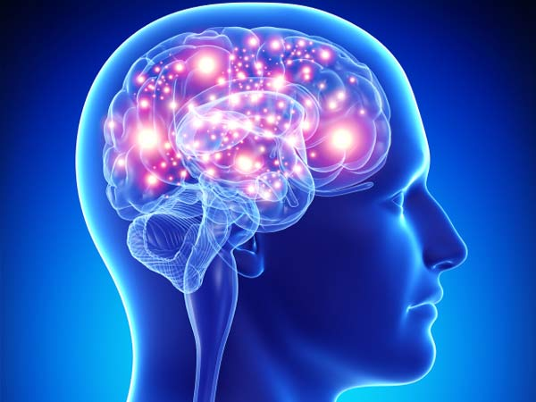
Questions?
Notes:
https://www.google.com/search?q=brain+images&espv=2&biw=805&bih=873&tbm=isch&imgil=67iDoWZXAKgP5M%253A%253B1K1uYdEFzoWkTM%253Bhttp%25253A%25252F%25252Fmsbraininjury.wildapricot.org%25252F&source=iu&pf=m&fir=67iDoWZXAKgP5M%253A%252C1K1uYdEFzoWkTM%252C_&usg=___HpNS5fPZphu6pEiDgXzK9f6_t8%3D&ved=0ahUKEwiExqPYt8fOAhUE6SYKHZpVDtAQyjcILw&ei=KdCzV8SNDYTSmwGaq7mADQ#imgrc=IhKJZEEmMCbbdM%3A

Slide 29
Educational Data
Education | n | %
Master’s | 7 | 29%
Senior | 5 | 21%
Junior | 7 | 29%
Sophomore | 3 | 13%
Freshman | 2 | 8%

