Slide 1
An Examination of Adolescent Athletes and Non-Athletes on Baseline Neuropsychological Test Scores
Christopher P. Tomczyk, LAT, ATC
Megan E. Mormile, ATC
Tamerah N. Hunt, Ph.D., FACSM

Slide 2
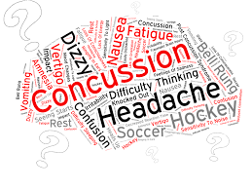
Background
Concussions are complex pathophysiological processes affecting the brain caused by direct or impulsive biomechanical forces¹
  Symptoms, altered cognition, and postural instability²
High school population
  63,000 SRC annually³
  Incidence rate as high as 15.3%³

Slide 3
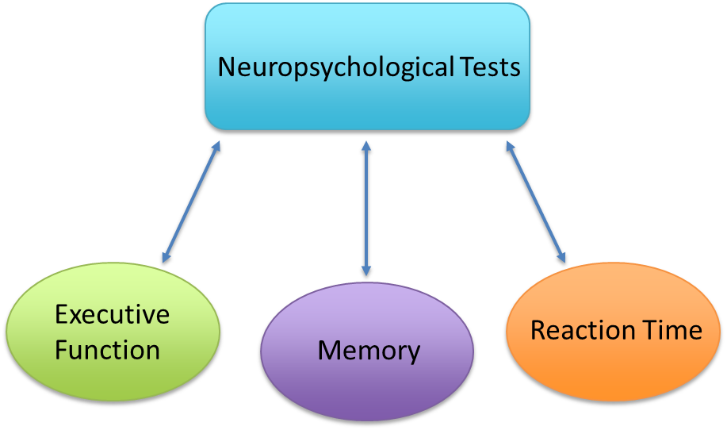
Background
Neuropsychological tests⁴
  Linked to specific brain functions/pathways
  Used to measure cognitive ability
  Can detect differences when compared to a reference (i.e. baseline)
  Immediate Post-Concussion Assessment and Cognitive Test (ImPACT)

Slide 4
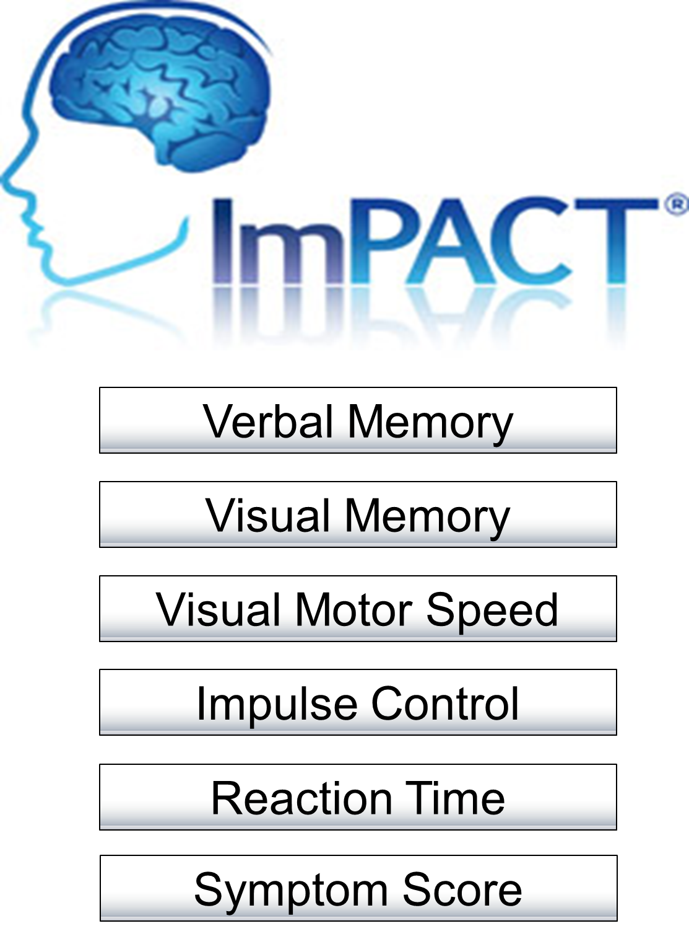
Background
ImPACT
  Five composite scores: Verbal Memory, Visual Memory, Visual-Motor Speed, Reaction Time, Impulse Control
  Total Symptom Score
  Sensitivity: 91.4%, Specificity: 69.4%⁵
  Popular in the high school setting
  Age⁶ and Sex⁷ differences

Slide 5
Purpose
To examine the effects of athletic status (athlete vs. non-athlete) on baseline neuropsychological test scores is a high school population
  Facilitate a more accurate interpretation of results
Utilization of non-athletes as healthy controls?

Slide 6
Methods
Participants
  662 high school students (ATH n=383, NON n=279)
Main Outcome Measures
  ImPACT composite scores
Procedures
  ImPACT administered prior to the competitive season (athletes) and school year (non-athletes).
Statistical Analyses
  Descriptive statistics
  One-Way ANOVA (alpha level set a priori p<0.05)
    SPSS v23.0 (IBM Inc. Armonk, North Castle, NY)

Slide 7
Results

Slide 8
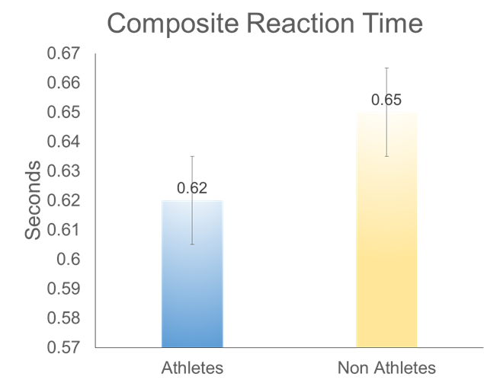
Results

Slide 9
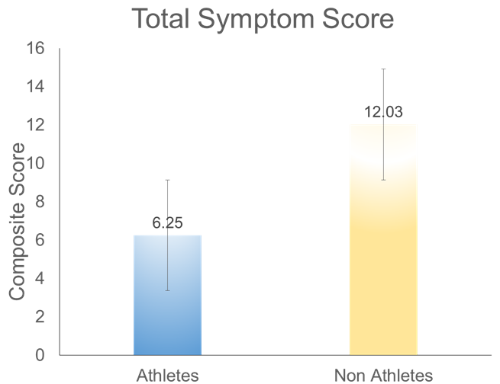
Results

Slide 10
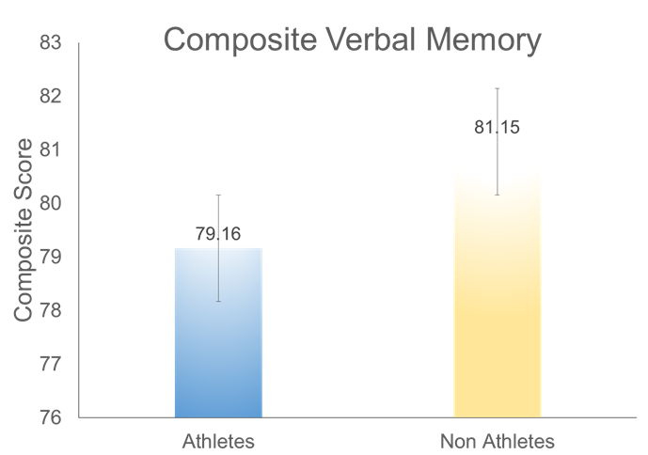
Results

Slide 11
Discussion
Athletes had significantly faster reaction times than non-athletes.
  Bruzi et al.¹¹
  Verma et al.¹²
Athletes reported less symptoms than non-athletes
  Athletic Identity¹³
  The Culture of Risk¹⁴
  Heighted pain tolerance¹⁵

Slide 12
Discussion
Non-athletes had significantly higher Composite Verbal Memory scores than athletes
  Extracurricular activities, such as music, can lead to structural changes¹⁰ and greater verbal memory capacity¹⁶
Clinical Implications
  Non-athletes should not be utilized as controls in concussion research.
  If comparing a post-injury non-athlete’s ImPACT results it is paramount to be aware of these differences

Slide 13
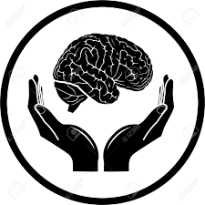

Conclusions
Concussion is a complex brain pathology that relies heavily on tracking altered cognition for diagnosis and management
Significant differences are present at baseline when comparing adolescent athletes and non-athletes
Clinicians and need to be cognizant of these normal differences when treating non-athletes utilizing the current concussion protocol
Investigators should refrain from using non-athletes as controls in future concussion research

Slide 14
References
McCrory P, Meeuwisse WH, Aubry M, et al. Consensus Statement on Concussion in Sport: The 4th International Conference on Concussion in Sport, Zurich, November 2012. J Athl Train Allen Press. 2013;48(4):554-575.
Broglio SP, Cantu RC, Gioia GA, et al. National Athletic Trainers’ Association Position Statement: Management of Sport Concussion. J Athl Train Allen Press. 2014;49(2):245-265.
McCrea M, Hammeke T, Olsen G, Leo P, Guskiewicz K. Unreported concussion in high school football players: implications for prevention. Clin J Sport Med. 2004;14(1):13-17.
Seidman, LJ. Neuropsychological testing. Harvard Mental Health Letter. 1998;14 (11):4-6.
Schatz P, Sandel N. Sensitivity and specificity of the online version of ImPACT in high school and collegiate athletes. Am J Sport Med. 2013;41(2):321-326.
Covassin T, Swanik CB, Sachs M, Kendrick Z, Schatz P, Zillmer E, Kaminaris C. Sex differences in baseline neuropsychological function and concussion symptoms of collegiate athletes. Br J Sports Med. 2006;40(11):923-927.
Register-Mihalik JK, Kontos DL, Guskiewicz KM, Mihalik JP, Conder R, Shields EW. Age-related differences and reliability on computerized and paper-and-pencil neurocognitive assessment batteries. J Ath Train. 2012;47(3):297-305.
Langlois JA, Rutland-Brown W, Wald MM. The Epidemiology and Impact of Traumatic Brain Injury. J Head Trauma Rehabil. 2006;21(5):375-378.
Ursache A, Noble KG. Neurocognitive development in socioeconomic context: multiple mechanisms and implications for measuring socioeconomic status. Psychophysiology. 2016;53:71-82.
Schlaug G, Jancke L, Huang Y, Steinmetz H. In vivo evidence of structural brain asymmetry in musicians. Science. 1995;267:699-701.
Bruzi AT, Fialho JVAP, Fonseca FS, Ugrinowitsch H. Comparison of reaction time between basketball players, artistic gymnasts and non-athletes. Revista Brasileira de Ciencias do Esporte. 2013;35(2):469-480.
Verma, S., Mishra, A., and Singh, A. (2011). Effect of long term exercise training on auditory and visual reaction time. Indian J Physiotherapy & Occupational Therapy. 5(3):126-129.
Brewer BW, Van Raalte JL, Linder DE. Athletic identity: Hercules’ muscles or achilles heel?. Inter J Sport Psych. 1993;24(2):237-254.
Nixon II HL. Accepting the risks of pain and injury in sport: mediated cultural influences of playing hurt. Sociology Sport J. 1993;10:183-196.
Ryan ED, Kovacic CR. Pain tolerance and athletic participation. Perceptual and Motor Skills. 1966;22(2):383-390.
Kilgour A, Jakobson L, Cuddy L. Music training and rate of presentation as mediators of text and song recall. Memory Cognition. 2000;28(5):700-710.

Slide 15

Questions?

