Slide 1
Training Method Influences on Postural Stability
P. Chrysosferidis, B. Szekely, M.E. Mormile, K. Grimes, B.A. Munkasy, D. Powell, N.G. Murray

Slide 2
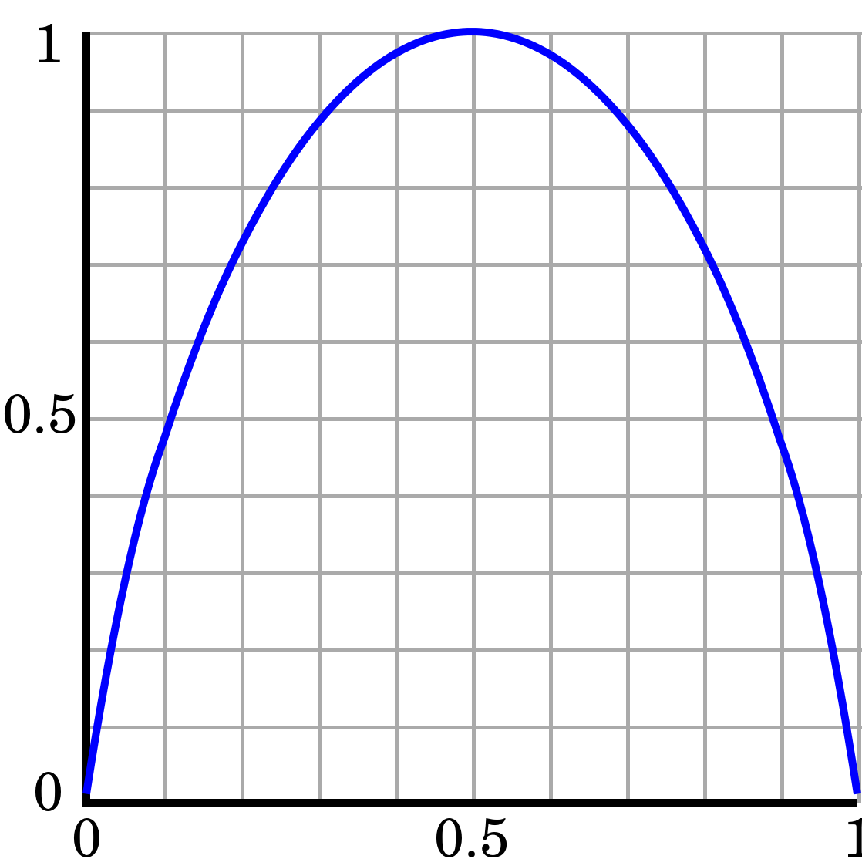
Introduction
Center of pressure is most commonly assessed with a force platform
It has been previously used as an indicator of postural control^{1,3}
Linear and non linear methods ²
Sample Entropy (SampEN) is a non-linear metric used to detect more subtle changes ²
Peak Excursion Velocity (PEV) and Root Mean Square (RMS) are linear metrics ²

Slide 3
Background Information
Less postural sway magnitude has been associated with better control during quiet stance ²
Stable Surface Trained (SST) incorporates a distal to proximal loading pattern ¹
Unstable surface trained (UST) may incorporate a proximal to distal loading pattern ¹
A gap in research concerning postural sway between SST and UST during a sport-like dual-task
Previous studies have demonstrated with less static postural sway in SST ^{1,3}

Slide 4
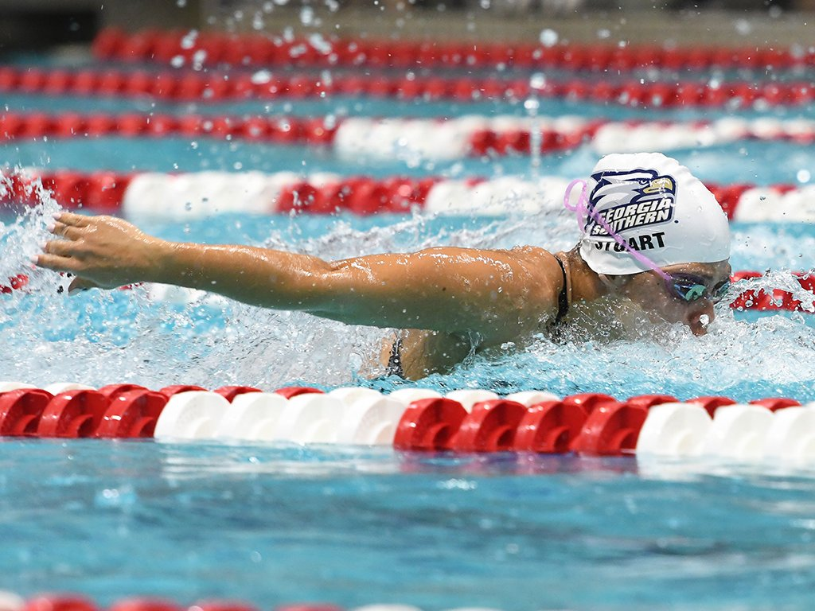
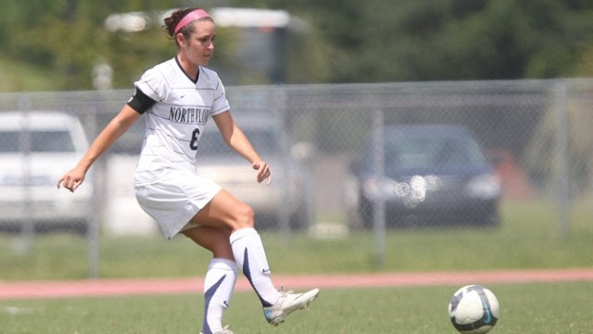
Purpose Statement
The purpose of this study was to determine differences in postural control between SST and UST athletes
It was hypothesized that the SST will demonstrate with greater postural stability than UST

Slide 5
Methods
Participants:
7 female UST
  Age: 18 ± 0.5 years.
  Height: 161.1 ± 5.8 cm.
  Weight: 61.9 ± 4.8 kg
.
7 female SST
  Age: 18 ± 0.5 years.
  Height: 167.6 ± 7.6 cm.
  Weight: 62.1 ± 5.1 kg
Testing:
Each participant performed two 30 second trials of both eyes open (EO) and eyes closed (EC) conditions.
They also performed a sport-like dual-task (Wii Fit Soccer) for approximately 62 seconds.

Slide 6
Methods
Instrumentation:
  AMTI OR6 Series force plate (AMTI, 1000Hz, Watertown, MA)
Data Analysis
  MatLab (MATLAB Inc., Natick, MA)
  All raw center of pressure data was analyzed using a custom MatLab code
  Filtered using a 4th order 30 Hz low pass Butterworth filter
  RMS, SampEn, and PEV in the anteroposterior (AP) and mediolateral (ML) were calculated

Slide 7
Statistical Analysis
  SPSS (IBM Inc., Version 23, Chicago, IL)
  Multivariate ANOVA (alpha level = 0.05) was run per condition and direction
    Eyes Open Eyes Closed WFS
    AP PEV AP PEV AP PEV
    AP RMS AP RMS AP RMS
    AP SampEn AP SampEn AP SampEn
ML PEV ML PEV ML PEV
ML RMS ML RMS ML RMS
ML SampEn ML SampEn ML SampEn

Slide 8
Figure 1. SampEn across condition
S: Stable Surface Trained, U: Unstable Surface Trained, EC: Eyes Closed, EO: Eyes Open, WFS: Wii Fit Soccer Heading Game, *: significant difference.

Slide 9
Figure 2. PEV across condition
*
S: Stable Surface Trained, U: Unstable Surface Trained, EC: Eyes Closed, EO: Eyes Open, WFS: Wii Fit Soccer Heading Game, *: significant difference.

Slide 10
Figure 3. RMS across condition
*
*
S: Stable Surface Trained, U: Unstable Surface Trained, EC: Eyes Closed, EO: Eyes Open, WFS: Wii Fit Soccer Heading Game, *: significant difference.

Slide 11
Discussion
It was hypothesized that the SST will demonstrate with greater postural stability than UST
The results from this study rejects the hypothesis
SampEn across the ML direction was greater in the SST while AP was greater in the UST though no significance was present
Greater PEV for the SST across conditions may be indicative of less postural control ²
Statistically greater RMS values during WFS for the SST in the AP direction demonstrates with less postural control compared to UST during the WFS ²
UST demonstrated with greater postural magnitude than the SST
In the EC ML condition

Slide 12
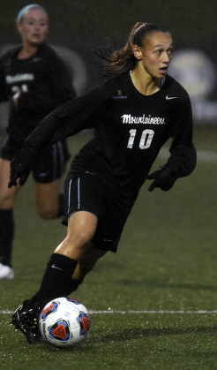
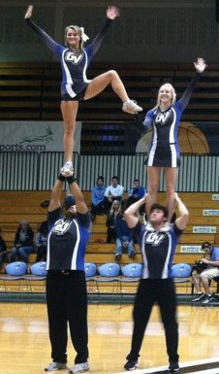
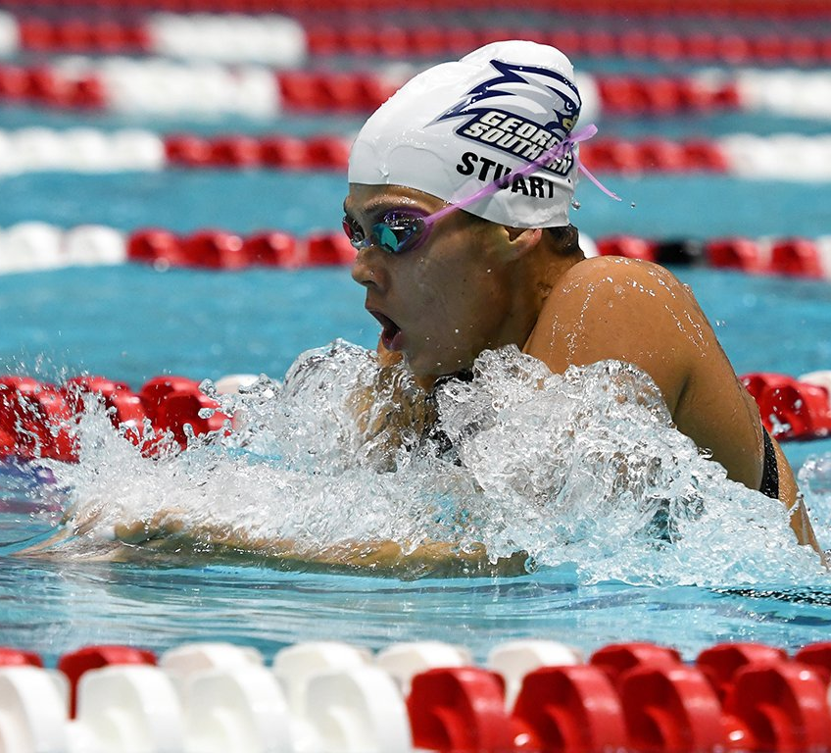
Conclusion
These differences may be due to a variation in postural control strategy
SST produce force distal to proximal, where UST produce proximal to distal ¹
These results should be further studied using electromyography analysis to determine the recruitment of muscles and their contribution to postural control

Slide 13
Limitations
Lack of an adequate sample size
Should include males in the study
Different playing strategies
Lack of various unstable surface athletes

Slide 14
References
1. Powell DW, Williams DSB. Athletes trained using stable compared to unstable surfaces exhibit distinct postural control profiles when assessed by traditional and nonlinear measures. Human Movement Science. 2015;44:73–80. doi:10.1016/j.humov.2015.08.013.
2. Palmieri RM, Ingersoll CD, Stone MB, Krause BA. Center-of-pressure parameters used in the assessment of Postural control. Journal of Sport Rehabilitation. 2002;11(1):51–66. doi:10.1123/jsr.11.1.51.
3. Kiers H, van Dieën J, Dekkers H, Wittink H, Vanhees L. A systematic review of the relationship between physical activities in sports or daily life and Postural sway in upright stance. Sports Medicine. 2013;43(11):1171–1189. doi:10.1007/s40279-013-0082-5.

Slide 15
Thank you!
Questions?

