Slide 1
Association between Birth Spacing and Neonatal Health Outcomes in Georgia
Victor Chukwu, MBBS, MPH
Gulzar Shah, PhD, Mstat, MS
Kavita Gohil, BDS, MPH
Uche Okoro, MBBS, MPH
Annual Research Symposium,
April 14th, 2017
Georgia Southern University
Presented By Victor Chukwu

Slide 2
Outline
Introduction
Background
Methods
Results
Conclusion

Slide 3
Introduction ~Definitions
Neonate: A baby within the first 28 days of life.
Infant: A baby within the first year of life.
Birth Spacing (also known as the interpregnancy interval) is the time between (or number of months) between a live birth and the conception of the next pregnancy.
Short Interpregnancy interval: The conception of a live birth occurring less than 18 months from the preceding live birth (2).
Short interpregnancy intervals were categorized as less than 6 months, 6–11 months, and 12–17 months.

Slide 4
Introduction ~Definitions
Low Birth Weight: Birth weight of less than 5.5 lbs, or 2500 grams. (CDC).
Small for Gestation: Birthweight at or below the 10th percentile for a given gestational age (CDC).

Slide 5
Background
According to Centers for Disease Prevention and Control (CDC), there were about 4million live births in 2014, of which 23000 died before their first birthday.
About 6 infants die for every 1000 live births.
Although the infant mortality rate has declined by 13% since it recently peaked in 2005, there is still a two times higher death rate among the blacks infants than the white infants.
Georgia Southern University Research Symposium

Slide 6
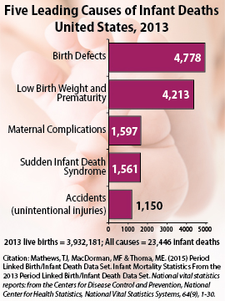
Background
Five leading causes of Infant Mortality
Five leading causes of Infant Mortality
Birth Defects
Low Birth Weight and Prematurity
Sudden Infant Death Syndrome
Maternal Complications
Accidents (Unintentional Injuries)
Georgia Southern University Research Symposium

Slide 7
Background
In Georgia, the infant mortality rate has remain consistently higher than the national rate over the recent years. In 2015, the infant mortality rate was 7.8 per 1000 infants. (6.0 National)
Georgia Southern University Research Symposium

Slide 8
Background
Optimal inter-pregnancy care can play a big role in reducing some of these leading causes of infant mortality, especially preterm births, low birthweight, birth defects and maternal complications of pregnancy.
According to the National Vital Statistics System; about 29% of US mothers had births with a short interpregnancy interval of less than 18 months.
Short intervals were common among mothers aged 35 years and above, non-Hispanic black mothers and low educational status.
The aim of our study is to analyze the association between birth spacing and neonatal outcomes in Georgia.
Georgia Southern University Research Symposium

Slide 9
Methods
For this research the 2013 Pregnancy Risk Assessment Monitoring System (PRAMS) data for the state of Georgia was used
The dependent variables included: length of infant intensive care unit stay at birth, length of hospital stay, birth weight and small for gestational age based on 10th percentile.
The independent variable included: years since last live birth.
Data analysis was done using SAS, Version 9.4. Multivariate analysis was done using logistic regression.
Georgia Southern University Research Symposium

Slide 10
Result
Birth Intervals were grouped as:
Group 1 – 0 to 1 year
Group 2 – 2 years
Group 3 – 3 to 4 years
Group 4 – 5 to 8 years.
Maternal Age Grouped as:
Group 1: 13 – 17 years
Group 2: 18 – 24 years
Group 3: 25 – 35 years
Group 4: above 35 years
Georgia Southern University Research Symposium

Slide 11
Result – Descriptive Statistics
Georgia Southern University Research Symposium

Slide 12
Results
Bivariate Analysis
Birth spacing interval of 2-4 years was associated with a lower rate of admission in the intensive care unit
Birth interval of 2 years or greater was associated with a shorter length of stay in the hospital after delivery.
OR=0.616, P=0.043, 95% CI (0.386,0.985)
2 years: OR=0.619, P = 0.017, 95% CI=0.417, 0.918;
3-4years: OR= 0.628, P = 0.008, CI = 0.446,0.884
Georgia Southern University Research Symposium

Slide 13
Results
Multivariate Analysis (with Controls):
Birth spacing interval of less than 1 year was associated with increase rate of admission in the Intensive Care Unit (P=0.0381), while controlling for birthweight and maternal diabetes.
Birth spacing interval of 2-4 has lower odds of longer hospital stay after birth when compared to birth spacing interval of less than 1.
while controlling for history of maternal diabetes and maternal
history of hypertension.
(OR = 0.617, P= 0.0273, 95% CI 0.402, 0.947)
Georgia Southern University Research Symposium

Slide 14
Results
Multivariate Analysis (Cont’d):
Birth spacing interval of 2 - 4 years have lower odds of having small for gestation babies than those with birth spacing interval of less than 1, though result were not statistically significant.
while controlling for smoking during pregnancy
OR=0.787, P = 0.5115, 95% CI (0.384, 1.611)
Georgia Southern University Research Symposium

Slide 15
Discussion
Many studies have showed the relationship between birth spacing and maternal adverse outcomes, but very few studies have showed how these are related to the newborn and infants.
However, a recent study (2010,California) had similar results, concluding that women with birth spacing interval of less than 1 year were at higher risk for preterm birth [3].
Georgia Southern University Research Symposium

Slide 16
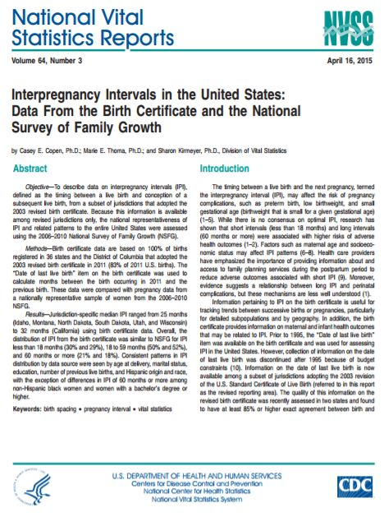
Discussion
Data from the 2015 National Vital Statistics Report and the National Survey of Family Growth also demonstrated that in the United States 30% of women have a birth spacing interval of less than 18 months. Short birth spacing intervals in the U.S. are inversely associated with maternal age, with more than two thirds (67%) of teenagers between ages 15–19 having less than 18 months birth spacing interval [4].
Georgia Southern University Research Symposium

Slide 17
Discussion
The Question: when should postpartum contraception be actively initiated in such a way that it does not hinder breastfeeding and cause adverse maternal health effects? And what is the best contraception method that can balance these goals?
Many women would opt for the non-hormonal options, which are few and associated with high failure rates. So healthcare providers should communicate with women about the failure rate of these options.
Pregnancy can occur any time in a woman’s reproductive life, contraception counselling should be a major part of a woman’s healthcare. (5). Mothers should also be aware of adverse neonatal outcomes associated with short interpregnancy intervals.
Georgia Southern University Research Symposium

Slide 18
Limitations of Study
Data constraints; as values for birth spacing interval was given in years rather than months. (zero years could be 2 months or 9 months). That would have given a better illustration of the association between the birth spacing intervals and the neonatal outcomes.
http://jgdiaries.com/wordpress/?cat=5
Georgia Southern University Research Symposium

Slide 19
Conclusion
Public Health agencies can identify women who are pregnant after a short interval and follow them closely to avoid adverse effects. (6)
It will be of great public health importance to increase awareness of these results and also provide community counselling centers where these issues can be discussed.
Georgia Southern University Research Symposium

Slide 20
References
(1) Centers for Disease Control and Prevention
https://www.cdc.gov/chronicdisease/resources/publications/aag/pdf/2016/aag-infant-health.pdf
(2) Thoma ME, Copen CE, Kirmeyer SE. Short interpregnancy intervals in 2014: Differences by maternal demographic characteristics. NCHS data brief, no 240. Hyattsville, MD: National Center for Health Statistics. 2016.
(3) Shachar BZ, Mayo JA, Lyell DJ, Baer RJ, Jeliffe-Pawlowski LL, Stevenson DK, Shaw GM. Interpregnancy interval after live birth or pregnancy termination and estimated risk of preterm birth: a retrospective cohort study. BJOG. 2016;123(12). doi:10.1111/1471-0528.14165. [Epub ahead of print].
(4) Copen CE, Thoma ME, Kirmeyer S. Interpregnancy intervals in the UnitedStates: data from the birth certificate and the national survey of family growth. Natl Vital Stat Rep. 2015;64(3):1–10.
(5) Sridhar, A., & Salcedo, J. (2017). Maternal Health, Neonatology and Perinatology. Optimizing maternal and neonatal outcomes with postpartum contraception: impact on breastfeeding and birth spacing.
(6) Zhu , B., Rolfs, R. T., Nangle, B. E., & Horan, J. M. (1999). Effect Of The Interval Between Pregnancies On Perinatal Outcomes. The New England Journal Of Medicine, 340(9)
Georgia Southern University Research Symposium

Slide 21
Thank You
Georgia Southern University Research Symposium

