Slide 1
Attitudes and Behaviors of medical students Towards Business Education and Training
Alea Simmons, Undergraduate Honors Student
Dr. Steve Charlier, Department of Management

Slide 2
Background
Healthcare and health spending is a huge part of our economy/ big business and lots of money involved.
Medical schools have started to adapt to this by increasing the number of MD/MBA programs. Currently, there are 61 MD/MBA programs offered in the USA.
MD/MBA are all optional- no requirement for Bus. Ed.
There is a perceived demand for Business Education among some medical students, but there is no definitive value of how important this knowledge is to medical students
Trying to gauge medical student perceptions of the value of business education during their medical school training
Notes:
FOURTH BULLET POINT-- Medical schools and business schools have perceived that there is a need/demand, but there has been limited research done to see what medical students actually perceive is important. Because of this lack of research, it is hard to gauge the actual value of business education or any other sort of higher level education.

Slide 3
Research Questions
1. What are the attitudes and behaviors of medical students towards business education and training?
2. Are there different opinions between students whose school offers MD/MBA program vs. just MD program?
3. Do demographics and stage of medical schooling influence medical student attitudes towards business education?
4. Does prior undergraduate experience in business education influence medical student attitudes towards business education?
5. Are there facets of business education that are deemed more important than others to current medical students?

Slide 4
Methods
Sample/Data Collection
  Participants recruited from multiple medical schools- Creighton, Mercer, MCG, FSU
  62 from Georgia Schools; 62 from private university in Nebraska; 13 from unknown
  Asked participants to recruit others and had a few from other institutions (California, Missouri, Maryland, Wisconsin)
  Data was collected in first quarter of 2017
  Participants were anonymous, but location was geo-coded via IP address
  Survey distributed via Qualtrics. No incentives or tangible benefits were provided to participants
  153 started the survey; usable data from 137
Notes:
Creighton, Nebraska is the school that offers the MD/MBA program
Others we are not sure about.

Slide 5
Methods
Measures
  Demographics (e.g., gender, age)
  Year of medical school (e.g., first year through residency)
  Location of medical school (e.g., Georgia, Nebraska, other)
  Prior undergraduate business education
  Overall rating of importance of business education
  Ratings of facets of business areas
Notes:
Ratings of business areas were taken from a journal survey and were slightly altered to fit our survey.

Slide 6
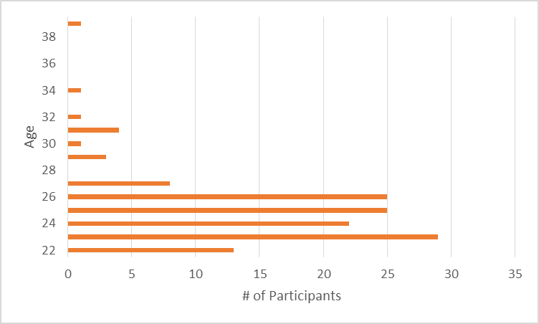
Demographics
Gender
Age

Slide 7
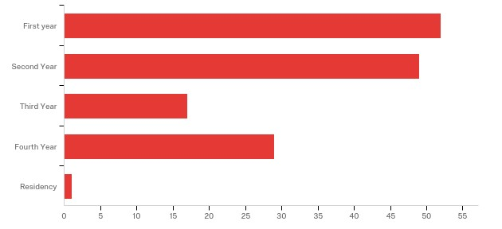
Year of study
Notes:
Mainly had first and second year students, but our range was first year students to residency students.

Slide 8
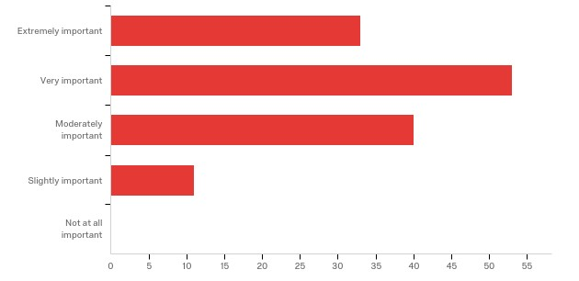
Results
1. What are the attitudes and behaviors of medical students towards business education and training?
Notes:
Mean= 3.8 on a scale of 1-5. This mean is in between moderately important and very important. No students makred that business education was “not at all important”.

Slide 9
Results
2. Are there different opinions between students whose school offers MD/MBA program vs. just MD program?
Georgia
Nebraska
Other
Mean: 3.81
N= 62
95% CI: [3.58, 4.04]
Mean: 3.68
N= 62
95% CI: [3.45, 3.88]
Mean: 4.23
N= 13
95% CI: [3.77, 4.65]
Notes:
There is a slight difference between the means, but statistically speaking, there is no significant differences between the means as they are almost identical. Creighton was slightly lower than the other two groups which is interesting considering that Creighton offers an MD/MBA program while the other schools do not.

Slide 10
Results
3. Do demographics and stage of medical schooling influence medical student attitudes towards business education?
Variable | Gender | Age | Yr of School
Gender
Age | -.14
Year of School | -.07 | .35**
Bus Ed Importance | -.06 | .12 | .16*
* = p < .05; ** p < .01
Notes:
This is a correlation matrix. Independent variables: demographics. Dependent variables: importance of Business education.
As students progress through their medical training, there is a positive relationship between how they rated business education and its importance which is shown by this .16*.
This makes sense because a third year, fourth year, or even residency student is more future driven than say a first or second year med student. This is because the third and fourth years have passed their USLME’s and are thinking about whether or not they want to own their own practice or work for a hospital or HMO.

Slide 11
Results
4. Does prior undergraduate experience in business education influence medical student attitudes towards business education?
Variable | UG Bus Ed | UG – Acctg | UG – Fin | UG – Mktg | UG – Mgnt | UG – Econ | UG – MIS
UG Bus Ed
UG – Acctg | .44**
UG – Fin | .41** | .31**
UG – Mktg | .49** | .90** | .54**
UG – Mgnt | .38** | .14 | .23** | .16Ϯ
UG – Econ | .77** | .57** | .46** | .51** | .35**
UG – MIS | .36** | .51** | .30** | .37** | .19* | .38**
Bus Ed Importance | .07 | .07 | .15Ϯ | .08 | .07 | .11 | .09
Ϯ = p < .10; * = p < .05; ** p < .01
Notes:
-Positive trend between people who had business education in undergrad
-Finance in particular had a marginal statistical significance
First column was “did you take a business course”
In this result, we found that students who took Finance in their undergraduate degree rated business education more important in comparison to students who did not take business courses in their undergrad. This positive relationship is shown by .15. When looking at the two groups of students (those who took undergrad business courses vs. those who didn’t) there really isn’t much of a difference in the medical students’ attitudes towards business education and training.
Main point - undergrad business education does not seem to have much impact on overall attitudes towards business education during med school (marginal relationship with finance - can talk to this being one of the more rigorous areas of business education; hence, students who took finance as an undergrad may be more attuned/interested in business in general). Still, all areas are positive (UG business education in general seems to align with viewing bus ed in medical school as important...may just be an issue with low base rate of UG bus ed in sample).

Slide 12
Results
5. Are there facets of business education that are deemed more important than others to current medical students?
Notes:
* Ethics significantly higher than 1st three
* HRM/OB and Finance significantly higher than purchasing

Slide 13
Discussion
Major findings:
  >90% of sample rated business education as “moderately important” or higher
  No significant differences between medical students at schools that offer an MD/MBA vs. schools that do not
  Importance of business education increases as students move further into their medical school training
  Minimal impact of undergraduate business education on medical student attitudes towards business education in general (exception of Finance)
  Ethics very important; HRM/OB and finance also important
Limitations and Implications
Notes:
Limitations:
* Relatively small samples across locations
* Geocoding may be invalid as IP addresses are not 100% accurate
* Low base rate for undergrad business education being less than 15% of participants (may not be able to detect effects)
Implications:
* Clear need for business education of medical students. However, MD/MBA programs may not be the best option.
* Timing of training - late in med school curriculum (student perceived need is higher as they progress through the program)
Preferred emphasis on soft skills (ethics, HRM/OB) and finance.
Ethics is hugely important to future doctors, but there are different types of ethics taught by a business school in comparison to a medical school.
MD/MBA programs may not be meeting the need of students wanting some soft business skills.

