Slide 1

A Centralized Storage Model for Distributed Solar Generation System
Optical Networks & Smart Grid Lab.
Ananya Nag
Advisor: Dr. Rami Haddad
Department of Electrical Engineering
Georgia Southern University

Slide 2
Outline
Objectives
Motivation
Centralized vs. Decentralized System
Proposed Approach
Conclusion

Slide 3
Objectives
To use the solar power in the most optimal way.
To employ a centralized and decentralized storage system for distributed PV.
To make a comparison of the grid power dependency between centralized and decentralized storage PV systems.

Slide 4
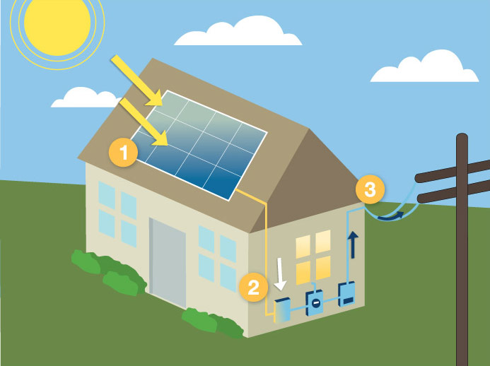
Motivation

Slide 5
Motivation
The growing demand for solar power
    One of the most valuable source
    electrical energy production
Unavailability
    During night
    Bad weather conditions
Battery storage
    To store surplus solar power
    Back-up power during unavailability of sunlight

Slide 6
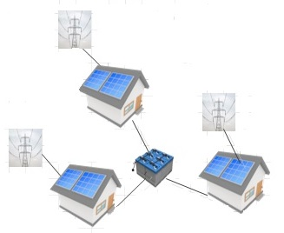
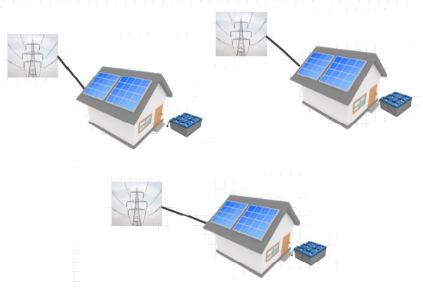
Distributed Vs. Centralized System
Model for decentralized storage
Model for centralized storage

Slide 7

Modeling of PV Module
The expected output power of any solar panel is
    $P_{oe}=η_{g}×A_{m}×N×G_{t}$
    $η_{g}=η_{r}×[1−β_{r}×(T_{c}−T_{r}$)]
    The value of $β_{r}$ is 0.0025$K^{−1}$

Slide 8
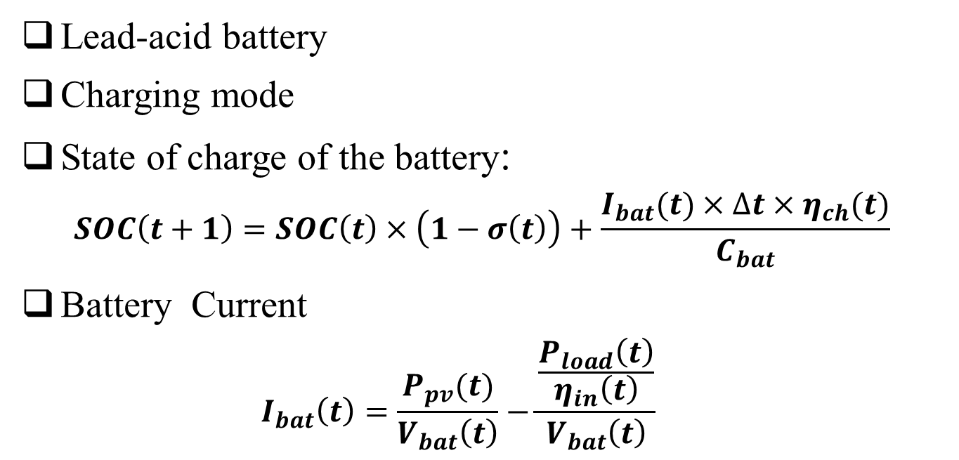
Modeling of Storage Device
Lead-acid battery
Charging mode
State of charge of the battery:
  $$SOC\left(t+1\right)=SOC\left(t\right)×\left(1−σ\left(t\right)\right)+\frac{I_{bat}(t)×∆t×η_{ch}(t)}{C_{bat}}$$
Battery Current
  $$I_{bat}\left(t\right)=\frac{P_{pv}(t)}{V_{bat}\left(t\right)}−\frac{\frac{P_{load}\left(t\right)}{η_{in}\left(t\right)}}{V_{bat}\left(t\right)}$$

Slide 9
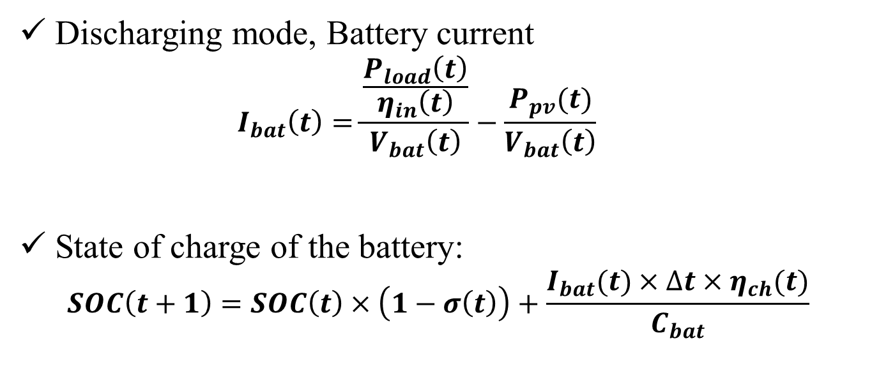
Modeling of Storage Device
Discharging mode, Battery current
  $$I_{bat}\left(t\right)=\frac{\frac{P_{load}\left(t\right)}{η_{in}\left(t\right)}}{V_{bat}\left(t\right)}−\frac{P_{pv}(t)}{V_{bat}\left(t\right)}$$
State of charge of the battery:
  $$SOC\left(t+1\right)=SOC\left(t\right)×\left(1−σ\left(t\right)\right)+\frac{I_{bat}(t)×∆t×η_{ch}(t)}{C_{bat}}$$

Slide 10
Experimental Setup
Hourly load profiles from sixty different locations have been obtained over a year.
Solar irradiation and temperature data.
The variations of the load profiles at every hour is quiet different from place to place.
All the load profiles can be considered as a single load data.

Slide 11
Hourly Load Profile
Annual hourly load profile for Abilene residential house (loc# 2)
Annual hourly load profile for San Antonio-Stinson residential house (loc# 27)

Slide 12
Average Load For Individual Area
Average Load for every individual area over a year

Slide 13

Grid Power Consumption
Total number of batteries are 900
Total grid power dependency over a year is 509.06 kW (Centralized storage model)
Total grid power dependency over a year is 611.93 kW (Decentralized storage model)
Saving in grid dependency between the two model is 102.87 kW (16.8%).

Slide 14
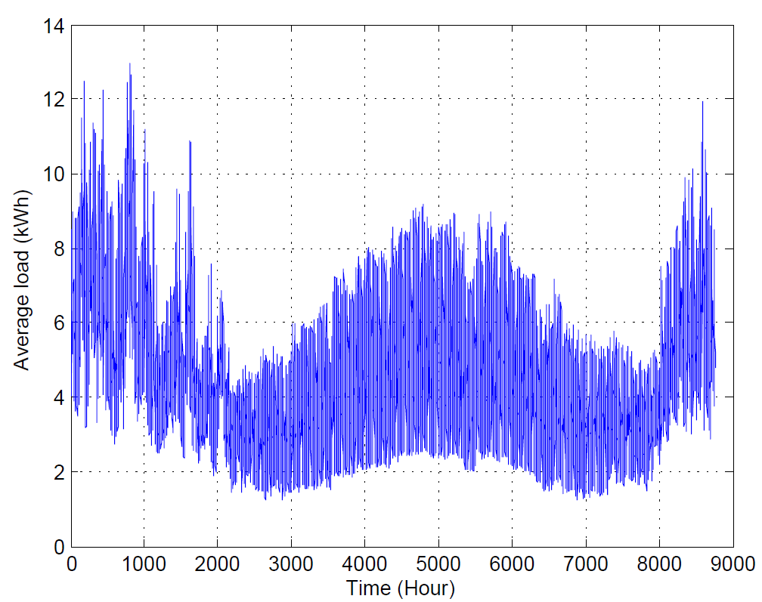
Average Hourly Centralized Load Power
Coefficient of variability for the centralized system aggregated load profile is 0.417

Slide 15
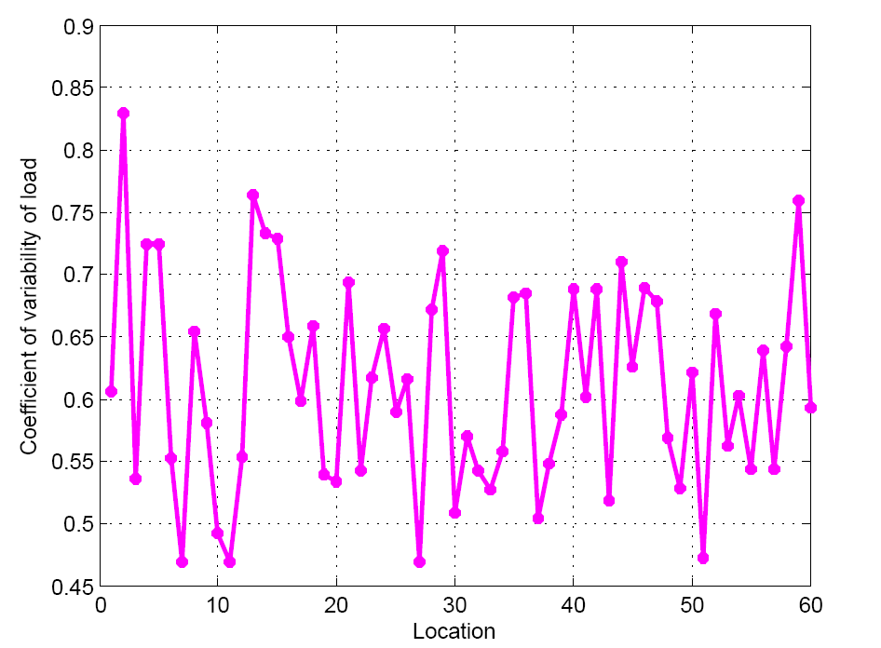
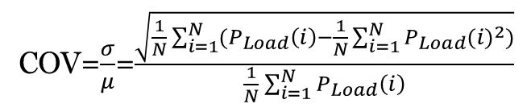
Load Coefficient of Variability
COV=$\frac{σ}{μ}$=$\frac{\sqrt{\frac{1}{N}\sum_{i=1}^{N}{({P_{Load}\left(i\right)−\frac{1}{N}\sum_{i=1}^{N}{P_{Load}}(i)}^{2})}}}{\frac{1}{N}\sum_{i=1}^{N}{P_{Load}\left(i\right)}}$
Coefficient of variability values ranges from 0.47 to 0.83 with an average of 0.61

Slide 16
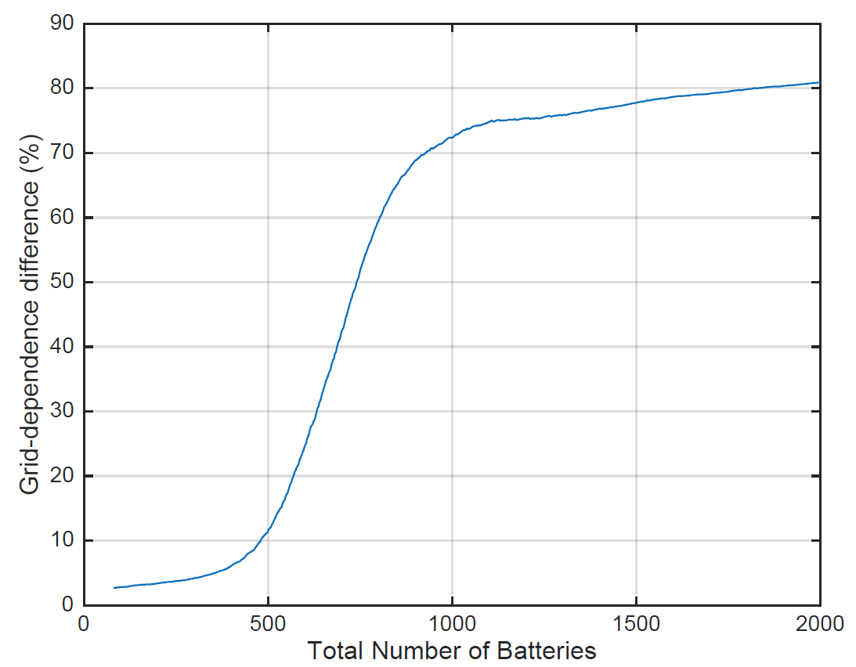
Grid-Dependency and the battery number

Slide 17
Conclusion
In this study, we proposed a photovoltaic system with a centralized storage.
The model is able to reduce the dependency on grid power.
A case study was implemented using 60 different residential housing locations in the State of Texas.
The centralized solar storage system reduced the dependency on the grid power by 16.8% compared to the decentralized system.

Slide 18

Thank you.
Any Questions?

