Slide 1
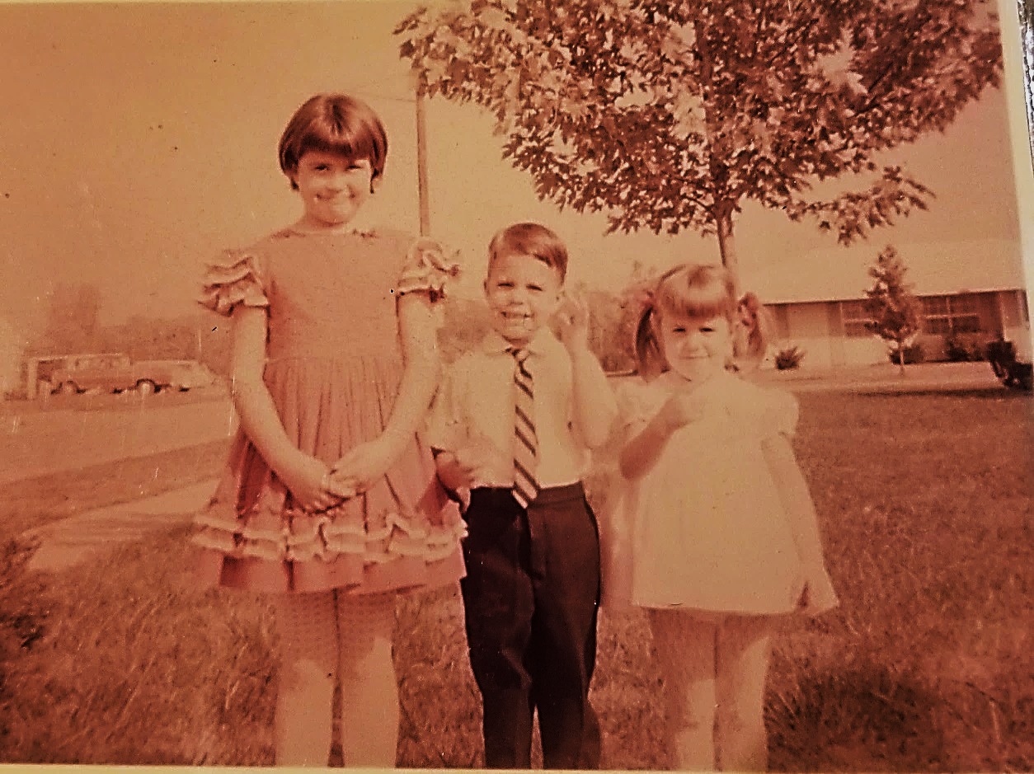
A Girl Named Sue:
A Child’s Journey From Complex Trauma to Hope, Healing and Recovery
Jamie Like, District Social Worker
Henderson County Schools
270-831-8769
jamie.like@Henderson.kyschools.us
Notes:
NOTE:
To change the image on this slide, select the picture and delete it. Then click the Pictures icon in the placeholder to insert your own image.

Slide 2

What Led You to Choose This Session Today?

Slide 3
Core Beliefs
You don’t know what you don’t know
Where we come from has everything to do with where we are at but it doesn’t dictate where we are going
Never underestimate the impact you can make in the life of a child
Damage from childhood trauma can be mitigated
Relationships, relationships, relationships is the key to everything!

Slide 4
What is Complex Trauma?
Complex trauma describes both children’s exposure to multiple traumatic events—often of an invasive, interpersonal nature—and the wide-ranging, long-term effects of this exposure. These events are severe and pervasive, such as abuse or profound neglect. They usually occur early in life and can disrupt many aspects of the child’s development and the formation of a sense of self. Since these events often occur with a caregiver, they interfere with the child’s ability to form a secure attachment. Many aspects of a child’s healthy physical and mental development rely on this primary source of safety and stability.
https://www.nctsn.org/what-is-child-trauma/trauma-types/complex-trauma

Slide 5
Let’s Begin at the Beginning: Sue’s Journey
Parental Separation at an Early Age and Parental Abandonment/Neglect
Other Family Members as Care Takers
Re-unification with Mother
Witnessed Domestic Violence
Experienced Physical Abuse & Emotional Abuse
Re-unification with Father
Experienced Sexual Abuse
Short Term Re-unification with Mother & Transition to Foster Care
Suicide Attempt
Recovery
Purpose

Slide 6
The Reality of Today’s Children
A new federal report shows Kentucky and Indiana, respectively, have the highest and second-highest rates of child abuse in the country. According to the "Child Maltreatment" report from the Children's Bureau of the U.S. Department of Health and Human Services, Kentucky had 22,410 victims of child abuse in 2017. That represents about 22.2 victims per 1,000 children in Kentucky, first among all states in 2017 and more than double the national average of 9.1 victims per 1,000 children.
Indiana followed up in second nationally with 18.6 victims per 1,000 children in 2017. Indiana had an estimated 29,198 child abuse victims in 2017, an uptick of about 34 percent from the 21,755 victims identified in 2013.
The estimated 22,410 child abuse victims in Kentucky in 2017 marks an increase of about 27.5 percent from 2013, when 17,591 child victims were identified in the commonwealth, according to the report. (Louisville Courier Journal Published March 29, 2019)

Slide 7
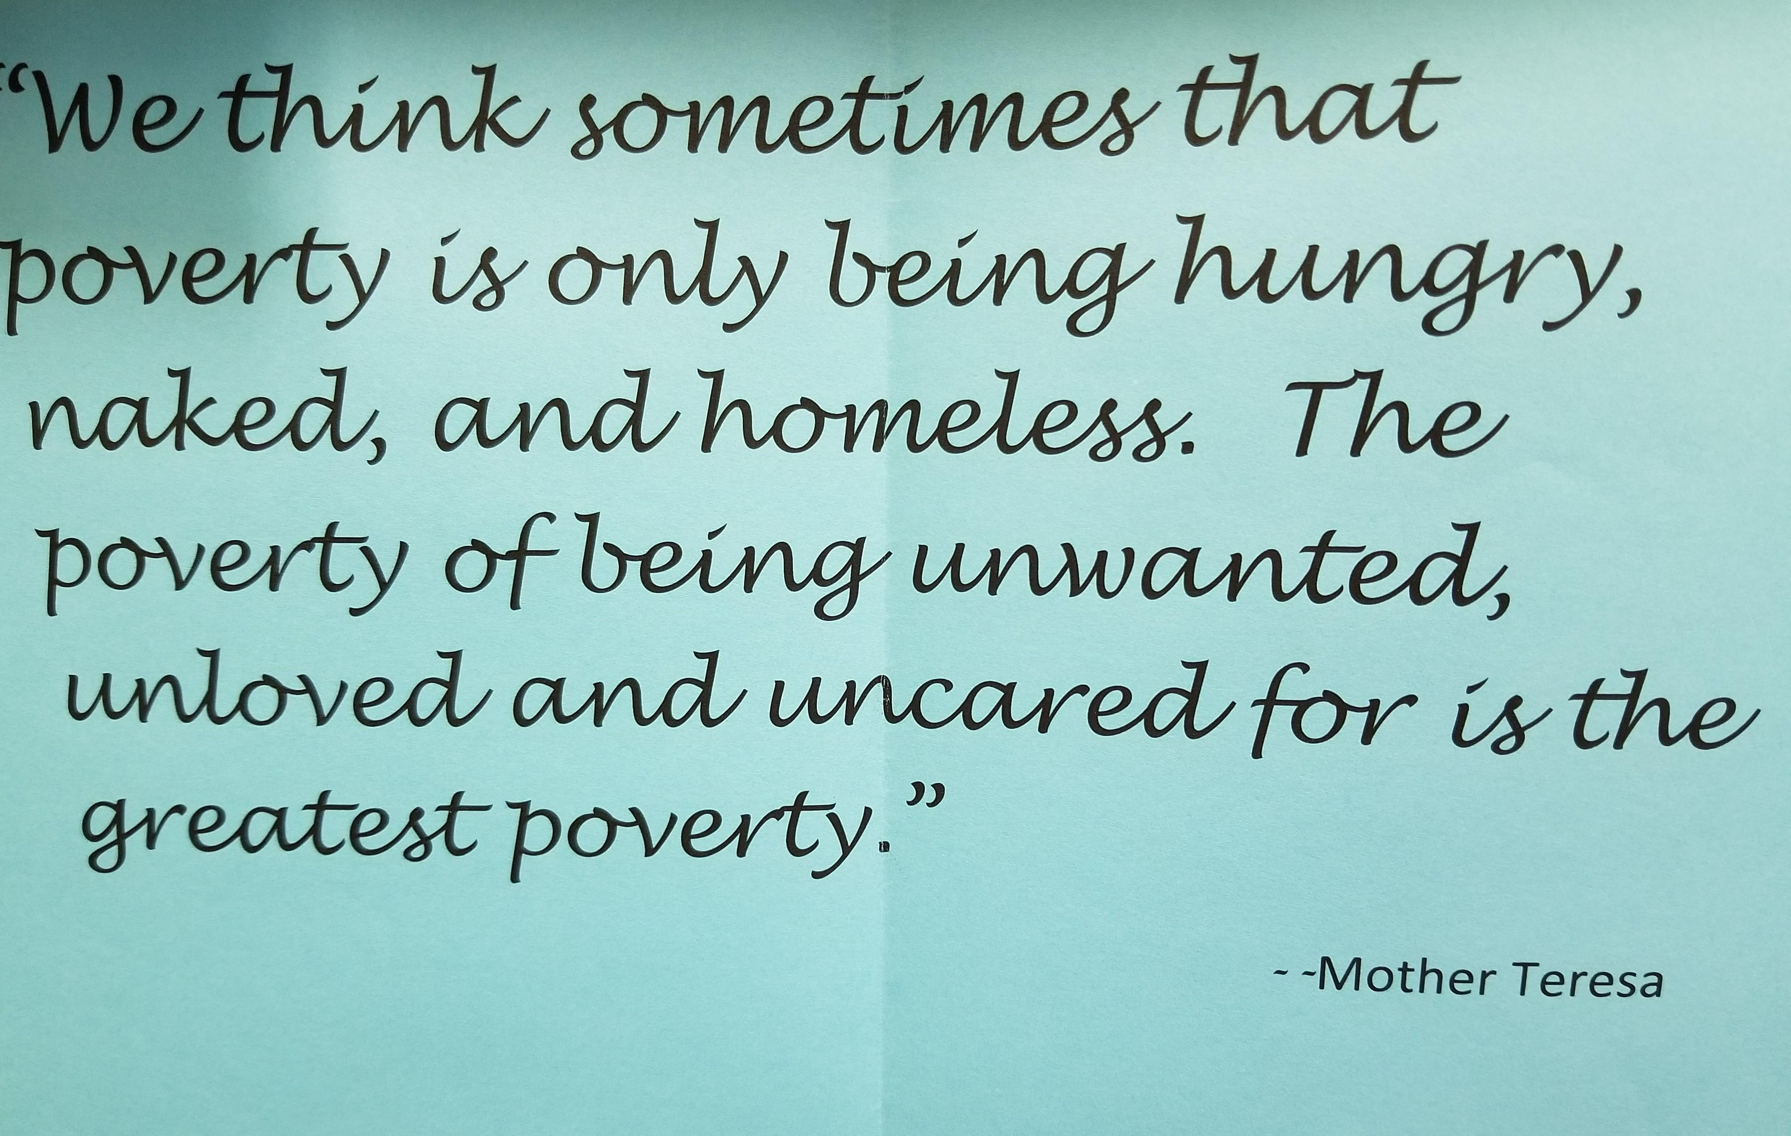

Slide 8
Trauma Changes a Child’s View of the World
“The world is a safe place” “The World is a Dangerous Place”
Growth/promotion orientation Survival Orientation
Trust Distrust
Cooperation Manipulation
Focused attention Hypervigilance/distraction
Self protection Risk Taking
Long life expectancy Short Life Expectancy
COACT Colorado, Office of Behavioral Health

Slide 9
Complex Trauma Can Affect Children In a Multitude of Ways
https://www.nctsn.org/what-is-child-trauma/trauma-types/complex-trauma
Attachment & Relationships Children Learn that they cannot rely on others to help them Children are more vulnerable to stress Experience problems in romantic relationships, friendships and with authority figures Physical Health: Body & Brain The immune system and the body’s stress response system may not develop normally Impaired development of the brain and nervous system Chronic or recurrent physical complaints Emotional Responses Difficulty identifying, expressing or managing emotions Difficulty calming down when upset Vigilant and guarded in their interactions with others Dissociation Children may dissociate or mentally separate themselves from the experience | Behavior Children may be easily triggered or set off, struggle with self regulation and lack impulse control Children may be over controlled, rigid and unusually compliant with adults Cognition: Thinking & Learning Children may have problems thinking clearly, reasoning or problem solving Children may struggle with sustaining attention or have learning difficulties Self Concept & Future Orientation Children may view themselves as powerless, “damages” and may perceive the world as a meaningless place in which planning and positive action is futile.

Slide 10
Other Ways That Complex Trauma Affects Children
Economic Impact
The cumulative economic and social burden of complex trauma in childhood is extremely high. Based upon data from a variety of sources, a conservative annual cost of child abuse and neglect is an estimated $103.8 billion, or $284.3 million per day (in 2007 values).
The estimated average lifetime cost per victim of child maltreatment was $210,012, which includes costs relating to health care throughout the lifespan, productivity losses, child welfare, criminal justice, and special education.
Long Term Health Consequences
Traumatic experiences in childhood have been linked to increased medical conditions throughout the individuals’ lives. The Adverse Childhood Experiences (ACE) Study is a longitudinal study that explores the long-lasting impact of childhood trauma into adulthood. The ACE Study includes over 17,000 participants ranging in age from 19 to 90. Researchers gathered medical histories over time while also collecting data on the subjects’ childhood exposure to abuse, violence, and impaired caregivers. Results indicated that nearly 64% of participants experienced at least one exposure, and of those, 69% reported two or more incidents of childhood trauma. Results demonstrated the connection between childhood trauma exposure, high-risk behaviors (e.g., smoking, unprotected sex), chronic illness such as heart disease and cancer, and early death.

Slide 11
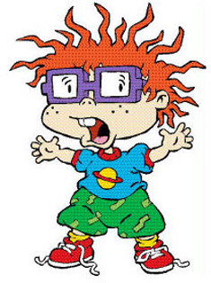
My ACE Score is what???
Kids/Adults with high ACE Scores are not doomed!
Notes:
Key Ideas:
even among this middle class, educated, white population, typically not thought of as high risk for trauma exposure, ACE and trauma exposure was notable
ACEs are inter-related: having one ACE increases the risk of having more

Slide 12
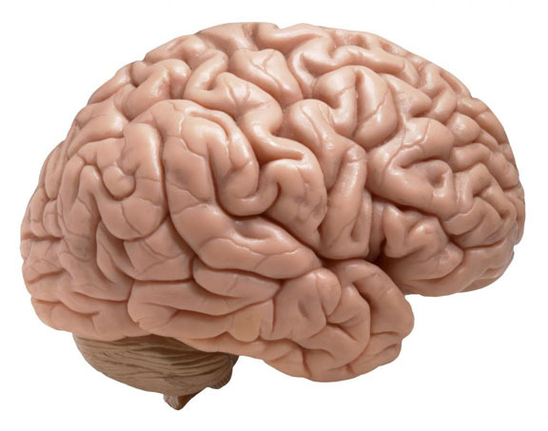
The Brain is Malleable. Corrective Relationships Can Act As an Essential Tool in Rewiring and Restructuring The Brain.
Over time, the traumatized person develops – after much testing – enough trust in the constancy and accepting, respectful response by the important other to their psychological needs that they feel safe in exposing their deepest feelings. When emotional situations similar to childhood occur, they can now be processed in a new, healthier way. This experience helps repair the damage produced by the traumas of the past. It can help the stunted personality become unstuck, grow and mature.

Slide 13
Who Can Help Form These Corrective Relationships?
Teachers and other school staff (teachers aides, bus drivers, cafeteria workers, etc…
Counselors/Therapists
Neighbors
Clergy/Youth group leaders
Other youth serving programs(Big Brothers/Big Sisters, Boys & Girls Club, 4-H, Scouts athletic programs, etc…)
Any positive, emotionally healthy adult

Slide 14
Trauma Sensitive Schools
A trauma-sensitive school is one in which all students feel safe, welcomed, and supported and where addressing trauma’s impact on learning on a school-wide basis is at the center of its educational mission.
In Trauma Sensitive Schools, Adults:
Share an understanding of how trauma impacts learning and why a school wide approach is needed for creating a trauma sensitive school.
Supports all students to feel safe physically, socially, emotionally and academically
Address students’ needs in holistic ways, taking into account their relationships, self regulation, academic competence and physical and emotional well being.
Explicitly connect students to the school community, providing them with multiple opportunities to practice newly developing skills
Embrace teamwork with a sense of shared responsibility for every sense
Anticipate and adapt to the ever-changing needs of students and the surrounding community
Ask what’s happened to child instead of what’s wrong with a child
https://traumasensitiveschools.org/tlpi-publications/download-a-free-copy-of-a-guide-to-creating-trauma-sensitive-schools/

Slide 15
Turning Negative Into Positives
Research was conducted in the early 1980’s by two psychology professors from The University of North Carolina on Post Traumatic Growth (Tedeschi and Calhoun)
PTG research showed survivors who experience traumatic events were often spurred towards positive life changes
Eventually they determined that people were reporting positive changes in one or more of the following five distinct areas as a result of their trauma:
  Increased inner strength
  An openness to new possibilities in life
  Closer and often deeper relationships with friends and family
  An enhanced appreciation of life
  A stronger sense of spirituality
Just because individuals experience growth does not mean that they will not suffer
Post Traumatic Growth is not universal

Slide 16
Coping Skills
Coping is defined as the process of managing external and/or internal demand that tax or exceed the resources of the person. It is a complex and multidimensional process that is sensitive to both the environment and the personality of the individual.
Types of Coping
  Positive appraisal is the reframing of a situation to see it in a positive light
  Problem-focused or approach coping happens when efforts are directed at solving or managing the problem that is causing it’s distress
  Emotion-focused or avoidant coping is coping that is directed at managing or reducing emotional distress such as looking on the bright side or seeking emotional support, having a drink or using drugs.
  Meaning-focused coping involves searching for meaning in adversity and drawing on values, beliefs and goals to modify the meaning given to and personal response to a stressful situation.
  Research has shown that in adolescence, problem- focused coping has shown to be more functional (seeking information or advice, accepting social support, making efforts to solve the problem), whereas the emotion-focused or avoidant is dysfunctional and can lead to withdrawal, fatalistic attitudes and avoidance of the problem
  Sense of control directly reduces psychological disturbances and buffers the effects of stress exposure on physical and mental health.
  https://www.drchadcoren.com/drchadcoren/Addiction_&_Mental_Health_Articles_&_Resources_files/Suicide%20Coping.pdf (Kilburn, E. & Whitlock, J.L. )

Slide 17
Building Resilience-Teaching Kids to “Bounce Back”
Resilience is “the process of, capacity for, or outcome of successful adaptation despite challenging or threatening circumstances” (Masten, Best & Garmezy, 1990). Along these lines, children are considered resilient when they experience prosocial development despite adversity (Masten, 2013).
Ten Ways to Foster Resilience In Young Children (Petty, 2014)
Build Empathy 8. Develop Responsibility
Identify a Go-To Person 9. Offer Meaningful Participation
Listen 10.Teach Problem Solving
Learn to “See Next”
Accept Children for Who They Are
Identify Strengths
Do-Overs
Notes:
1.You can help young children build resilience by becoming more understanding or able to see the view od someone else by using children’s literature.
In adolescents:
A. By helping them recognize the rise and fall of our thoughts and emotions i.e. shaking a “Mind-Body Jar” or glitter globe
B. Act out emotions together-emotional charades
C. Supportive attitudes during teamwork-Pass a bell in a circle without allowing it to ring
D. Caring or kindness cards-may you experience the joy of feeling safe, happy and calm
E. Compassion circles-Have you ever been bullied
2. Rule of 5-Every child/youth needs to have and maintain at least five positive, caring adults ("anchors") in his or her life who have and communicate high expectations for them.
Based on research from America's Promise; Hard Wired to Connect - Commission on Children at Risk; Derek Peterson, and Alaska ICE.
3. You may be listening but not hearing
4. The light at the end of the tunnel
8. Chores-a pet, a job in the classroom
9. Help develop classroom rules, decide on snacks or educational videos
10. Teach Problem Solving
A. Identify the problem
B. Think of 2 or 3 ways to solve the problem that all can agree upon

Slide 18
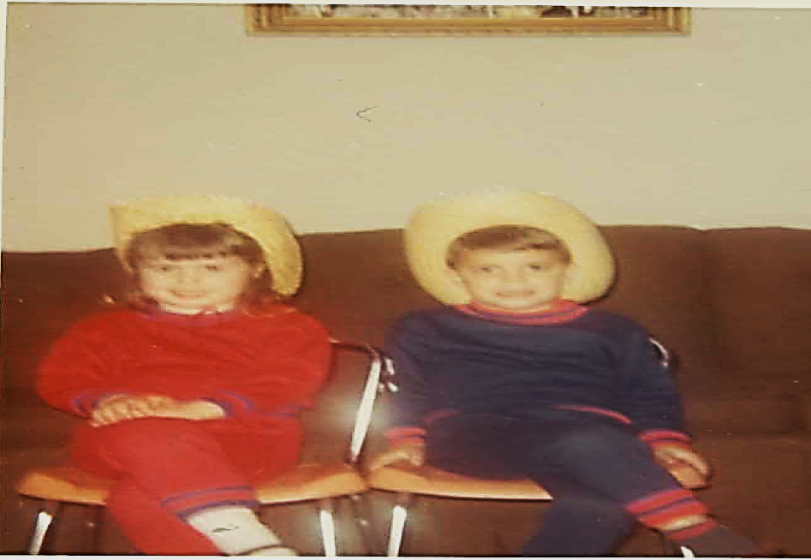
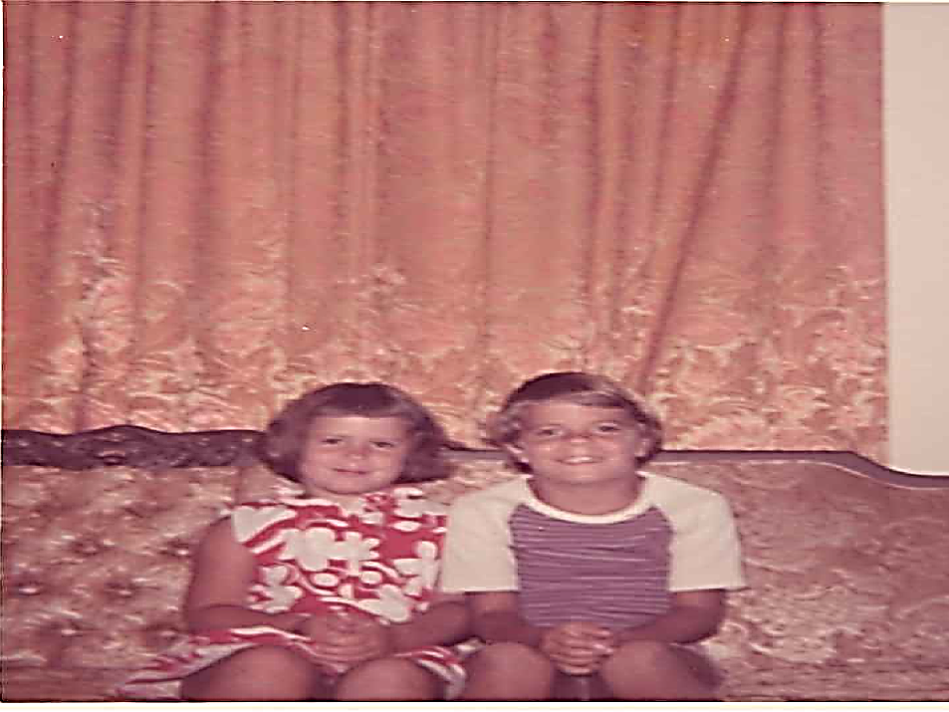


Eyes Are The Windows to The Soul

Slide 19

Questions

Slide 20
Contact Information
Jamie Like, District Social Worker
Henderson County Schools
Office: 270-831-8769
Cell: 270-823-3465
jamie.like@Henderson.kyschools.us

