Slide 1
Building impactful instructional leadership teams
Shatavia Elder
Jason Stamper
National Youth-At-Risk Conference – 2019

Slide 2
Woodland Middle School
Where We Began
Where We Are
Where We Are Going

Slide 3
Taking a Look
at the Data

Slide 4
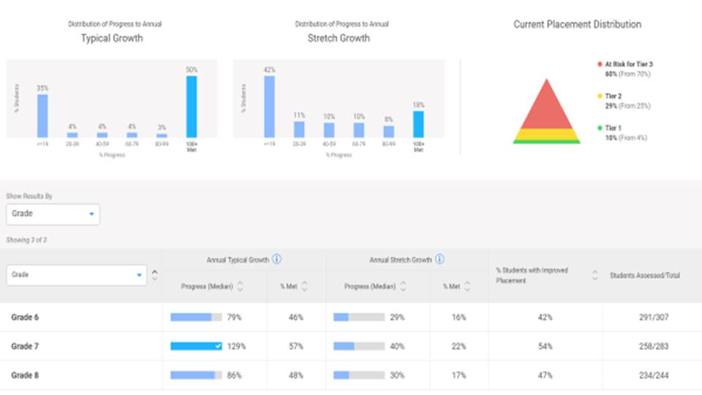
iReady Progress/Growth

Slide 5
Reading Plus Progress/Growth

Slide 6
Every High Impact Instructional Leadership Team (ILT) Operates As a Functional Professional Learning Community (PLC)

Slide 7
Why PLCs Are So Important
“A PLC is an ongoing process in which educators work collaboratively in recurring cycles of collective inquiry and action research to achieve better results for the students they serve.”
—DuFour, DuFour, Eaker & Many, 2010

Slide 8
Five Essentials
for Effective PLCs
Norms, Purpose and Outcomes
PLC Protocols
Practice, Practice, Practice
An ILT Member Present in EVERY PLC
Monitoring of PLC Outcomes into
Classroom Practice

Slide 9
Importance of Selecting ILT Members
University of Washington
Center for Educational Leadership

Slide 10
Selecting
ILT Members

Slide 11
Its Time Share Out

Slide 12
ILT Content/Roles and Responsibilities Exemplar
*Full Exemplar Available in Workbook

Slide 13
My Team is Established,
Now What?

Slide 14
The Importance of Building Trust
How the Best Leaders Build Trust
By Stephen M. R. Covey

Slide 15
The Importance of
Building Culture
Frequent and Meaningful Team Building
Different Voices Being Heard and Leading the ILT PLC
Systematic Celebrations (Flywheel)
Paraphernalia/Branding
Personality Inventory

Slide 16
Closing Point of Reflection
The success of your ILT requires resolve when success becomes challenging, persistence when others may want to give up, cohesiveness when things don’t go as planned and courage in the face of challenges. Consistency towards a common goal leads to success.
Lets Take a Page Out of the TMB Panyee Handbook

