Slide 1
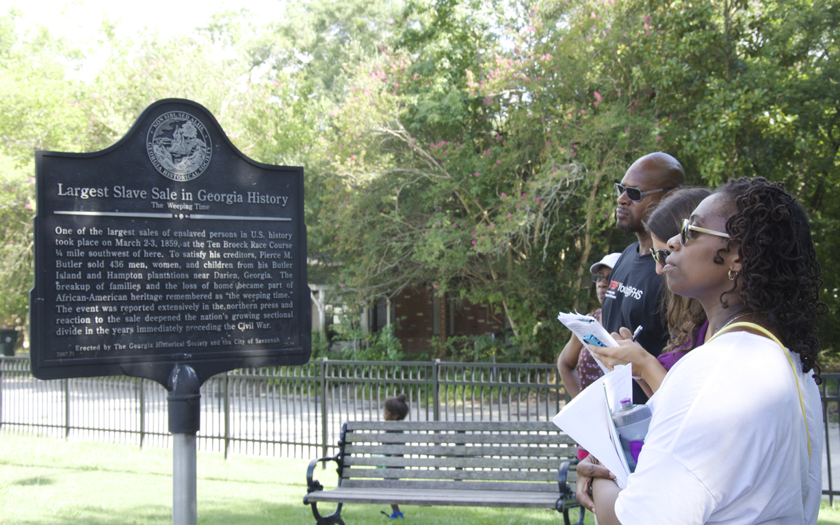
Learning to Listen: Engaging Students in Critical Reflection & Courageous Conversations
Presenter: Christen Higgins Clougherty, Ph.D. – Nobis Project

Slide 2
Inspire Purpose – Pivot Mindset – Activate Agency
We collaborate with and support educators in providing young people with an education that prepares them to become informed, compassionate, active, responsible and exemplary global citizens, both at home and abroad.
Nobis Project offers educators and schools professional development training, curriculum development workshops, and global service-learning programs for educators.
Our focus areas include cultural responsiveness, social justice, global citizenship, service-learning, and civic engagement.

Slide 3
DEFINE
(research)
DESIGN
Creative Action that
Directly Responds &
Inform Others
ACTION & DOCUMENTATION
REFLECTION

Slide 4
But how do I prepare for teaching about issues around inequity, social injustice, and caring?

Slide 5
Nobis Big Ideas
A conceptual framework for thinking about global issues and building them into service-learning projects.
Nobis Big Ideas helps…
Teachers plan lessons & projects
Students understand and relate to global issues
To develop meaningful & reciprocal relationships with Community Partners
Nobis Big Ideas include:
History
Power
Relationships
Global Citizenship
Cultural Responsiveness

Slide 6
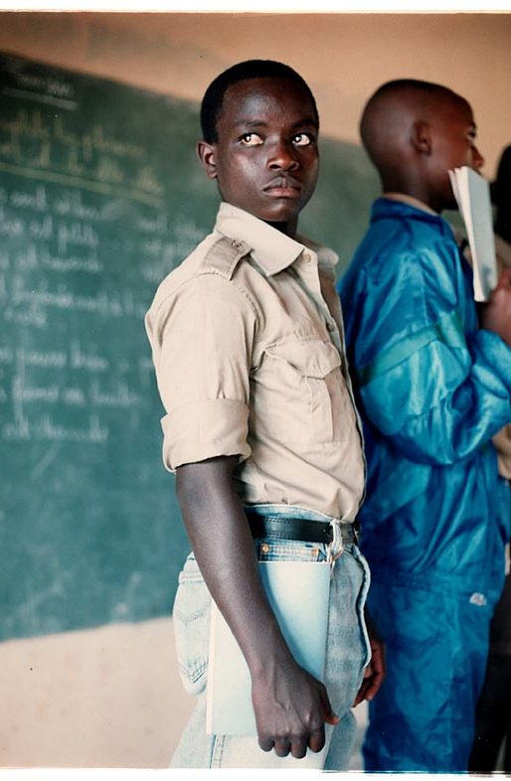
History
History - is a collection of various analyses and imaginative interpretations of the human experience that seeks to explain how society has changed over time.
Collective Identity - History provides individuals and communities with a sense of identity through their understanding of a shared past. In this way, history shapes how people identify and interact with one another, often in ways of which we are not aware.
Photo Credit: Imke Lass

Slide 7
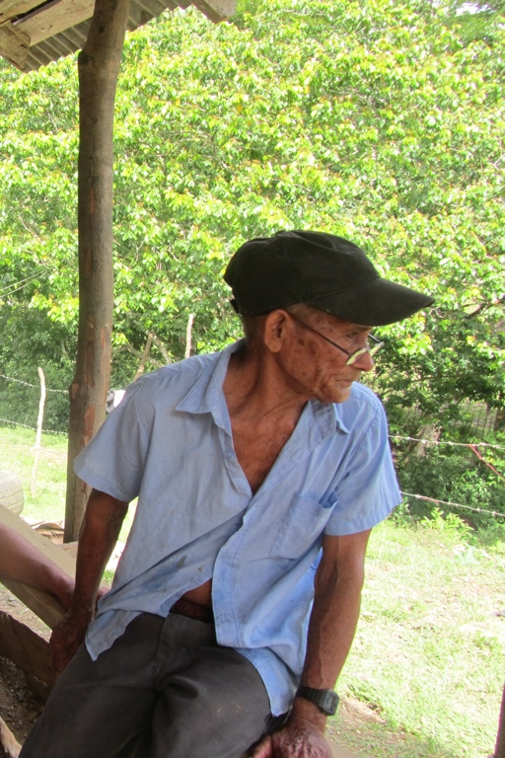
Why History?
Preparing for the Future - Exposing and questioning differences in interpretations enhances our understanding of the human condition throughout time and therefore better prepares us to imagine and work towards different futures.

Slide 8
Power
Power, as a social force, is the degree of impact of a person, institution, or system in relation to others’ beliefs, behaviors, or values.
Power is not necessarily only defined as ‘power-over’, it is also the capacity to act or to prevent an action. This takes the form of ‘power-with’ and ‘power-within’.
Power has often been defined as something one does, not something one has.

Slide 9
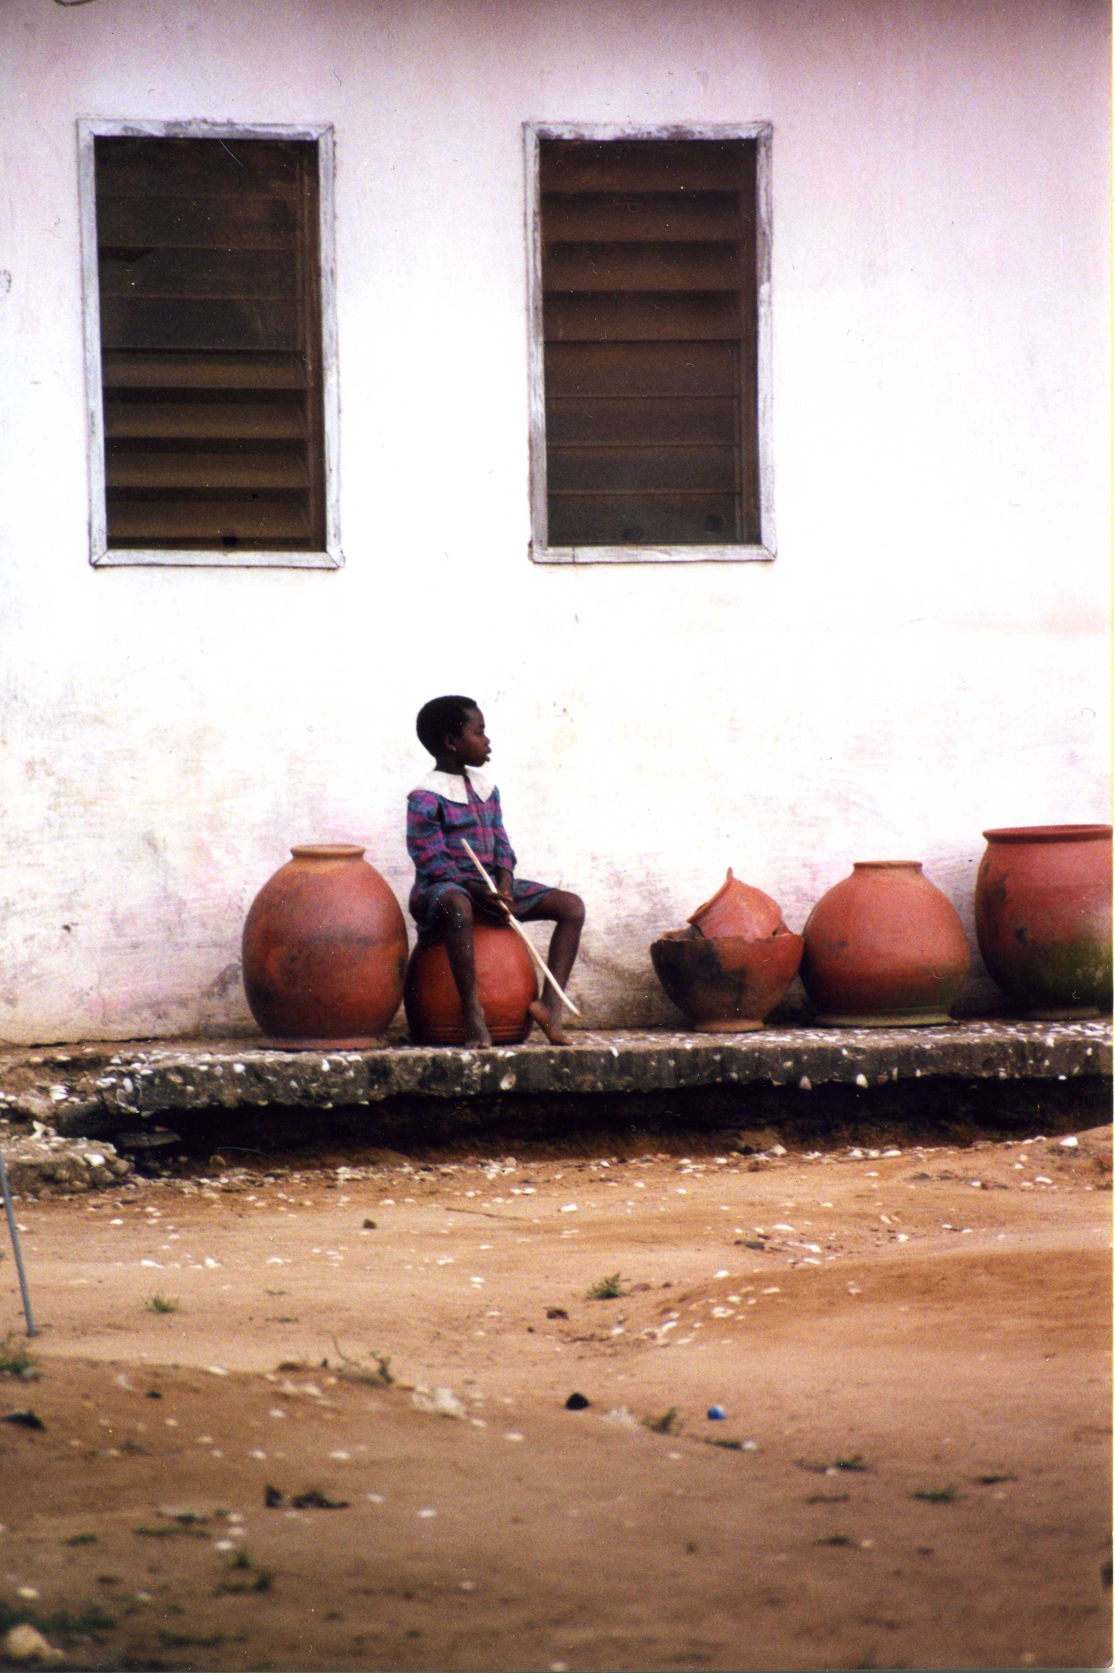
Privilege – Unearned Power
Privilege operates on personal, interpersonal, cultural, and institutional levels and gives preferential treatment to one individual or group, while withholding from another.
Characteristically invisible to those who have it, privileges are unearned assets granted to dominant groups, whether desired or not.

Slide 10
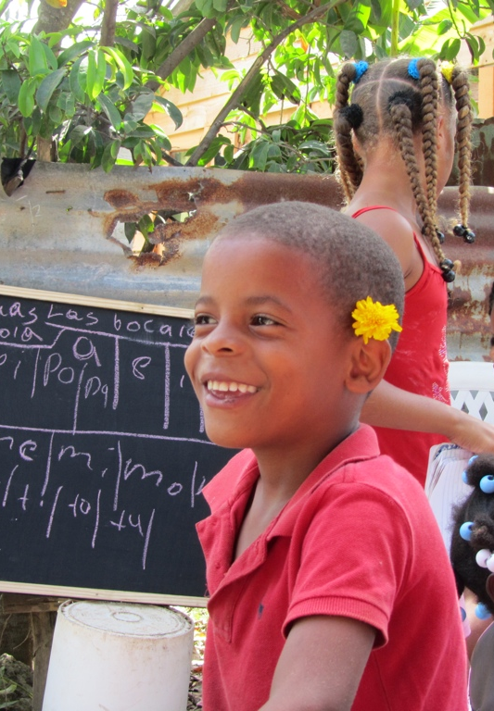
Relationships
Listen First - When trying to understand the origins and dynamics of problems facing a community, it is important to always start with those affected by the problems.
Only through reciprocal community partnerships, where both parties are set to benefit, can meaningful relationships be achieved and the work of sustainable empowerment begin.

Slide 11
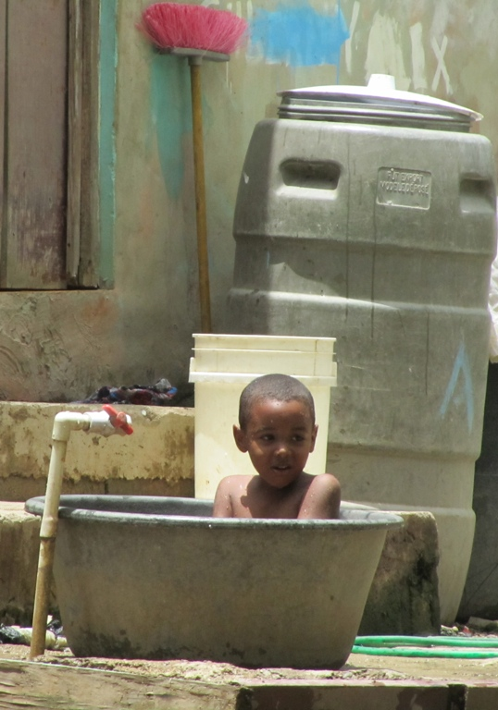
Global Citizenship
Civic Engagement - Preparing students for globally relevant participation in society, at the local, national and international levels.
Shared Fate - Informing students on the global interdependence of humanity and the environment and how these interconnections create consequences on a global scale.
Social Responsibility - Developing a sense of mutual obligation and critical understanding of social rights and how to take responsible action that impacts global issues and works towards peace and social change.

Slide 12
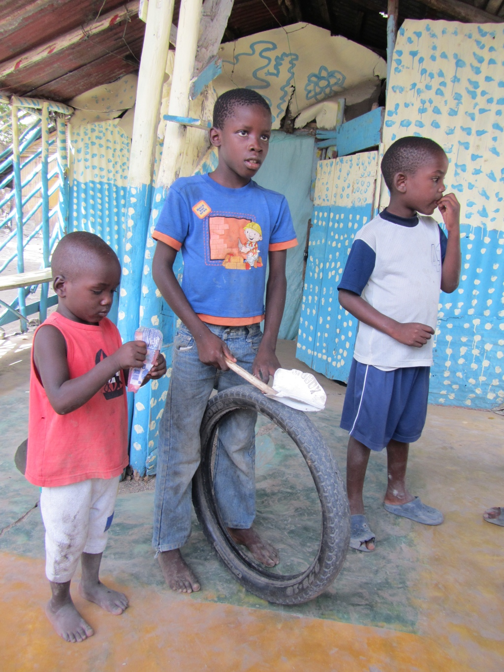
Cultural Responsiveness
A culturally responsive classroom nurtures students’ curiosity and their development of respect for the values and perceptions of others. Students learn to:
Listen to other people’s thoughts, feelings, experiences and perspectives without judgment;
Develop a respect for everyone;
Develop the skills to analytically process conflicting sets of values with respect for the differences in peoples and their cultures, identities, and worldviews.

Slide 13
What does this look like in the classroom?

Slide 14
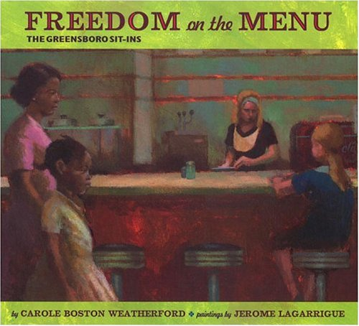
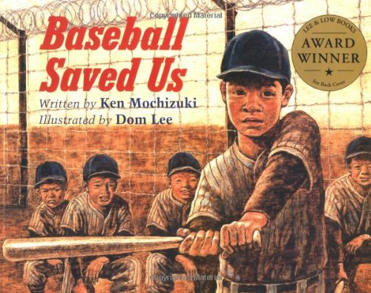
4th Grade: “Fences”
What fences existed in the past? Do these still exist today? How do the characters react? How do you react?

Slide 15
“Fences”
Race: Neighborhoods, Redskins, “Chocolate City”
Class: Private School, houses, health care
Education: tuition, access to books, safety
Gender: Women’s suffrage, unequal pay
Nationality: Immigration, border fences, citizenship

Slide 16
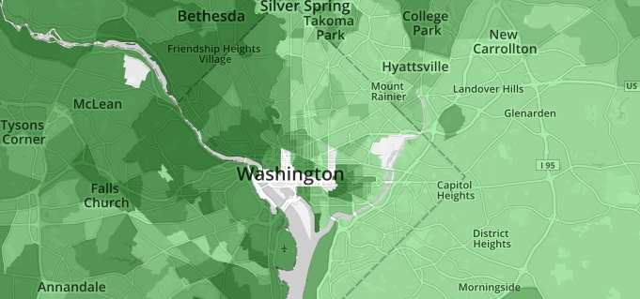
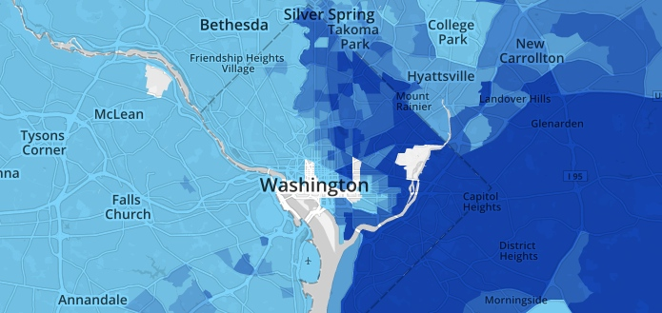
Our Community
“Fences” that exist in our area around race, education, class
http://projects.nytimes.com/census/2010/explorer

Slide 17
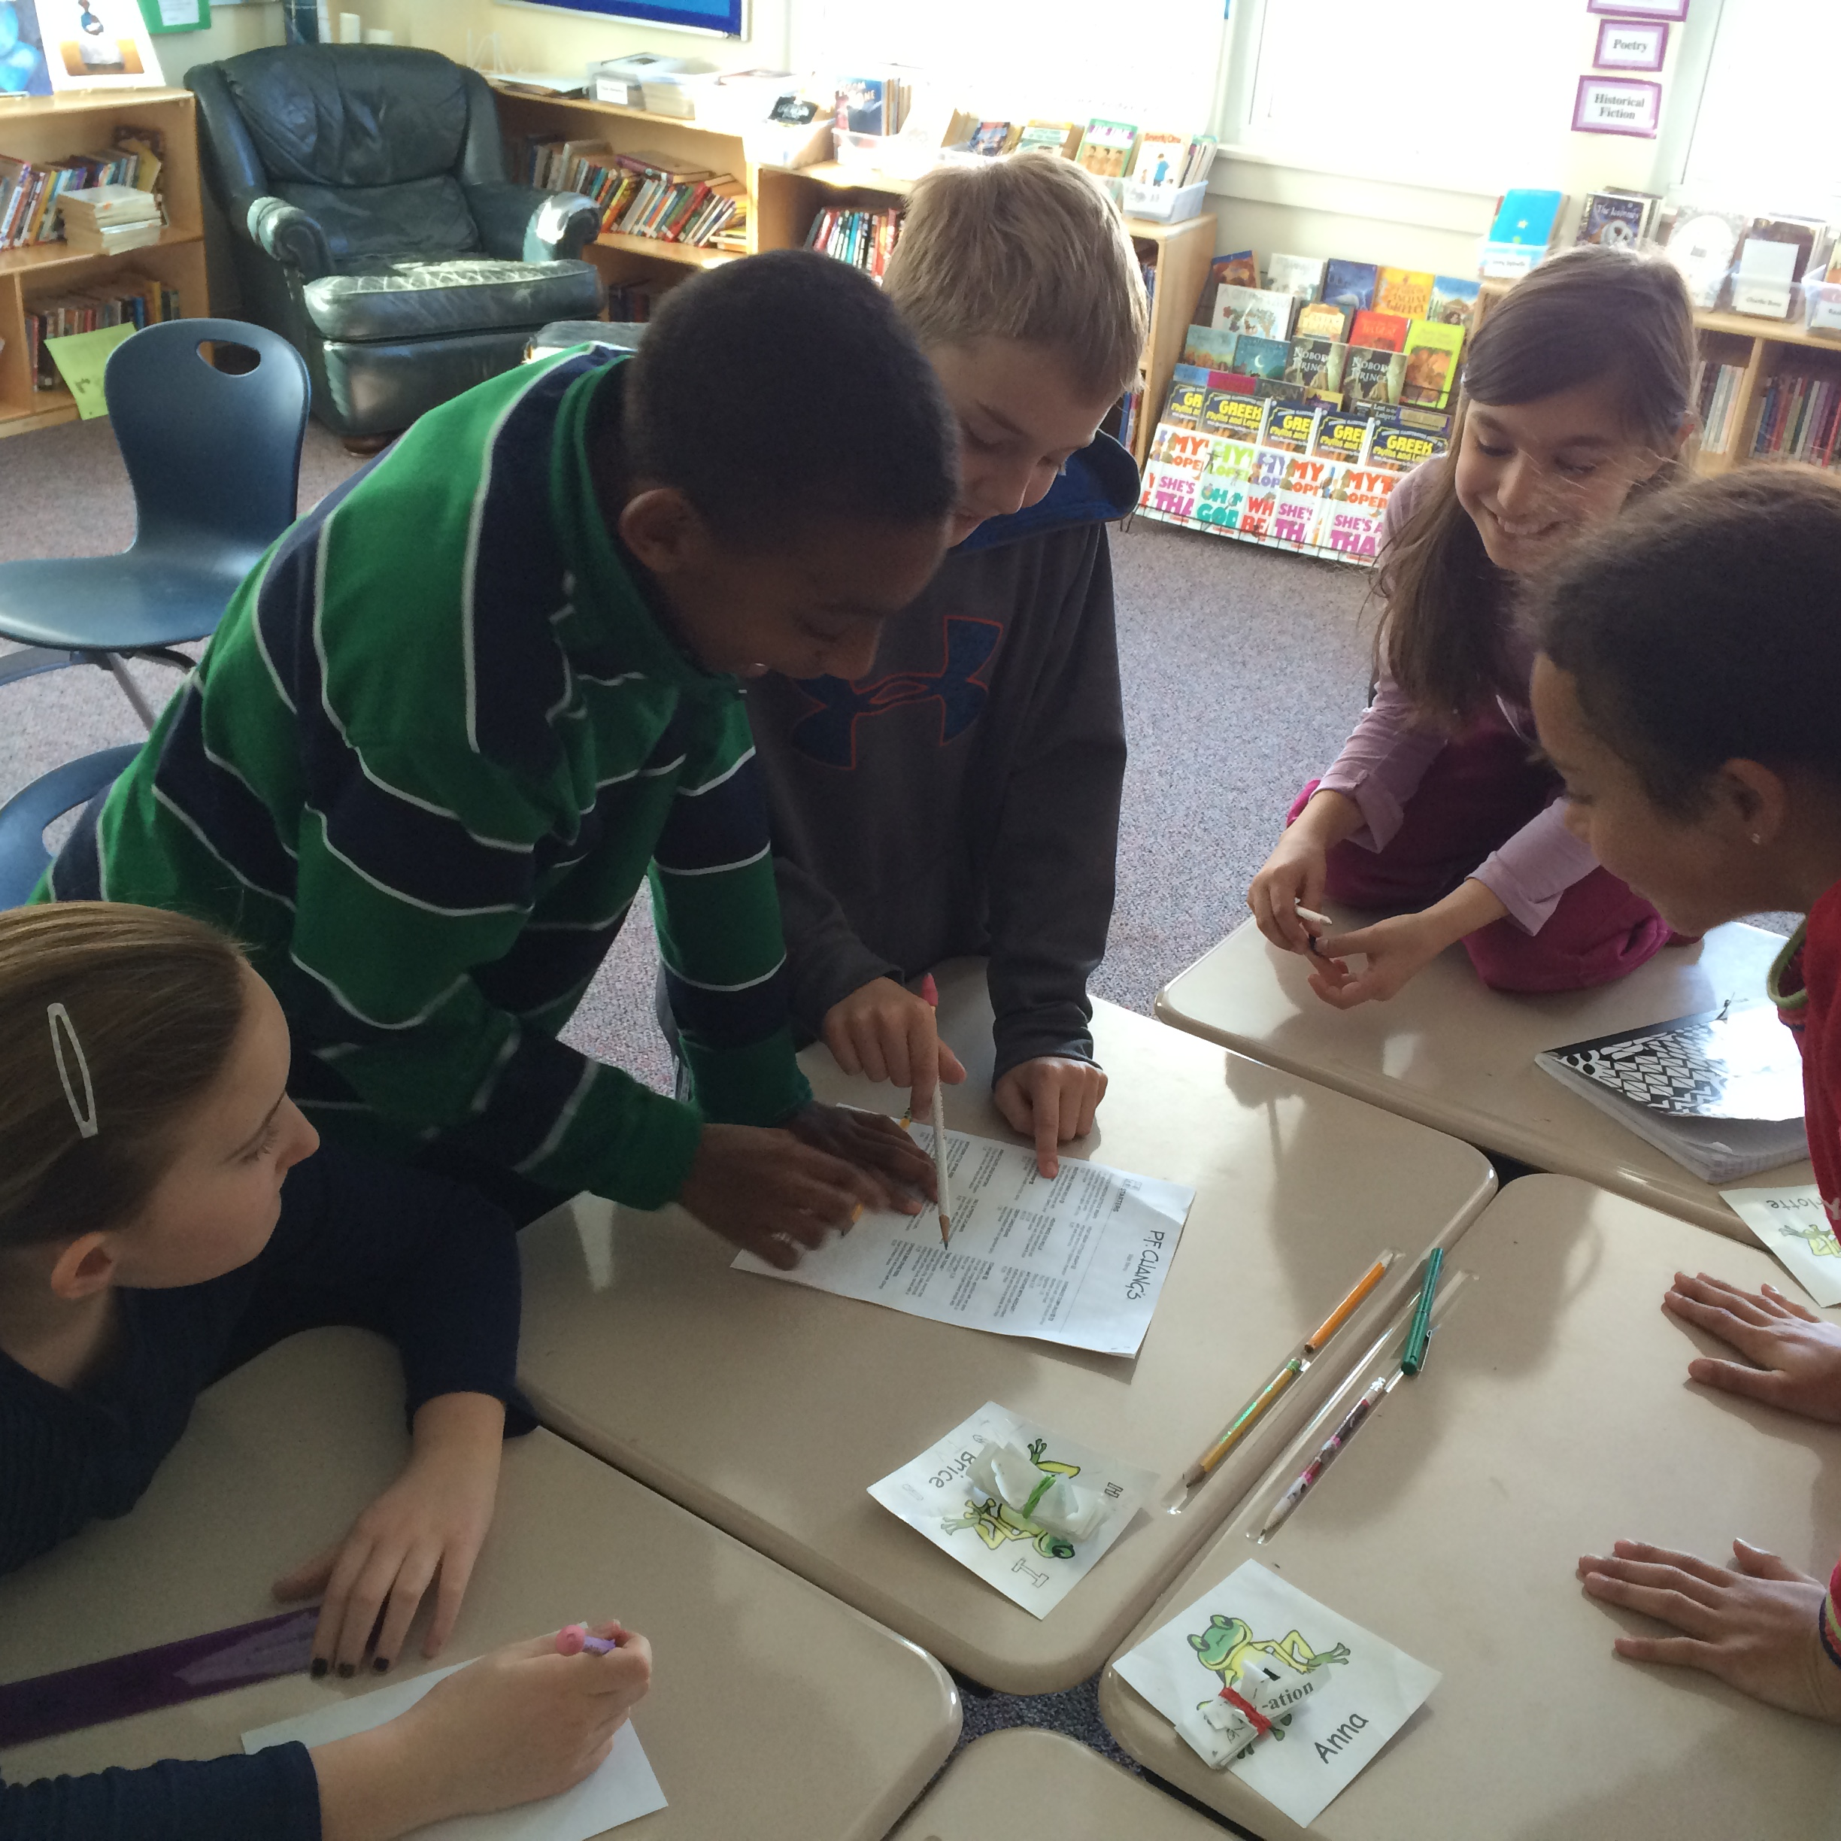
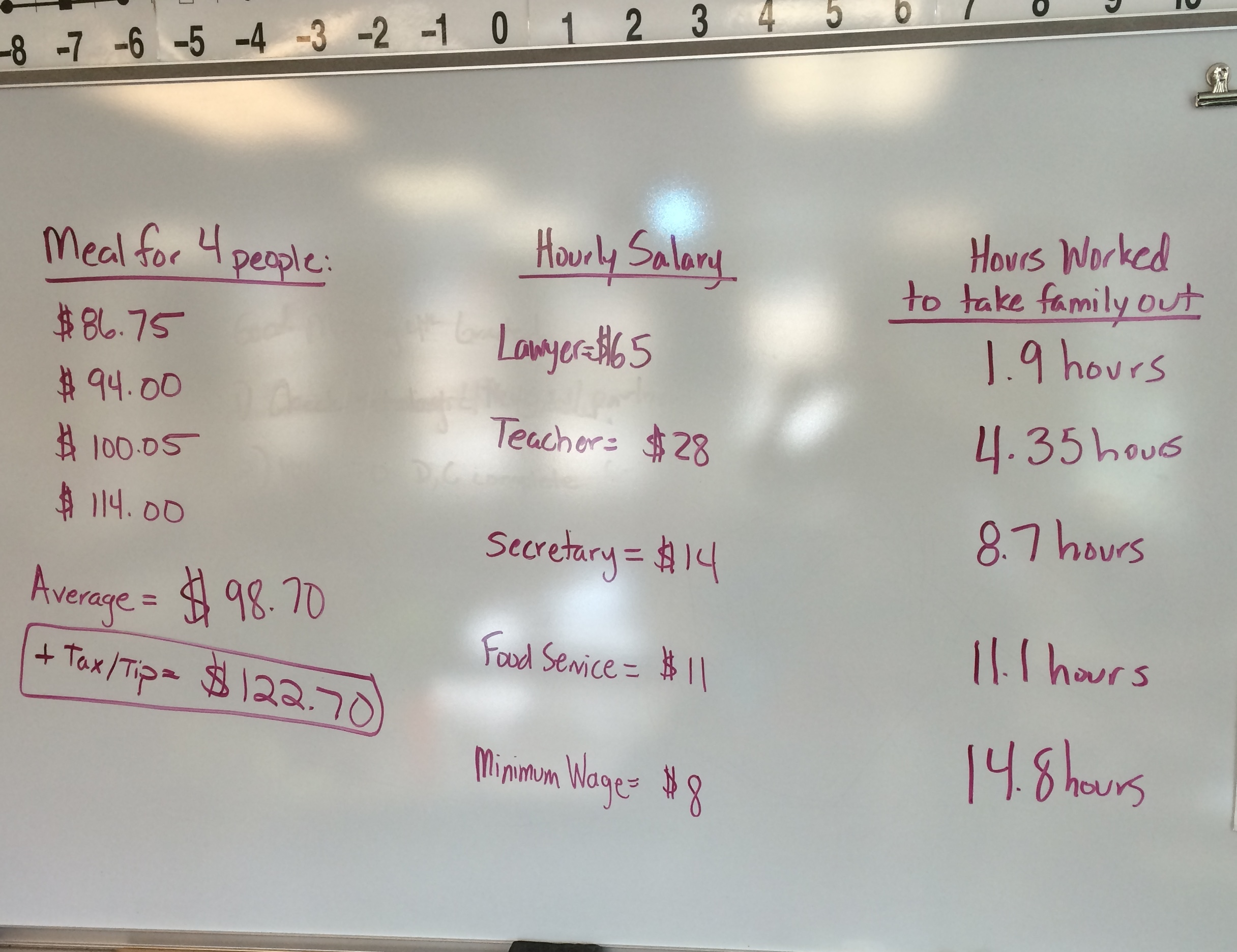
Exploring Privilege
Activity: Using a menu, decide the total cost of a meal for a family of four. Then using data from center for childhood poverty, how many hours would one have to work to afford a meal out?

Slide 18
What can we do?
Remembering our exercises and discussions, please reflect on how our world remains a place of inequality and what you can do to interrupt this cycle.
Questions to Consider:
What are ways in which our city is still unequal?
How can we make a positive impact in our local community?
How can we try to solve a problem such as poverty?
What is something you would protest or stand up for?

Slide 19
Power, Love, Education and Justice (PLEJ) for LIBERATION
An innovative project that brings together social justice educators in the community with imprisoned educators in California's solitary confinement cells. The goal of this project is to create a justice-oriented, people-centered curriculum about the prison system for teenaged youth and young adults.

Slide 20
10th Grade Service & Justice Seminar: Exploring Parallel Struggles with C.A.R.E. (Community, Accountability, Reciprocity, Equity)
Identify social justice issues, select a focus area
Explore intersectionality
Investigate multiple perspectives and appreciate differences
Understand power dynamics
Connect systemic issues to our lives
Break down barriers and work in solidarity with those most affected by inequities

Slide 21
Reflections
“Mume’s words have resonated in my heart… Hearing his account allows me to broaden my mind. Pen paling allows him to share his experiences with me and I learn from them…” – Sierra, 10th grade
“There is so much value in hearing someone else’s story, rather than just hearing the facts. Hearing about Mume’s struggles only made me want to help more…” – Abby, 10th grade

Slide 22
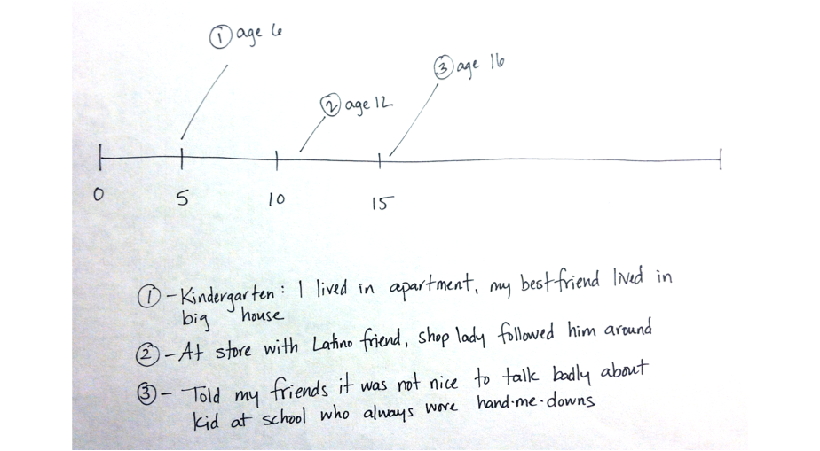
Personal History Timeline

Slide 23
Personal History Timeline
The first time you were aware you were from a different class than others.
A time you became aware that your membership in your class group meant you were denied or were granted privileges.
A time when you took an action(s) against classism.

Slide 24
How do I prepare my students to listen to community partners?

Slide 25
Listening
Pair – Share
Each person has three minutes to share
When it’s your turn to listen, you give the whole three minutes to the sharer.
Don’t interrupt
Don’t ask questions
Just communicate that you are listening with your body language

Slide 26
Story of My Name
History of your name
Reflect social identities (gender, ethnicity, etc.)
Teacher presumptions based on name?
Discriminated because of your name?
Privileged because of your name?
Changed your name?

Slide 27
Facundo the Great
https://storycorps.org/animation/facundo-the-great/

Slide 28
Reflection
Pulse Taker - How did this activity make you feel?
What did you observe as you were doing the activity?
Where are the connections to the Big Ideas?
History
Power
Relationships
Global Citizenship
Cultural Responsiveness

Slide 29
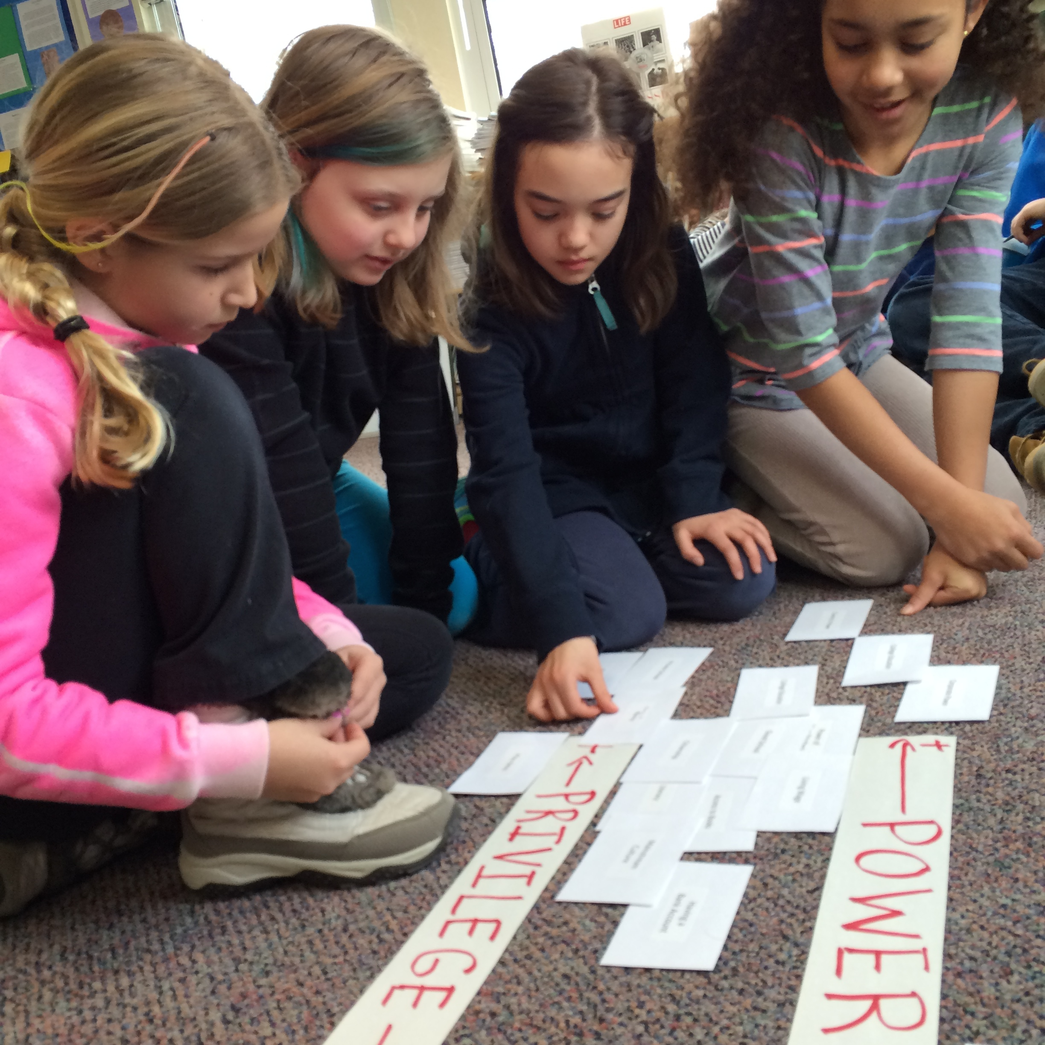
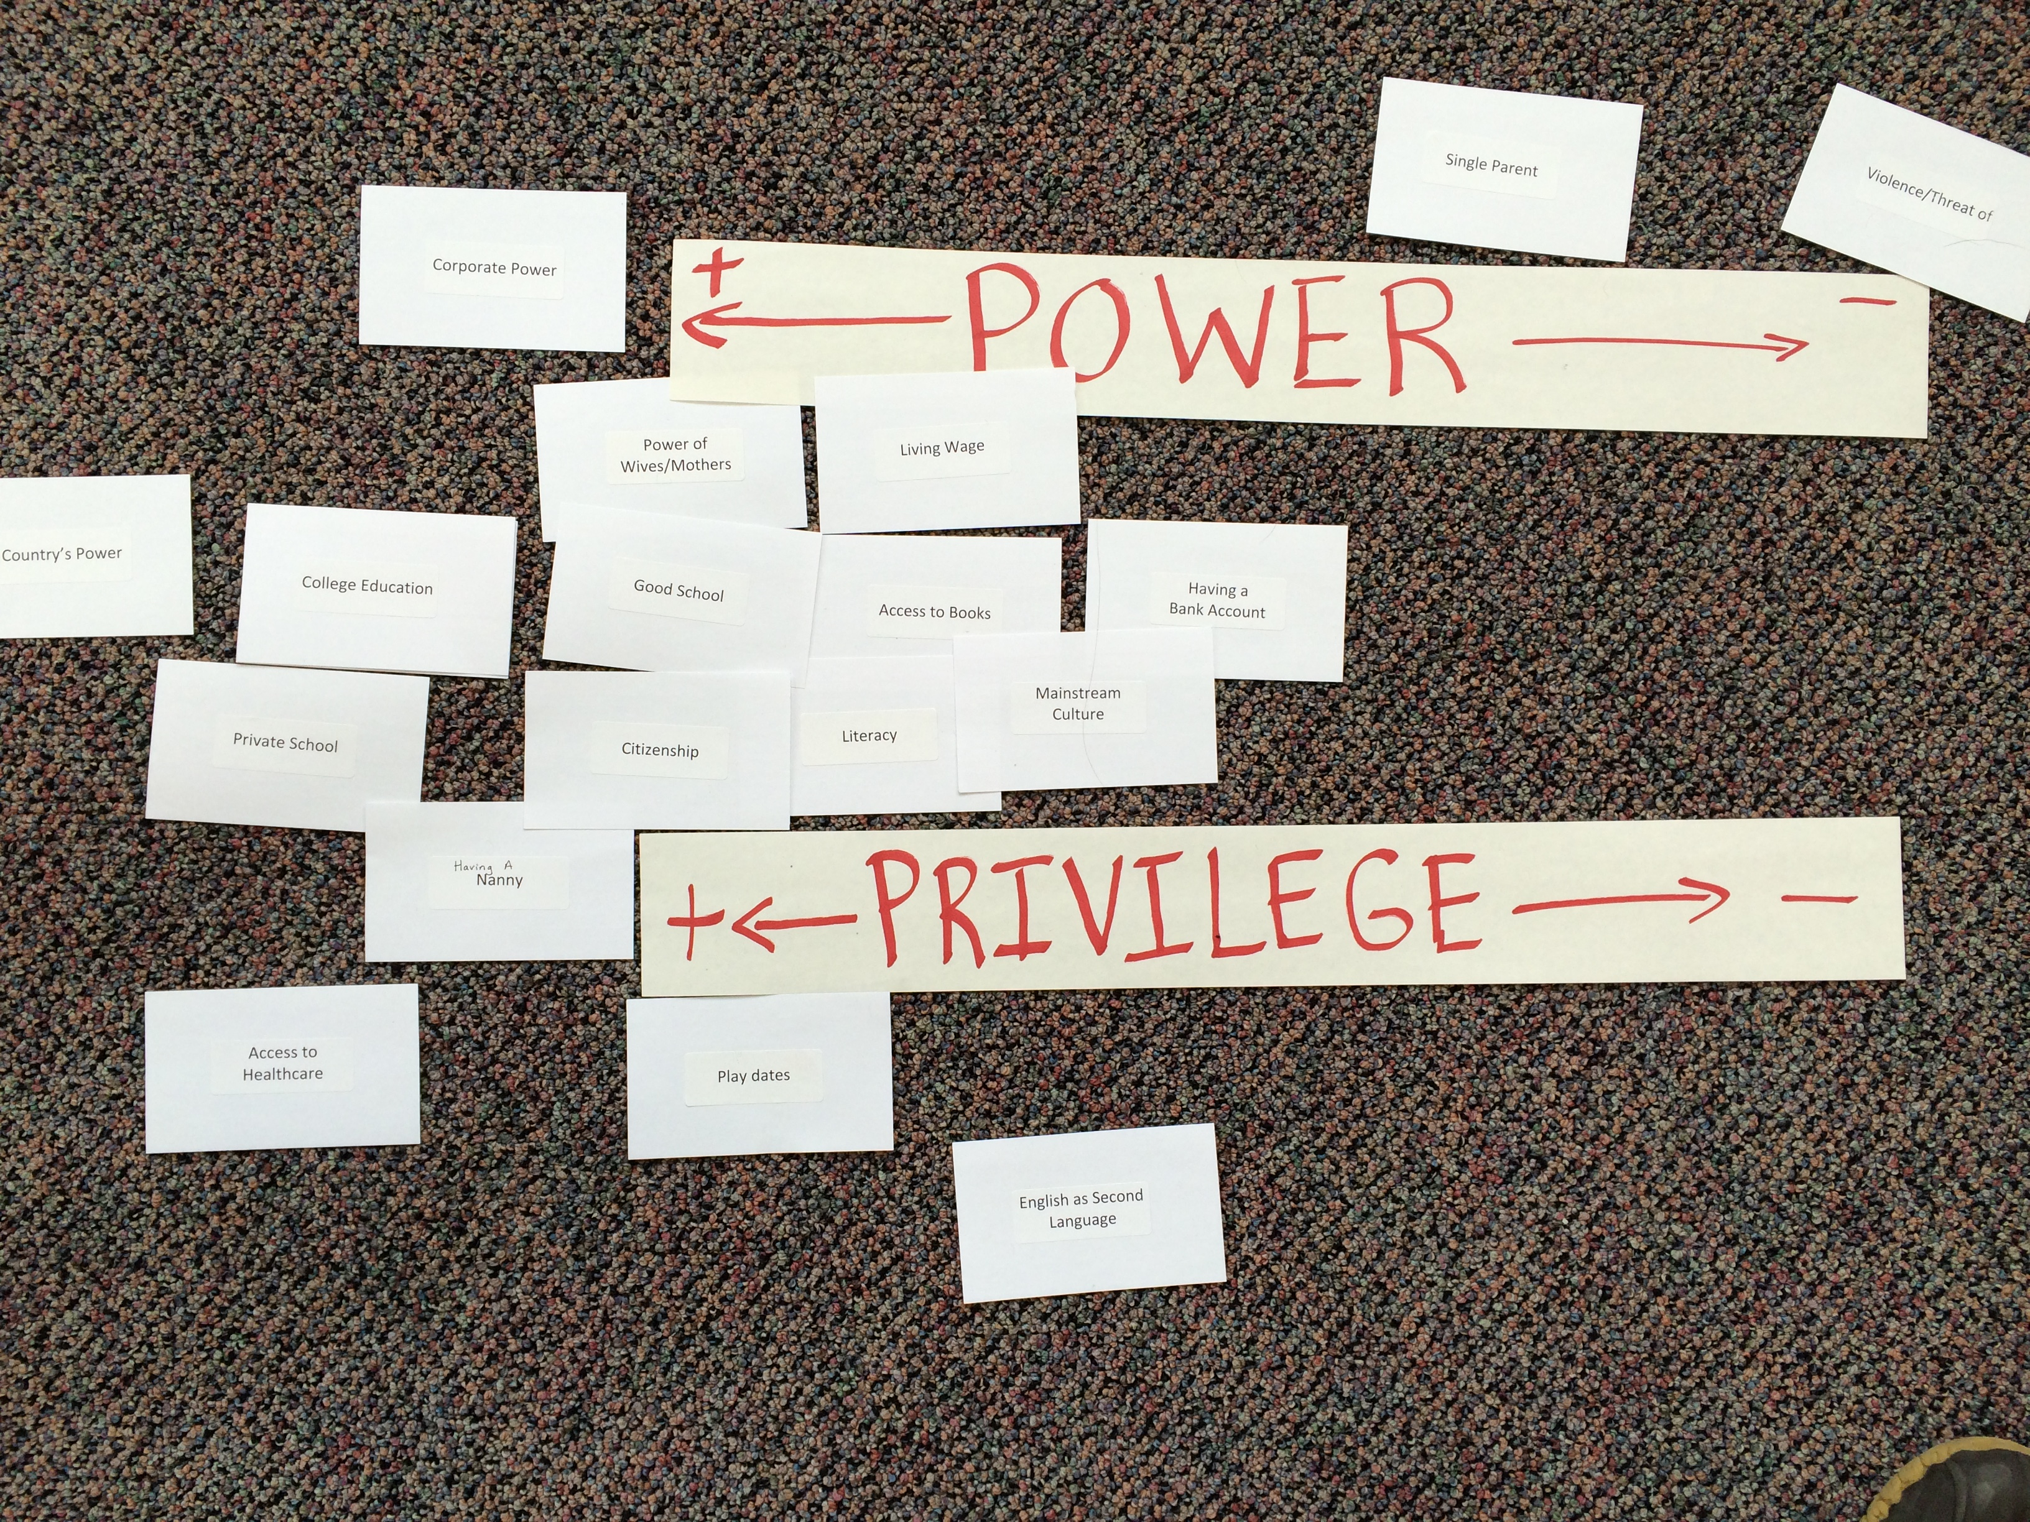
Let’s Try Together
“Power / Privilege Continuum Activity”

Slide 30
Savannah, Ga & The Lowcountry
Race, Power, and the Preservation of African-American History & Gullah-Geechee Culture in the Lowcountry
Five-day program
Explore preservation of African-American and Gullah-Geechee history and culture.
Experience how different museums and heritage organizations preserve the history of African-Americans in the Lowcountry.
Focusing on the themes of
Race
Slavery
Sense of place
Considers two different experiences:
Urban environment of Savannah
Rural Gullah-Geechee culture on the barrier island Sapelo.

Slide 31
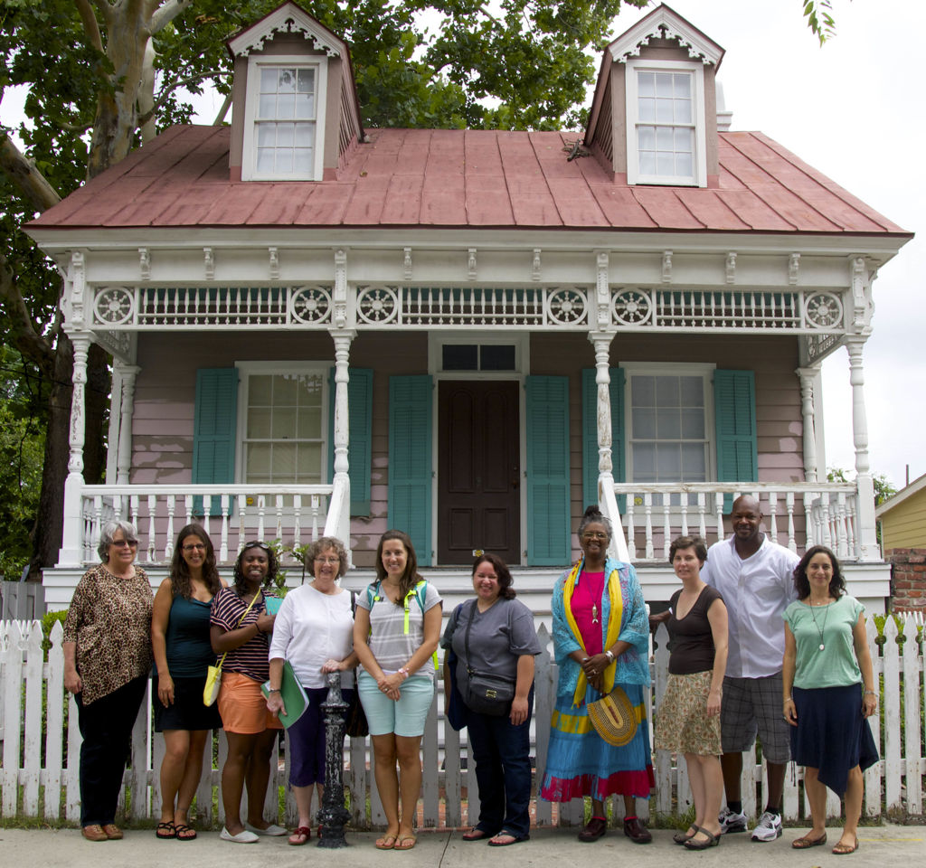
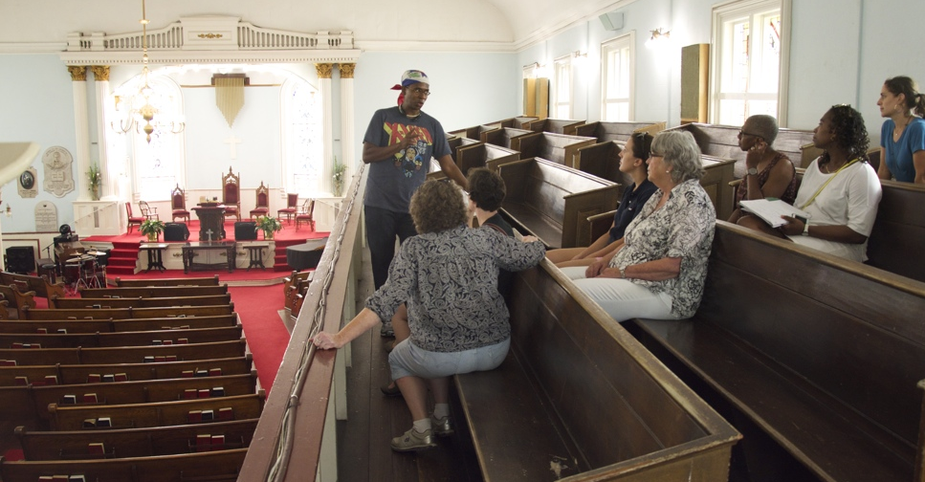
Savannah, Ga & The Lowcountry

Slide 32
Dominican Republic
Building Global Connections: Examining Power, Privilege, Gender and Race in a Global Context
Eight-day program to a small, Caribbean beach village, Cabarete.
Work with Mariposa DR Foundation whose work centers on the education, health and welfare of Dominican and Haitian immigrant families living in poverty.
Focusing on the themes of
Poverty
Race
Role of girls in breaking poverty cycle
Considers dynamics of a variety of communities:
Tourist experience
Rural Dominican communities

Slide 33
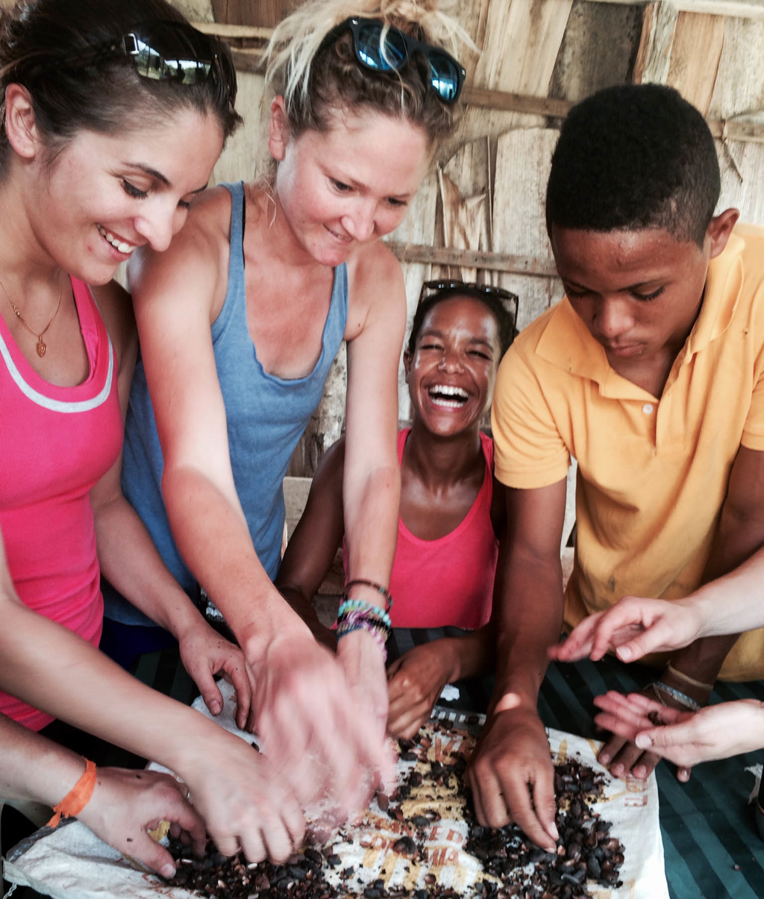
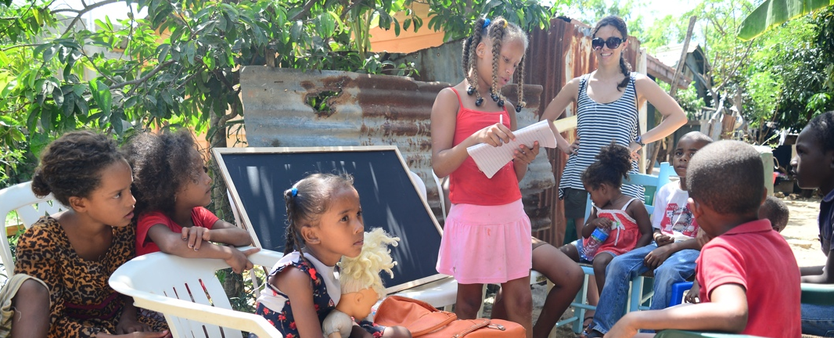
Dominican Republic

Slide 34
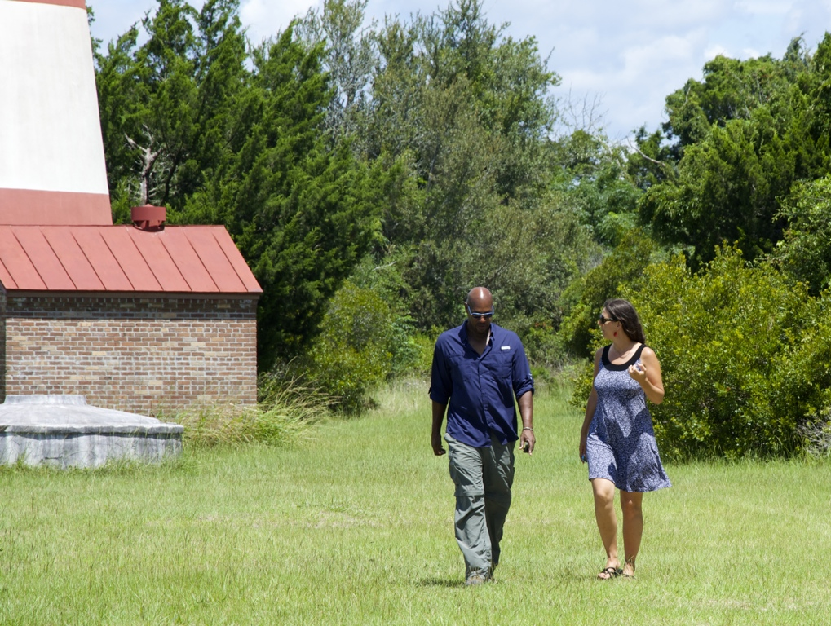
Questions?

Slide 35
Christen Higgins Clougherty, PhD, Executive Director
www.nobisworld.org
christen@nobisproject.org 912.403.4113
Nobis Project, Inc. © January 2019

