Slide 1
Meeting the Needs of Diverse Gifted Learners
Piedmont Middle School, Charlotte, NC
Karen Gorman, Academic Facilitator
Maranda Thornburg, IB Coordinator
Jackie Barone, Principal

Slide 2
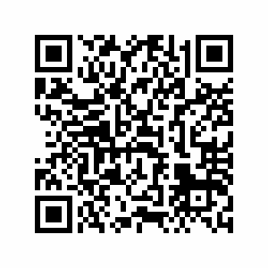
Follow Along
with Us!
http://bit.ly/SLCGiftedLearners

Slide 3
SHAPE of You!

Slide 4
What does it mean?

Slide 5
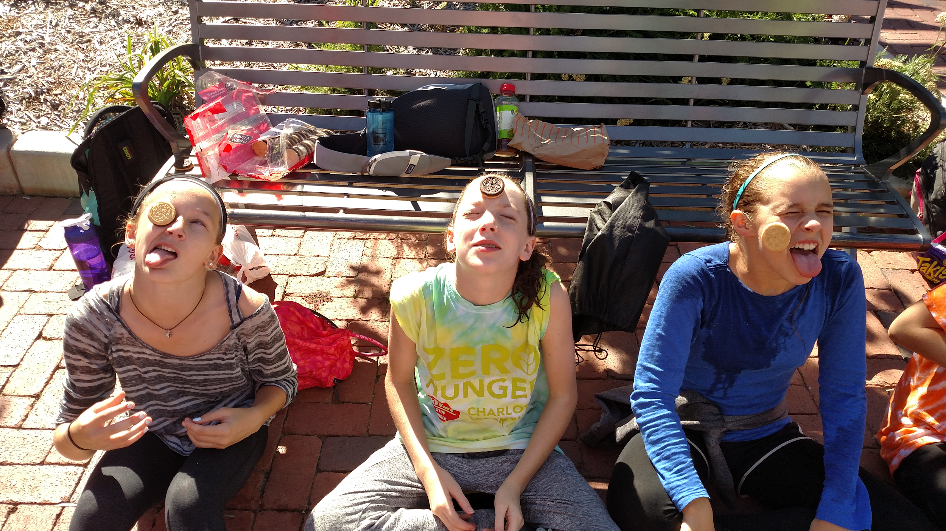
Other ways we learn about our kids...
Interest Inventories
“1st Homework Assignment”
Sit with them at lunch
Home base and dismissal time
Amazing Race 1st quarter
Learner Profile connections to self
This I Believe
License Plates
Puzzle and quilt pieces

Slide 6
It’s Not Just for the Kids!
Staff “16 Personalities Test”
Staff Experience Circle
“Reply all” to newsletter questions
Stress relief Fridays!
Modeling ways for teachers to get to know their students
Administration gets to know everyone

Slide 7
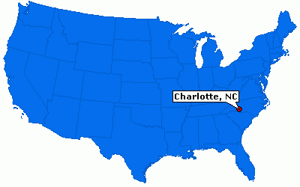
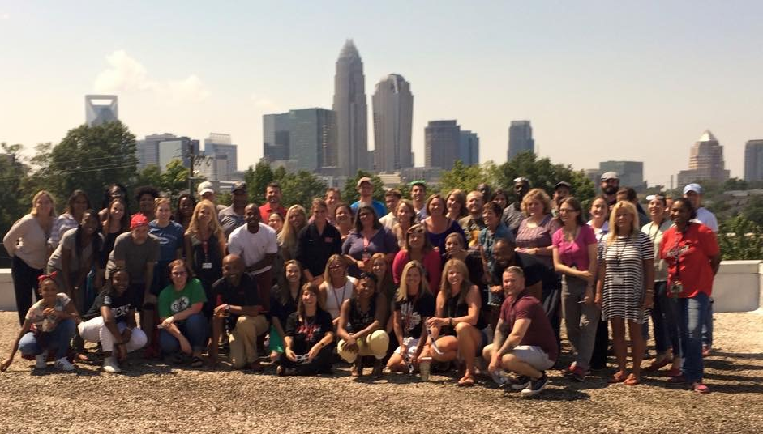
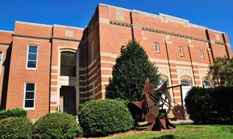
Piedmont Open Middle School, An IB World School

Slide 8
Demographics & School Info
Current Enrollment: 1,055
SWD (15) 0.5%
AIG (405) 38.4%
MCV (17) 1.6%
EL (2) 0.2%
~40% FRL
Grade Levels
6th (370) 35.1%
7th (364) 34.5%
8th (321) 30.4%
African American (636) 60.3%
White (187) 17.7%
Hispanic (120) 11.4%
Asian (80) 7.6%
Two or more (31) 2.9%
Pacific Islander (1) 0.1%
55+ Elementary schools

Slide 9
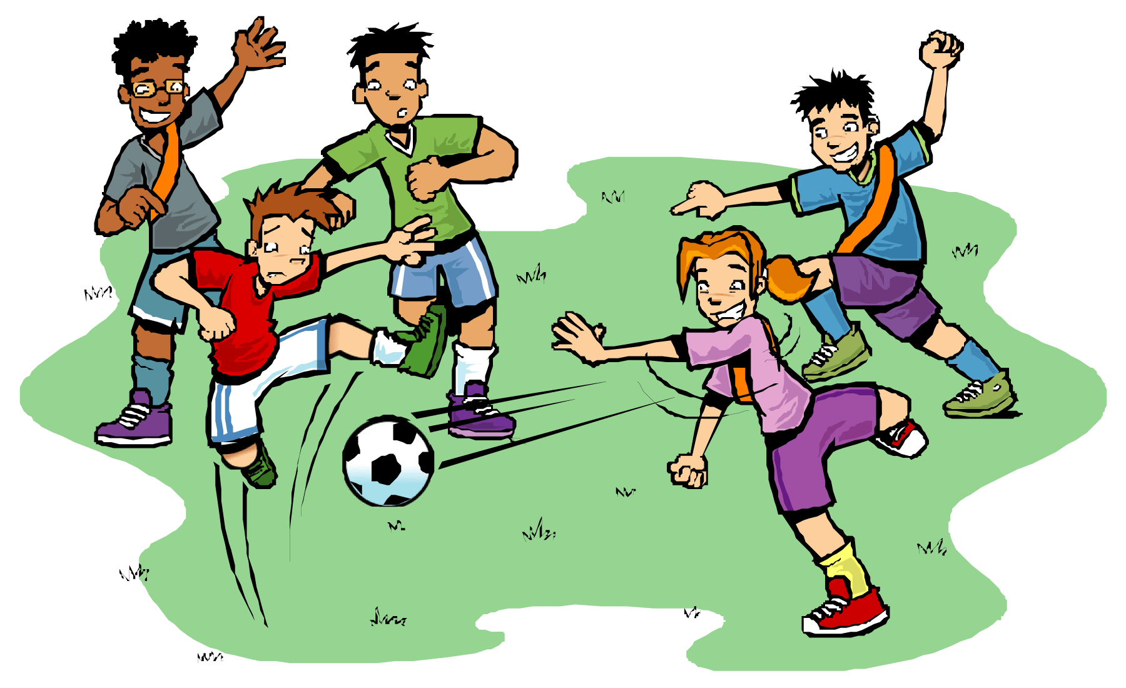
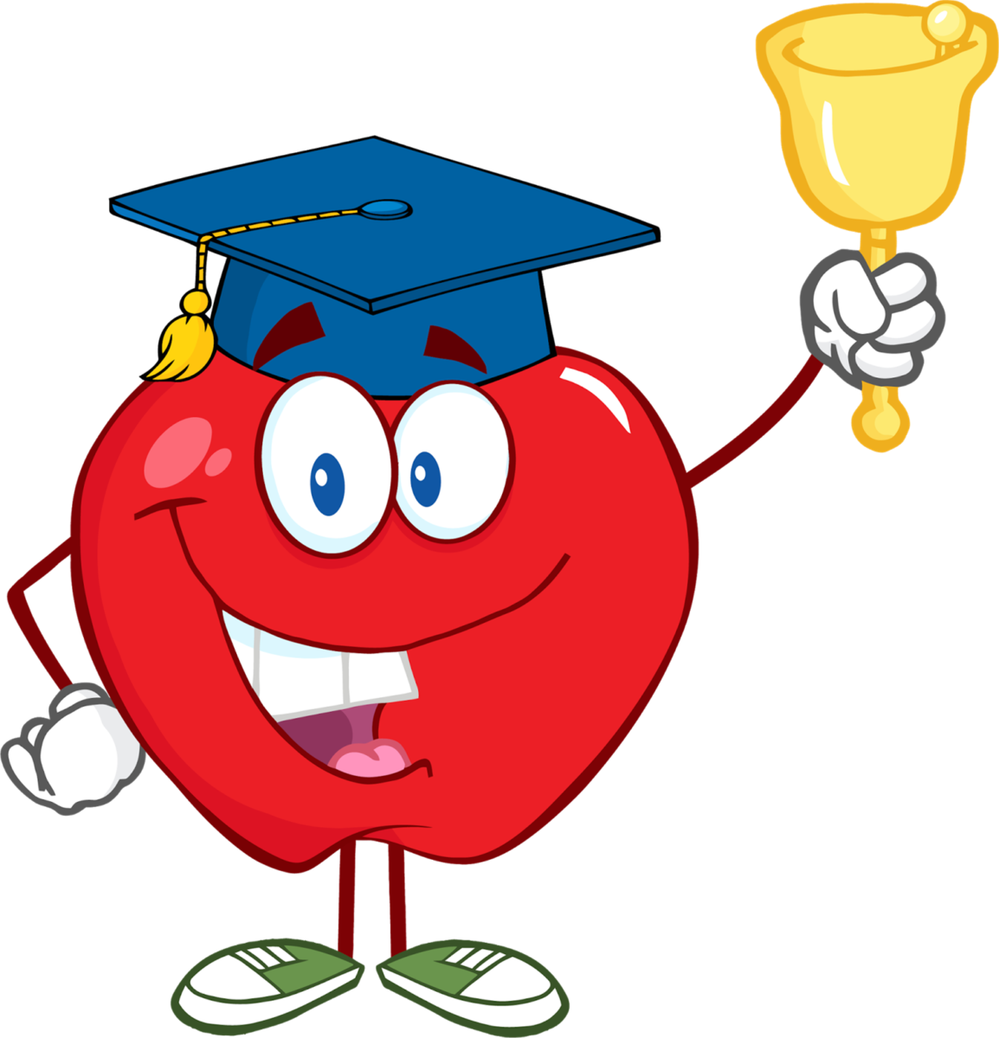
Key Components @ Piedmont
Lunch/Healthy Kids
Advisory Program
Flexibility
6th Block

Slide 10
Amazing Advisory!
Social and Emotional Needs
Schoolwide & Monthly w/ altered bell schedule
Interest inventory yearly
Needs Assessment yearly (students, parents AND staff!)
Design lessons specific to the current student needs
IB content embedded (ATL, learner profile, etc.)
Through home base classes
Prepare students to feel comfortable sharing sensitive topics
Developing empathy

Slide 11
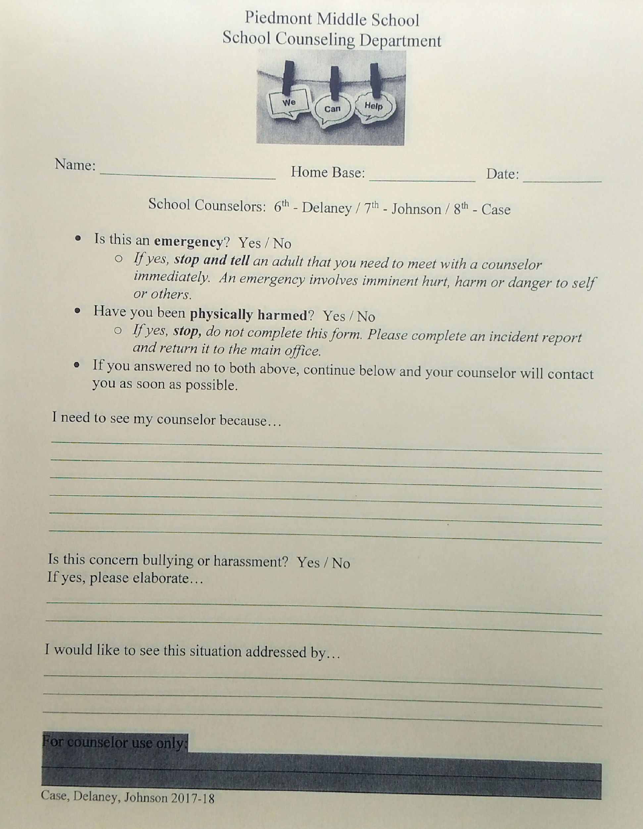
Advisory, continued…
Help Sheets…not just for the DRAMA!
Stressed
Pressure
Other students
Balancing extra-curriculars
Confidential

Slide 12
Advisory, continued…
Classroom Guidance
Lunch Bunches
Popcorn Posse
Building Relationships
Community Partnerships (Shriners, TRiO, etc.)
Student-student
Student-teacher

Slide 13
Advisory Continuum, 2017-2018
6th Grade | 7th Grade | 8th Grade
Needs Assessment | Needs Assessment | Needs Assessment & Group Building
Reflective Learning- Advisory & Me | Bullying | Drug & Alcohol Awareness
Proactive, Responsible, Reflective | Mindfulness | College and Career Readiness
Put First Things First! | Internet Safety | Sexual Harassment
Think “Win-Win!” | Financial Responsibility | Suicide Awareness & Prevention
Seek First to Understand, Then to be Understood | Contributing to Our Community | Kindness
Synergize-Teamwork | Art of Learning/Learning Styles | Social Media & Your Health
Sharpen the Saw (Balancing) | Truthfulness | High School Registration
EOG/NCFE Preparation w/ Stress Management and Test-Taking Skills | EOG Preparation | EOG Preparation

Slide 14
Key Components @ Piedmont
Lunch/Healthy Kids

Slide 15
Lunch/Healthy Kids
Social & Emotional Needs
Field (inventive play, social time, structured sports, Community Garden time)
Study time (inside or outside; tutoring sessions w/ teachers or self-guided)
Media Center (Maker Spaces, technology exploration, time for group projects & research)
Video

Slide 16
Lunch/Healthy Kids
Relationships for student to student and student to teacher
Counselor, Admin and SRO available daily
Mixed teams @ lunch
New friendships
Open to diversity
“Mix It Up Day”

Slide 17
Key Components @ Piedmont
Flexibility

Slide 18
Flexibility!
Before/After School
During School
HB time (8:45-9:15)
Tutoring, study, locker, breakfast, car lot talks
Basketball w/ teachers
GSA Club
Robotics Club
International Day
Bell Schedules!!
Love of Learning
Holocaust Museum
Culture Cluster Gallery Walk
Pigman Trial
Civil War Simulations
MORE!!
Restructuring classes
Ability
Interest
Compacting

Slide 19
Noteworthy Projects and Assignments
6th | 7th | 8th
Culture Meal | Pigman Trial | Community Project
Letter-writing to religious leaders | Culture Cluster | Civil War Simulation
Love of Learning | Holocaust Museum | Civil Justice Speeches
Newspaper Project | Earthquake Structures | Podcasts/Vlogs
Hyperdoc/Biome project | Physics Choice Projects | Natural Selection Lab
Greek Mythology IDU | Acceleration Lab | Modeling Math Project
Titanic IDU | Trench Warfare | OBX IDU
Egyptian Tools Project | Scale Model | Civil Rights Museum
Prism Math Lab | French Revolution Debate Cafe | Save the Princess Math Lab

Slide 20
Key Components @ Piedmont
6th Block

Slide 21
6th Block Rocks! (Especially on Mondays…)
Check it out!
bit.ly/ClubDayMSA

Slide 22
6th Block, Tuesday-Friday “Flex”
Remediation: Compass Learning, Reflex, Pull-out groups
Acceleration: novel studies, Science Olympiad, special topics (Genocide, Media Literacy)
Other
Rotations, organizational strategies, test prep, study hall, Advisory topics, assemblies, guest speakers, service opportunities, and more! ☺

Slide 23
A day in the life of a Piedmont student…
4 Core classes daily→ 55 minutes
1 Encore class (A-day/B-day)→ 80 minutes
All students take a world language, health and PE
Lunch→ 25 minutes
Counselors, AP & SRO available daily
Healthy Kids daily→ 25 minutes
Media Center open
6th block Academic Enrichment→ 40 minutes

Slide 24
PLC/Instructional Support “All students are OUR students.”
Mondays | Tuesdays | Wednesdays | Thursdays | Fridays
4 person teams | Personal Planning | Team Conferences | 3 person teams (department) | Whole team
-IDU planning -Student trends -Round tables | -Student data -Calls/emails home -Differentiation planning | -Counselor/Admin -Parent/Student -Core teachers -Plan for individual needs | -Tiered assignments -Regrouping -Common assessments with extensions | -Counselor -Admin -12 teachers -Additional breakouts in 4-person teams as needed

Slide 25
How do you challenge your gifted learners?
Crowdpurr.com
Q83AN

Slide 26
Leadership Organization
Principal
Administrative Team
Instructional Leadership Team
Department Chairs
Team Leaders
School Leadership Team/PTSA
Classroom Teachers

Slide 28
Survey!
Karen Gorman
Karenj.Gorman@cms.k12.nc.us
Maranda Thornburg
Maranda.Thornburg@cms.k12.nc.us
Jackie Barone
Jackie.Barone@cms.k12.nc.us

