Slide 1
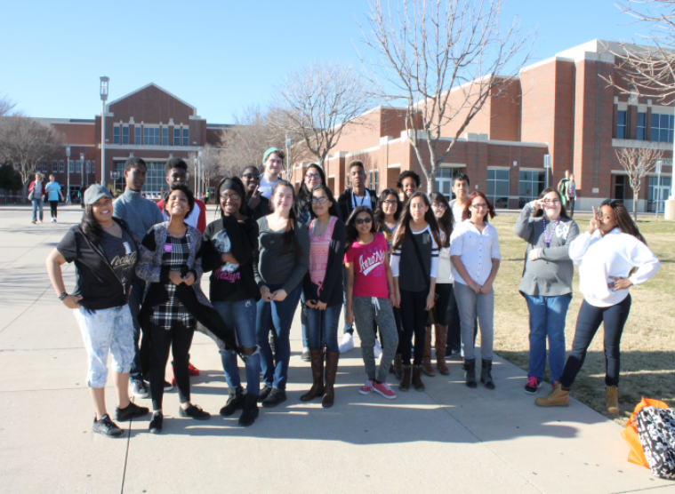
Early College High Schools: Achieving the Dream of College for Urban, North Texas Students By Wendy Jasper
National Youth At Risk Conference
Savannah, GA
March 2017

Slide 2
Introduction

Slide 3
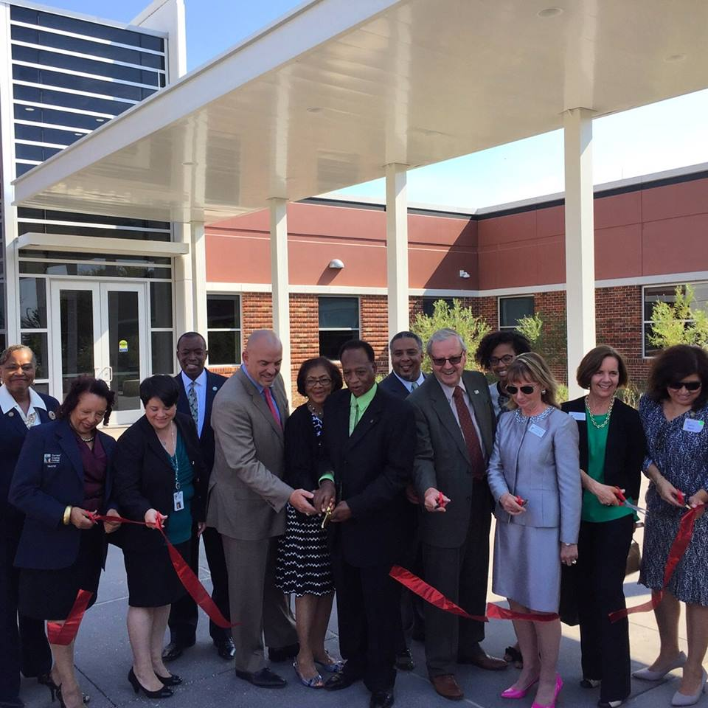
Vision
Early College High schools have been developed between Tarrant County College and various North Texas Urban School districts in order to provide an entrance to college education for students who may not otherwise be able to pursue a college education due to financial, domestic or other reasons

Slide 4
Vision (Cont.)
Early College High Schools in Texas provide dual credit at no cost to the student even if the student is not a designated title I student
They provide a more rigorous academic environment so that the student is prepared for college if he or she should choose to continue a baccalaureate program after high school
The barriers to college access are reduced
Works with the school district’s early alert programs to identify students that may be at risk via outside influences (gangs, etc.)

Slide 5
Target audience
The primary Target Audience of any Early College High school in texas is students who qualify for free and reduced lunch. This is also the case in many similar programs in other states across the nation.

Slide 6
Planning
The application process begins with a request to the state for permission to open a new program
Applicants must also receive approval from the Institution of Higher education (IHE) in the form of a letter of intent to sponsor the echs program
The speed of approval and opening dates of any program are determined by the model the ISD and ihe want to follow
School within a school
Ihe On-site
Isd or ihe third party site (satellite center or county/state building lease)

Slide 7
Recruitment and student application

Slide 8
Recruitment and student application

Slide 9
Implementation
Once the state has approved the plan listed in an application, it will be time to move your chosen model forward for the oncoming school year. This will include:
Course scheduling
Student recruitment
Submission of course requests to your ihe
Teacher selection and credentialing (for embedded instructors)
Transportation and meal planning
Information technology selections
One on one technology
Classroom technology

Slide 10
Data analysis
While many ECHS programs in texas are in their first two years and not all data is readily available, let us look at some common points between the three programs at tcc-south campus
Students in Each of the three programs is a majority African American or Hispanic student ethnicity
Students in Each of the programs is primarily female
Most students are college ready via tsi testing by the start of their sophomore year in reading and writing and has met the math requirement by the end of their sophomore year

Slide 11
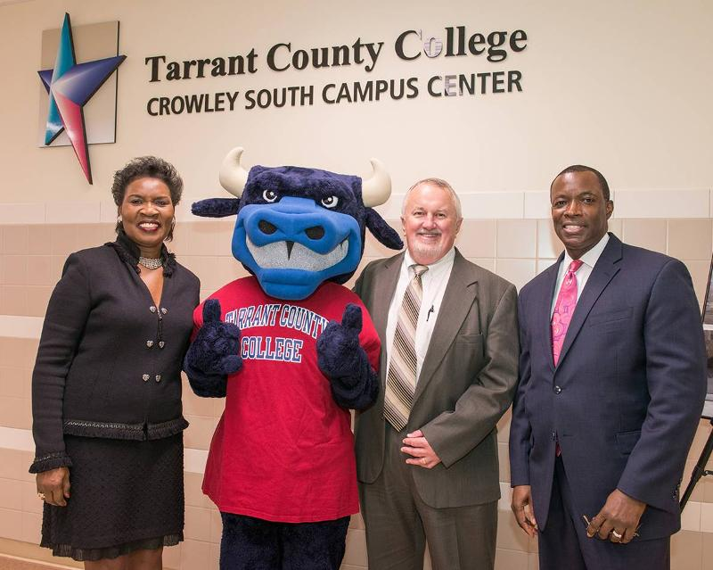
Best practices
It is vital that any echs maintain weekly correspondence or meetings with their ihe
Make sure that all site visits from the state are prepared well in advance as benchmark paperwork will be required for update in each meeting
Don’t hesitate to ask questions

Slide 12
Contact information
Wendy n. jasper, MPA
Director of Academic affairs
Tarrant County College-South Campus
5301 Campus drive
Fort Worth, texas 76119
817-515-4019 Office
Wendy.jaspermartinez@tccd.edu

