Slide 1
Scooping, Clipping and Snipping
leveraging the power of curation tools to enhance libguide design and use
presented by Ruth Baker
Learning Commons Librarian
Zach S. Henderson Library
Georgia Southern University
Notes:
Want to share two of my favorite things in the universe: Evernote and LibGuides
Ideas for tapping into the synergy between online curation tools (e.g. Evernote, ScoopIt, and Feedly) and LibGuides for improved design and collaboration, and to promote the use of LibGuides beyond standard subject or research guides (online poster presentation, library events).

Slide 2
CURATION TOOLS
Evernote-a versatile suite of products to capture virtually any kind of information that can be digitized, across multiple platforms: PCs, Mac and mobile devices
Scoop.It- an online system for curating content from multiple web sources (incl. blogs, news, twitter and youtube results) across multiple platforms
Feedly- a magazine style news reader with cross-platform apps
Notes:
auto-sync in background, thumbnail view shows graphics, multiple-file type compatibility, drag-n-drop;

Slide 3
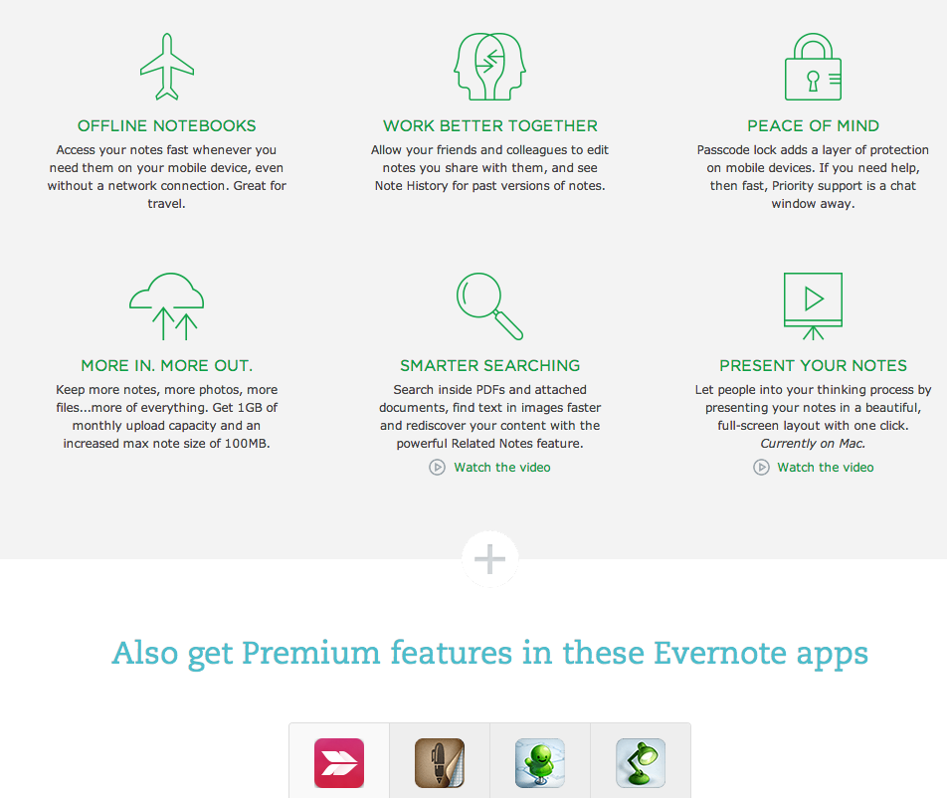
Evernote Premium
[Source: http://www.evernote.com/premium]
Notes:
New features: TOC notes, Web clipper: bookmark, simplified article as well as URL or full page; OCR handwritten notes, searchable PDFs; more u/l capacity (1GB), larger notes (up to 100 MB)
integration with Skitch, Penultimate, Galaxy S-Note, et al. ; features/related services in “Trunk”
Announcements and user stories

Slide 4
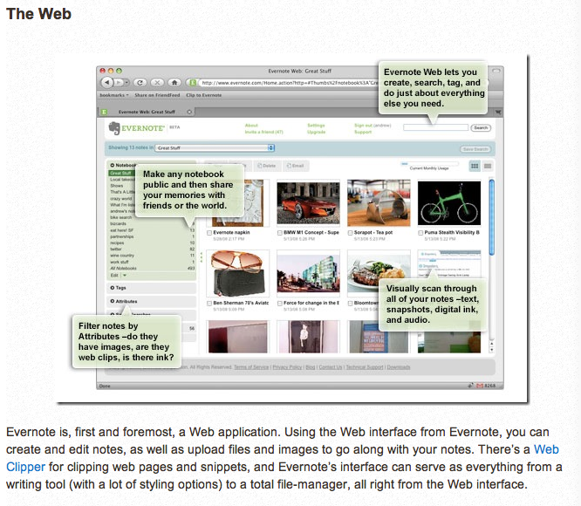
Adding to Evernote from the Web
http://www.makeuseof.com/tag/6-ways-to-add-your-information-to-evernote/

Slide 5
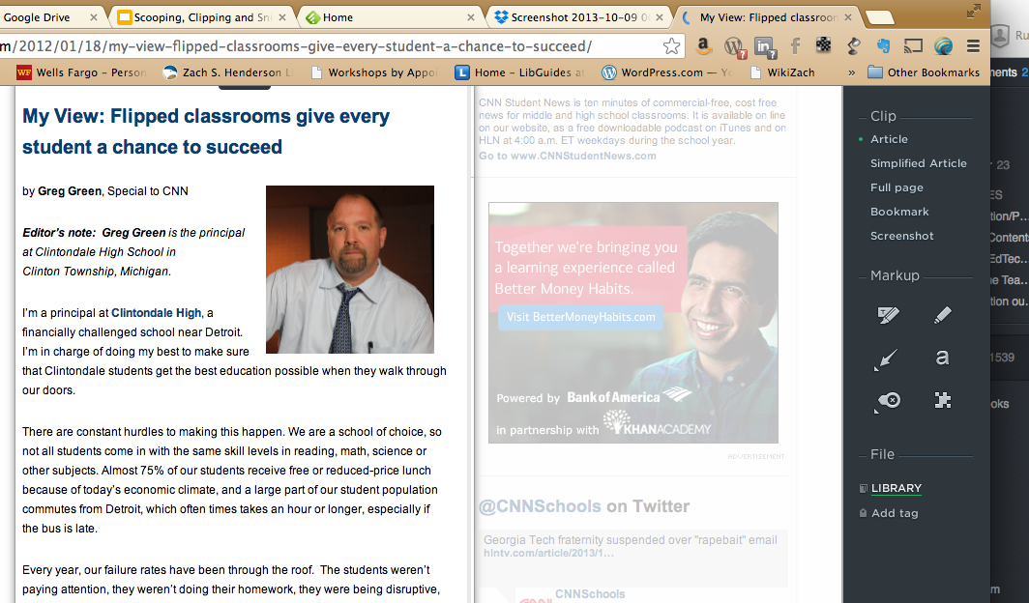
Evernote Web Clipper
Notes:
Note web clipper add-on for major browsers (dont need to have EN client running)

Slide 6
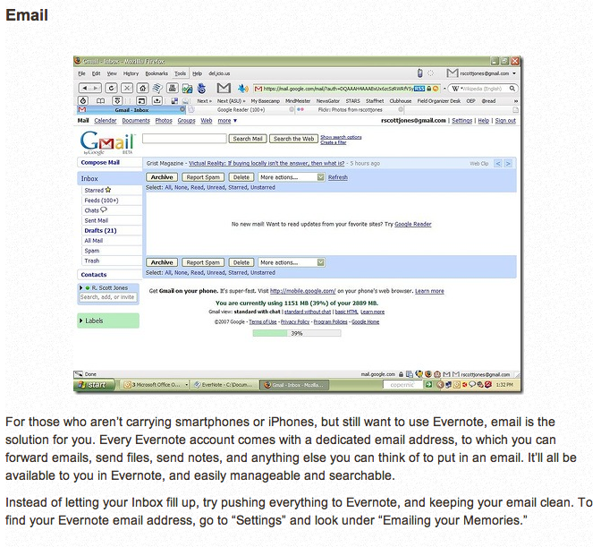
Adding to Evernote via Email
[Source: http://www.makeuseof.com/tag/6-ways-to-add-your-information-to-evernote/ ]
Notes:
send to specific notebook and add tags on-the-fly; also ScanDrop s/w--scan directly to Evernote; camera photos

Slide 7
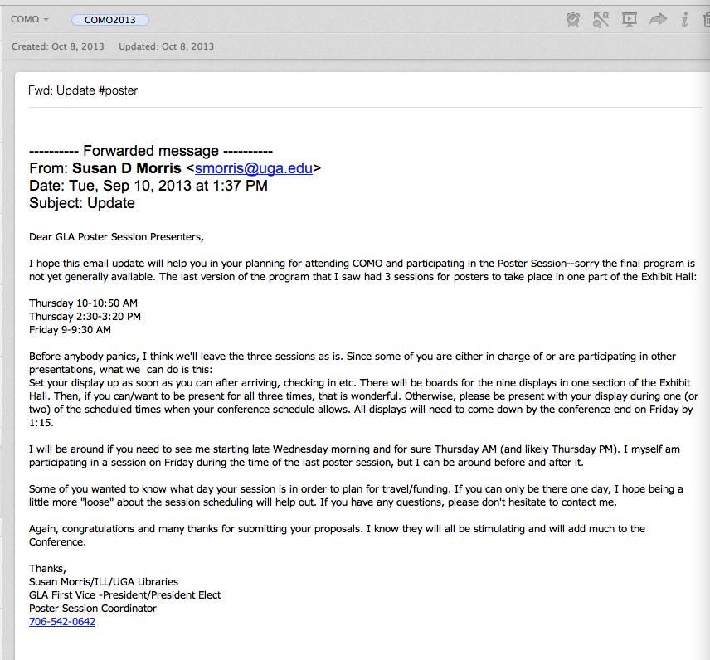
Email to Evernote Notebook with Tags
Notes:
@notebook #tag -- add on the fly (“Smart Filing”)
esp. useful for users w/o smartphones

Slide 8
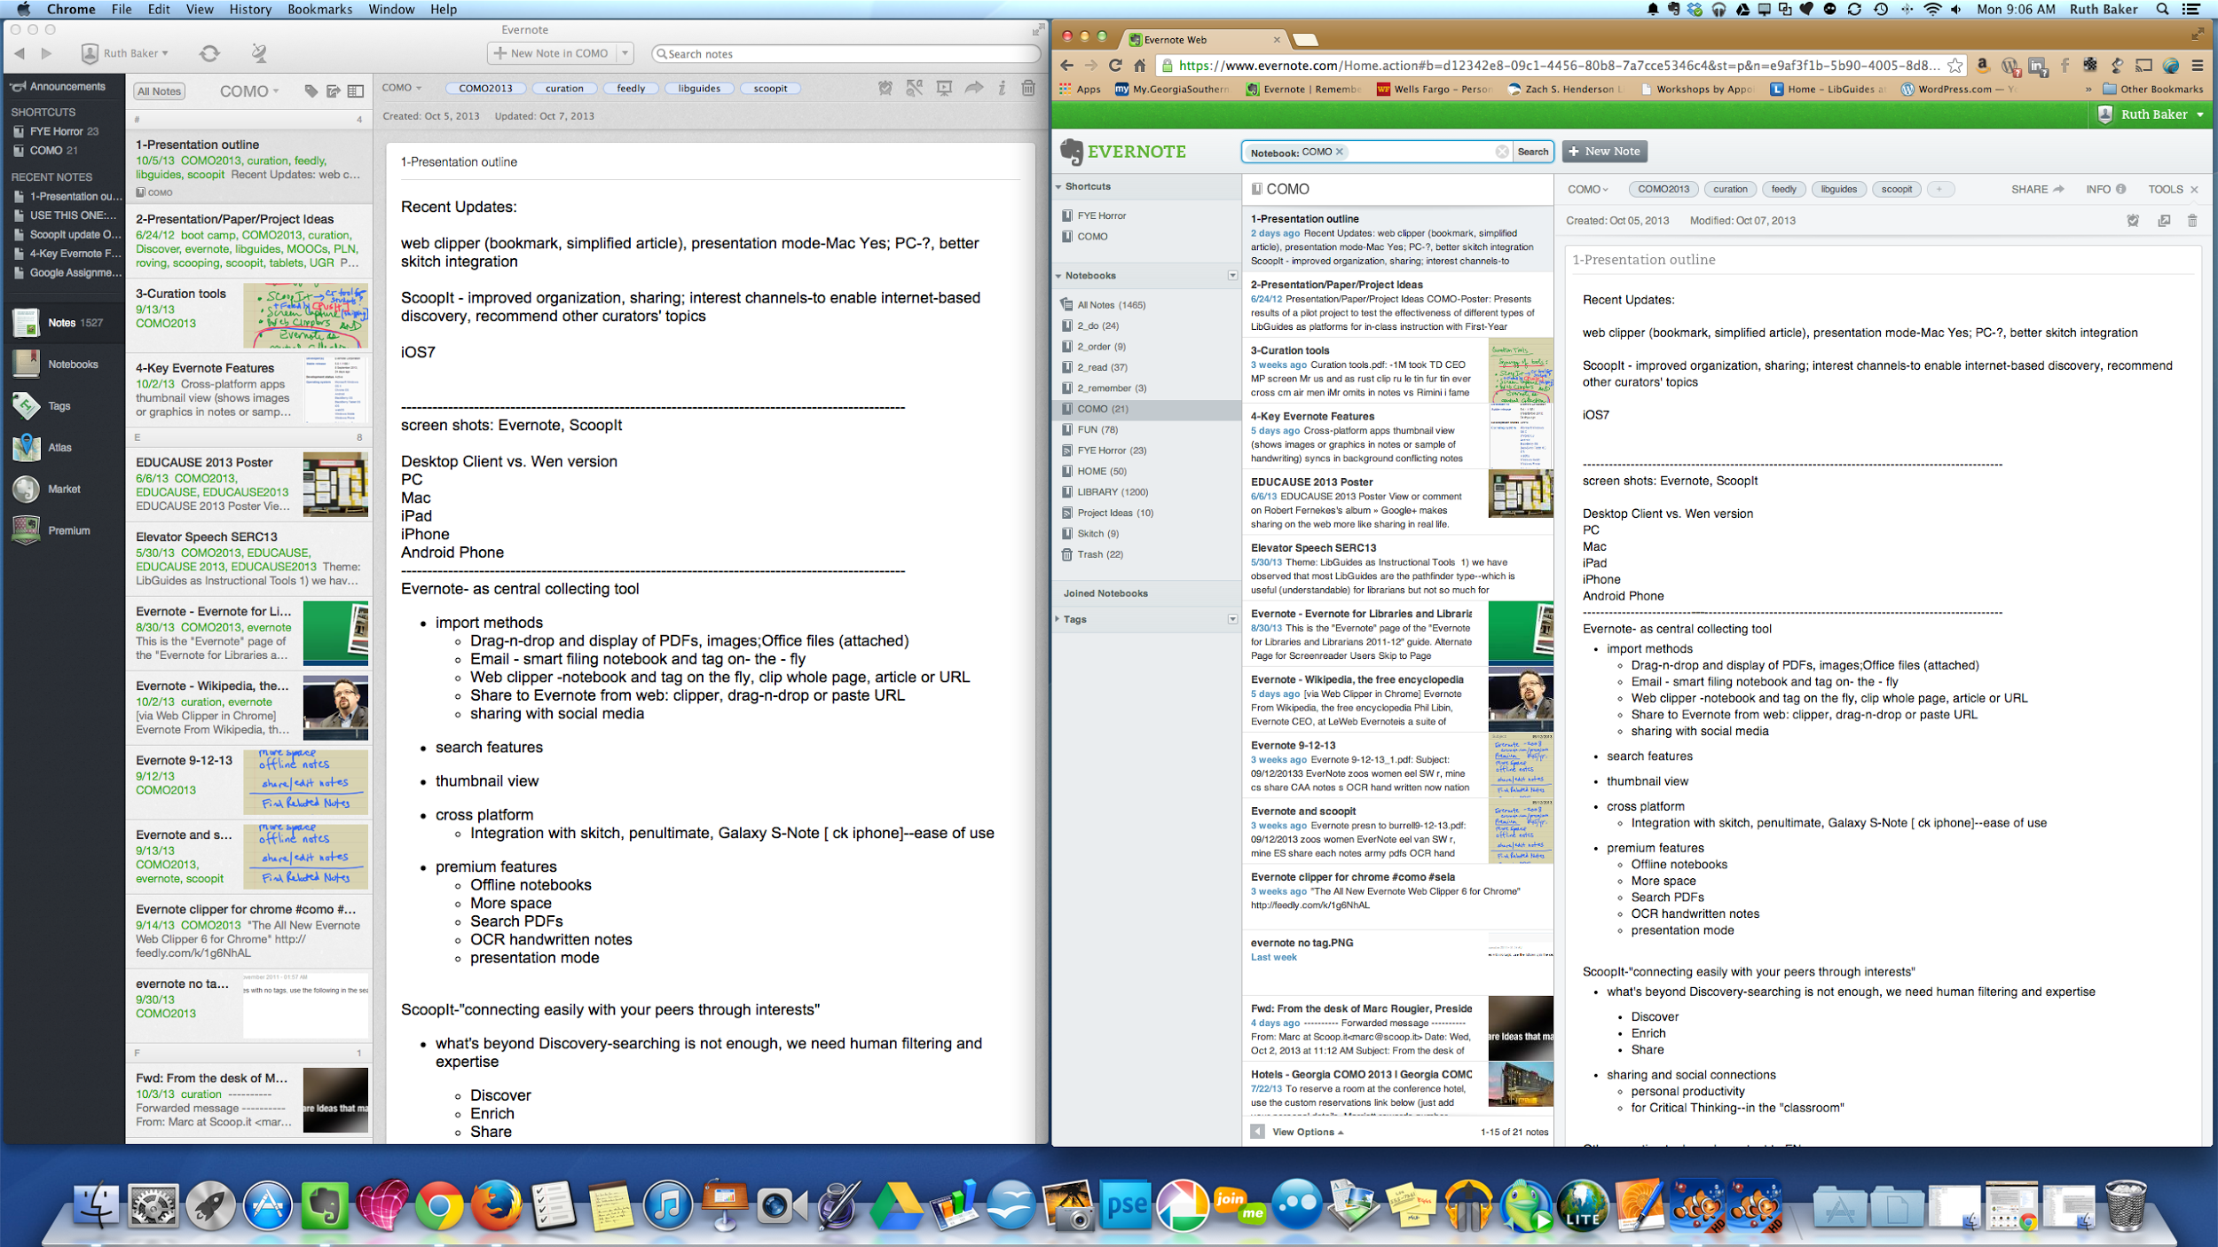
Evernote Desktop/Web for Mac
Notes:
Notes images in “snippet” view

Slide 9
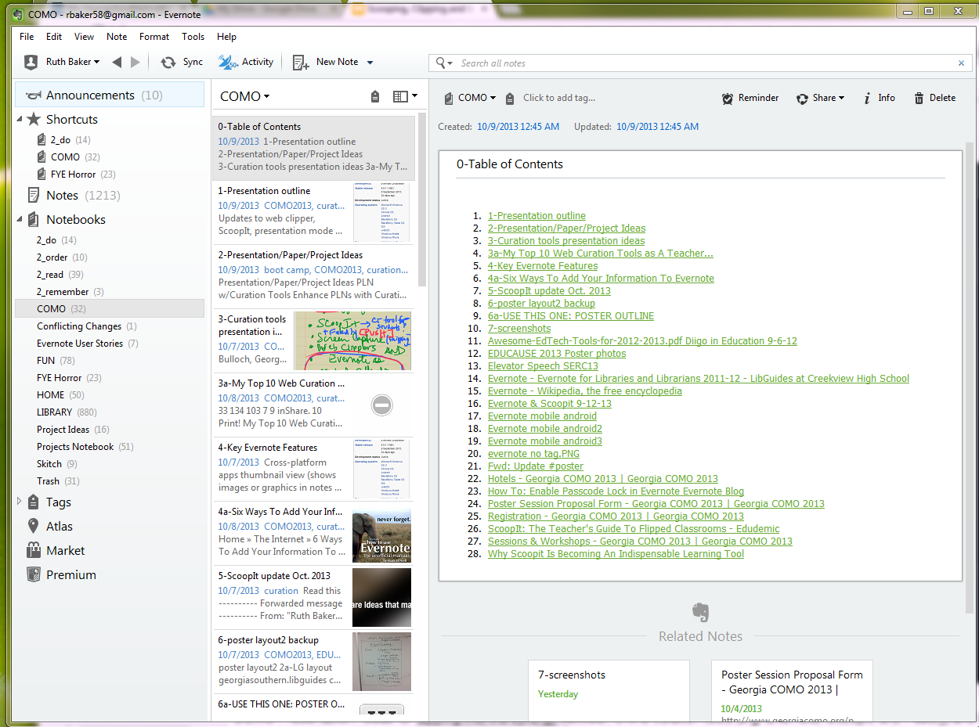
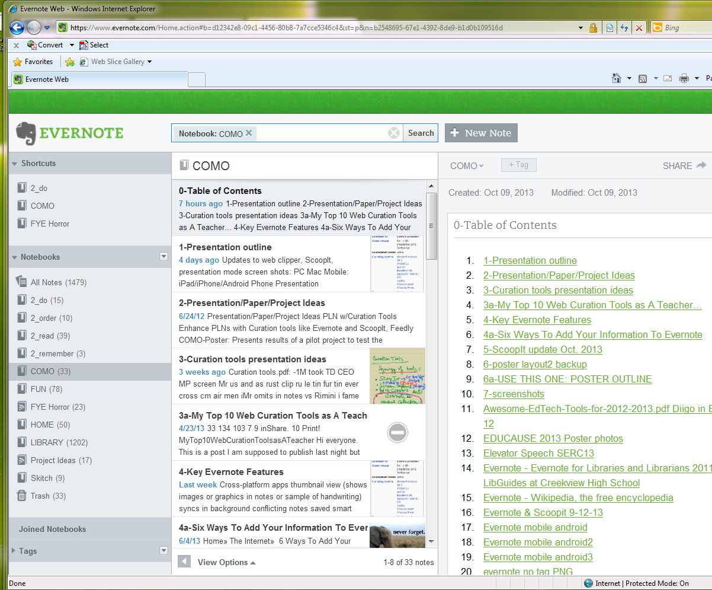
Evernote Desktop/Web for PC (Windows 7)

Slide 10
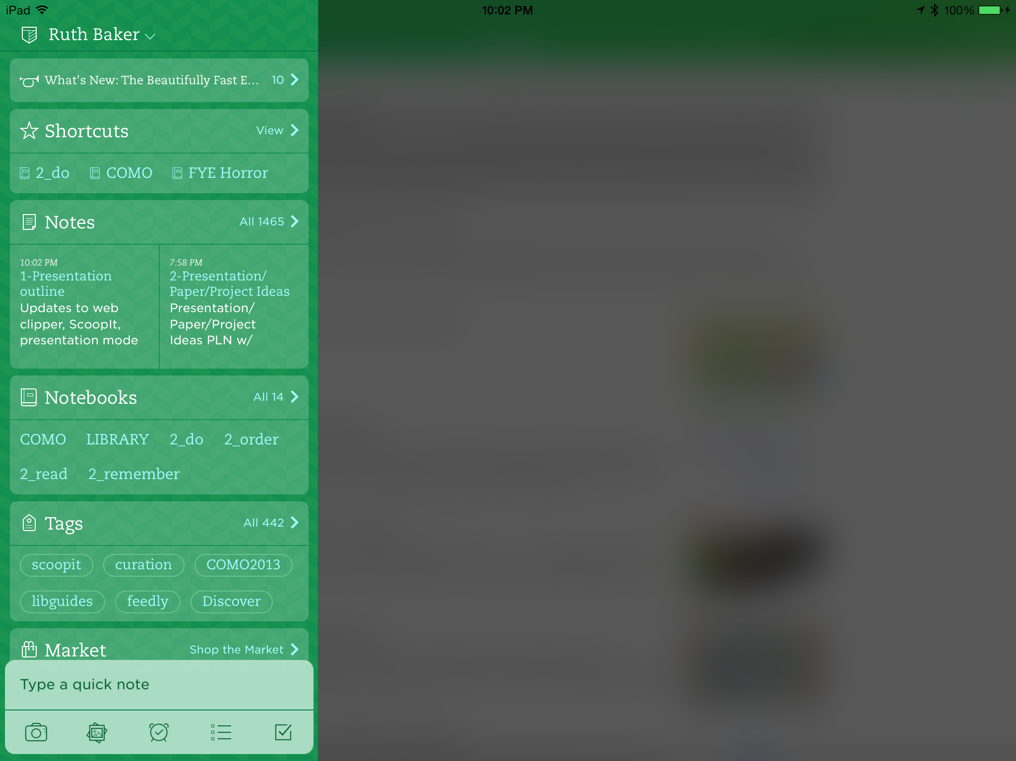
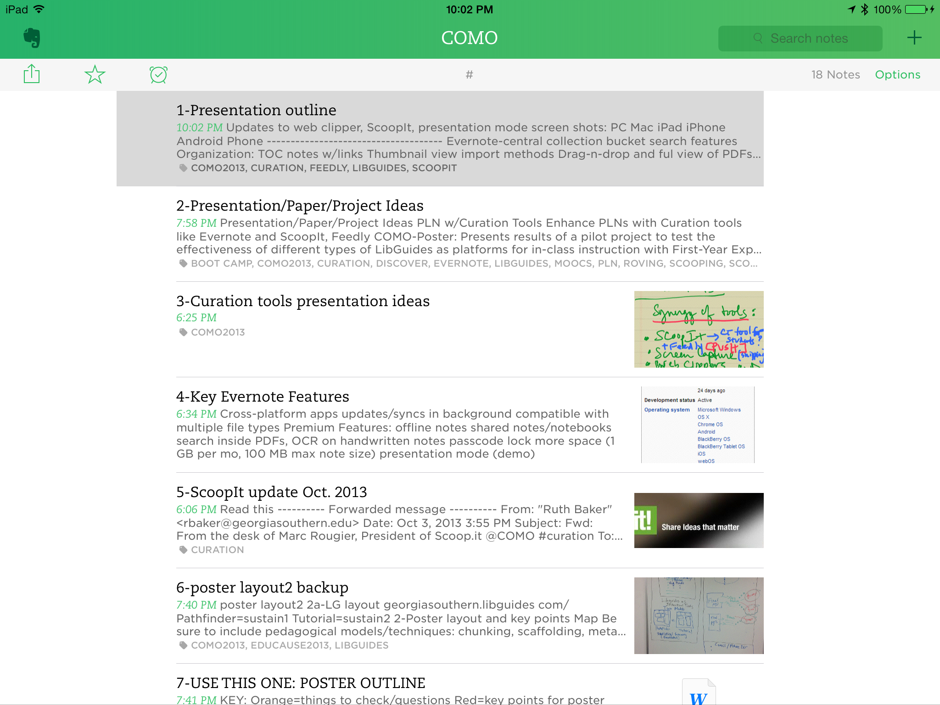
Evernote Mobile: iPad (iOS7)
iPhone
iPad

Slide 11
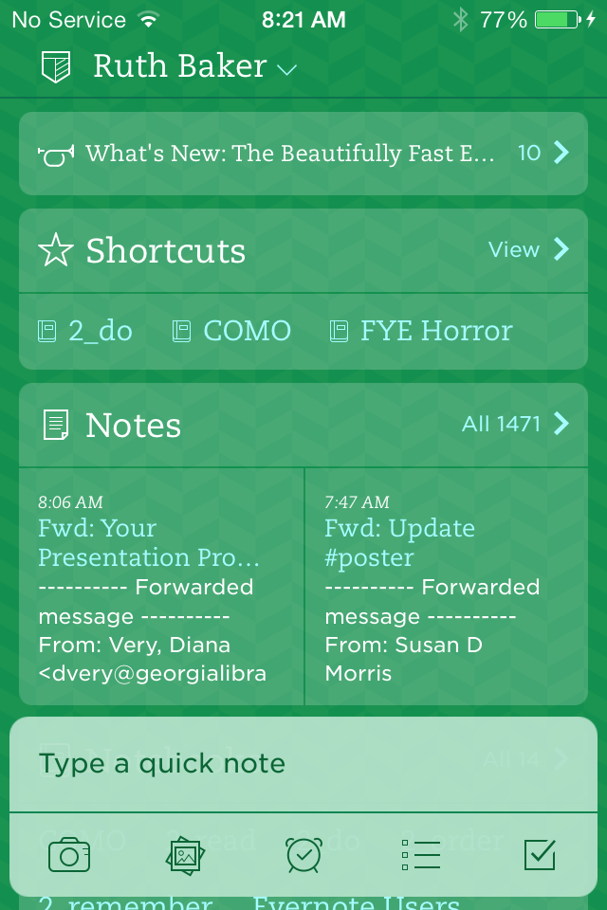
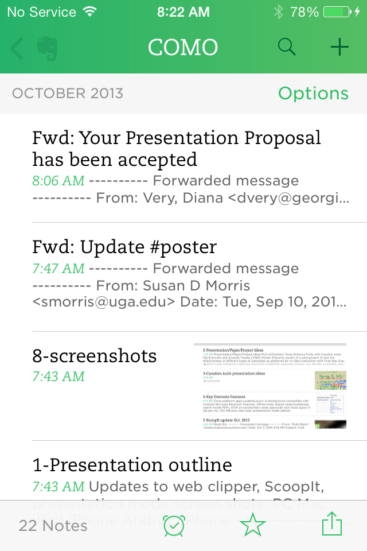
Evernote Mobile: iPhone (iOS7)

Slide 12
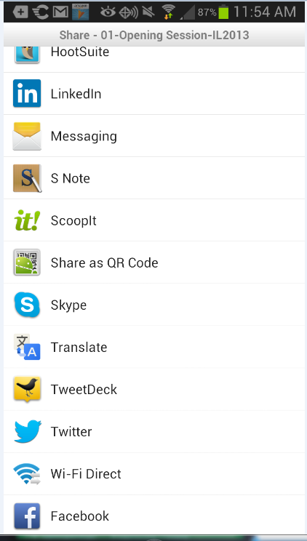
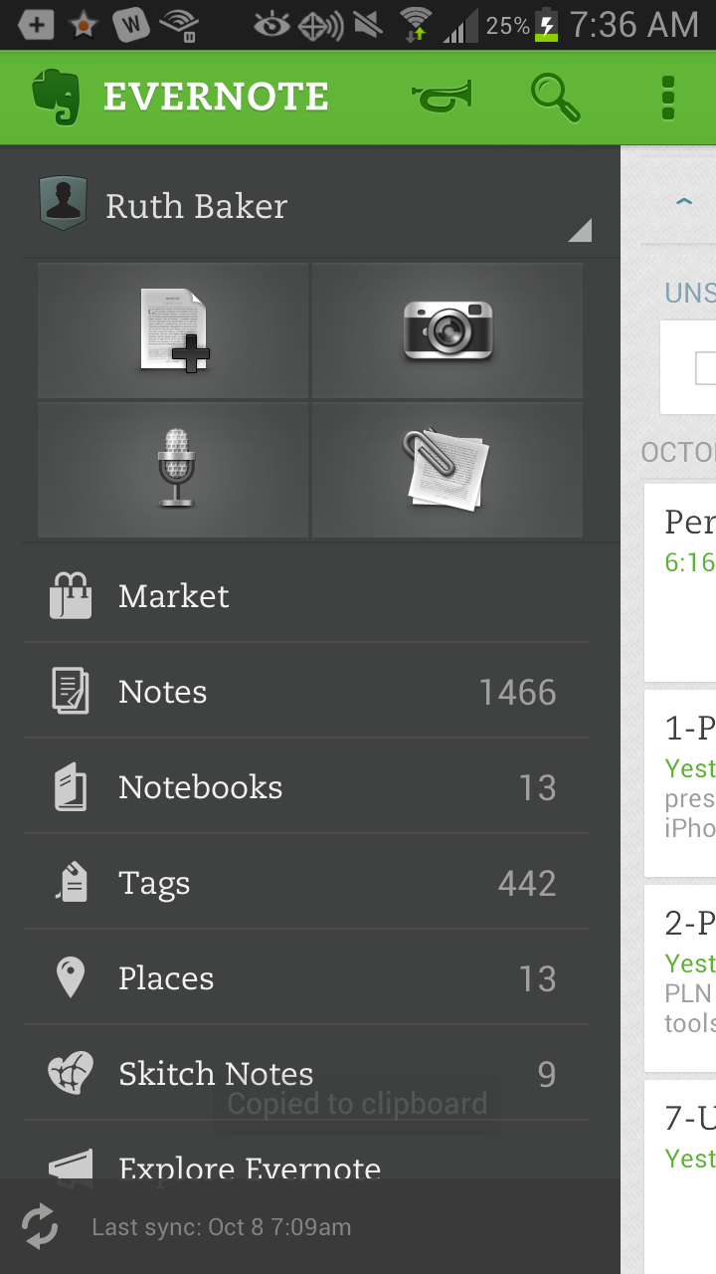
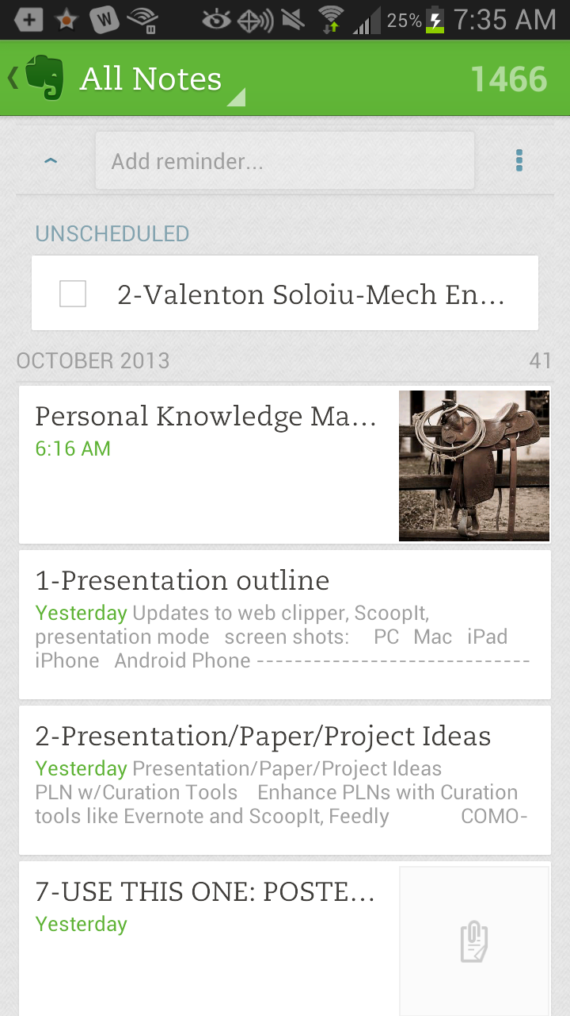
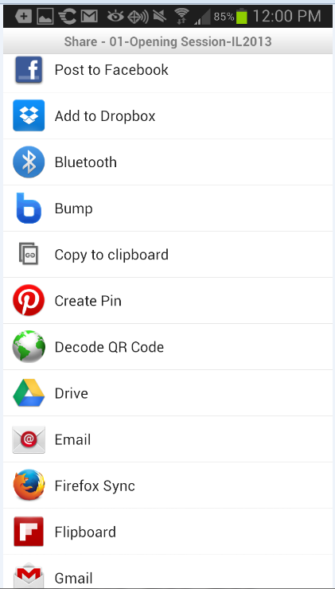
Evernote Mobile: Android

Slide 13
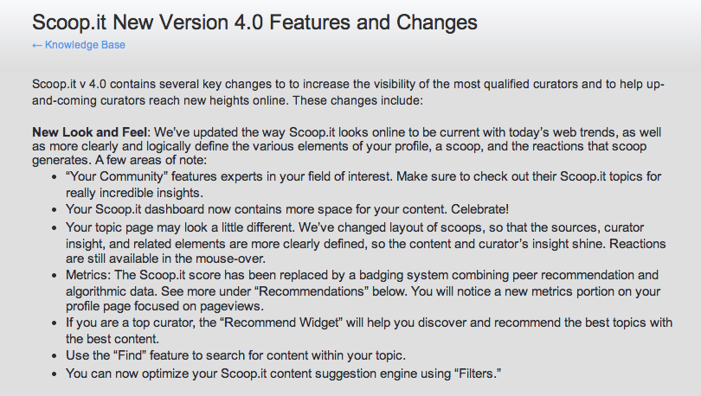
Scoop.It--What’s New
Notes:
also browser add on for “scooping”content while surfing

Slide 14
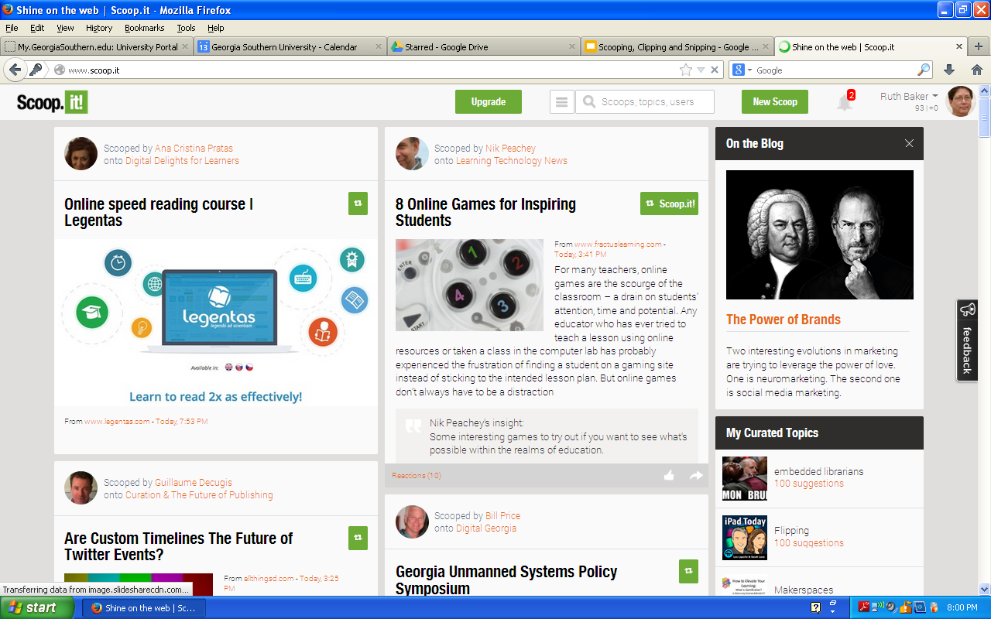
ScoopIt for PC/Web (Windows XP)

Slide 15
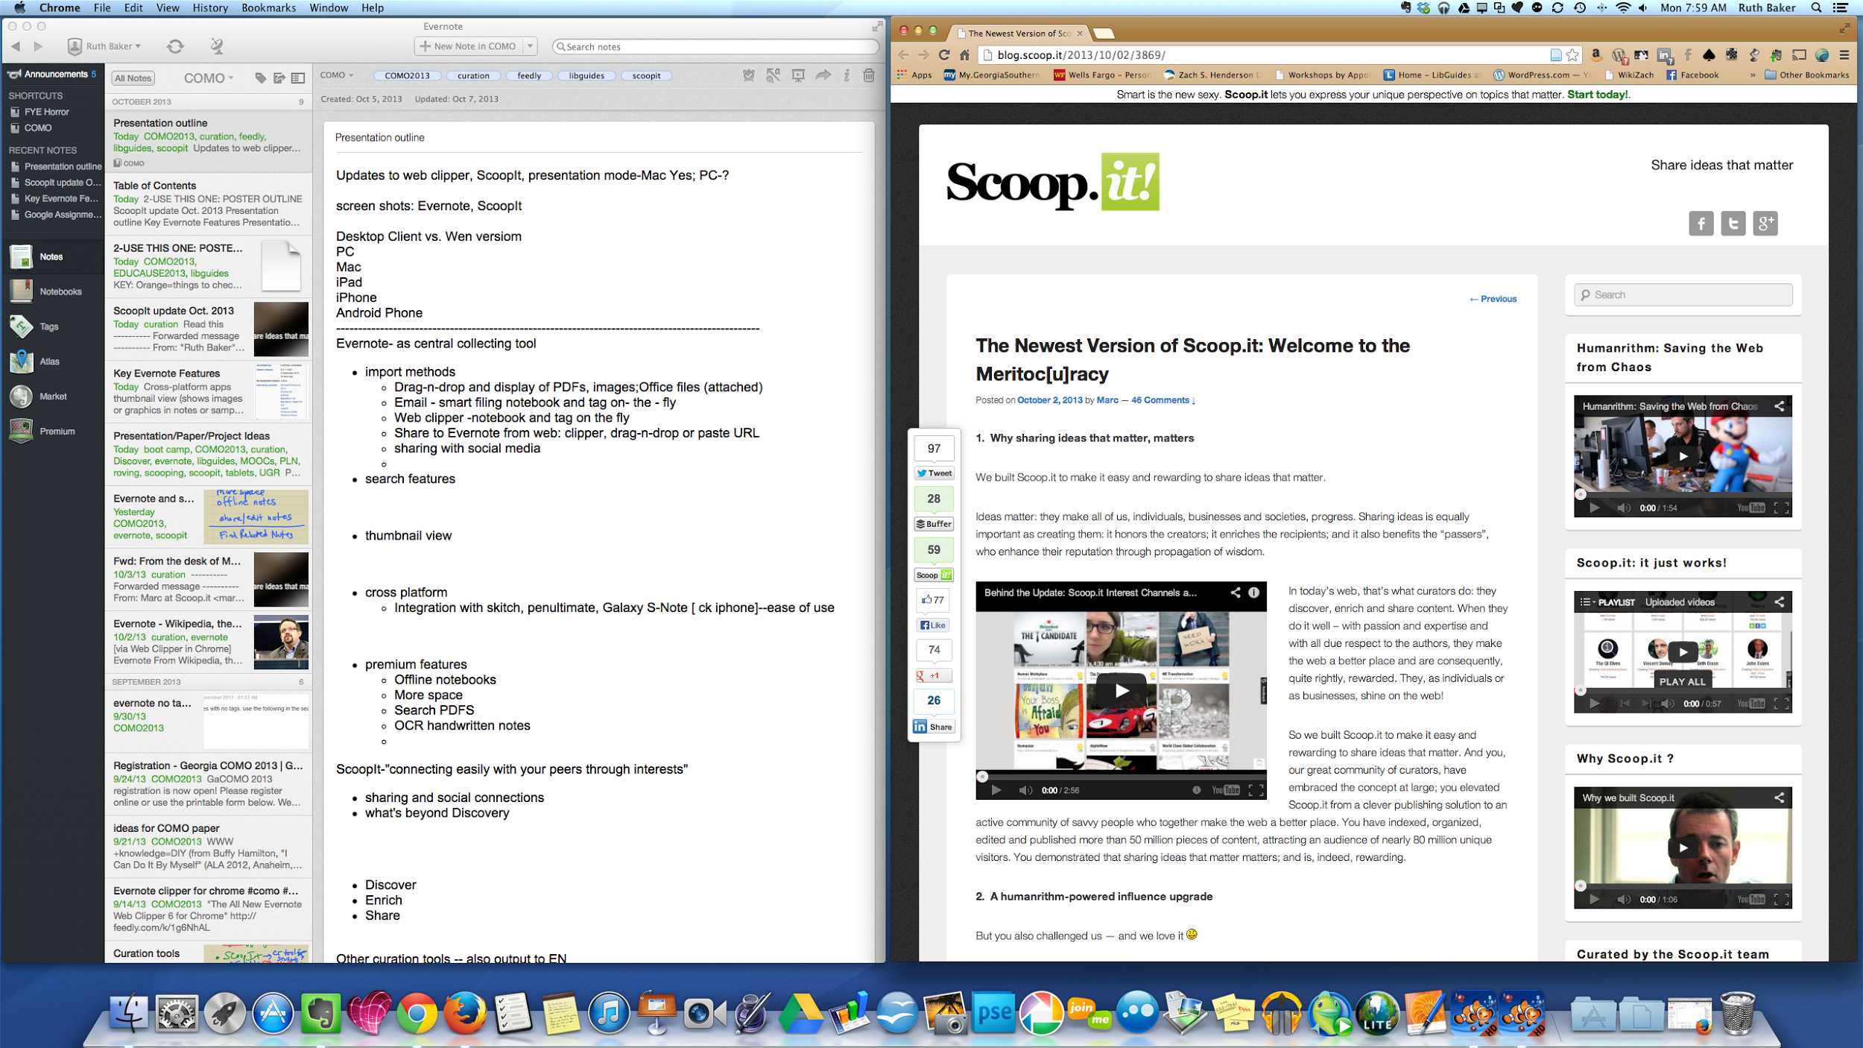
ScoopIt for Mac
Notes:
email to Evernote; or copy URL

Slide 16
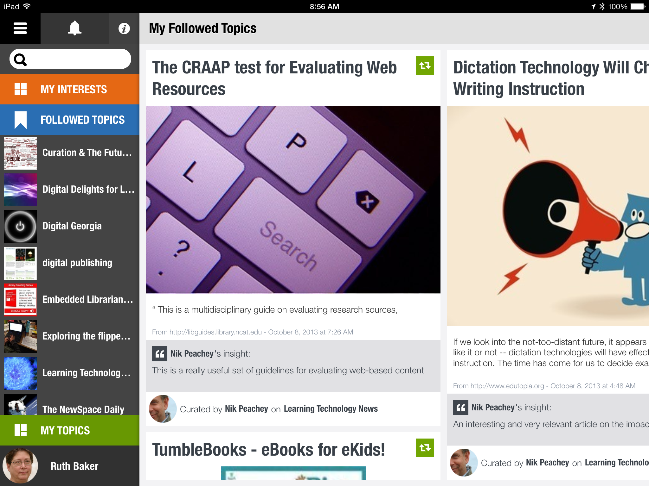
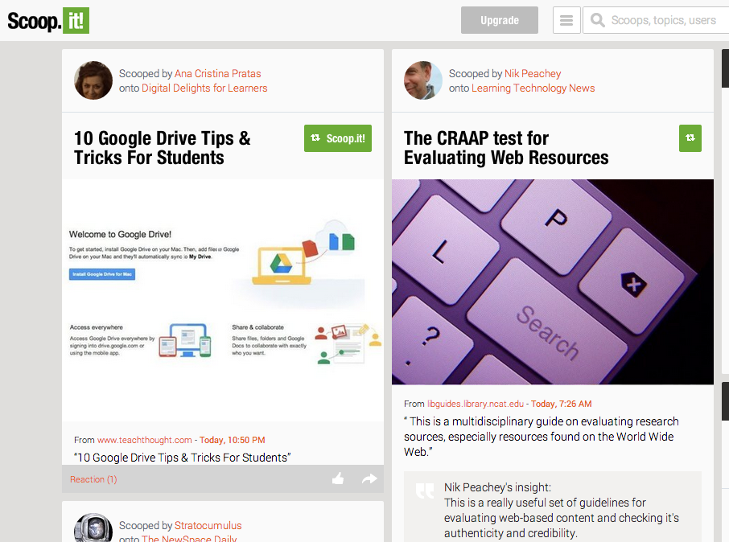
ScoopIt Mobile: iPad/Mac
2013-10-08 08.56.22
Notes:
note recent article about ScoopIt as Critical Thinking tool for students

Slide 17
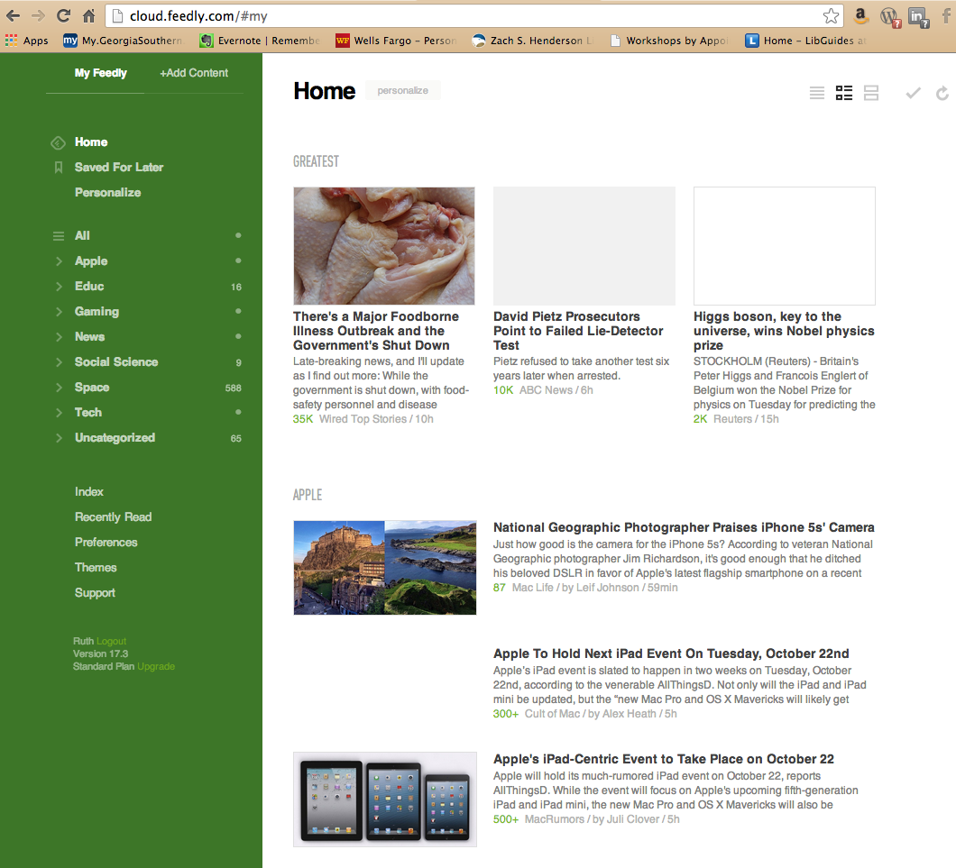
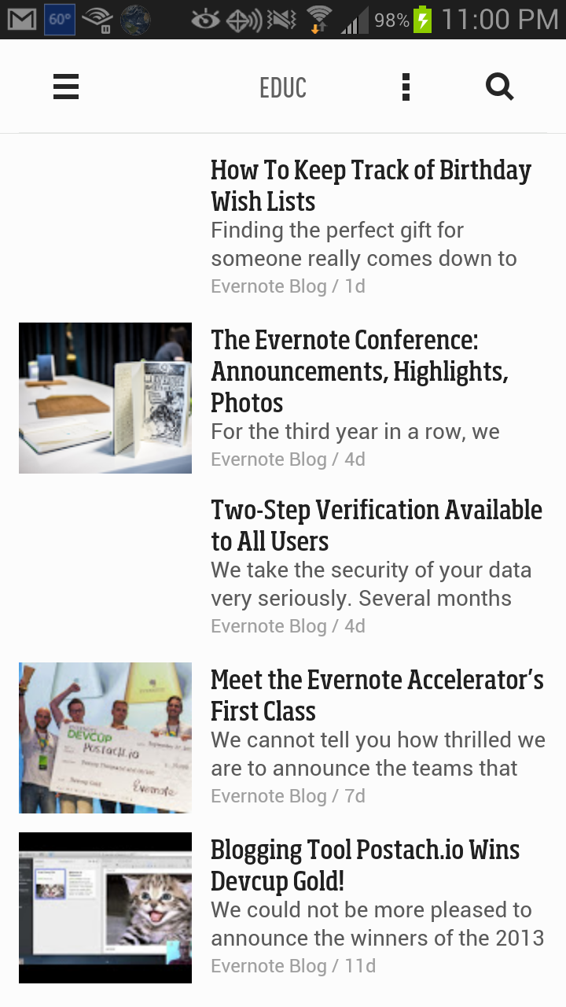
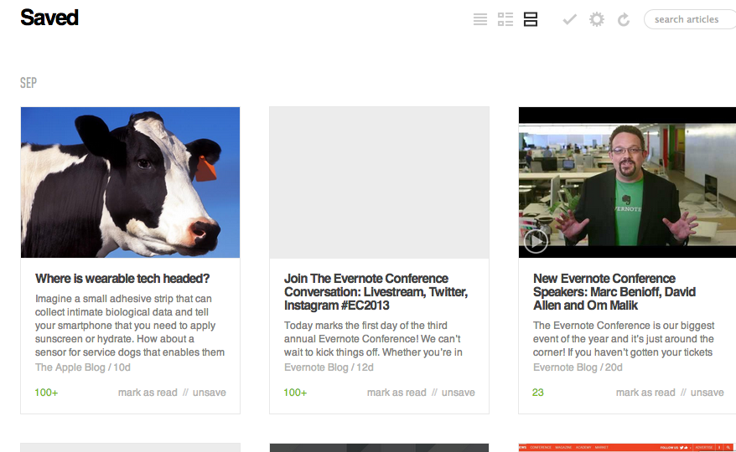
Feedly: Mac/Android
Notes:
export by email to Evernote

Slide 18
Putting It All Together
LibGuide Development
http://www.evernote.com
(note: examples only available during live presentation)
Poster text draft & layout
screenshots (snipping tool and screen capture)
imported articles & notes

Slide 19
Utilities for LibGuide Enhancement
Screen shots:
PC: Windows 7 Snipping Tool
Mac: Screen Capture Keyboard Commands
Cmd-Shift-3: full screen
Cmd-Shift-4: partial screen capture
Other tools: Wordle.net, MS Office clipart, Google Forms, Refworks (bibliographic management software), EBSCO Discover Search widgets, & Dropbox (photo auto upload)

Slide 20
Beyond Subject Guides
Tutorials
http://georgiasouthern.libguides.com/food2
Library Events
http://georgiasouthern.libguides.com/bbw
Online Poster Presentations
http://goo.gl/6YKKe
[Note: images captured with Snipping Tool]

Slide 21
Conclusions
Curation Tools and LibGuides Can Work Together to:
Collect and build content: links to databases, clipped pages/articles/images, URLs, store video & widget embed code; LinkedIn, Flipboard are other key content sources
Use Evernote for collaboration
Shared notebooks (Evernote premium)
Build project drafts
Capture whiteboards
Brainstorming
Go beyond subject guides to create tutorials, event pages,online presentations; internal staff resources/training

Slide 22
Contact Info
Ruth Baker
Learning Commons Librarian
Zach S. Henderson Library
Georgia Southern University
Statesboro, GA 30458
rbaker@georgiasouthern.edu
912-478-7823
@rbakergsu

