Slide 1
GMA Practicum Project
Eatonton, GA

Slide 2
City of Eatonton
The City of Eatonton is rich in antebellum history as it was the home of celebrated authors Alice Walker (The Color Purple) and Joel Chandler Harris, who wrote the beloved children’s fables of Uncle Remus, Chick-fil-A founder Truett Cathy, original Tuskegee Airman Hiram E. Little, Sr., and two-time Olympic gold medalist Vincent Hancock. Eatonton remains a hub for local artists and features many cultural attractions, including one of the finest performing arts facilities in the State, the Plaza Arts Center.

Slide 3
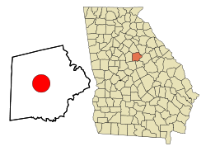
Facts About Eatonton
Population: 6,597 (2017 Census)
County: Putnam
Location: Middle Georgia
Attractions:
  Plaza Arts Center
  Uncle Remus Museum
  Rock Eagle 4-H Center
Notable People:
  Vincent Hancock - Olympic gold medalist (skeet shooting)
  Joel Chandler Harris - Author of the Uncle Remus stories
  Alice Walker - author of The Color Purple
  S. Truett Cathy - founder of Chick-fil-A

Slide 4
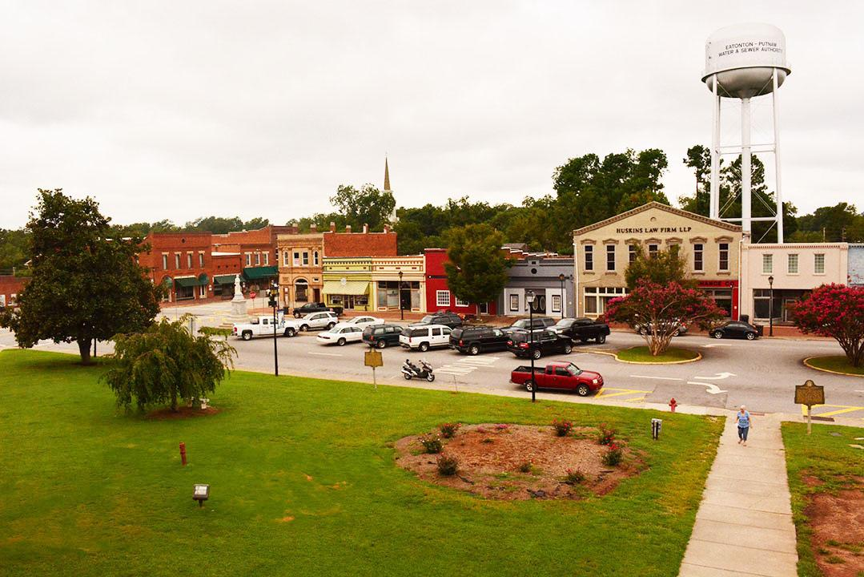

Slide 5
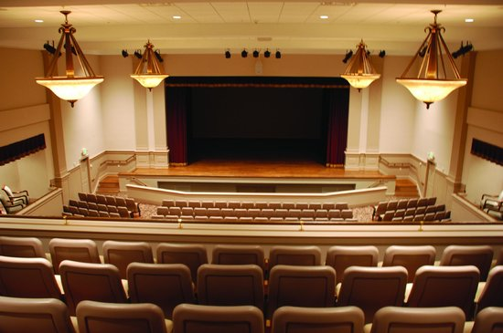
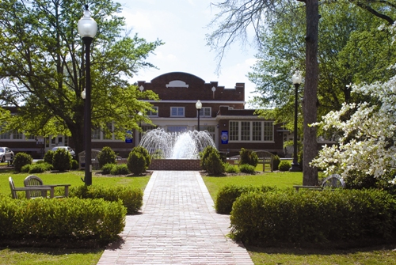
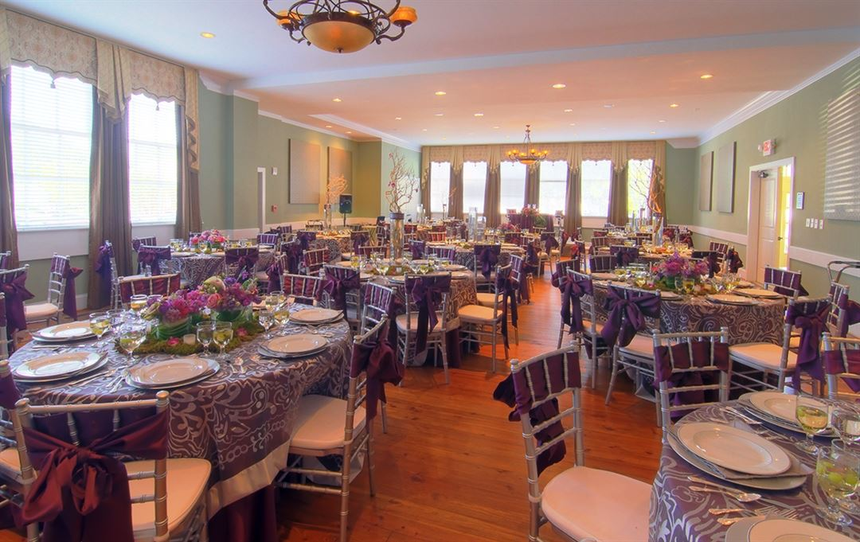

Slide 6
Task
The city of Eatonton desires to research the efficiency and effectiveness of its economic development activities and certain aspects of its economic profile. Specifically, the City
would like to achieve insight into the following:
Strengths and weaknesses of our current methods to recruit new business, to support existing business, and to support entrepreneurship both within the downtown business district and outside the district (but within the city limits)
Deficiencies in current infrastructure, utilities, and technology
Current availability and deficiencies of broadband internet services within our city limits
Challenges in accessing job opportunities and job training; where citizens work, shop, dine, and play (how to enhance, etc.)

Slide 7
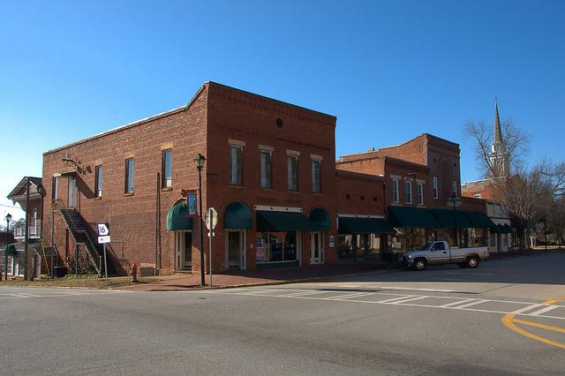
Historic Downtown
103 Historic Units
  74.6 percent of the downtown business units are considered historic
  Problem - city does not have any guidelines for maintaining the historic nature of the units
In May 2002, the Georgia State Income Tax Credit for Rehabilitated Historic Property was signed into law.
  The credit is a dollar for dollar reduction of State of Georgia income taxes and is meant to serve as an incentive to those who own and want to improve their historic properties by completing a rehabilitation project
    Program provides owners of historic residential (principal residence) properties who complete a DNR-approved rehabilitation the opportunity to take 25% of the rehabilitation expenditures as a state income tax credit
    Two additional program categories became available providing income tax credits capped at $5 million and $10 million per project and with a $25 million annual program cap.

Slide 8
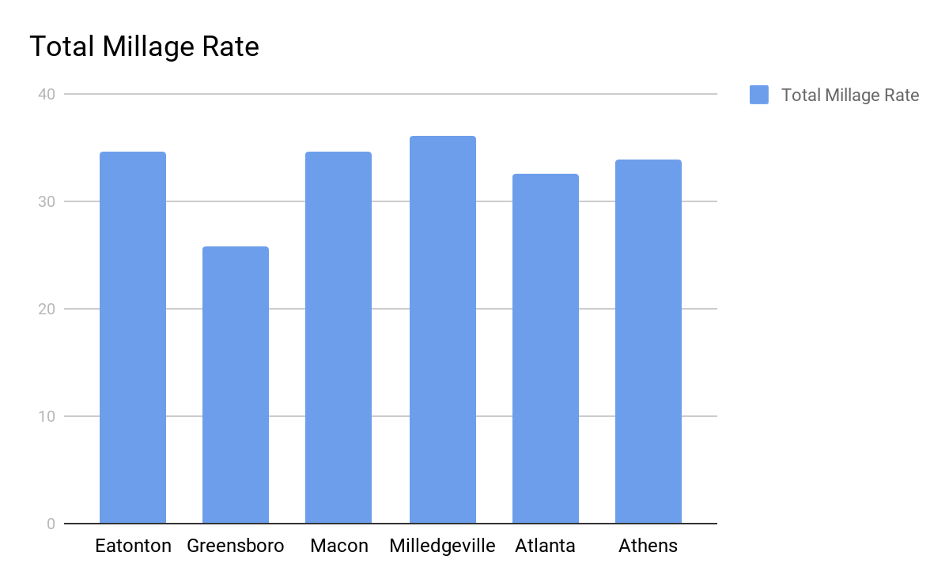
The tax rate used to calculate local property taxes. The millage rate represents the amount per every $1,000 of a property's assessed value.

Slide 9
What does this mean?
(Millage Rate)
No real advantage for the city of Eatonton
  More than cities of Athens and Atlanta, but about the same as smaller cities nearby
If Eatonton has a lower rate compared to other cities, it places Eatonton at an advantage due to being less expensive
If there are cities with a bigger market with the same or lower millage rate, people and businesses are more inclined to go to the larger cities to make more profit at the same rate

Slide 10
Downtown
Tax Increment Financing
“A flexible, self-financing tool to pay for infrastructure projects without raising taxes or diverting resources from other capital needs”
-Citizens Budget Commission
30.4 percent of the business units downtown are having no impact on the economy
  42 vacant units
    May require minimum work to become fully functional
Tax Increment Financing
  By using TIF, cities usually divert future increases in property tax revenue from a defined area or district to a community-based economic development plan or program for public improvement.
  How it works:
    Tax exempt TIF bonds are sold to provide financing for the purchase and preparation of the land
    Once prepared, the land is sold to developers below cost of preparing the site (known as land write-down)
    Pre-development costs are recouped through the tax increment fund over the life of the project, and the money in the fund is used to repay TIF bonds

Slide 11
Tax Increment Financing
As businesses locate in a TIF district and the area redevelops, the property values rise. Rather than simply collecting the increased taxes from TIF district properties, the city splits the property tax revenues into two streams.
First Stream - Set at the original amount of the property value before redevelopment, known as the “base rate.” This stream continues to go where it did previously, typically to the school district or the city's general fund that pays for local services such as police and fire departments.
Second Stream - contains the additional tax money generated by the higher property value, or the “tax increment.” This stream does not go to the city or schools, but is kept separate and used to pay for the redevelopment.

Slide 12
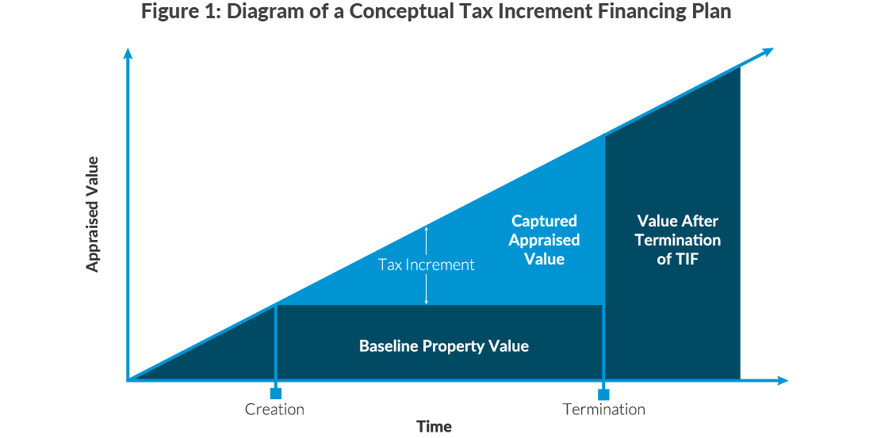
Tax Increment Financing

Slide 13
Broadband Internet Service
“In eras past, economic success depended on creating networks that could shift people, merchandise and electric power as efficiently and as widely as possible. Today’s equivalent is broadband ... Easy access to cheap, fast internet services has become a facilitator of economic growth and a measure of economic performance.” - The Economist
A public service that will ensure equal access for all, regardless of the community, to help address the digital divide.
A recent study for the Fiber Broadband Association found that access to broadband ranked only second to safe neighborhoods as a factor for relocating to a new community.
Both consumers and businesses now look for broadband connectivity when making stay-or-go decisions in any given community.
Businesses are able to participate in the global economy and leverage next-generation technologies much more easily
Economic Development
Creates Jobs
Attracts New Businesses
Serve Existing Businesses
Keeps Critical Jobs in Town
Advances Healthcare and Research
Initiates Technology Booms
Educational Advancements for the Community

Slide 14
Local key informant interview
President of Eatonton-Putnam Chamber of Commerce
  Mrs. Roddie Anne Blackwell
Strengths of Eatonton Business Economic Development
  Location: Between Macon, Atlanta, and Athens
  Multi-Agency Cooperation: City, County, Chamber of Commerce, developers, MainStreet Eatonton, and more are able to adapt and be flexible to meet the needs of current and prospective businesses
Weaknesses of Eatonton Economic Development
  Permitting can be a long process filled with input from State level Agencies
  Turnaround time for permits and documentation can be untimely leading to delays in business process
Infrastructure Deficiencies
  Lack of Broadband internet
  Water and Sewer infrastructure is lacking. Not owned by the city but Water Authority. One business has mentioned lack of water pressure for fire suppression system

Slide 15
Local key informant interview
A Kid World Of Peace
  Owner: Shirlon Mathis
History of Business
  One of three child care facilities located in the city of Eatonton . Provides daily child care services for kids ages 6 weeks to 12 years old.
  Shiron has currently owned the rights to the building for 10 years now and was renting prior to purchasing the property.
Code violations/renovations
  Throughout the 10 years Shirlon has owned the building she reports no building code violations
  There were also no major renovations performed on the building that were reported during our interview.
Possible Barriers for future business
  Shirlon experienced no problem opening her business. The city of Eatonton encourages more business to move in and help make the process very user friendly.

Slide 16
Strengths and weaknesses of the current business climate
Strengths
  Business currently operating have a long history of being in the community
  Owners of majority of the businesses are locals and have developed relationships with the consumers
  The ability to set own market prices for certain services that might be unique to the specific area
Weakness
  Limited potential for advancement in certain job fields
  While majority of the people in the town are in the education field, the limited number of education facilities makes it tough to advance

Slide 17
Challenges in accessing job opportunities and job training; where citizens work, shop, dine, and play
Internal Factors:
Lack of jobs in the area
Lack of community events
  Ex. Career Fairs
Lack of educational opportunities
  Promote expansion must upgrade educational facilities
External Factors:
City of Atlanta being approximately 1 hour away which provides a more diverse job market
Proximity to interstate (approximately 25 minutes from I-20)

