Slide 1
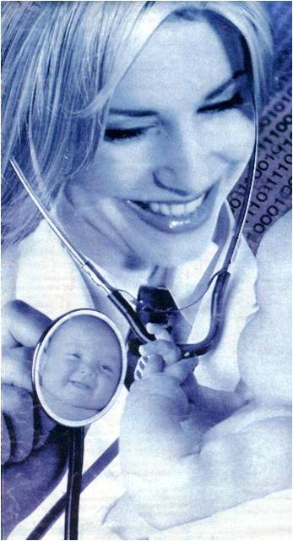
Medical College of Georgia
Augusta University
Designing an e-Guide
for physical examination
in pre-clerkship
medical education:
A pilot study
Elena Wood, MD, PhD; A.J. Kleinheksel, PhD

Slide 2
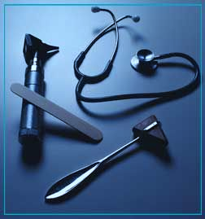
Medical College of Georgia
Augusta University
Medical Education
Undergraduate Medical Education
Pre-Clerkship
Physical Diagnosis
Physical Examination

Slide 3
Medical College of Georgia
Augusta University
Generations of Learners

Slide 4
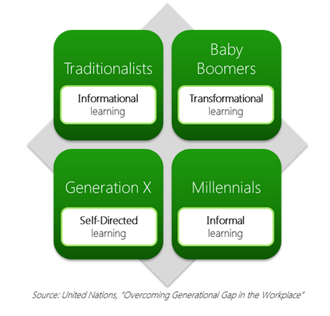
Medical College of Georgia
Augusta University
Generations of Learners

Slide 5
Medical College of Georgia
Augusta University
Leveraging Generational Traits
Receiving immediate information from multiple sources
Multitasking
Processing pictures, sounds, and videos before text
Interactive media

Slide 6
Medical College of Georgia
Augusta University
PE skills
Textbooks
WANTED
Visuals
Change needed!
Independent learner
Basic science integration
Lack of standardization

Slide 7
Medical College of Georgia
Augusta University
Purpose
Design a standardized electronic guide on psychical exam techniques for future reference.

Slide 8
Medical College of Georgia
Augusta University

Slide 9
Medical College of Georgia
Augusta University

Slide 10
Medical College of Georgia
Augusta University

Slide 11
Medical College of Georgia
Augusta University

Slide 12
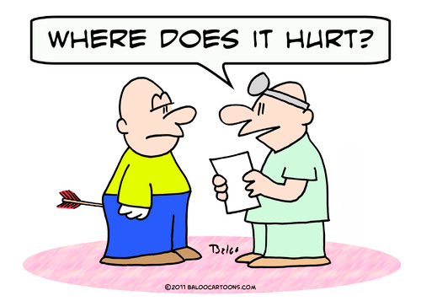
Medical College of Georgia
Augusta University
Features
Designed for first year medical students
Overlay of anatomy
Interactive PDF
Embedded quizzes for self-assessment

Slide 13
Medical College of Georgia
Augusta University
Evaluation
Focus group with second year students
4 students
Survey of first year students
112 out of 193 students (58%)

Slide 14
Medical College of Georgia
Augusta University
Evaluation

Slide 15
Medical College of Georgia
Augusta University
Evaluation
Downloaded 50%
Content was clear 4.5 (A+SA)
Helpful
Anatomy references 4.4 (A+SA)
PE techniques 4.2 (Agree)
Confident with Patient 3.8 (Agree)

Slide 16
Medical College of Georgia
Augusta University
Conclusion
Findings are consistent with theories of multimedia and adult learning
A well-designed e-guide has the potential to positively impact medical education
Students appreciated the compact and structural presentation
Validated need for additional e-guides

Slide 17
Medical College of Georgia
Augusta University
Thank you!
Questions?

