Slide 1
Using Puppets as Story Props for Read-Alouds
Presenters: Dr. Paulette Harris, Linda Smith, & Sarah Wong
Augusta University Literacy Center

Slide 2
Gardener Codding Test of Kindergarten/First Grade Readiness Skills (TKFGRS)
Year 1 Results After Using Puppets as Story Props:
Composite Score: Letter Knowledge, Phonetic Identification, Story Comprehension, and Word Writing

Slide 3
What Characteristics from Research are Indicative of Good Story Re-Telling Practices Using Story Props?
Adult Practices that Work With Picture Books:
Relate the story to the child’s interests and experiences.
Start with picture books.
Use story props that help young children make connections to picture books.
Encourage the child to respond to effective story props that enhance the impact and enjoyment of picture books significantly.
Ask open-ended questions
Review the story
Re-tell the story

Slide 4
Why is Re-Telling stories with Story Props Beneficial?
Re-telling is highly beneficial to English and dual language learners.
Children with special needs benefit from participating in story re-telling with props such as:
Shadow puppets
Stick puppets
Cloth puppets
Paper bag puppets
Finger puppets
Sock puppets
Egg carton puppets
Flannel board puppets
Mask puppets
Hats, caps, visors, gloves, and headbands

Slide 5
What Characteristics from Research are Indicative of Good Story Re-Telling Practices?
Child Re-Telling Practices that Work:
The child is prompted to re-tell the story.
The child is encouraged to role-play the story.
The adult prompts the child to elaborate on the story.
The child is encourages to use manipulatives and other visual aids as the story is re-told.

Slide 6
Research on Story Re-Telling & Pre-Emergent Literacy Skills
Pre-Emergent Skills Advanced by Re-Telling Include:
Oral language development, both receptive and expressive
Visual discrimination
Auditory discrimination
Concept development
Comprehension development
Word meanings
Details
Sequence
Inference
Main idea

Slide 7
Tips from Research for Oral Story Re-Telling
Re-tell stories from predictable books.
Children see themselves as readers of predictable books.
They learn the text quickly
They can join in on keywords and phrases
They can read along with simple text
They will learn to re-tell many predictable books verbatim
As children acquire 1-1 matching of spoken to written words, they begin to recognize words

Slide 8
Hints from Research for Adults when Engaging in Oral Story Re-Telling
Be familiar with the story but don’t need to memorize verbatim
Choose stories with familiar refrains where children can participate in the action of the story.
Use gestures and eye contact
Be sure to vary the length of the story to match children’s attention spans
Practice oral re-telling

Slide 9
Research Results: Will 3 or more story re-telling strategies used in a single re-telling episode likely result in positive outcomes?
Findings:
One to two characteristics were not effective.
Three or more had a more significant effect.
Five to six characteristics had the largest effect.

Slide 10
Strategies from Research that Support the Adult Use of Story Re-Telling
For Effective Story Re-Telling, You Need:
High-quality children’s book collection
Begin acquiring a story prop lending library
Generate a Pinterest literacy board of re-telling ideas
Share story props that are commercial and take time to create your own props

Slide 11
Research Says for Story Re-Telling, Look for Stories that Include:
1. Repetition of the same phrase, sentence, or passage throughout the story (for example: Three Little Pigs)
2. A familiar sequence such that the story is organized around a recognizable concept for children, such as days of the week, letters of the alphabet, or opposites.
3. Look for stories where a pattern is repeated with a slight variation. (for example: The Gingerbread Boy).
4. Look for stories where questions that are similar are repeated throughout the story (for example: Mama, Do You Love Me?).
5. Look for stories that contain a chain so that the storyline is linked so that the ending of the book goes back to the beginning (for example: If You Give a Pig a Pancake).
6. Look for stories that are cumulative so that each time a new event occurs in the story, all of the previous events are repeated (for example: This is the House that Jack Built) .

Slide 12
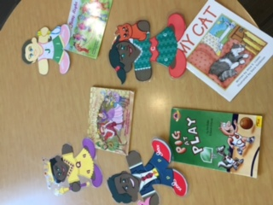
Puppets as Story-Props Build on Children’s Unique Reading Styles

Slide 13
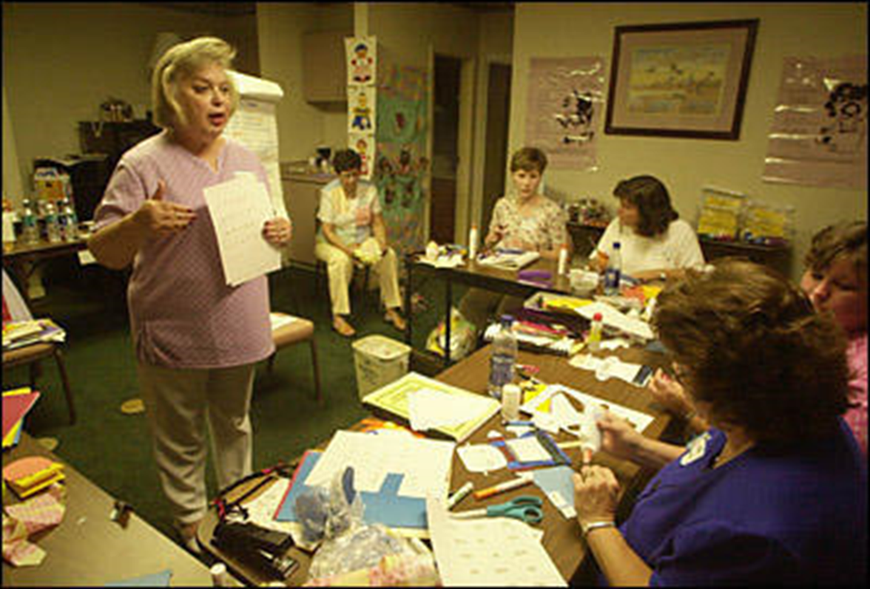
The “right” reading style, matched to any student’s learning preferences increases reading motivation and achievement.

Slide 14
Global learners prefer:
1. Soft lighting

Slide 15
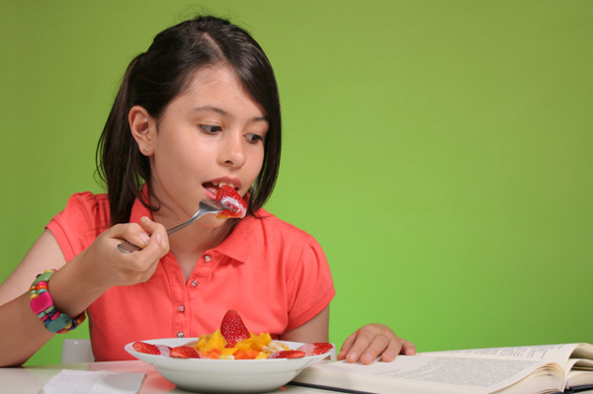
Global learners prefer:
2. Snacking When Reading

Slide 16
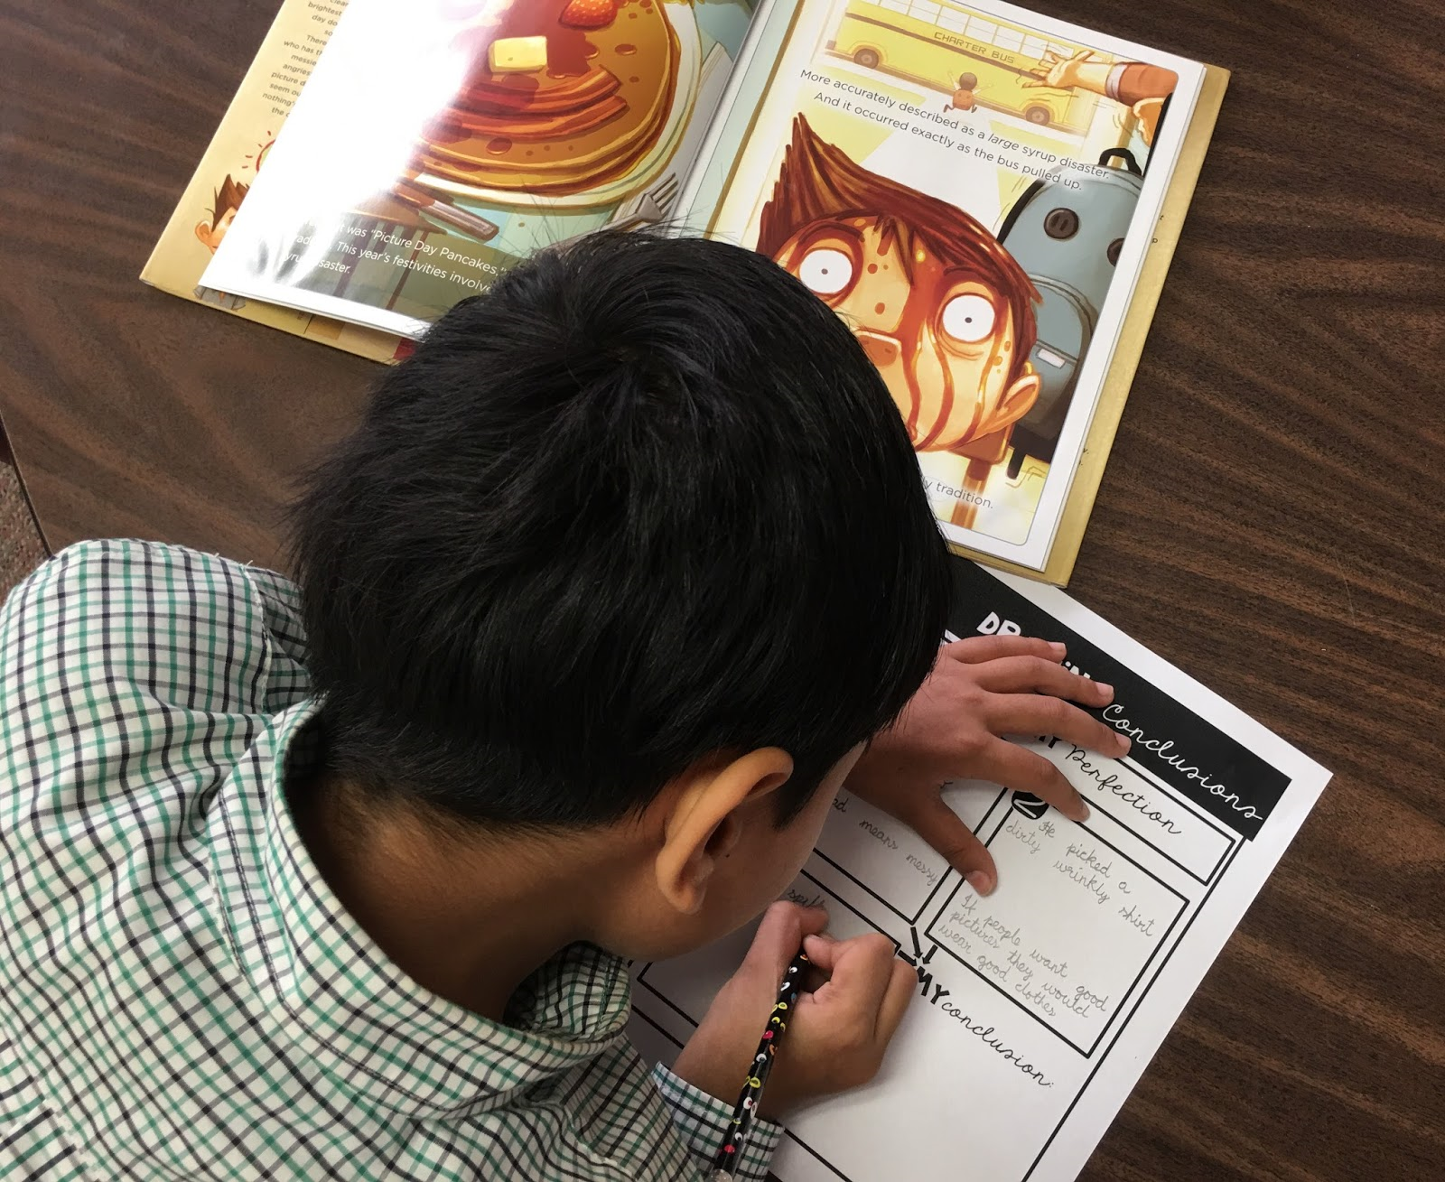
Global learners prefer:
3. Drawing about what they have read

Slide 17
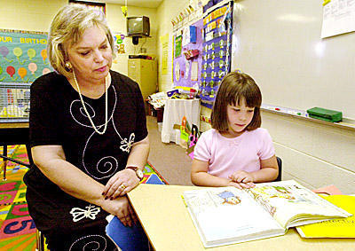
Analytic learners :
Prefer to read alone and begins with facts from story gradually moving to the explanation of the overall topic the author presented.

Slide 18
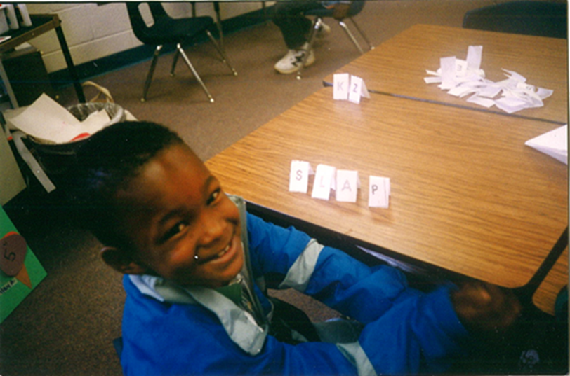
Tactile learners trace as they learn to read

Slide 19
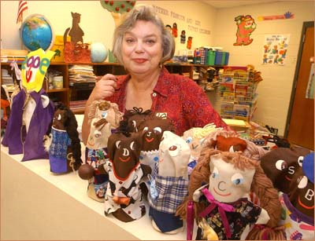
Kinesthetic learners use manipulatives with hands-on learning

Slide 20
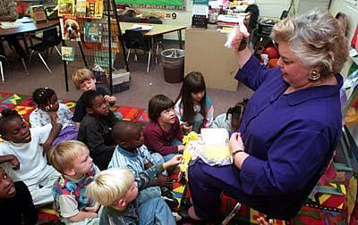
Reflective learners really like to re-enact stories

Slide 21
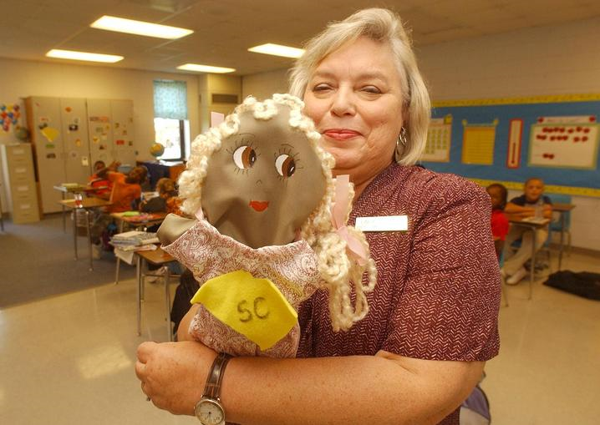
Auditory and visual learners like to hear and see as they read

Slide 22
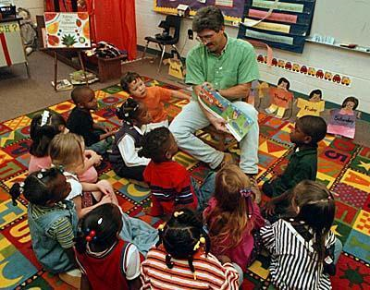
Accommodating the styles of learning to read through research-based reading aids struggling readers of all ages

Slide 23
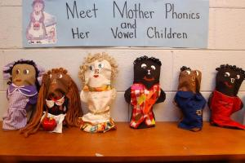
Puppets help children bring literature to life

