Slide 1
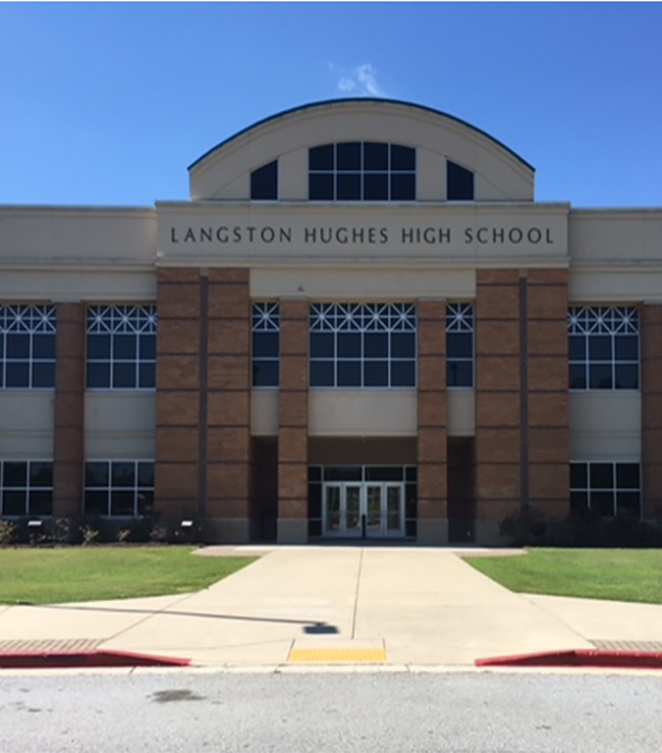
Langston Hughes High School Road to a Successful High School PBIS Implementation: Glows and Grows
GAPBS 12th Annual Conference
December 5, 2019

Slide 2
Learning Outcomes:
Participants will understand the importance of creating a cohesive PBIS Team to meet the challenges of a high school environment.
Participants will acquire a variety of systems and interventions to improve school climate and culture.
Participants will explore Tier 2 supports and interventions to redeliver to their respective schools.

Slide 3
Who We Are: Langston Hughes High School's Demographics
Student Population (2019-2020): 1,941
Black/African American: 1,701
Hispanic/Latino: 191
Multiracial: 24
White: 18
Asian: 6
Native Hawaiian/Pacific Islander: 1
ESOL: 69
Services for Exceptional Children (including GNETS and CBI): 242
Advanced Placement Program: 292
Homeless: 20
Dual-Enrollment Scholars: 117
Talented and Gifted Program: 116

Slide 4
Supported by:
Mr. Charles Chester, Principal
Dr. Kevin Scott, Program Specialist SLC
Mrs. Maribel Bell, Director of Student Discipline
The D.O.T.
"The Department of Transformation"
Elements for a Cohesive Team:
Coach
Administrator
School Social Worker
Parent Liaison
Department Chairs
Teachers
Behavior Specialist/RTI/MTSS Support

Slide 5
Despite our best efforts, the combining of many different neighborhoods and schools brought its share of challenges.
The next slides will outline the behavioral data of our second year and show the need for change to ensure our future success.
Opened in 2009 with nearly 2400 scholars zoned from 3 different rival South Fulton County Schools.

Slide 6
"Rough Road" DISCIPLINE DATA: 2010-2011

Slide 7
Description of Incidents for 2010-2011

Slide 8
Drilling Down
Tier 1 Focus Area:
Attendance
Attendance Subgroup:
Tardiness
Data Collection:
Teacher Surveys
School-Wide Data
Discipline Reports (Increased altercations during transition)
Social Worker Referral
Two-Way Parent Communication

Slide 9
Panther P.R.I.D.E
Scholar Professional Development System
Monthly Lessons
PBIS Reward System
PBIS Incentives
PBIS Initiatives
Share Monthly Discipline Data

Slide 10
PANTHER P.R.I.D.E. Behavior Matrix

Slide 11
PBIS Rewards System
Scholars earn points for positive behavior
Incentives can be personalized (i.e. Homework pass)
Any staff member can award points
Scholars use points to purchase incentives

Slide 12
PBIS Initiatives
Panther of the Month
PBIS Rockstar Teachers
Dress for Success Wednesdays
15/15 Hall Pass Rules
Sweep Tardy Policy
Positive Panther Calls

Slide 13
Dig In: SWOT Analysis
Strengths
Weaknesses
Opportunities
Threats

Slide 14
Strengths Strengths
PBIS Positive impact on discipline
Discipline Data shows a decrease in scholar infractions
Moving from Operational to a DISTINGUISHED High School
School climate rating improved from 2 to 4 Stars
District and Building Leadership Support
Change in Leadership
Strengths​

Slide 15
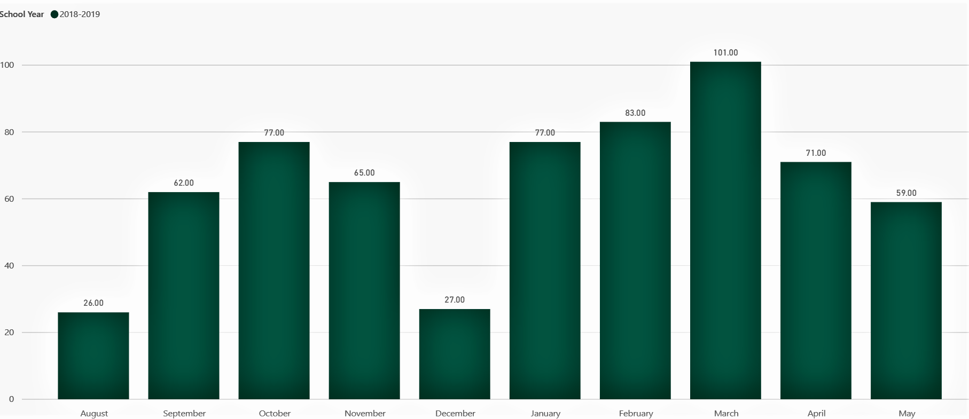
DISCIPLINE DATA:
2018-2019

Slide 16
DISCIPLINE DATA: 2010 VS. 2019

Slide 17
Vision + Teamwork = Distinguished

Slide 18
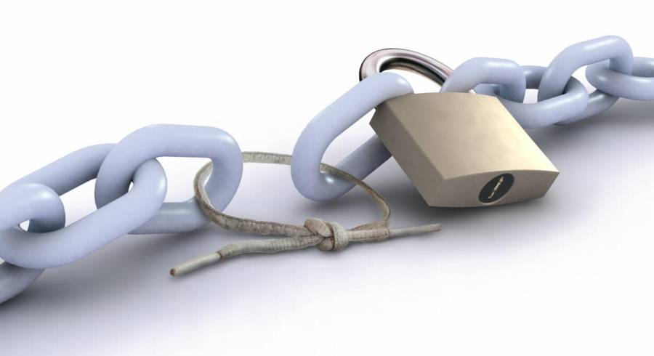
Weaknesses
Implementation of PBIS Lessons/Incentives
Scheduling Constraints
Off-campus student programs
Financial Constraints
Frequency of PBIS Events
Teacher Buy-In
Scholar Buy-In
Purchase of the PBIS Rewards and it's components
Scale of the Events
Stakeholder Participation
Change in leadership

Slide 19
Changing Culture and Climate
Establishing a Growth-Mindset
Building Teacher-leader capacity with Tier 2 Implementation
Student ownership of our PRIDE behavior and academic expectations
Increased Community and Business Partnerships
Big District Push
9 Distinguished Schools
42 Operational Schools
Langston Hughes is the only Distinguished HS in Metro Atlanta (1 of 5 in the state of GA)

Slide 20
Threats
Parental Involvement
Streamlined Organizational Structure and Communications
Multi-Tiered System of Supports
Positive Behavior Interventions and Supports
RTI – Response to Interventions
Time Constraints
District-wide Scheduling
Planning
Parent engagement at the high school level
Working class community limits ways parents can support the school

Slide 21
Under Construction: Present State
Tier 2 Implementation
CICO Mentorship Program
Behavior Expectation Videos

Slide 22
Tier 2 Implementation: Check-In/Check-Out
Established CICO Mentorship Program
Pilot: November – December 2019
Full Implementation – January 2020
Tier 2 Folder
Teachers have digital access to folder
Contains various resources for Tier 2 Implementation
Focus area: Unexcused absences (over 13 days)
Plan to target some students with excessive ISS days and infractions like disrespect/defiance
Resources located within the QR Code Link

Slide 23
Tier 2 Implementation: CICO Nuts and Bolts
SUMMARY OF CICO PROCESS:
Selected 20 Teacher-Mentors
Strategic assignment of teacher and students
Teacher-Student Ratio – 1:3; Pilot Teacher-Student Ratio – 1:1
Identified students using the District's Behavior Risk Report (Attendance Indicator)
Cross-referenced with School Social Worker (SSW) Reports
Attendance Referral Form
SHORT-TERM GOALS:
Ongoing Teacher training to increase buy-in
Feedback is necessary from stakeholders (i.e. mentors, teachers, CICO students, and administration)
The great debate: Paper vs. Electronic process

Slide 24
Tier 2 Implementation: Behavior Expectation Videos
Additional Supports and Interventions
Videos based on our highest infractions
Student-produced scenarios on "What To Do and What Not To Do"
Langston Way PD: Starring Students, Faculty, Staff, and Parents

Slide 25
Tier 2 Implementation Example: Tardy Video

Slide 26
Thank You!
“Kids don't remember what you try to teach them. They remember who you are.”
~Jim Henson
“I’ve come to a frightening conclusion that I am the decisive element in the classroom. It’s my personal approach that creates the climate. It’s my daily mood that makes the weather. As a teacher, I possess a tremendous power to make a child’s life miserable or joyous."
~Haim Ginott

Slide 27
Email us at LH_PBIS@fultonschools.org. Follow us @Theefavored_1; @Dr_Isom11; @LoveTeachGrow.
Feel free to contact us! We would love to share ideas and answer any questions.

Slide 28
Q & A Session

