Slide 1


From Chaos to Calm
Three Behavior Management Strategies for “Complex” Students
A FREE Webinar With Jeff Copper
ADHD Coach & General Manager of Attention Talk Network
Elaine Taylor-Klaus CPCC, PCC
Diane Dempster, MHSA, PCC,CPC
Co-Founders
Notes:
From Chaos to Calm: Three Behavior Management Strategies to Help “Complex” Students Achieve
Taking Aim
Manage Triggers
Naughty vs Neurological
Effective Systems and structures

Slide 2





I’m Trying!
Try Harder

Slide 3



Everything’s going to be OK!

Slide 4


Working with “Complex” Kids is different!

Slide 5
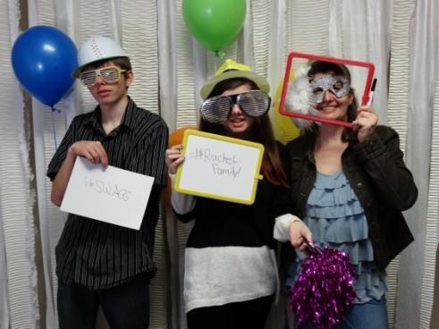
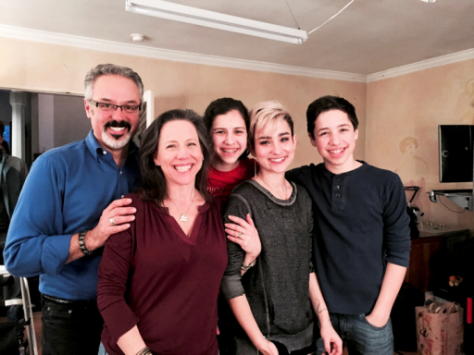

Slide 6
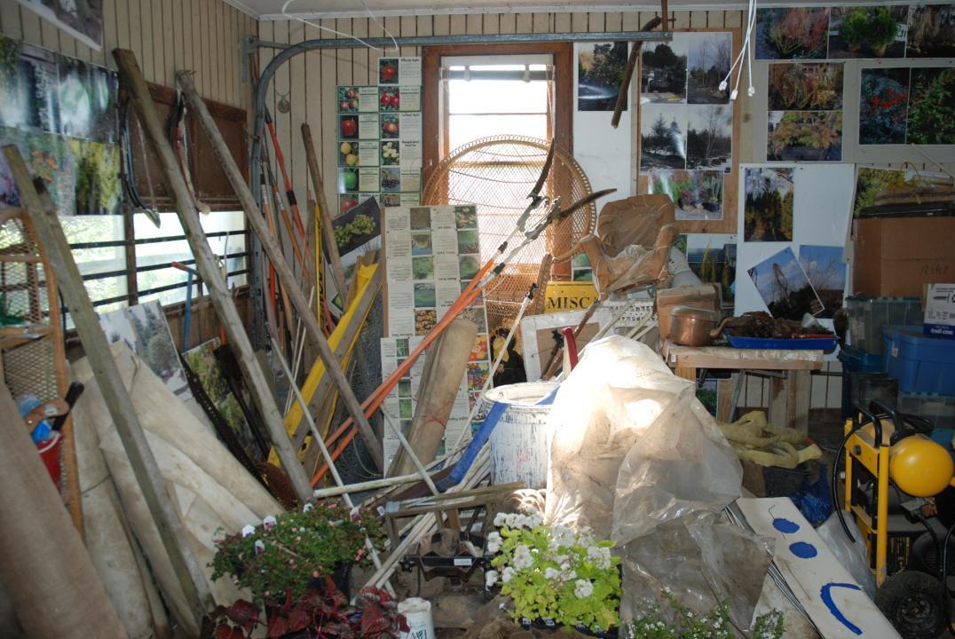
Notes:
We’re not just dealing with one issue
We’re dealing with LOTs of co-existing conditions – 95% of TS

Slide 7

Change Feels Hard!

Slide 8
Coaching Tip #1:
Celebrate the Victories, Large & Small!

Slide 9
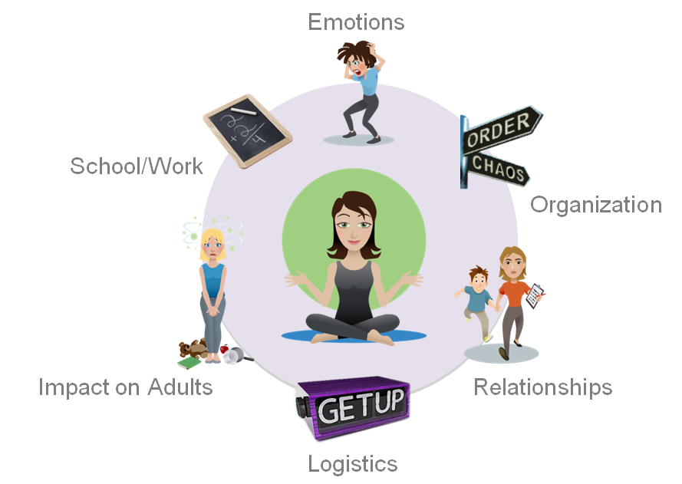
6 Key Challenge Areas
Notes:
Distractibility
Impulsivity
Restlessness/Hyperactive
Emotional intensity
Organization
Relationships
We’ve identified, through working with parents, 6 universal challenge areas……
Research on the Most Difficult Times of Day; on the Top 5 Parent Concerns; on Top Parent Challenges
And MOSTLY, on what we’ve heard from the thousands of ImpactADHD parents whom we talk with, email with, support, etc.
Problem & Benefit
Emotional intensity – Diane yelling at my kids
Organization – Tell Matt & Howie
Relationship – Elaine tells Michelle’s story
Logistics – Getting up and out in the morning or before dinner or bedtime is a hot-button time. – Elaine
Impact on the Mom – Elaine to tell her story
School – Lana & Josh/ Sheri & Noey -15 year olds – Scaffolding and not doing for them needed to learn skills to stop doing it for him and teaching him to do it for himself.

Slide 10

Treatment Improves
Outcomes

Slide 11

Treatment
Includes
“Behavior Therapy”

Slide 12
“Imagine a treatment that could manage the behavior of a child with ADHD, make you a better parent, and enlist teachers to help him do well in school…There is such a treatment. It’s called behavior therapy.”*
~Laura Flynn McCarthy,
ADDitude Magazine

Slide 13
“Behavior Therapy represents a broad set of specific interventions that have a common goal of modifying the physical and social environment to alter or change behavior.”
~ American Academy of Pediatrics:
http://pediatrics.aappublications.org/content/128/5/1007

Slide 14
“Although Behavior Therapy shares a set of principles, individual programs introduce different techniques and strategies to achieve the same ends.”
~ American Academy of Pediatrics:
http://pediatrics.aappublications.org/content/128/5/1007

Slide 15

A New Approach to Working with Kids
Notes:
Pitch

Slide 16
The Coach-Approach
A style of communication & leadership that:
Teaches Resilience
Motivates Independence
Inspires Kids to Overcome Obstacles
Helps Kids Reach To their Full Potential

Slide 17


Desperation
HELP!

Slide 18
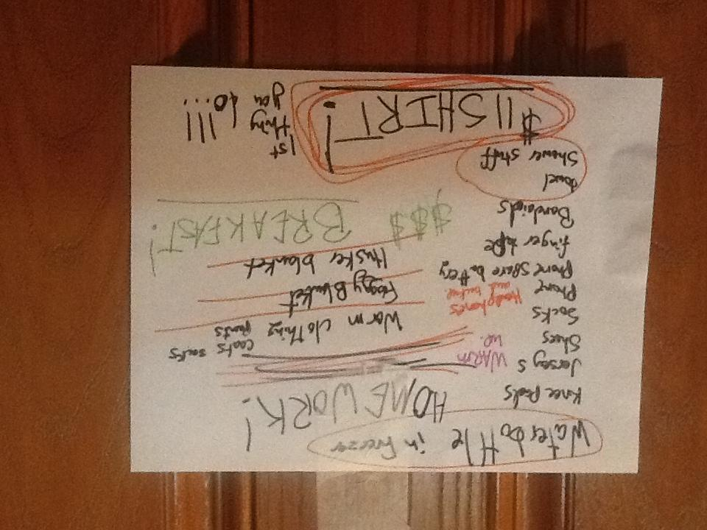
Inspiration!

Slide 19




Systems and Structures are a key component of any BEHAVIOR MANAGEMENT System

Slide 20
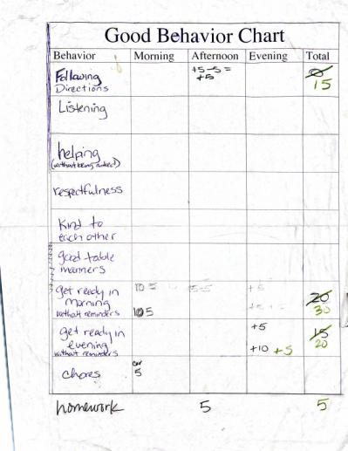
Systems & Structures are tools, Not the END Goal

Slide 21


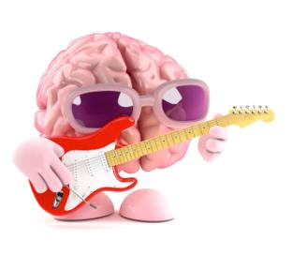
Structures are stronger in context

Slide 22

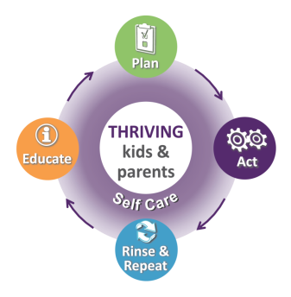

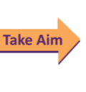
ImpactADHD® Action Model
Four Critical Response Areas
Activate the Brain
Shift Expectations
Positivity
Systems & Structures
ImpactADHD® 2014 all rights reserved
Notes:
We’re going to teach you how to tackle your family’s school troubles by using the Parenting Action Model that you learned in the Orientation.
PARENTING ACTION MODEL VISUAL
Throughout this course, we’ll provide different information and strategies, but the bottom line approach to what we’re going to do in the coming modules is how all change happens: see the need, figure out what to do about it, make a plan, take action, see how it’s working, tweak it and do it again! So we want you to REALLY learn this model, because you’re going to use it frequently whenever you are facing challenges, both large and small.

Slide 23

    Three Strategies for Success
    Take Aim
    Naughty vs Neurological
    Be Positive
Notes:
SUM UP what’s been discussed so far

Slide 24
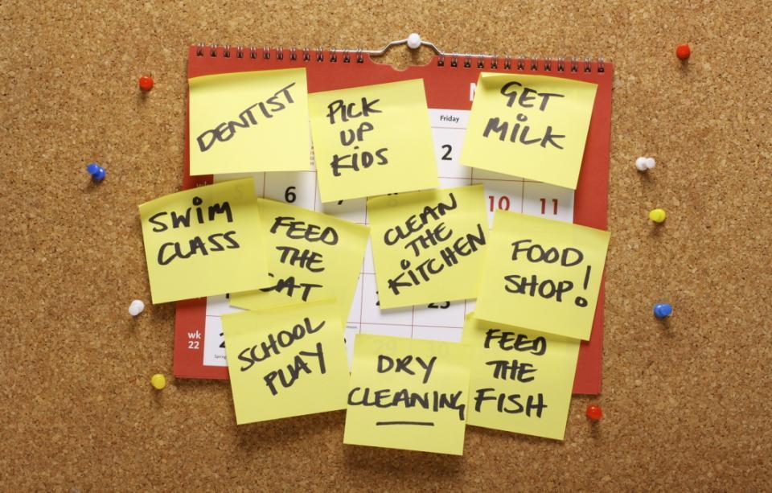
You can’t do it all at once!
Notes:
Different things you might explore depending on your family’s challenge areas –
We cover a lot of different approaches in our group coaching program – Parent Success System ☺ --
Executive Functions
Or
Learning styles
Or
Love languages
Just Depends….

Slide 25

Taking Aim Makes Systems & Structures more Effective
Notes:
Reiterate again what we “typical

Slide 26

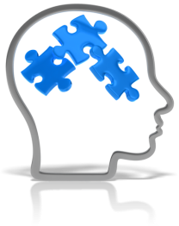
Is it …
Naughty or Neurological?
Notes:
Whenever you hear yourself saying to yourself, “why can’t you just…”
Ask yourself…. is it Naughty or Neurological?
If children are being naughty, it means that they CAN do something, but they won’t. If you treat that behavior as naughty, you can re-direct it over time. The goal is to help your child learn that “Crime does not pay!”
So when you ask yourself, “Is it naughty or neurological,” and the answer is really that he was just being naughty, then you can respond appropriately.
But if a child’s challenges are neurological – if he’s struggling with Anxiety, or Impulsivity, or limited working memory -- it means that there is some way in which he CAN’T do something until he learns how.
If you treat that neurological behavior as naughty, you are likely to foster a child who will either give up (“nothing I ever do is good enough, anyway”) or try to get even (“I’ll show her!”).
On the other hand, if you recognize when a child’s neurological challenges are not naughty, you’ll create an environment where your child sees you as an ally. This will help you foster a child who is hopeful, optimistic, and feels understood and willing to work together with you to solve problems.

Slide 27

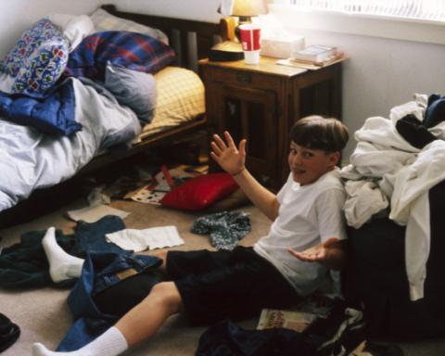
There are two components to School Success:
Cognitive/Intellect &
Executive Function
Notes:
Two kids – one that is thinking – and one with chaos/disorganization…

Slide 28


Slide 29

Stay CALLLMMM!

Slide 30

Focus on What’s Working

Slide 31

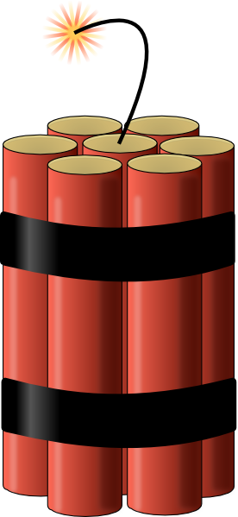
What are YOUR Triggers?

Slide 32

Strategy for Calming Down and Managing Triggers
Touch on the Stress Cycle by focusing
On Reclaiming the Brain
Identify 3 things that work for them to
Reclaim the Brain??

Slide 33
Key Strategies for Complex Kids
Celebration
(Solutions are in Successes)
Stay Calm
Inspiration! (Believing in what’s Possible)
Focus on what’s working
Smart is NOT the same as Organized
END with structures, don’t Start there
Naughty or Neurological?
Take Aim

Slide 34

Wrap Up
What did I focus on, or pay most attention to, today?
What’s my clarity, or take-away?
What is a realistic action step for me to take?
How can I set myself up for success with this action?

Slide 35

Q & A

Slide 36

www. SanitySchool.com

