Slide 1
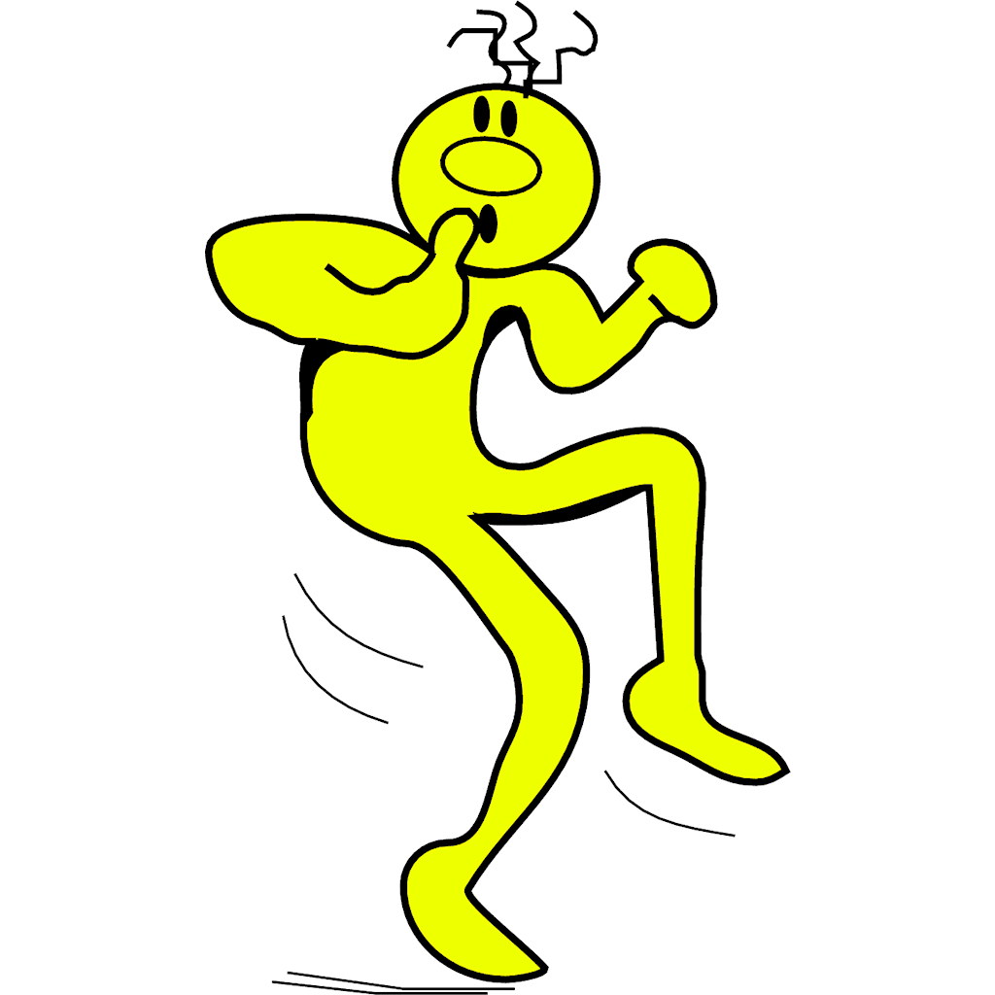
How to be "Sneaky Smart" with Elementary Classroom Management
Jeffery R. Craver, Ph.D.
School Psychologist
Rockdale County Public Schools

Slide 2
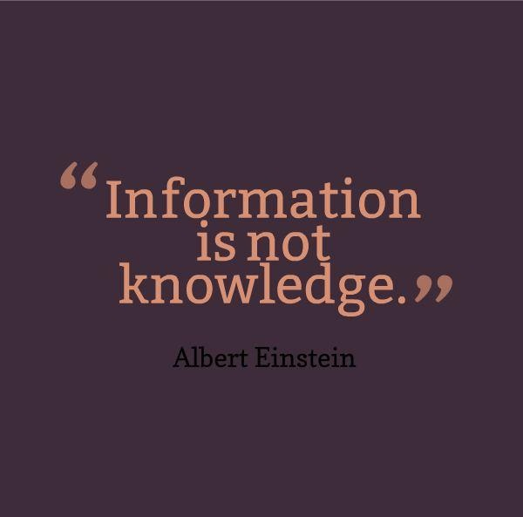

Many Thanks to:
Dr. Terrance M. Scott, Univ. of Louisville
Dr. Rob Horner, Univ. of Oregon
Dr. Kent Parker, Oconee School District, SC
John Maag, Univ. of Nebraska
TED Talks Videos & NPR

Slide 3

Goals for Today
Help improve some of the evidenced based interventions that you already use (& this may require some honest self-reflection)
Expose you to some new strategies/ interventions to try as you deal with challenging behaviors, & perhaps re-frame some thoughts
Help you to make your life in the classroom easier

Slide 4
Student Outcome and Prevention Model for Schools
Tertiary Prevention:
specialized & individualized
strategies for students with continued failure
~5%
Secondary Prevention:
supplementary strategies
for students who
do not respond to primary
~15%
Primary Prevention:
school-wide or class-wide
systems for all
students and staff
~80% of Students
Notes:
4

Slide 5
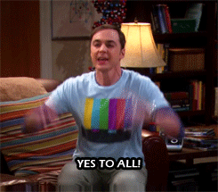
Being Sneaky Smart
Creates the Chance to both
Prevent & Teach

Slide 6
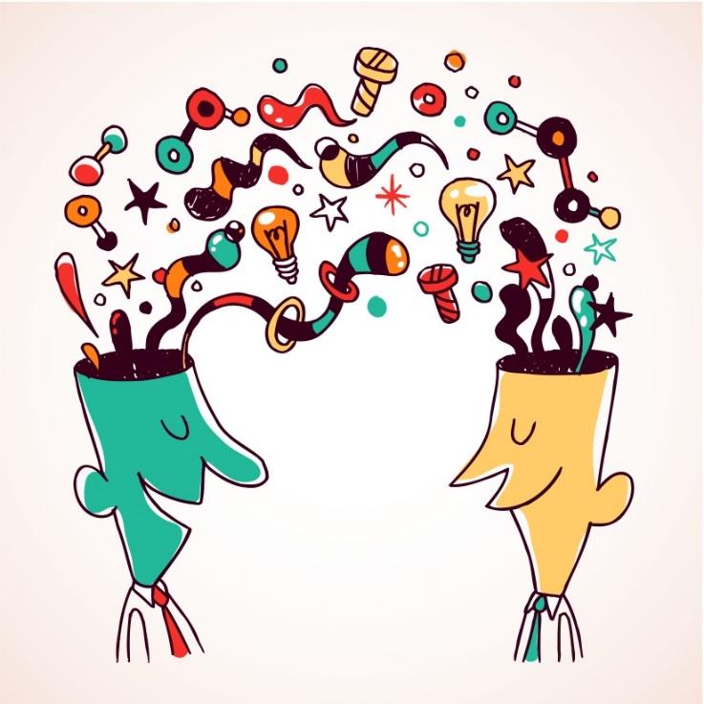
Sharing some lessons learned from others
START BY

Slide 7
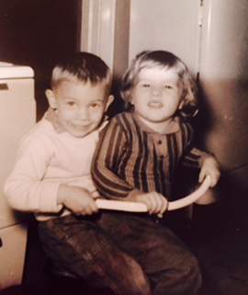
It is hard to imagine why a child would . . .
Intentionally behave in
a way that would make
other people respond in a
manner that makes him miserable
Ross Greene, PhD

Slide 8

An “Ah Hah” Moment…
It was that unexpected response from a parent…

Slide 9
And I get that:
As educators we seek to teach, not manage behaviors
We want parents to “parent” & support us
We are under great time pressure & constraints
And yes, none of us would likely have even “done that” or “spoken that way to an adult”

Slide 10
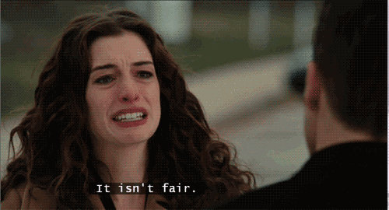
And I also get…

Slide 11
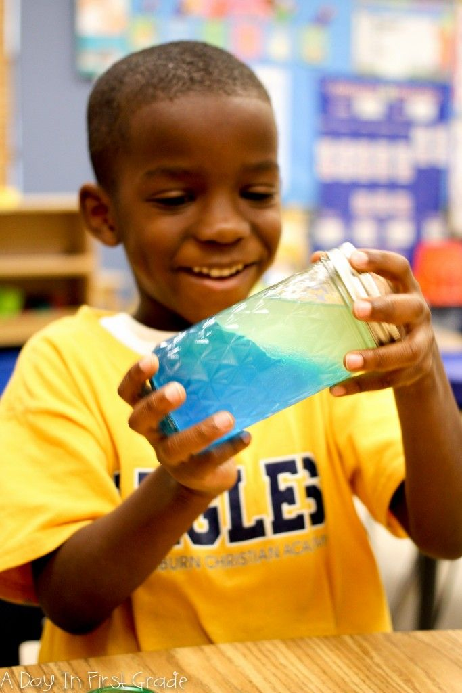
Sneaky Smart Strategy
Sometimes when we focus on creating & facilitating learning experiences rather than the management/discipline it:
  Automatically engages kids
  Causes us to have natural, authentic “flow”
  Because after all, education matters to us!

Slide 12
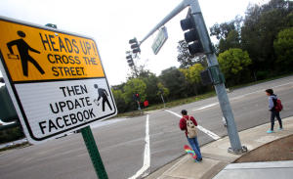
Reassess whether we have been clear in expressing the expectations (when taking a grad course, you expect that syllabus at the 1st class, don’t you?)
Engage students immediately by:
  Planning your opening
  Creating a multi-modal experience
  Grabbing their attention

Slide 13
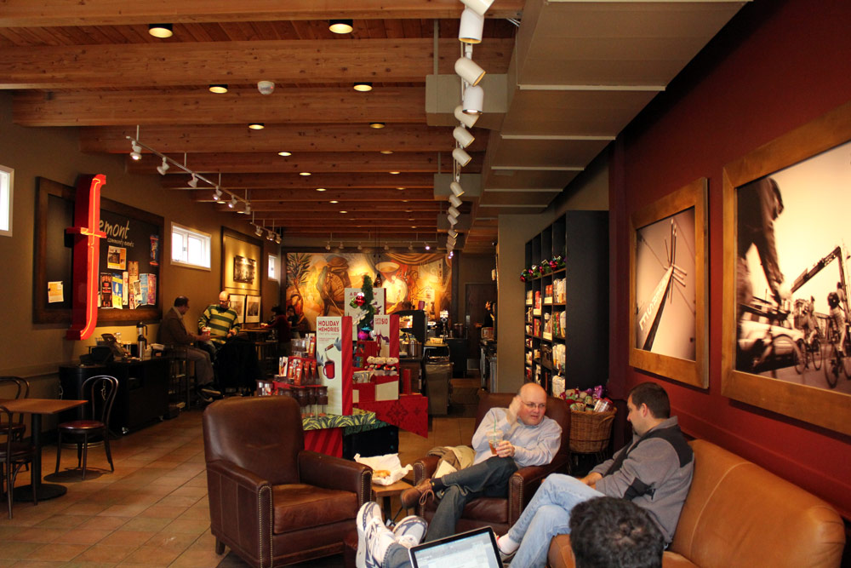
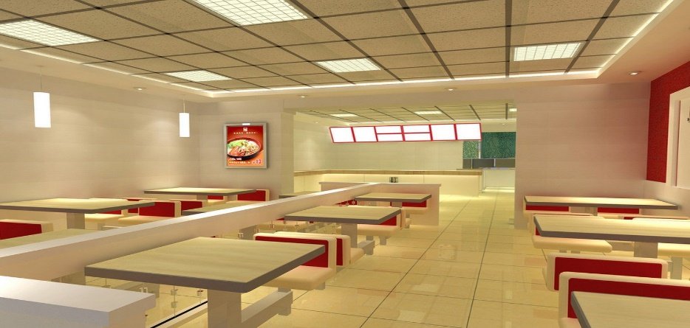


Space is Important

Slide 14
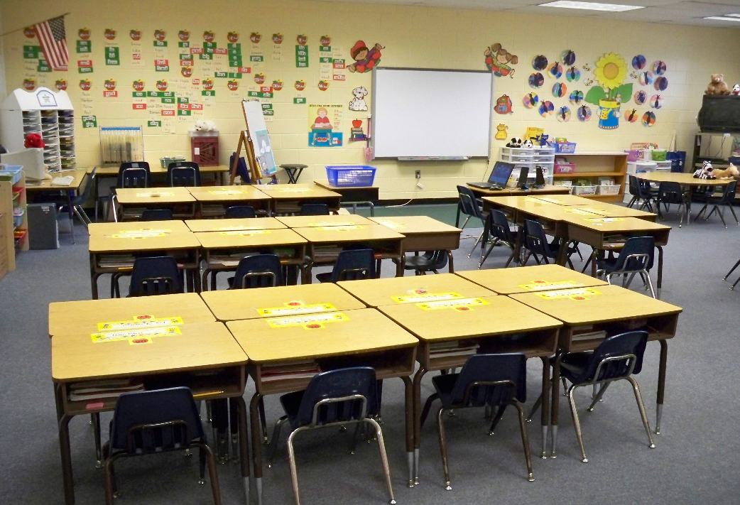
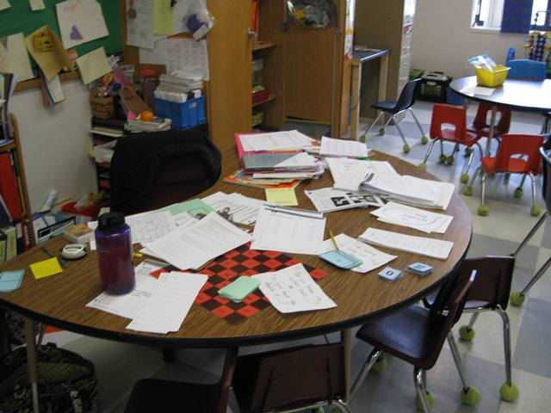
Engage students immediately by:
  Planning your opening
  Grabbing their attention
  Making a multi-modal experience
  What do they see/hear?

Slide 15
2016 study-compared the effects of watching a music video about fossils to a video with same content, but w/o music or music-video style. 87 middle schoolers in New Zealand were randomly assigned to watch one or the other.
Both groups showed significant improvements from their initial scores immediately after watching a video.
28 days after-Video w/o music: Students forgot what they'd learned but music video watchers retained more when tested.

Slide 16
Website: NPR-songs-help-you-learn-scientific-concepts
http://www.npr.org/sections/13.7/2016/05/02/476419823/can-songs-help-you-learn-scientific-concepts

Slide 17
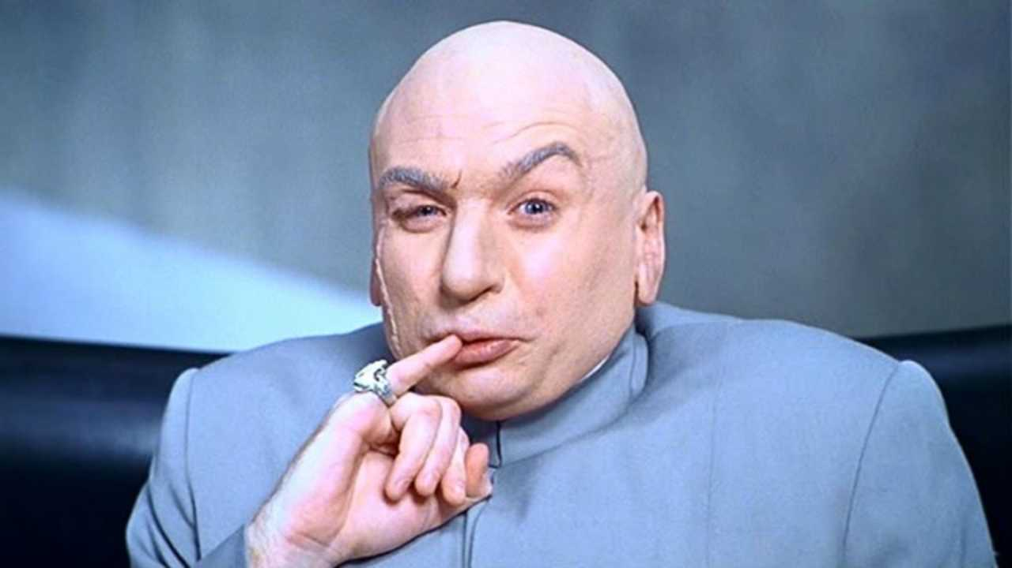
More Lessons Learned:
Being Sneaky Smart does not mean “giving in”
It is all about looking at our (adult) behavior & being sneaky smart regarding prevention
The positive supports/pre-corrects that we can put into place
Adults have control in creating a positive trajectory of compliance
It is best to alter the environment-physical & emotional

Slide 18
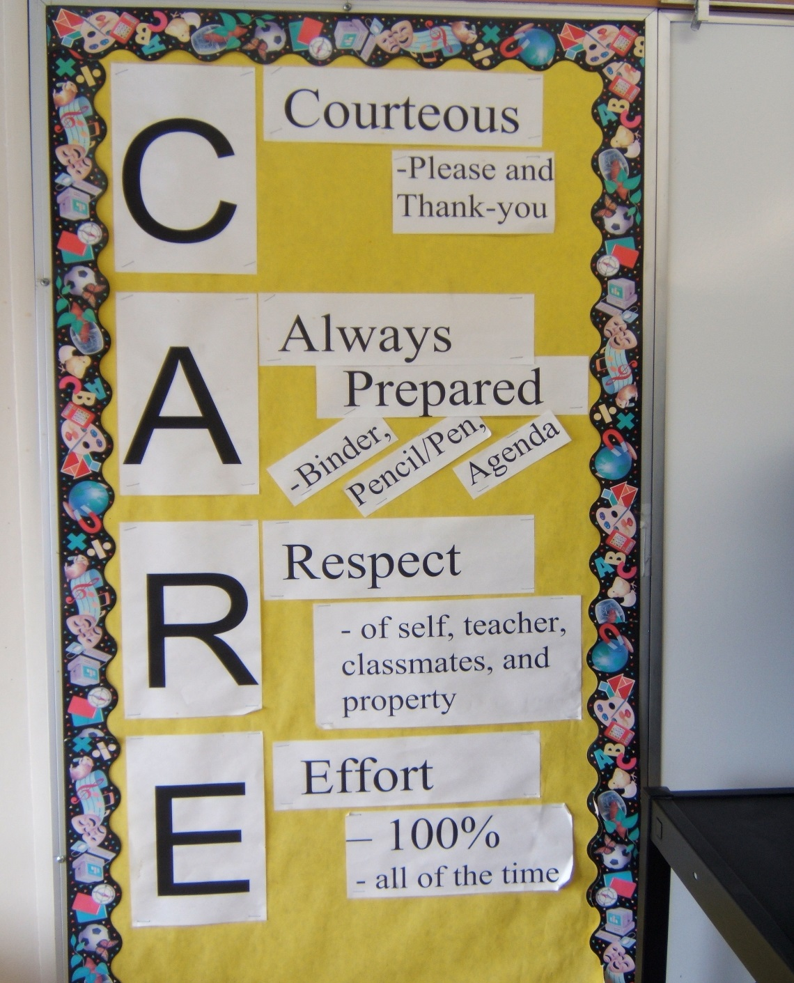
Sneaky Smart Strategy
Focus on structure,
class procedures &
expectations of what
needs to happen during
any unstructured times
-class entry, if you finish
your work, etc.

Slide 19
As you watch this short video…
And you see the adult interactions with these elementary students, ask yourself if the adults were setting the stage for that positive trajectory of likely getting the student to comply in the future…
What behaviors are the adults “giving life” to?
What emotional environment are they setting up?

Slide 20
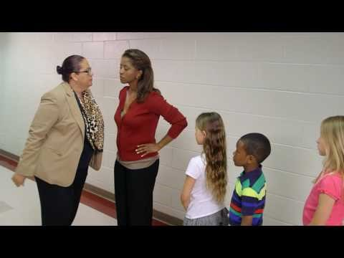

Slide 21
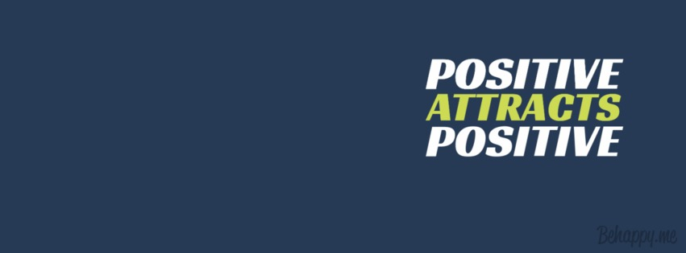
Be Sneaky Smart by…
Giving “LIFE” to what you want to see more of
AKA Being Positive

Slide 22
Interventions that Focus on the Positive
100 Squares
Transition tickets/Lottery
Mystery Hero Student
Role Model Student
Student of the Week/Month
Using visuals to chart positive progress (T. over E.)

Slide 23
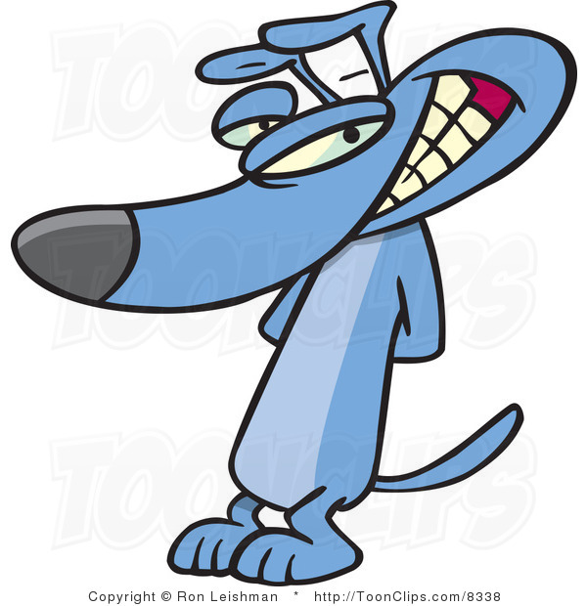
Your Turn
What are some strategies
that you have used
or seen used to
increase the
“positives” in your
classes?
Notes:
Beginning of class strategies
Checking in with students have them share
Use of assignment books

Slide 24
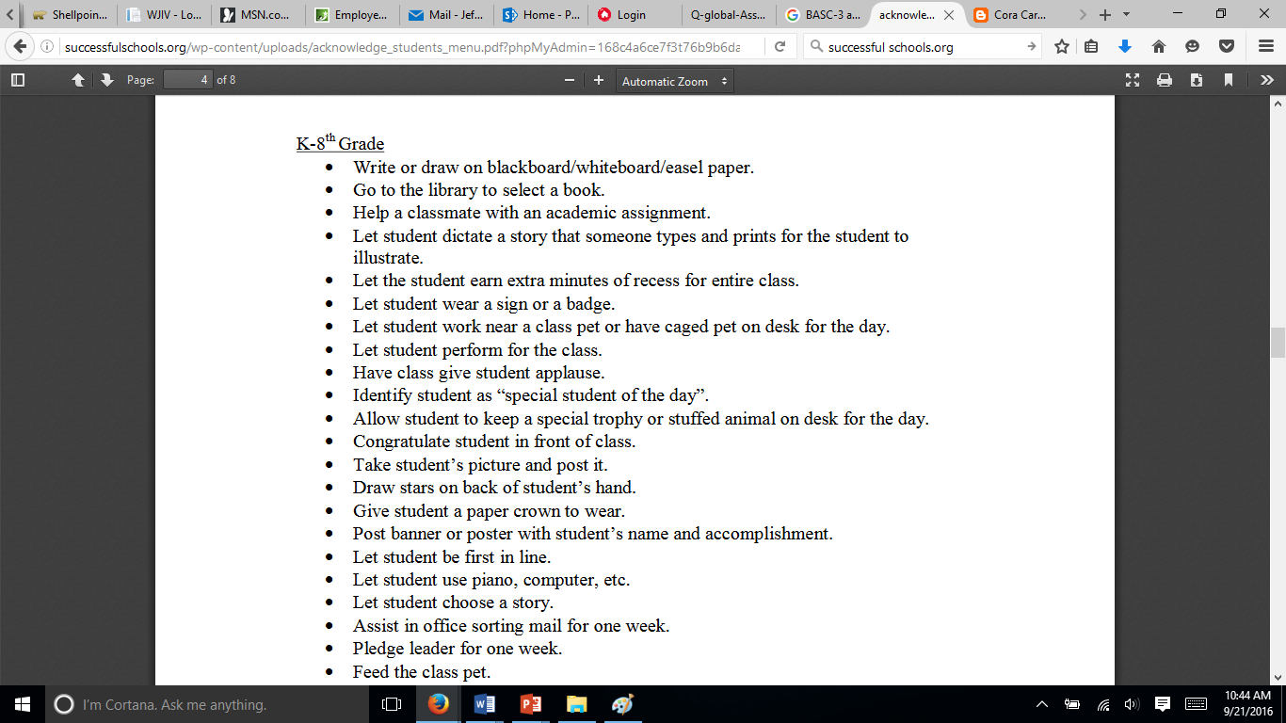
For a Great List of Reinforcing Ideas that cost no money, & contains no sugar or salt: www.successfulschools.org under behavior

Slide 25

Along with being positive . . .
Have fun with your kids when reviewing what is & is not acceptable in your class (i.e., what is the rule about approaching your desk? Which door do we exit out of to go to special area?)
Because students tend to have sudden onset amnesia, don’t forget to refresh & review your expectations AND what the pay off will be!
Notes:
25

Slide 26
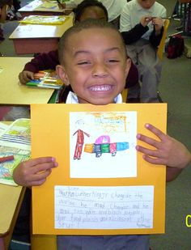
Sneaky Smart Strategy
Work on the “alliance/connection” that you have with students. If students feel respected AND respect you, this is going to have a major impact on what you can get out of them.

Slide 27
Life is Like An Echo
You Get Back What You
Send Out

Slide 28

Teacher efforts to get to know students are also important . . .
Research shows that the most reliable predictor of outcome is the “alliance” that is perceived by the student
This is greatly influenced by the student’s views of how respected they feel by the teacher & whom they respect
Remember that it is hard to get excited over someone else’s goal so include the student’s input as you work to figure out the intervention
Think about inquiring, “Tell me something about your teacher that worked for you” or “You had such a good day today; How did you do that?”

Slide 29
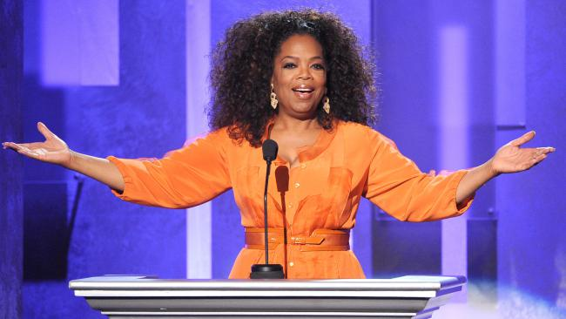
Any other Oprah fans in the house?

Slide 30
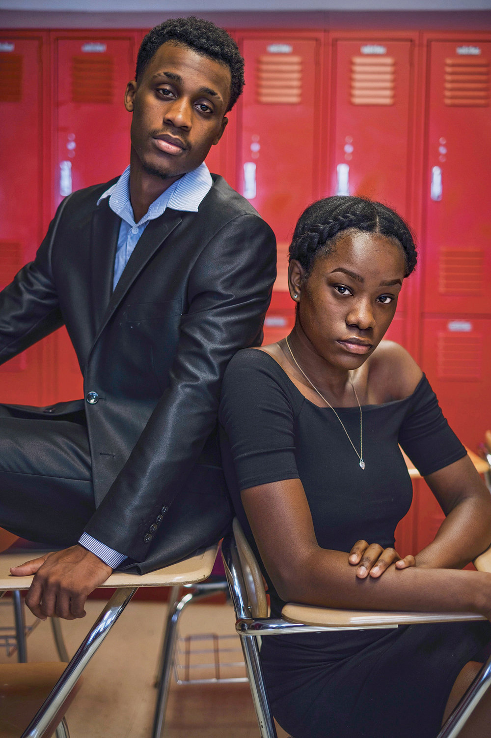
“…when someone is speaking loudly at you, rather than responding to them with the same tone, all you have to do is be quiet. Because to be mature about a situation & walk away or sit there & talk low…it is satisfying-like, Hey, I kept my composure…& the other person is thinking, I guess I have to find another way to come at this…rather than yelling…”
--Tuscon Irvin, 17, a junior that underwent mediation
training, Source: NY Times, Sept. 11, 2016 Education
Issue

Slide 31

More Bottom Lines:
QTIP
A retired teacher said, “If I find that I truly do not like a student, it is my job to find ways to like him or her.”
Calmly talking to a student in a private place is going to produce a more positive outcome

Slide 32

Be Sneaky Smart By:
Solving the “core” issue by communicating with the child to respectfully resolve things
The student should not see you as having to go to an outsider to deal with them
So find a way to talk it out & yes, it may take more than once

Slide 33

Be Sneaky Smart by…
Catching students being good
Strategy isn’t used b/c we get locked into “they should behave”
The second time a teacher gives a verbal warning needs to be a cue to catch them

Slide 34
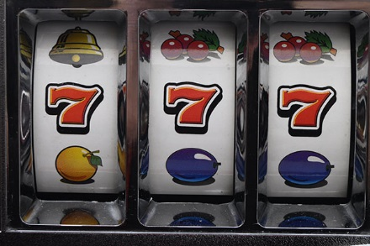
Sneaky Smart
Intermittent reinforcement for appropriate behaviors can maintain while punishment is best when delivered continuously
Think small & Reinforce successive approximations

Slide 35
Behavior is Communication
I don’t want to do this! (Escape) | I want ATTENTION! | I want this! (Tangible) | I like doing this! (Sensory)
Difficult tasks Prolonged work Social demands Want to be in THIS place! Want to be with THAT person! | From adults From peers From parent From anyone | Computer/ tablet Edible Activity Privilege Toy Object | It feels good It looks good It sounds good It tastes good It soothes me It’s a habit

Slide 36
Only 2 Basic Functions
Pos Reinf
Neg Reinf
Existing aversive condition identified

Slide 37
Classroom management research
Reveals that on-task classrooms are led by teachers who consistently teach/reinforce/ acknowledge positive behavior AND
Have minimal disruptions in instruction (avoid letting a student derail the instruction)
Notes:
37

Slide 38
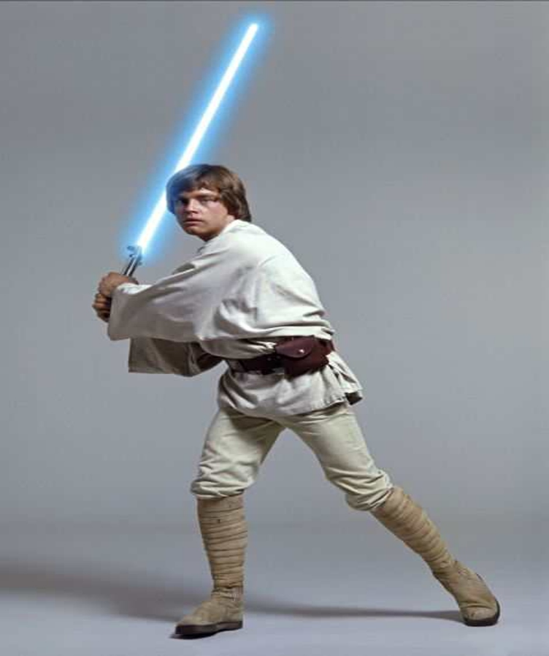
A favorite SS Strategy: Deferral Tactic (AKA Jedi strategy-put things on “pause” to collect yourself): “We all have a dark side; that doesn’t mean we need to give into it!”

Slide 39
Prevention (or being sneaky smart) is NOT “giving in” & it creates the chance to teach
I don’t want to do this! (Escape) | I want ATTENTION! | I want this! (Tangible) | I like doing this! (Sensory)
Reduce or remove the demand | Give extra attention | Give choices of activities | Provide time for sensory break
Divide the task into smaller parts | Pair with a special peer | Do preferred activity first | Allow to hold a comfort item
Give a break or quiet time | Include in group activity | Provide tangible rewards & priv. | Provide a visual schedule showing times for breaks
Shorten length of tasks | Give student a special job | Follow schedule for jobs/chores | Intervene early when student is “ouchy”
Remove from non-preferred places | Seat student near you | Use a visual to show progress | Provide ways to achieve in approp ways

Slide 40

About encouragement:
Research clearly indicates that the behavior-specific praise increases on-task behavior. “Mark, I like the way you are listening; Anthony, I appreciate you raising your hand.” VS. “Good job; nice work.”
Also, give reasons for the rules: “Picking up around our areas, makes it safer for us to walk.”
Notes:
40

Slide 41

Survey of Student Perspective of Respectful Teacher Behavior
Participants
  Over 5,000 middle & high school students
  Chicago, IL, Hammond, IN, Houma, LA & Webster, MA
  Approximately 76% of students at school receive free or reduced lunch
Survey asked students, What are some ways that teachers show you

Slide 42
Top 12 Answers
Of the over 5000 responses, the ones listed were written by 200 students or more.
1. Talk privately to students when a problem occurs.
2. Use a calm tone of voice, even when they are upset. (No yelling)
3. Respect personal space
(Don't touch, grab, eyeballing, crowd)

Slide 43
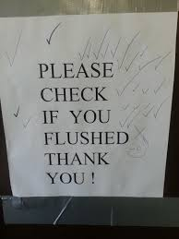
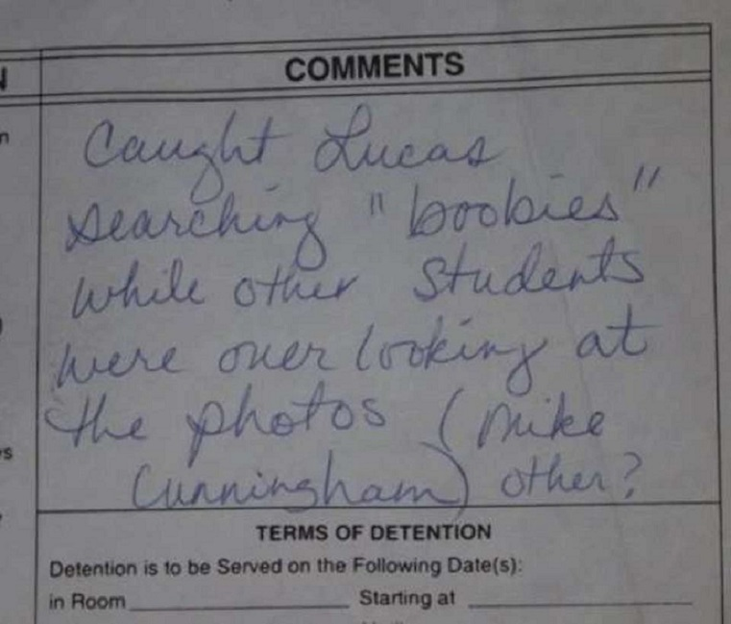
Top 12 Answers (continued)
Listens without interrupting.
5. Has a sense of humor.

Slide 44
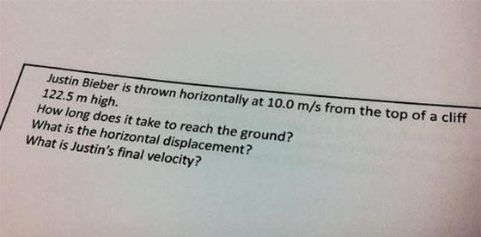
6. Displays student work around the classroom/school.
Prepares exciting lessons.
8. Let parent/guardian know student did a good job sometimes (see a balanced picture).

Slide 45

Top 12 Answers (continued)
9. Use student's name or addresses them as ma’am or sir when talking to them
10. Be available during non-classroom times
11. Returns work promptly
12. Talk sincerely - no sarcasm or “eye rolling”
Worth noting: “Smiles at me
& acknowledges my birthday”
received multiple mentions.

Slide 46
Ways to Sneaky Smart-Connect
Make a conscious decision to connect
ALWAYS connect with a greeting
Select the adult “connector”
Make an effort to find out about a common object, subject, etc.
Find a way to bring that interest into the curriculum!*

Slide 47
Making Connections Life Lessons
Attachments just don’t happen
Feeling connected should be a priority for all students, especially the difficult ones
“Does this student see me as someone who imposes, limits, & corrects OR as a helper, guide & ally?”*

Slide 48
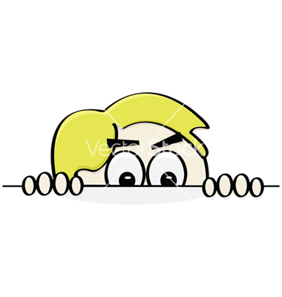
Other Sneaky Smart Activities to Interrupt A Negative Cycle
Run an errand
Fill a cup with water
Deliver something to another teacher
Getting materials ready, etc.
All of the above can set the stage to adjust the behavioral momentum in a positive way

Slide 49


One of the Important & Often Overlooked Ingredients of Teaching Behavior Is the “Script” that the Adults Agree to Use to Both Teach New Behavior & to Correct Behavior

Slide 50
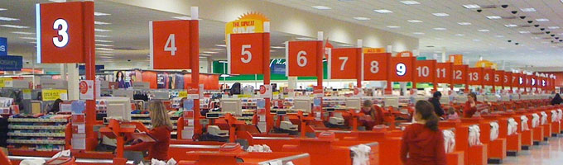
Sneaky Smart Strategy
Use the “Wal-Mart” questions rather than what we typically resort to out of frustration: “How can I help you?”
“What do you need?”
These questions keep you calm, redirects/ refocuses the student and will tend to not escalate the student

Slide 51
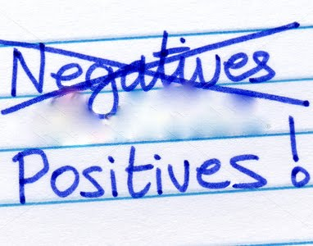
Change Starts Within
Us As Adults
As you go from this point in the year, be aware of the emotions that are aroused within & work on your language:
  The language we internally say
  The language we overtly say
  We can make a vow to ourselves today- that we will make a change in the negative & deficit-laden language we use

Slide 52
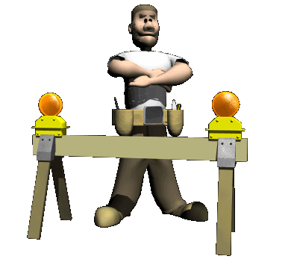
Group Activity
Notes:
What we are talking about is changing how we work with kids. Let’s do an activity. Everyone stand up. Cross your arms like the bossy older sister. Got them crossed? Look down and note which arm is on top. Drop your arms. Raise your right hand if your right arm was on top. (Hmmm. About half of you.) Okay- arms down. Raise your left hand if your left arm was on top. (Surprise, surprise…about half of you.) Okay- that was fun. Thanks…only kidding there’s more to that. “Now, I want you to cross your arms the opposite way. If your left arm was on top- put your right arm on top. Vice Versa with the right arm on top – switch to left. “How’s that feel?” It feels funny and awkward doesn’t it? That’s how change feels. It feels funny at first. It feels weird, but eventually, you will be able to do it without even thinking about it. Change is hard.
52

Slide 53
Great Resources
PBIS.org
PBISWorld.com
Successfulschools.org
Florida & Missouri PBIS state websites
www.livesinthebalance.org

Slide 54

  Why do we remember that special teacher that we had when we were younger?

Slide 55

Summary Video (3:45)

Slide 56
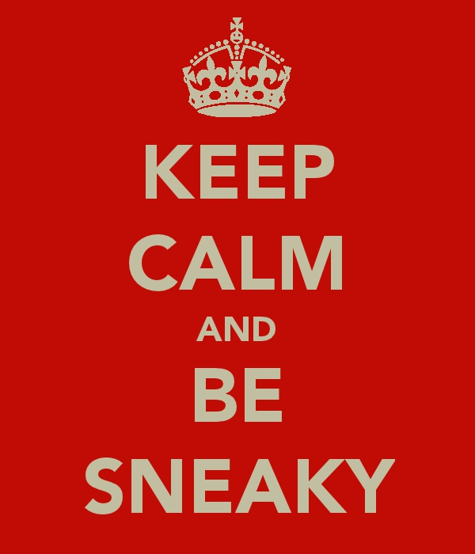
Many thanks for your attention!
Now go out
there & be
Sneaky Smart—
And help others
to be more sneaky
smart!

