Slide 1
Notes:
Poll Title: If you came with a warning label, what would it say? https://www.polleverywhere.com/free_text_polls/6Jc0FoRQAPYpqlJ

Slide 2
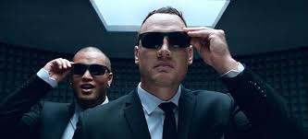
Classroom Management & Culturally Responsive Practices
Making The Unseen…….SEEN
Presented by
Jason Byars
Lisa Pearce
Linda Porter
Notes:
Welcome to our presentation, We’re excited to be here with you this afternoon for Classroom Management & Culturally Responsive Practices.
Let me find out who we have in the room.
Ask:
1-5 years?
6-10 years?
11+ years?
Middle school?
High school?
How many administrators? Teachers? Other?
Great – again I’m excited to work with you this afternoon. Let’s get started.

Slide 3
Making the Unseen …… Seen
Classroom climate
Cultural mismatch between home, school and educator
Cultural responsive practices
Toolbox of strategies and interventions: PBIS best practices
Notes:
What are the Unseen’s? Comprehensive, practical, easy, and effective strategies that have an impact on effective classroom and behavior management that is directly related to student achievement
Climate: how does it feel, sound (common language), operate, mood, attitude, control, safe, respectful, welcoming?
Cultural Mismatch: what do I assume, what do I know, how do I foster a positive culturally responsive classroom?
Specific instructional strategies that address: behavior, cultural responsive practices, and our unconscious bias
It acknowledges the legitimacy of the cultural heritages of different ethnic groups, attitudes, and approaches to learning
It builds bridges of meaningfulness between home and school experiences as well as between academic abstractions and lived sociocultural realities.
It uses a wide variety of instructional strategies that are connected to different learning styles.
Addresses: prevention, expectations, monitoring, encouragement and correction

Slide 4
WHY DOES IT MATTER?
Majority of discipline referrals come from the classroom!
44% of Teachers leave within the first five years!
Teachers vs. The Invisibles
It’s about the process, not the end result!
Our students needs us NOW more than ever!
Notes:
So why does it matter:
1. Classroom Behaviors: Student Incivility, Insubordination, Disrespect, Profanity, Disorderly Conduct
Testing & TKES #1 Reasons
Other Reasons:
Level of preparation, quality PL, school level leadership, non teaching duties
18% - Student Discipline
17% - Lack of Support
12% - Felt Disrespected and Stressed Out
3. Invisibles: home life stressors (divorce, poverty, displaced, mental health, learning disabilities, social media)
4. The Process: classroom climate, relationships, cognitive engagement not cognitive compliance, it’s about the whole child
5. We must show our students who they are capable of becoming, where they can go, and how to get there!

Slide 5
WHY DOES IT MATTER?
85% of Teachers receive no training on how to manage behaviors.
1 in 5 Students have a mental illness
1 in 3 Have a learning disability
1 in 10 are gifted
62% are classified disadvantaged
Notes:
So why does it matter?
State the description - ask audience for percentage or ratio
Jason to add STATS on Project AWARE Universal Screener data on internalizing behaviors

Slide 6
WHY DOES IT MATTER?
Notes:
So, why does this matter? Because these are our kids...before we move on, let’s look at a real high school with some of the same challenges we face with our students.
3:08 – name calling
As you watch, what resonates with you? How does this resonate as it pertains to your school?
Stop video at 3:12

Slide 7
WHY DOES IT MATTER?
LANGUAGE
RELIGON
ETHNICITY
RACE
AGE
PERSPECTIVE
SEXUAL ORIENTATION
GENDER
NATIONALITY
Notes:
Add to that, students bring a diverse variety of cultural beliefs and values through:
As educators, we are expected to meet the needs of all students regardless of any of these things. We have to have a level of cultural competence that allows us to teach across all this diversity.
Now, look back at your warning label. Wouldn’t it be great if our students came with a warning label?
NO EASY TASK – NOT ONE RIGHT WAY
These are the students we teach each day, sooooooooo

Slide 8
How well do you know this generation?
Notes:
Before we move on…..How well do you know this generation? Are you still teaching they way you did 3 years ago? 5 years ago? 10 years ago?
Say: “What do you make of a person who describes his or her life this way”
I spend my time on 3 to 5 screens each day, equivalent of a full-time job.
I made my best friends through Tumblr and Instagram.
I binge watch YouTube and Netflix.
I am not totally sure about my sexual identity.
I don’t identify with an ethnic race, but with the human race.
I don’t remember a world before social media.

Slide 9
How well do you know this generation?
Generation Y
Generation Z
Alias: Millennials or Digitals
Born: 1983 – 2000
Grew up in a time of expansion
Norm for connection: hangout, parties
1st Tech Gadget: CD’s, iPod
Myspace, gamers or sharers
Shaping Events: Columbine, dot.com era, iPod
College: Equates to a great job, college visits, graduate in 4 years.
Alias: Hackers or Homelanders
Born: 2001 – 2018
Grew up in a time of recession
Norm for connecting: social media
1st Tech Gadget: iPhone
Snapchat/Whisper - disappear
Shaping Events: 9/11, terrorist attacks, economic recession
College: ?, online attend where ever I want, graduate in 3, 5, or 10 years?
Notes:
Say: This new breed of people makes up a population called “Generation Z.”
They’re the ones following Millennials (aka Generation Y) who have dominated our culture over the last decade.
They now make up the youngest and largest percentage of the workforce, and Generation Z trails right behind them.
They’re the new kids on the block, the teenagers.
They’ve grown up in a post-9/11 culture, filled with wars, terrorism, economic recession, racial unrest, sexual-identity expansion, and lots of uncertainty.
They’re extremely post-modern.
If Millennials are slackers, these new kids are hackers. They know life is hard, and they plan to make their own way.

Slide 10
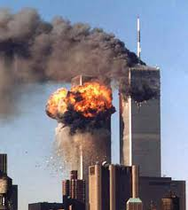
How well do you know this generation?
COLD WAR
1947 - 1991
POST TERRORISM
Notes:
Cold War: Rocky, Red Dawn, Knock Down That Wall
Terrorism: 911, ISIS, Radicals

Slide 11
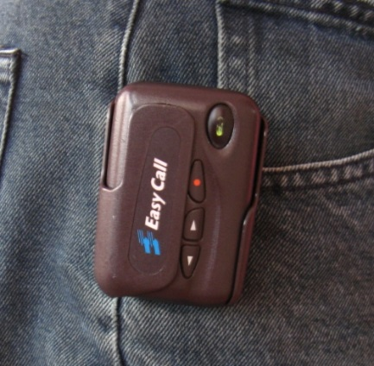
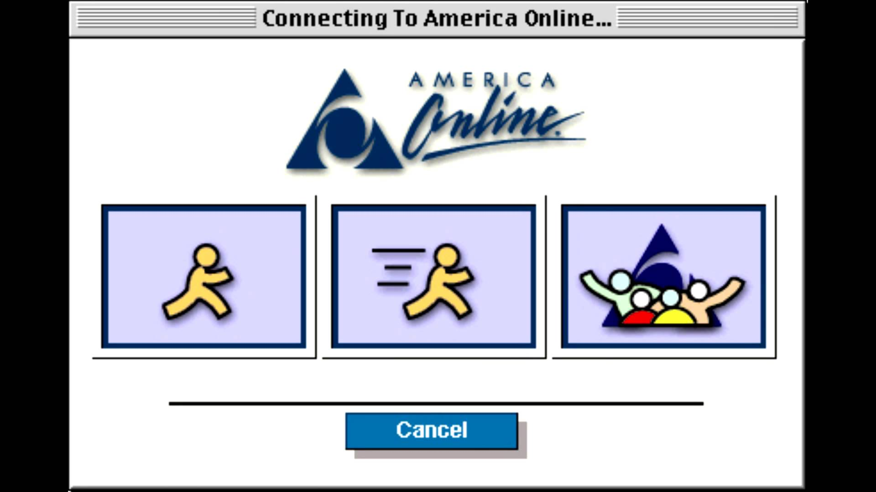
How well do you know this generation?
Technology, Instant Messaging & Surfing

Slide 12
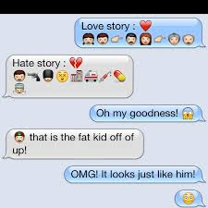
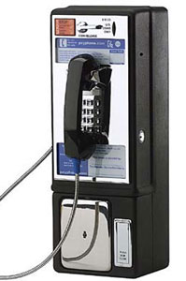
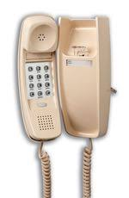
How well do you know this generation?
HOW DOES THIS GENERATION COMMUNICATE?

Slide 13
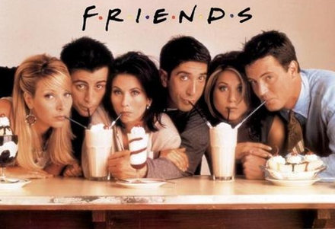
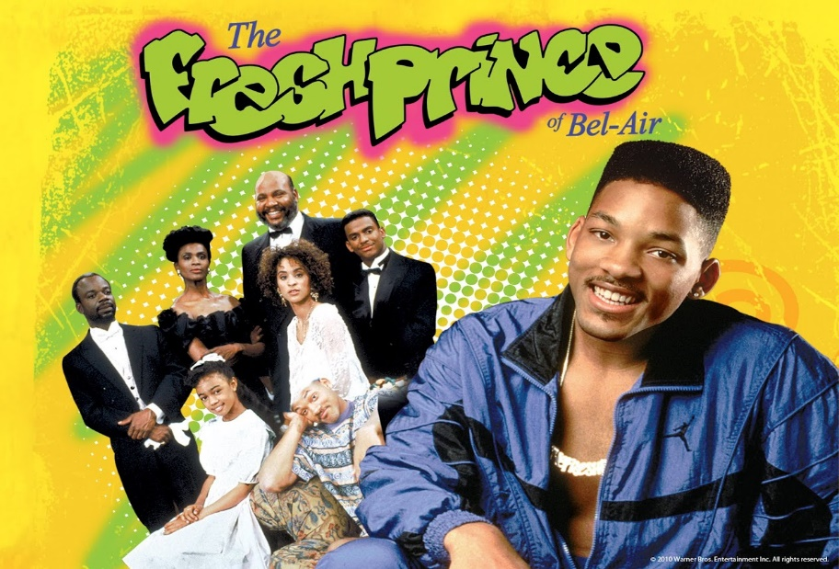
How well do you know this generation?

Slide 14
How well do you know this generation?

Slide 15
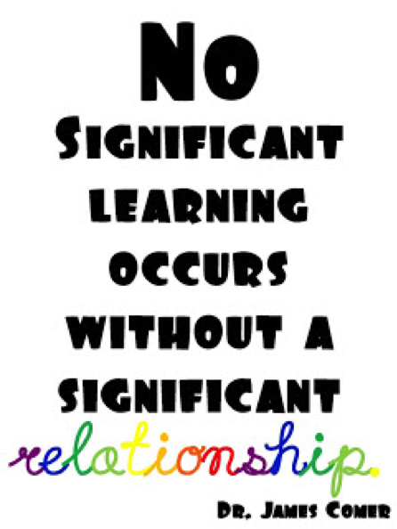
Creating Classroom Climate
NO SECRETS CLASSROOM
CULTURAL RESPONSIVENESS
RELATIONSHIPS
VISION
&
EXPECTATIONS
Notes:
So one of our remedies for creating classroom climate is to understand what a “No Secrets Classroom” is, Power of Relationships, and Cultural Responsive Practices.
Define it.
What is it: Intentional actions (proactive),
doesn’t mean you won’t problems – more aware you are and the more you prepare beforehand, the better you can manage behavior in your classroom
Today we are going to explore the elements of classroom climate. They fit together to make a proactively managed classroom.
No matter where you on the teaching spectrum, it’s positive to refresh your knowledge and add to your knowledge. Each year we get new kids.

Slide 16
Creating Classroom Climate
NO SECRETS CLASSROOM
VISION
&
EXPECTATIONS
Notes:
If your vision for your classroom doesn’t include impacting the lives of your students then you should create a bigger bolder vision!
How will you rally and unite your students? With contagious optimism that fosters relationships that create big results!!!!

Slide 17
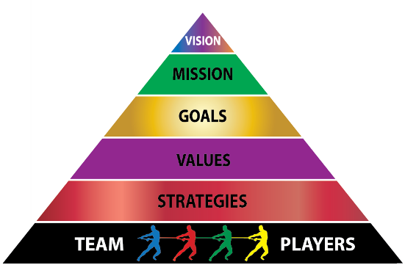
NO SECRETS CLASSROOM
WHILE THE MISSION IS ABOUT TODAY, THE VISION IS ABOUT THE FUTURE!
Where are we going?
PLANS, PURPOSE, DESIRED RESULT
PRINCIPLES OR STANDARDS OF BEHAVIOR, WHAT’S IMPORTANT?
CLASSROOM & BEHAVIOR MANAGEMENT
RELATIONSHIPS
Notes:
What is the vision for your classroom? What does your ideal classroom look like? Share some visions - personal and other teachers
Think with the end in mind - what you want your students to gain during their time with you and take with them when they leave?
Think of what those things are. For me it involved: community, communicating effectively, taking risks, persevering…
Relationships – Who are you? They won’t share who they are unless they trust you
Classroom & Behavior Management – systems that operate within the classroom: expectations, routines and procedures
o one of our remedies for this is proactive classroom/behavior management.
Define it.
What is it: Intentional actions (proactive),
doesn’t mean you won’t problems (think back to the pyramid) – more aware you are and the more you prepare beforehand, the better you can manage behavior in your classroom

Slide 18
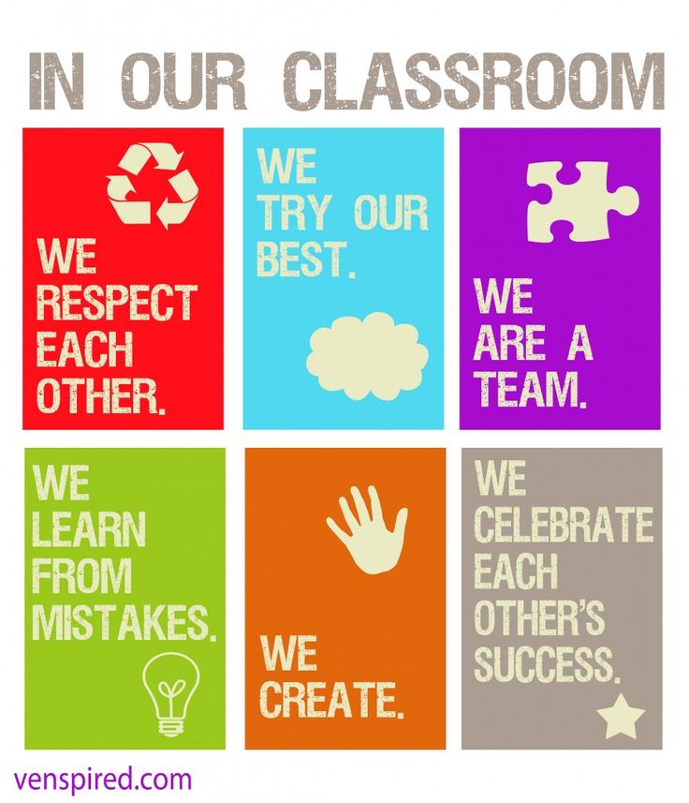
Think About It…….
What does your ideal classroom look like?
Notes:
What is the vision for your classroom? What does your ideal classroom look like? Share some visions - personal and other teachers
Think with the end in mind - what you want your students to gain during their time with you and take with them when they leave?
Think of what those things are. For me it involved: community, communicating effectively, taking risks, persevering…

Slide 19
NO SECRETS CLASSROOM Example Mission Vision & Goals
Notes:
Students need to know: “Who are you” “What are your expectations and goals” “Where are we going”
It’s important to sell your “product” science, math, culinary art, PE

Slide 20
NO SECRETS CLASSROOM Expectations
Mrs. Porter’s
Vision A stimulating community where students feel safe in communicating their needs, comfortable in taking learning risks, and challenged to work toward their greatest potential.
Notes:
Now, take those ideas and write out your vision.
Give your vision life – Share it, post it, visit it often
Think with the end in mind - what you want your students to experience and leave with
Find a partner, elbow –share your vision and comment
Ask for a few participants to share with the large group.
Share with your students – post it in the classroom. Give it life.

Slide 21
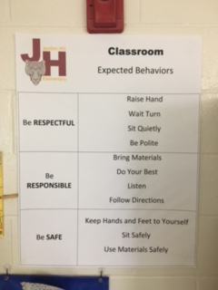
NO SECRETS CLASSROOM Expectations
3-5 EXPECTATIONS
POSITIVELY STATED
EXPLICITLY DEFINED
OBSERVABLE/MEASURABLE
VISIBLE “WHERE DOES IT LIVE?”
Notes:
Your expectations must be visible and referred to often.
It has to live in your daily practice to make a difference.
Research claims/state that teacher expectations have a tremendous impact on children from marginalized groups: esp. poor and minority students!!

Slide 22
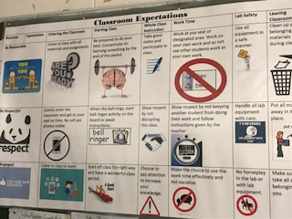
NO SECRETS CLASSROOM Expectations
WHERE DOES IT LIVE?
IS IT VISIBLE?
Notes:
This is a classroom behavior matrix for a high school science class. It identifies key class expectations and rules for how to follow those expectations in key settings. The bullet points under each location are reminders of the key parts in these location specific procedures that students should remember prior to entering that setting. The teacher uses these reminders to pre-correct and redirect students.

Slide 23
NO SECRETS CLASSROOM Expectations
INCLUDE STUDENT VOICE
Notes:
Give your students some voice – understand their needs. Ask them, what do you need from me? Take some time to ponder that question and list at least 10 things you think they will need. (Put the question in more elementary terms for younger kids)
Now, what do you need from your students. Take some time to ponder the question and list at least 10 things you know you need.
Compile and post the list. Use it as a reminder for you and your students about what is required from both sides.

Slide 24
What Do The Tiers of Interventions and Elements Look Like?
Primary
Secondary
Tertiary
Behavior Expectations Defined Behavior Expectations Taught Clearly defined consequences for problem behaviors Differentiated Instruction for Behavior Data collected on interventions
Progress Monitoring for at risk students System for increasing structure and predictability System for increasing contingent adult feedback Increase home/school communication Collect data on interventions tried
FBA (full and complex) supports in place Team-based comprehensive assessment Linking of academic and behavior supports Wrap Around Supports: Behavior Specialist, Project AWARE, 1:1 Supports Counselors Involved

Slide 25
NO SECRETS CLASSROOM
PROCEDURES
ROUTINES

Slide 26
NO SECRETS CLASSROOM
PROCEDURES
The “how” in meeting expectations!
ROUTINES
Have to be taught and practiced
Telling is not teaching.
For a child to learn something new, it needs to be repeated an average of 8 times.
For a child to unlearn an old behavior and replace with a new behavior, the new behavior must be repeated an average of 28 times.
Notes:
1. Produce ownership
2. Students who know what to do = results
3. Results = learning and achievement

Slide 27
NO SECRETS CLASSROOM
PROCEDURES
The “how” in meeting expectations!
ROUTINES
Define and teach classroom routines
How to enter class and begin to work
How to predict the schedule for the day
What to do if you do not have materials
What to do if you need help
What to do if you need to go to the bathroom
What to do if you are handing in late material
What to do if someone is bothering you.
Signals for moving through different activities.
Notes:
When students practice a sequential procedure that is aligned with class expectations, and they follow this procedure on a regular basis, often without teacher reminders, it is a routine.
It is important to define and teach classroom routines. Here are some examples of classroom procedures that your class should practice until they become routines: (not an exhaustive list)
How to enter the class and begin to work
How to predict the schedule for the day
What to do if you do not have materials
What to do if you need help
What to do if you need to go to the bathroom
What to do if you are handing in late material
What to do if someone is bothering you.
Signals for moving through different activities, such as “Show me you are listening”
How to determine if you are doing well in class
When defining and teaching routines, it is essential to establish a signal for obtaining class attention. Being able to quiet the class quickly saves instructional time.
Finally, the main area where teachers lose instructional time is during transitions. This is also often when most behavior problems occur. Developing and teaching effective transitions is very important.

Slide 28
Creating Classroom Climate

Slide 29
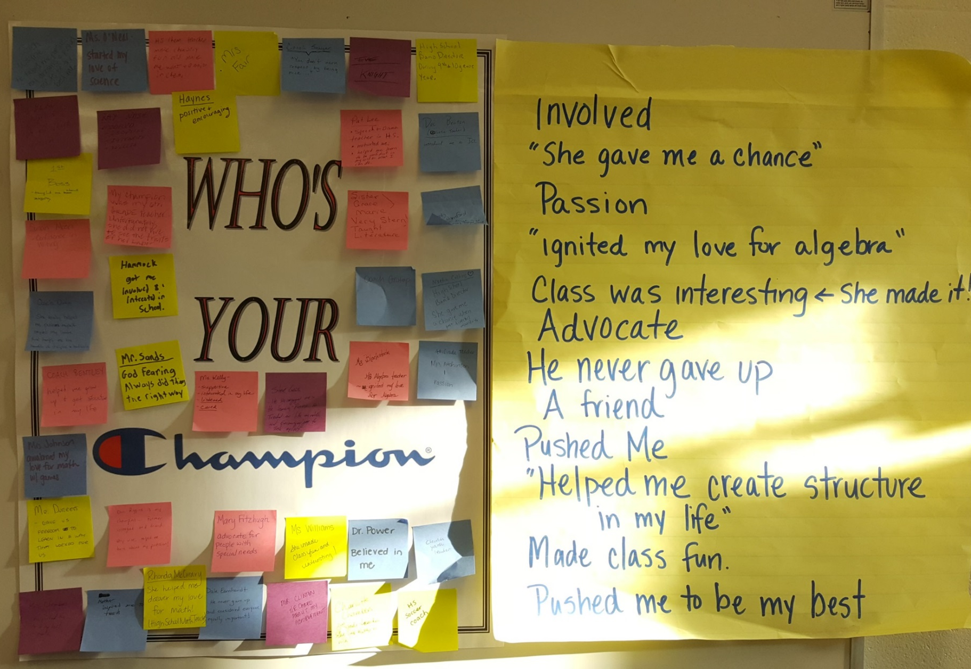
Relationships
Precedes learning
Continuous, ongoing
The MOST powerful tool we have
FACT: Behavior is functionally related to the teaching environment.
Notes:
Who’s your Champion? – have teachers write descriptive words on stickies' and post.
Share aloud and connect to relationships/trust.

Slide 30
Creating Classroom Climate
Notes:
What are some things you do to build relationships?
Joke of the day – incorporate some humor
Student Interviews – personal 1 on 1 questions that allow you to talk to students.
Do in the first few weeks for a few minutes per student. Allow them to ask you questions.
Noncontingent activities
Model the Minute to Win It cookie challenge
What else do you do to build relationships?

Slide 32
Creating Classroom Climate
“There will never be enough consequences to motivate tough kids to learn and to behave if we are not first developing positive relationships. And without positive teacher-student relationships, no discipline plan will work.”
~Jim Fay

Slide 33
Creating Classroom Climate
WHEN RELTIONSHIPS ARE FRACTURED
Notes:
To be restorative means to believe that decisions are best made and conflicts are best resolved by those most directly involved in them
Strategies don’t work if your tone is purely punitive
Punishments can leave kids feeling ashamed and embarrassed but we must separate the deed from the doer
Allow reintegration and to reclaim their good name in class
Lecture/detention requires no active participation on the part of the student who has misbehaved or the teacher who is providing punishment
The belief that punishment changes behavior is the basis for school discipline policies across the world, yet the belief is not supported by evidence
The most significant shortcoming of punishment strategies is that they stigmatize students and label them as “bad”

Slide 34
Creating Classroom Climate
CULTURAL RESPONSIVENESS

Slide 35
Creating Classroom Climate
A DEFINITION OF CULTURE
Culture is the shared perceptions of a group’s values, expectations and norms. It reflects the way people give priorities to goals, how they behave in different situations, and how they cope with their world and with one another. People experience their social environment through their culture.
Culture is transmitted from generation to generation
Notes:
This is our working definition for today
When our kids walk through the door, they are bringing a multitude of culture: race, socio-economic, religious, family, gender, sexual orientation, generational…(we see all of this in our school, widely diverse)
Each of those groups have values, expectations - they help us establish what’s important & how we deal with things. WHO WE ARE

Slide 36
Creating Classroom Climate Race & Poverty
Race is one of the most difficult topics in education
Race affects our students at every level - social, economic, educational, emotional, and psychological
Race and culture affect teaching and learning from primary to high school
Poverty occurs among people of all ethnic backgrounds
Poverty can be generational
Schools operate from middle-class norms
Notes:
Often when we think of culture, we think of race.
RACE PLAYS A ROLE in our schools - READ BULLETS
So is socio-economic = POVERTY
As educators we cannot continue to ignore the damaging effects of racial and poverty issues

Slide 37
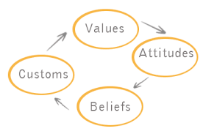
Creating Classroom Climate
Factors That Negatively Affect Culture
Youth Mental Health
Poverty
Trauma
Race
Notes:
Youth Mental Health
Very common, begin at earlier ages.
Children and youth with mental health problems have a lower educational achievement rates, grades, a greater involvement with the criminal justice system
Fewer stable long term placements in the child welfare system
Poverty
Generational or situational
Children are at an increased risk for social/emotional and behavioral health problems.
It’s not lack of money that causes a disconnect, it’s associated with parental stress, inadequate early care, education, and family or community violence.
Trauma
There is a profound amount of research on the impact of childhood trauma:
when children are injured
witness others harmed by violence
suffer sexual abuse
lose loved ones that can lead to social, emotional, and behavioral health problems
4. Race
Black males are among the largest group of students who underachieve academically, and are under-represented gifted and advanced programs
Black males are over-represented in special education programs and disproportionately suspended and expelled.

Slide 38
Creating Classroom Climate
Cultural Competence
The ability to understand, communicate with and effectively interact with people across cultures.
Cultural competence encompasses: being aware of one's own worldview. Developing positive attitudes towards cultural differences.
“Cultural gap” contributes to the achievement gap
STEP 1 - We must examine our own biases. WE ARE ALL BIASED.
Notes:
So here is where we must address cultural competence. DEFINE IT - BULLET #1

Slide 39
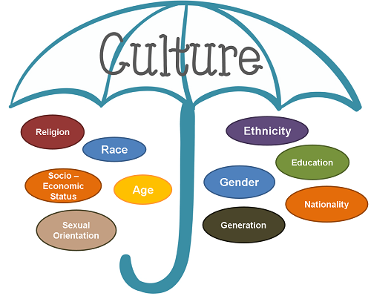
Creating Classroom Climate
STAND UP
GROWING UP
I KNOW HOW TO….
LEVEL OF CULTURAL COMPETENCE…
Notes:
Growing up
If you grew up with a mother and father
If you grew up with a single parent
If you grew up with grandparent(s)
If you experienced knowing someone with mental illness? Prego? Knew someone who was transgender?
If you’re a first generation high school graduate
If you’re a first generation college graduate
I know how to…..
I know how to get someone out of jail
I know how to buy a gun, even if without a license
I know to keep my clothes from being stolen at the laundromat
I know how to live without a checking account
I know what to do when I don't have money to pay the bills
I know how to properly set a table
I know how to order in a nice restaurant
I talk to my children about college
I know how to get the best interest rate on a new car loan
I know how to help my children with their homework and do not hesitate to call the school if I need additional information
Level of Cultural Competence
Do you know any language besides English?
When students walk into my room, do they notice something that reflects their culture?
I know/understands the cultural background of all my students?
I understand the difference between academic language and students social language?
I integrate resources from their cultures into my daily lessons?

Slide 40
Creating Classroom Climate
Cultural Competence Skill
Valuing diversity
Being culturally self aware
Understanding the dynamics of cultural interactions
Institutionalizing Cultural Knowledge and Adapting to Diversity
Notes:
Respecting different cultural backgrounds and customs, different ways of communicating and different traditions and values.
Understanding that your own culture — all your experiences, backgrounds, knowledge, skills, beliefs, values and interests — shapes who you are, where you fit into your family, school, community and society, and how you interact with students.
Knowing there are many factors that can affect interactions across cultures, including historical cultural experiences and relationships between cultures in a local community.
Designing educational services based on an understanding of students’ cultures and institutionalizing that knowledge so that educators and the learning environments they work in can adapt and better serve diverse populations.

Slide 41
Creating Classroom Climate
Becoming Culturally Responsive
Apply knowledge of ourselves and others to change our practices and expectations that value only one group’s perspective
FACT: 80% of teachers are white, middle class females.
Characteristics of Cross Culture Communication
Cultural “code-switching”
Invisible Expectations
Hidden Rules
Notes:
Box 1
In the classroom that perspective is sometimes one-sided based on our personal beliefs - “middle class perspective”
Be open to differences from your own
Be open to the youth culture that surrounds students today as opposed to the culture of our youth
Differences do make a difference in teaching. However, they don’t have to get in the way, but we have to pay attention to them so that they don’t.
Box 2
Cultural mismatch - shifting and mixing languages or practices of speech depending on who we’re conversing with; reflexive, subtle changes in speech, expression patterns
Invisible Expectations - what do we assume our students in our classroom “know
Hidden Rules - of behavior are key to school success; however educators must be willing to acknowledge that some school norms are hidden vs. (momma’s rules) There is a cultural incongruence with the norms of home culture and school culture
Validate and affirm the home language and cultural norms that support “code-switching”

Slide 42
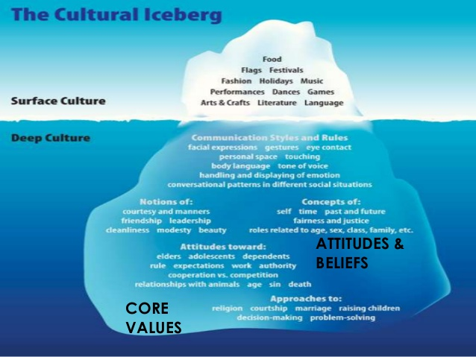
Creating Classroom Climate Cultural Competence
Surface Culture
Food
Fashion
Holidays
Music
Language
Deep Culture
Communication Style
Gestures
Eye Contact
Body Language
Displaying Emotions
Manners
Self Values
Expectations
Authority
Religion
Relationships

Slide 43
Creating Classroom Climate
Instructional changes are made to accommodate differences
“Singing harmony to our kids song...rather than forcing them to always sing our song”
Classroom is managed with firm, consistent, loving control
“Respect begins with the teacher”
Notes:
Teaching to learning styles, differentiation, cultural styles, age group, pop culture - relatable - understand cultural backgrounds
Not teaching only how we like to/comfort - come from where they are
(kinesthetic, art, music, movement, acting…) - MUCH EASIER SAID THAN DONE - look at how much you can incorporate throughout a day, week, through the unit - how much opportunity have I offered
Kids are coming to us with difficulty in relationships across cultures - respect is key - we establish and role model - NOT BACKING OFF EXPECTATIONS
Tough love, high demand, high acceptance, high love, respectful discipline that is instructional, not punitive
Example - data and disproportionality?
Designing educational services based on an understanding of students’ cultures and institutionalizing that knowledge so that educators and the learning environments they work in can adapt and better serve diverse populations.

Slide 44
WHY DOES IT MATTER?
LANGUAGE
RELIGON
ETHNICITY
RACE
AGE
PERSPECTIVE
SEXUAL ORIENTATION
GENDER
NATIONALITY
Notes:
These are the students we teach each day, so ………………………………………

Slide 45
THANK YOU

