Slide 1
Stories From the Satellite Library Lessons Learned From Launching A New Academic Branch Library
Heather Koopmans, Satellite Library Manager
Savannah State University
GICOIL Conference: February 21, 2020

Slide 2
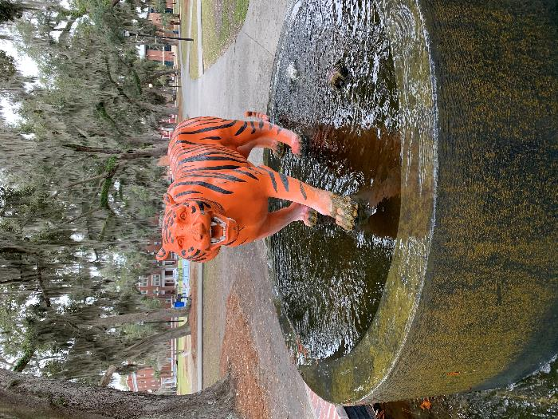
ABOUT SSU
HBCU; public, master's degree granting (“About SSU”, n.d.)
Fall 2019 FTE of 3,449 (University System of Georgia, 2019)
Time of transition: enrollment, retention (“Enrollment”, n.d.)

Slide 3
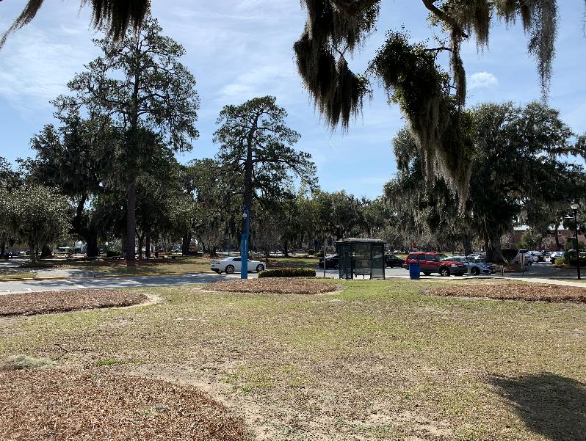
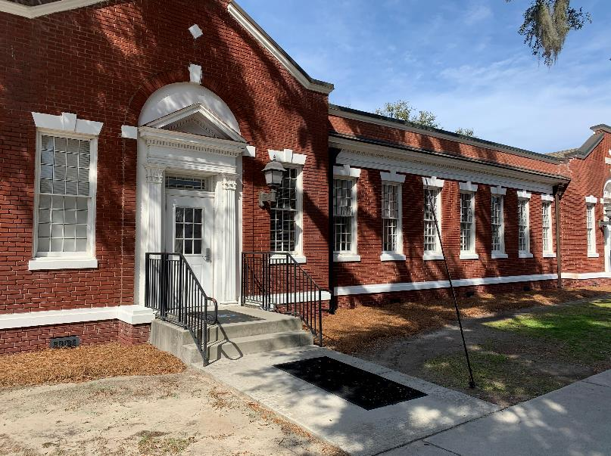
Why a Satellite Library?
Broad commitment to retention
Customer service
High-impact practices (“SSU Campus Plan Update”, 2018)
Envisioning a new student support center – early/mid 2017

Slide 4
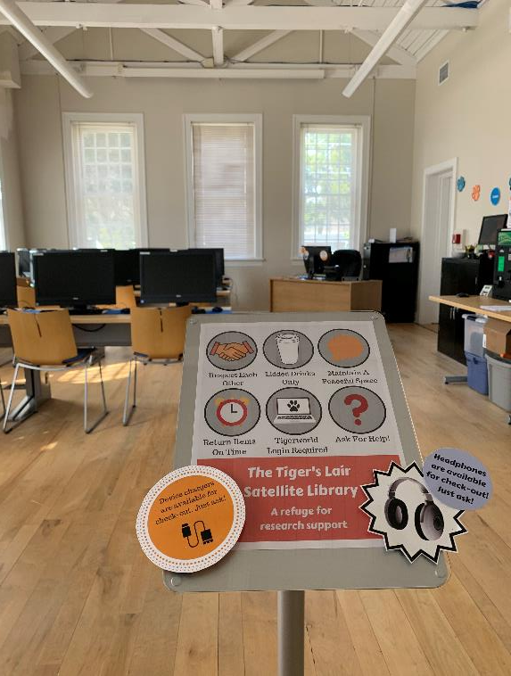
Why a Satellite Library?
Satellite Library vision – reach students beyond library walls
Foster academic success through connections with library faculty and staff
Provide a new library / study environment with extended hours: the Tiger’s Lair
Title III grant funds awarded in October 2017

Slide 5
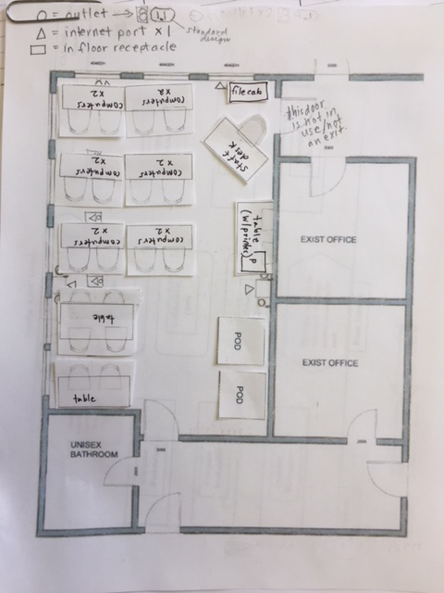
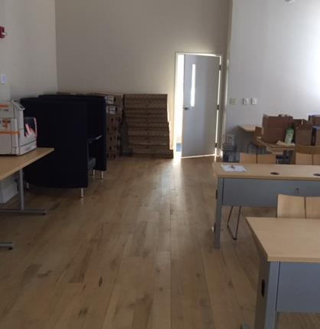
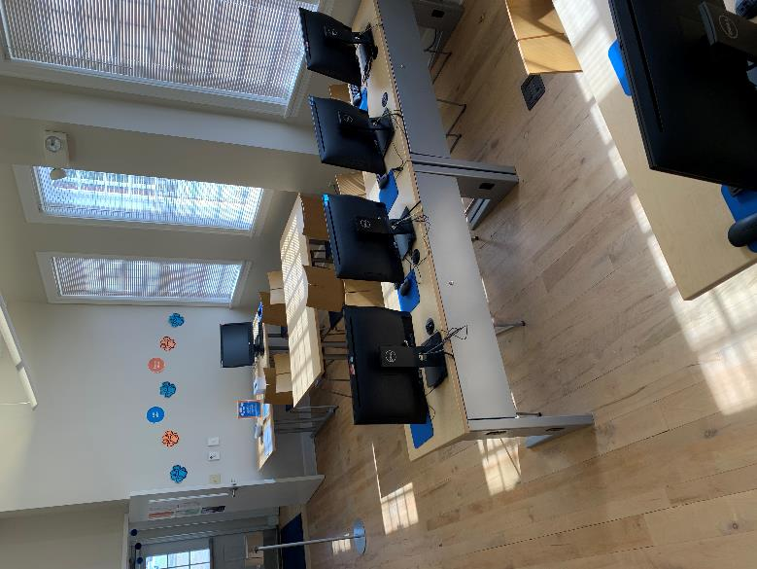
The First Year Oct. 2017 – Sept. 2018
Priorities: Establish Tiger's Lair facility, build awareness, generate & measure initial usage
Space preparation: order technology and furniture, confirm final layout, troubleshooting

Slide 6
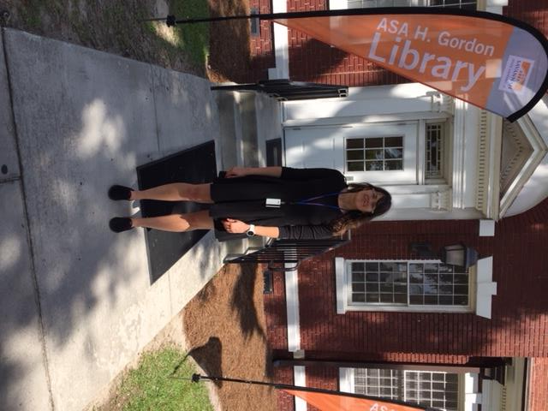
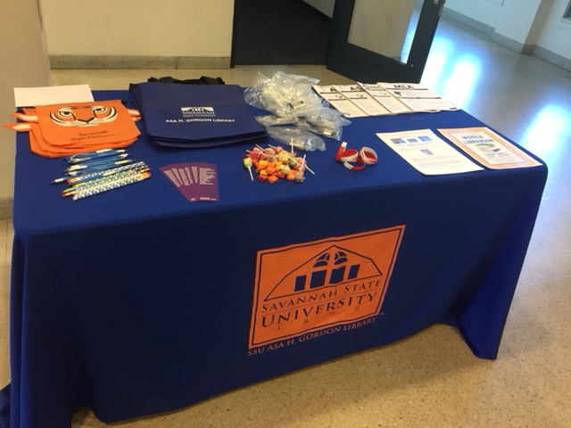
The First Year Oct. 2017 – Sept. 2018
Highlights:
Hire Satellite personnel
Promotion – primarily collaborative efforts
Plan services, policies, procedures
Tiger's Lair opened late May 2018; Grand opening in August 2018 (Fall semester)

Slide 7
The First Year: Oct. 2017 - Sept. 2018
Assessment
Year-end objectives: Increase overall library usage by 5%
Short-term objectives: Reach 40 interactions/week and 2 activities/ month (Satellite only)
Year-end: not met. Short-term: met, and exceeded
Average reach: 67 interactions/week and 4.7 activities/month

Slide 8
The First Year: Oct. 2017 - Sept. 2018
Lessons Learned
Difficult to predict branch usage based on main library usage
Use initial findings to create a more realistic baseline for future goals
Acknowledge factors that impact usage beyond the library's control
Proactive & varied approach to programming; the Satellite Library is more than the Tiger’s Lair

Slide 9
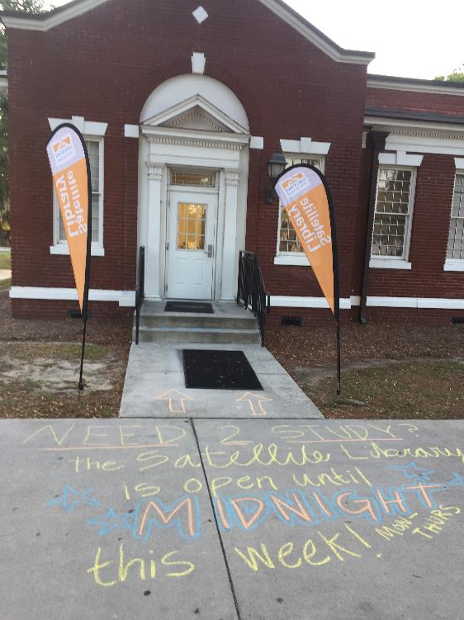
The Second Year Oct. 2018 – Sept. 2019
Priorities: Continue to grow awareness; track usage trends; adapt/adjust as needed
Environment: Morgan Hall shared with Access to Success advising
Establish and maintain consistent hours
Hire Satellite support staff

Slide 10
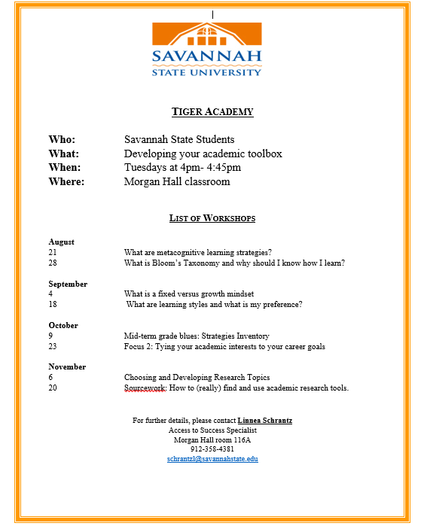
The Second Year oct. 2018 – sept. 2019
Instruction Highlights
IL at the Morgan Hall shared lab (Business, FYE, & others)
Library workshops in the Tiger Academy series – collaboration with Access to Success
Flier by SSU Access to Success, 2018

Slide 11
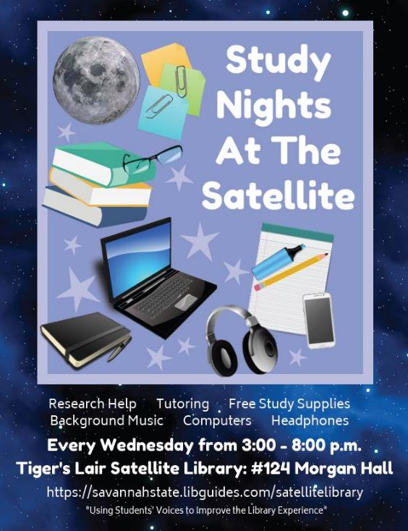
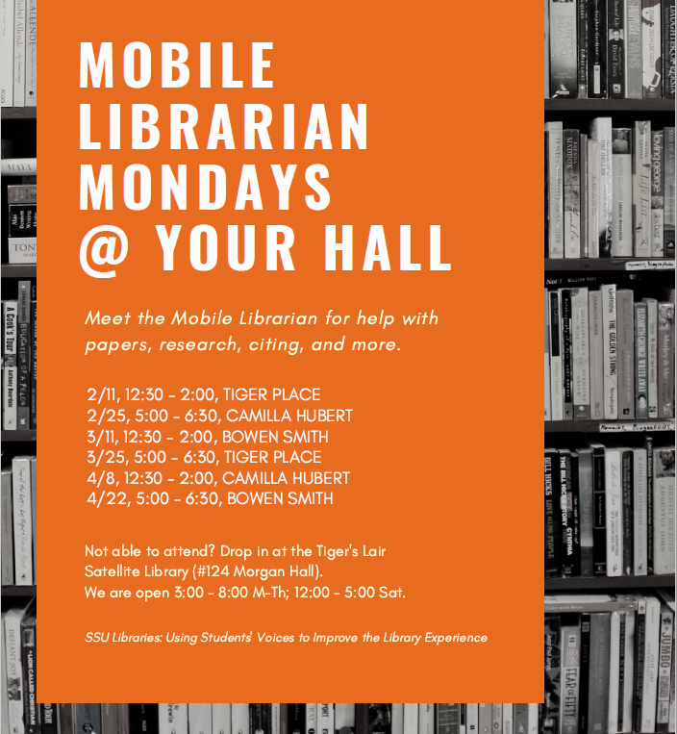
The Second Year Oct. 2018 – Sept. 2019
Outreach Highlights
Mobile Librarian – primarily in the residence halls
Study Nights at the Satellite
Social media, fliers, SSU radio & other methods

Slide 12
The Second Year: Oct. 2018 - Sept. 2019
Assessment
Year-end objectives: Increase interactions with the Satellite Library by 5%; increase activities by 50%
Short-term objectives: 42 interactions/week; 3 activities/ month
All objectives were met +++
Average: 91 interactions/week and 6 activities/ month

Slide 13
The Second Year: Oct. 2018 - Sept. 2019
Lessons Learned
Using Satellite-specific baseline data, goals were more achievable
Numbers demonstrated that there is a demand for Satellite Library services
Greatest reach: Outreach, instruction (48% of all interactions)
Spring 2019 survey: 76% had heard of or visited the Tiger's Lair. Desire for more research help.
Opportunity: Consider planning for reach as a % of the FTE, rather than a fixed target number

Slide 14
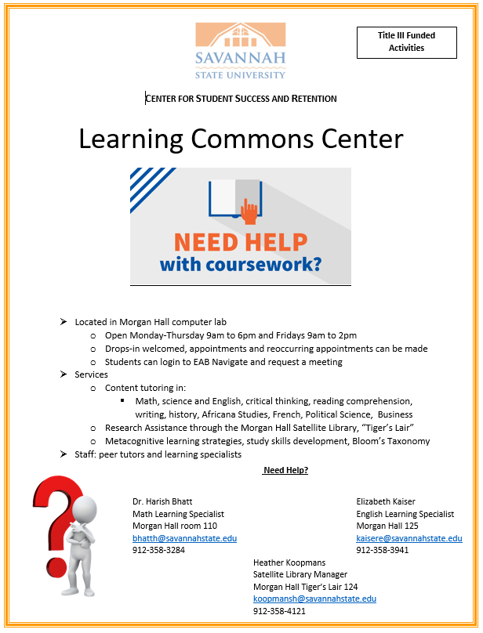
The Third Year Oct. 2019 – Sept. 2020
Priorities: Maintain high level of visibility; deepen the quality of interactions at the Lair; expand assessment
Environment: Morgan Hall re-branded as Learning Commons Center (peer tutoring, professional writing & math help)
Evolve Tiger's Lair hours in response to changes
Flier by SSU Learning Commons Center, 2019

Slide 15
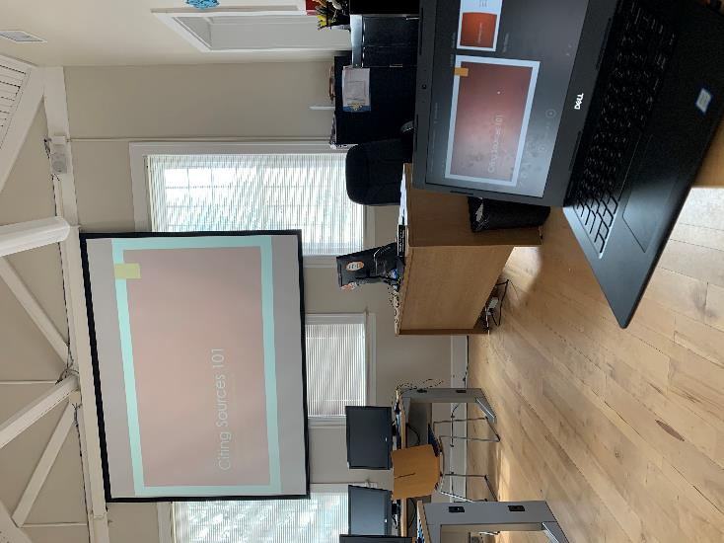
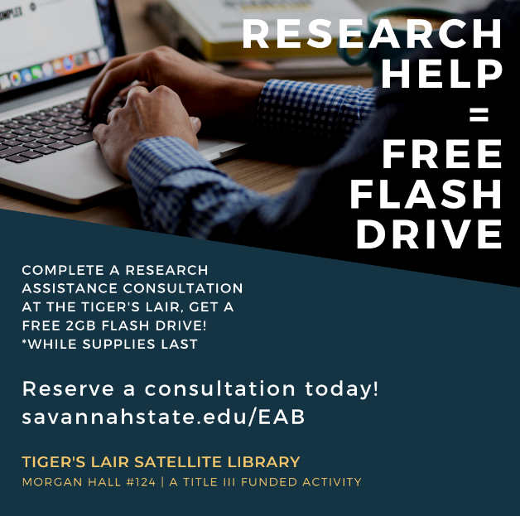
The Third Year Oct. 2019 – Sept. 2020
Instruction highlights
Move instruction into the Lair
Expand workshop offerings – library collaboration
Increase awareness and usage of research consultation services; pilot usage of EAB

Slide 16
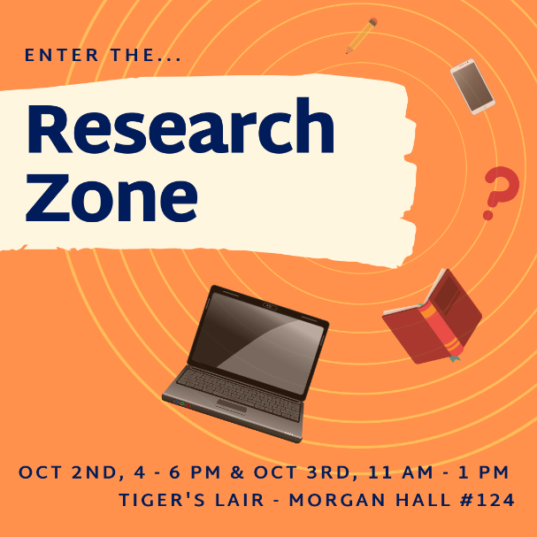
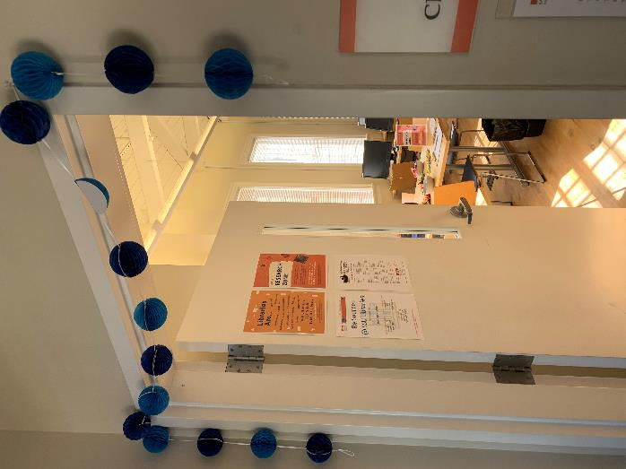
The Third Year Oct. 2019 – Sept. 2020
Outreach highlight
Research Zone events – inspired by “Research Party” reference model (Rieman-Murphy & Hunter, 2019)

Slide 17
The Third Year: Oct. 2019 - Sept. 2020
Assessment
Objective: Reach up to 5% of the FTE per month – counted by interaction
Objective: Provide 4 activities per month (+ 33% over prior baseline)
So far, so good
Q1 2019: Average of 8.4% FTE monthly reach; 9 activities per month

Slide 18
The Third Year: Oct. 2019 - Sept. 2020
Lessons Learned
Uptick in Lair walk-ins – 84 in Q1 2018 vs. 206 Q1 2019
Uptick in consultations – 8 in Fall 2018; 21 in Fall 2019; 25 so far in Spring 2020
Gather ongoing feedback with simple point-of-service methods

Slide 19
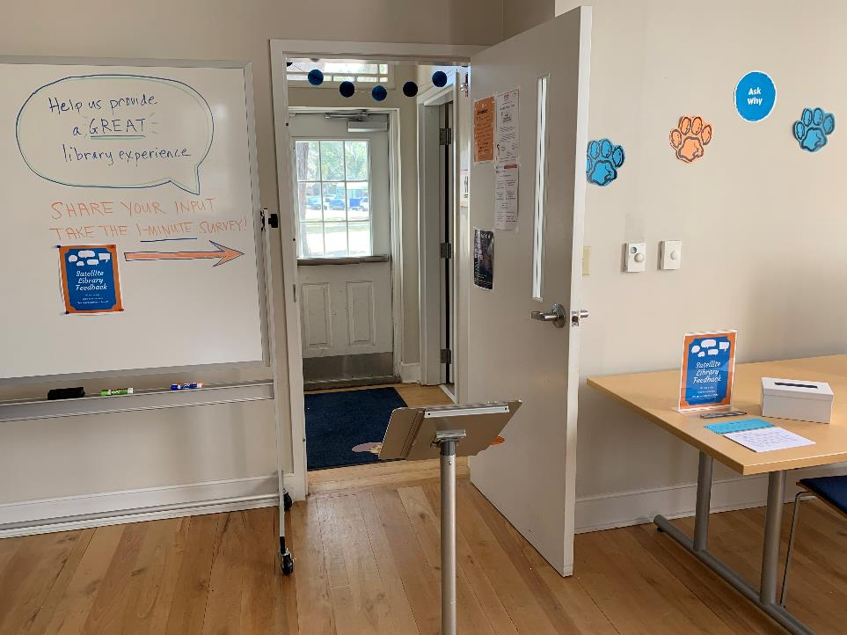
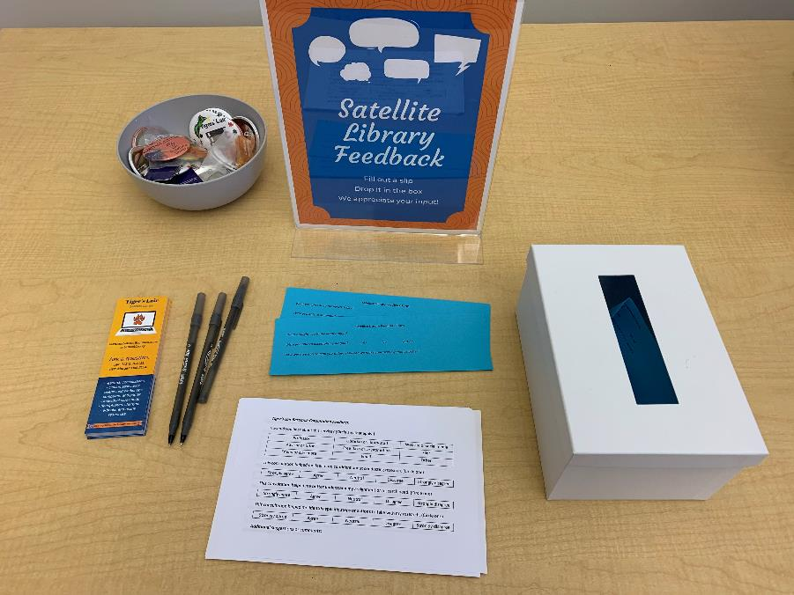

Slide 20
Future opportunities
Continue to assess the value of location
Where do students best respond to an alternative library presence?
When do students prefer to visit the library building?
Target location based on academic or social value
Maintain collaboration with the Learning Commons Center
Referrals, cross-training, shared programming
Continue to assess space usage. Is a dedicated library space essential?
Should the library continue to use learning analytics software?
Assess results of current pilot with using EAB
Is there a relationship between consultation usage and retention (etc.)?
Assess potential privacy risks; what further steps could be taken to protect privacy?

Slide 22
References
About SSU. (n.d.). Savannah State University. Retrieved February 1, 2020, from https://www.savannahstate.edu/about-ssu/index.shtml
Enrollment. (n.d.). Savannah State University. Retrieved February 1, 2020, from https://www.savannahstate.edu/irp/Enrollment/index.shtml
Rieman-Murphy, C. & Hunter, J. (2019). Affir​ming the research party reference model. Reference Services Review, 47(1), 48-59. DOI: 10.1108/RSR-11-2018-0071
Savannah State University Campus Plan Update 2018 (2018). Complete College Georgia. http://completegeorgia.org/savannah-state-university-campus-plan-update-2018
University System of Georgia Board of Regents Office of Research Policy and Analysis. (2019, November 12). Semester enrollment report: Fall 2019. https://www.usg.edu/assets/research/documents/enrollment_reports/SER_Fall_19_Final.pdf

Slide 23
Thank you!
Heather Koopmans
koopmansh@savannahstate.edu
https://savannahstate.libguides.com/satellitelibrary

