Slide 1
References and Citations as Expressions of Fairness, Helpfulness, and Decorum
Drew Nathaniel Keane,
Georgia Southern University
Georgia International Conference on Information Literacy, Savannah, 21 February, 2020

Slide 2
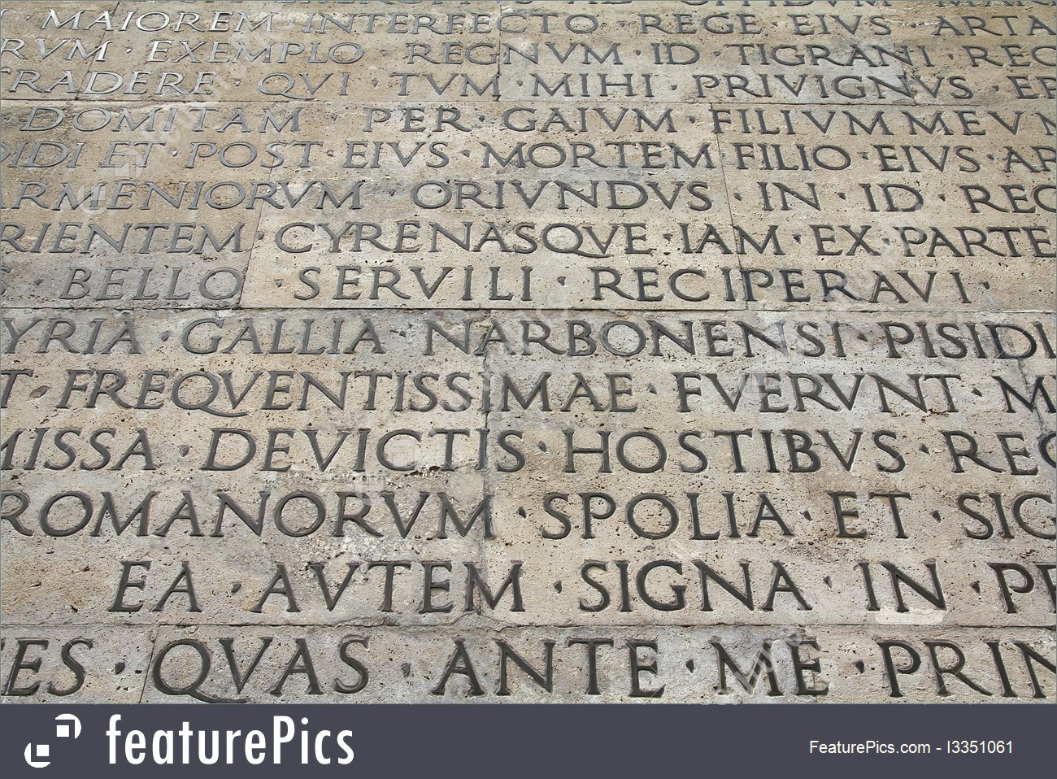

Slide 3
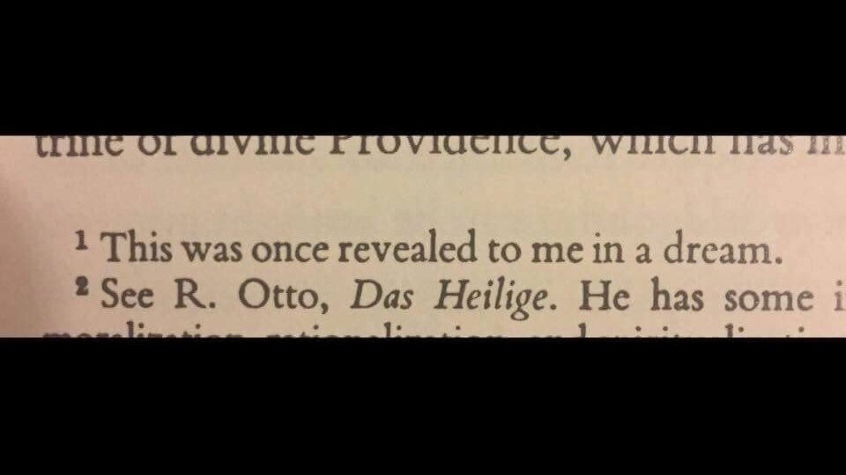

Slide 5
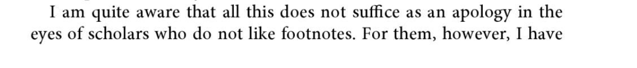

Slide 6
Interest
As curiosity or fascination
As a particular stake or bias
As value added

Slide 7
Why we need to talk about this
Macfarlane, B., Zhang, J., and Pun, A. (2014) Academic integrity: a review of the literature,Studies in Higher Education, 39:2, 339-358, DOI: 10.1080/03075079.2012.709495
— Much of the literature on academic integrity focuses on misconduct; there is little discussion of what constitutes ethical academic practice.
East, J., and Donnelly, L. (2012) Taking Responsibility for Academic Integrity: A Collaborative Teaching and Learning Design. JUTLP, 9.3. Available at : http://ro.uow.edu.au/jutlp/vol9/iss3/2
— Teaching on ethical use of sources tends to be remedial, ad hoc, and focused on avoiding punishment, despite the well-known pedagogical limitations of such approaches.

Slide 8
Why we need a different approach
Howard, R. M. (2000) Sexuality, Textuality: The Cultural Work of Plagiarism. College English 62.4: 473-491.
— The word plagiarism is itself problematic in a number of ways, masking the number of distinct issues involved; yet, we continue to use it.
Pennycook, A. (1996), Borrowing Others' Words: Text, Ownership, Memory, and Plagiarism. TESOL Quarterly, 30: 201-230. doi:10.2307/3588141
— Though we know concepts of originality, textual ownership, and citation are complex and differ across contexts, media, and cultures, plagiarism is still widely treated as a clear-cut moral matter which can be sufficiently explained by warnings, threats, and fear of severe consequences.
Emerson, L.; Rees, M. T.; and MacKay, B. (2005) Scaffolding Academic Integrity: Creating a Learning Context for Teaching Referencing Skills. Journal of University Teaching & Learning Practice, 2(3). Available at http://ro.uow.edu.au/jutlp/vol2/iss3/3
— Teaching citation is not the same as teaching academic integrity. The former is former is far less effective in absence of the latter.

Slide 9
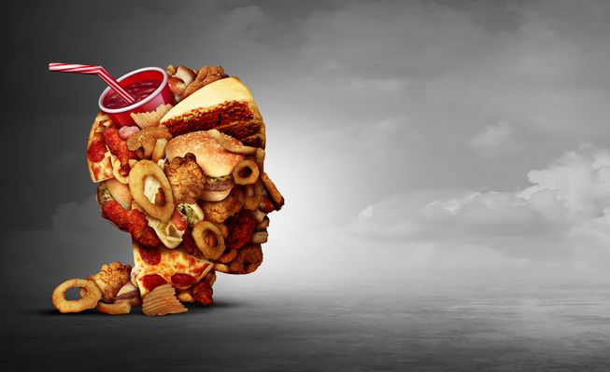
(Photo: Lightspring/Shutterstock)

Slide 10
Fairness
Give credit where credit is due.
Does not account for most of academic references.
Focused on what is used not why it is used.

Slide 11
Helpfulness
Assumes particular audiences and aims.
Assumes shared interests.
Requires judgement to determine what and how much.

Slide 12
Decorum
Conformity to group norms.

Slide 13
Decorum
Strategic not absolute.

Slide 14
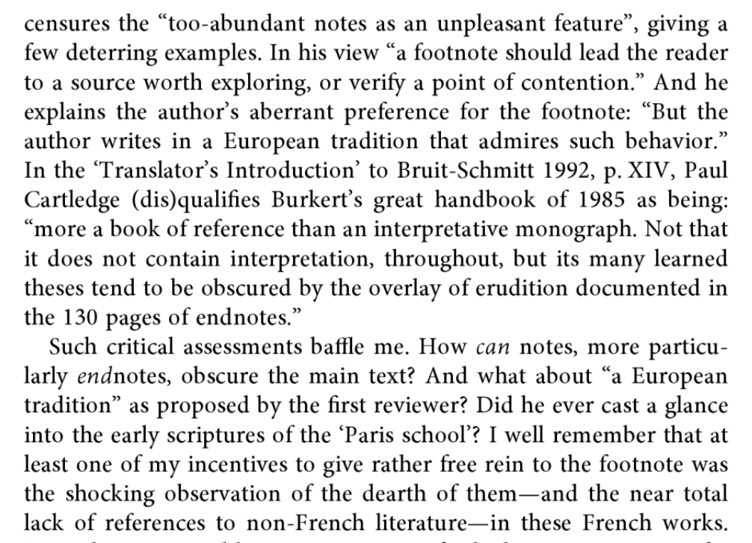
Decorum
Explicit instruction and acquisition required.

Slide 15
Decorum
Fish, S. (2010, August 9). “Plagiarism Is Not a Big Moral Deal.” The New York Times. Retrieved from https://opinionator.blogs.nytimes.com/2010/08/09/plagiarism-is-not-a-big-moral-deal/
“Plagiarism is breach of disciplinary decorum, not a breach of the moral universe.”
Recognizing the role of decorum allows distinction between higher level and lower level ethical concerns.

Slide 16
References express (at least) three ethical values
Fairness
Helpfulness
Decorum

Slide 17
References
Bartholomae, D. (1986). Inventing the university. Journal of Basic Writing, 5 (1): 4-23. Retrieved from: https://wac.colostate.edu/jbw/v5n1/bartholomae.pdf
Berdyaev, N. (1949). The divine and the human. R. M. French, Tr. London: Geoffrey Bles Ltd.
East, J., and Donnelly, L. (2012) Taking responsibility for academic integrity: A collaborative teaching and learning design. JUTLP, 9.3. Retrieved from : http://ro.uow.edu.au/jutlp/vol9/iss3/2
Emerson, L.; Rees, M. T.; and MacKay, B. (2005) Scaffolding academic integrity: Creating a learning context for teaching referencing skills. Journal of University Teaching & Learning Practice, 2(3). Available at http://ro.uow.edu.au/jutlp/vol2/iss3/3
Fish, S. (2010, August 9). “Plagiarism is not a big moral deal.” The New York Times. Retrieved from https://opinionator.blogs.nytimes.com/2010/08/09/plagiarism-is-not-a-big-moral-deal/

Slide 18
References
Harris, J. (2006). Rewriting: How to do things with texts. Logan, Utah: Utah State University Press.
Howard, R. M. (2000) Sexuality, textuality: The cultural work of plagiarism. College English 62.4: 473-491.
Lancaster, Z. (2016). Expressing stance in undergraduate writing: Discipline-specific and general qualities. Journal of English for Academic Purposes, 23: 16-30. DOI: 10.1016/j.jeap.2016.05.006
Macfarlane, B., Zhang, J., and Pun, A. (2014) Academic integrity: a review of the literature. Studies in Higher Education, 39:2, 339-358, DOI: 10.1080/03075079.2012.709495
Pennycook, A. (1996), Borrowing others' words: Text, ownership, memory, and plagiarism. TESOL Quarterly, 30: 201-230. doi:10.2307/3588141
Versnel, H. (2011) Coping with the gods: Wayward readings in Greek theology. Leiden: Brill.

